Slide 1
1
2
3
4
5
6
7
8
9
10
11
12

Slide 2
How are sports funded in the UK?
Voluntary
Private
Public

Slide 3
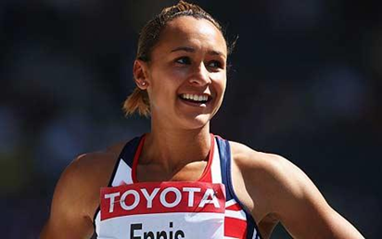
Funding for sport
Who or what is the main target for private sponsorship
High Profile and elite athletes

Slide 4
Name another types of funding that does not begin with P.
Voluntary
Donations and charities or private clubs.
Members subs, donations, NGB

Slide 5
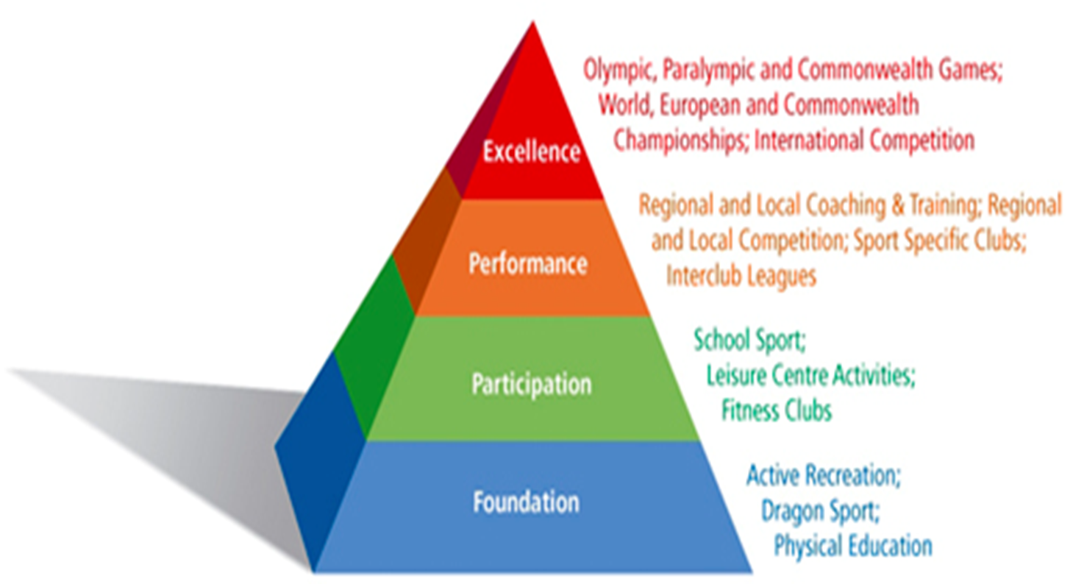
Name the four stages to the participation pyramid.
Give examples of each level

Slide 6
What group are in charge of the development of the top of the performance pyramid?
What is the main role of UK sports?
Manage funding from the national lottery.
Runs the world class pathway programme.
Runs a world class coaching strategy.
Development of direction of the EIS.
Co-ordinate programmes to attract major sporting events.
TASS Talent athlete scholarship scheme

Slide 7
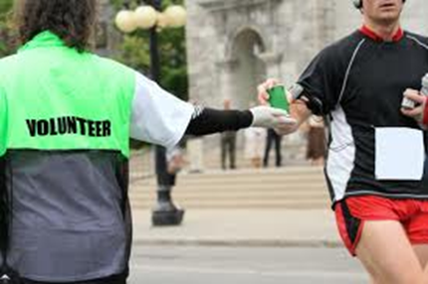
What is sports England?
It’s the government agency responsible for community sports in England.
What does sports England want?
Get people active
Current non movers to start
Limited movers to build to 30 min 3 times a week
Current 30min activity to do more.

Slide 8
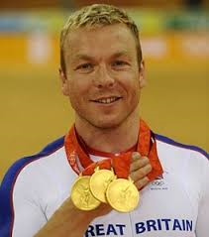
What is the role of the EIS?
You have to look after me.
Sports science and medicine
Performance analysis
Strength and conditioning.
Diet, Lifestyle management.

Slide 9
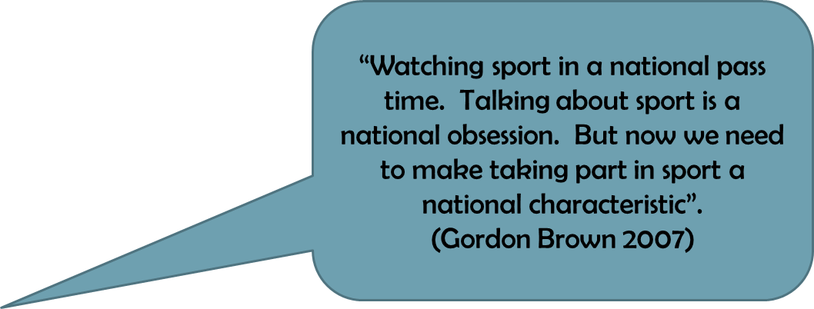
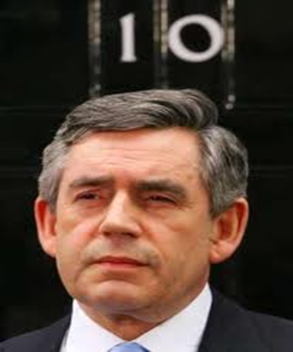
What Government initiatives are there to support sports?
National Curriculum
Competence
Performance
Creativity
Healthy active lifestyle

Slide 10
What does each NGB have to have in place to receive any funding from the DCMS. (department culture media sports)
Whole sports plan.

Slide 11
Name some of the barriers that restrict youngsters from taking part in physical activity.
Lack of kit
Not enough money
Fatigue after college or school
Body image issues
Anxiety due to surroundings (going out on your own)
.

Slide 12
Identify the issues surrounding participation of young people in physical activity. 4
Participation in physical activity is greatly influenced by their experience in school. If this is positive then they may continue to take part one they have left. The Wolfden report states that there is a large drop off after school in participation.
Possible barriers may be, money, kit, time or fatigue due to work pressure. There are several strategies to increase participation by the Gov. depending on where you are on the performance pyramid. Sports England has people places play as a strategy to improve mass participation.

Slide 13
10 Mark Question!
Discuss social and cultural factors that affect participation in physical activity in the UK.
[10]

