Slide 1
Acquiring Movement Skill
Classification of Motor Skills and abilities

Slide 2
Objective: know the classifications of skill
Muscular involvement Gross-fine
Environmental Open-closed
Continuity (discrete, serial, continuous)
Pacing (self paced, external paced)
Difficulty (simple-complex)
Organisational (low high)

Slide 3
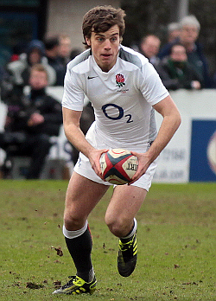
Environmental
OPEN CLOSED
We are concerned with how environmental conditions affect the movement skill.
Taking into account surroundings, team mates, opponents. This can also be weather.
So take the actions and place them on the continuum.
Remember to justify why you have places them where you have.
PASSING IN RUGBY

Slide 4
Criteria for Environmental Influence
Involves motor skills affected by environment
Perceptual and involve decision making
(adaptations and variations)
Externally paced in an unpredictable environment.
E.g., Passing in rugby, receiving a ball in netball.
Motor skill not affected by environment
Skill habitual-aim is to reproduce same technique model.
Self paced
Forward roll, gymnastics through vault, tennis serve.
Open Skill
Closed Skill

Slide 5
Task on page 9.
Justification for selection using the right terminology.
Ensure you are specific with example and justification.
If it’s vague you won’t get marks.

Slide 6
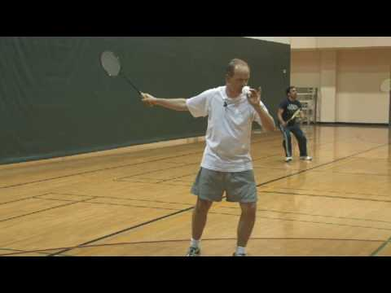
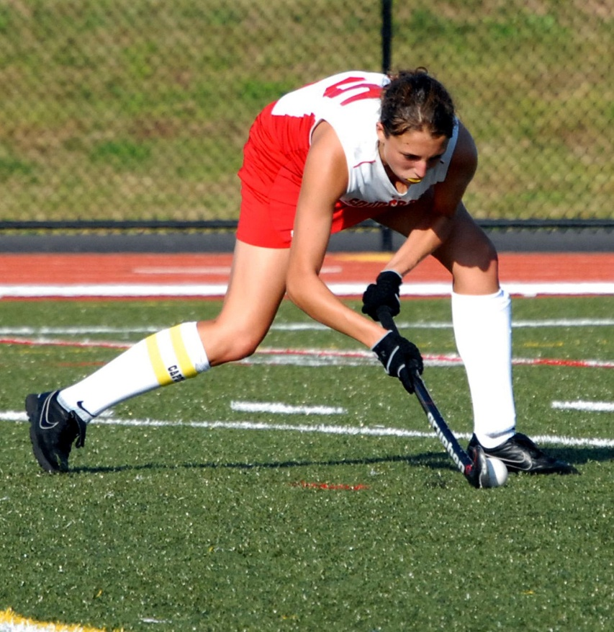
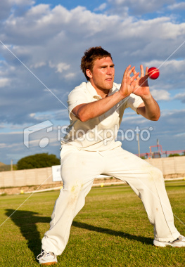
Continuity Continuum Discrete, serial, continuous
Discrete Skill
Motor skill that has a clear start and finish.
To be repeated it must start again, (single brief skill)
E.g.,……..

Slide 7
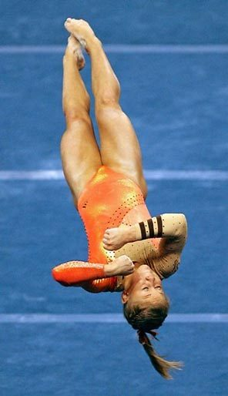
Serial Skill
A motor skill that has a number of discrete skills put together in a set order to make the sequence.
What example can you think of?

Slide 8
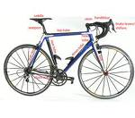
Continuous
Motor skill with no definite beginning or end
End of one cycle of movement is start of next.
Movement to be repeated several times to mean anything.
E.G.,………….

Slide 9
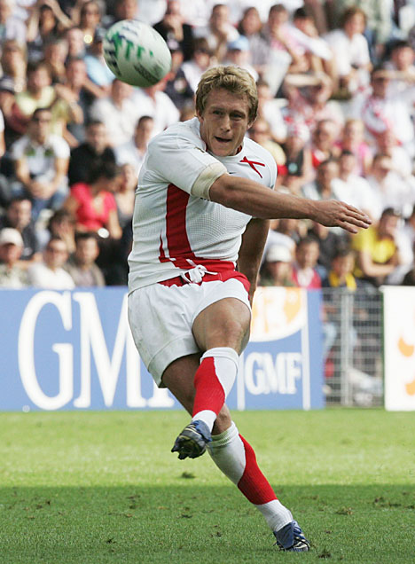
Pacing Continuum
Self paced- Externally paced.
Self paced decided when to start the movement and the rate in which it is carried out.
Normally closed skill.
E.g.,

Slide 10
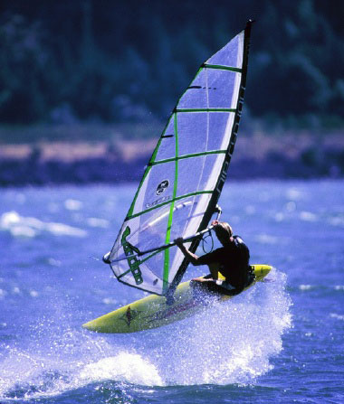
Externally paced Skill
Control of motor skill is determined by environment
Therefore normally an open skill with performer reacting to opponent
E.g., Receiving a pass in football, windsurfing. Receiving a tennis serve.

Slide 11
The difficulty Simple- Complex Continuum
Key term sub routines.
Free style in swimming consist of leg kick, arm action, breathing, body position.
These are sub routines that together make up motor skill.

Slide 12
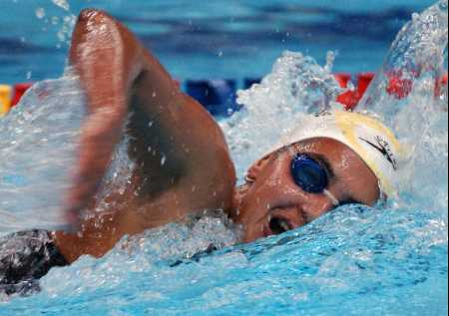
Difficulty
Simple
Small number of sub-routines-speed-timing, not critical.
Little information to process and few decisions to make
Use of feedback not significant
Swimming, cycling

Slide 13
Complex Skill
Performers have a high perceptual load with many decision to be made.
Skill has many sub-routines that when linked together speed and timing are crucial.
Somersault, gymnastics, tennis serve.

Slide 14
Organisational Low-High Continuum
Low organisation
Made up of subroutines which are easily separated and practiced alone.
Gymnastics, trampoline, swimming stroke.

Slide 15
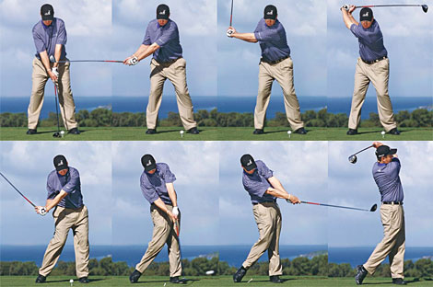
High organisation
Sub-routines are very closely linked and difficult to separate without disrupting the skill.
Practiced as a whole skill
Golf swing
Kicking a ball

