Slide 1
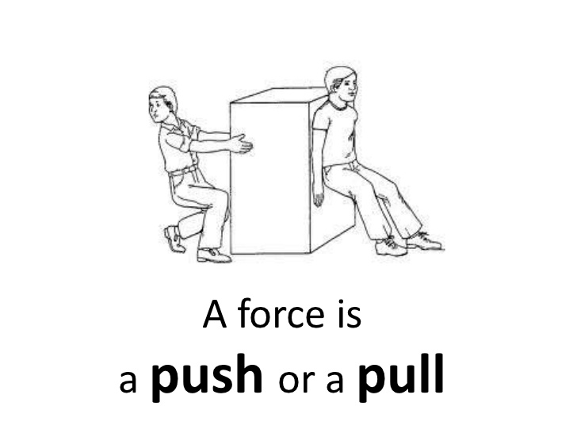
force
Force is a push or a pull that alters the state of motion of a body and can be calculated using the following equation:
Force = mass x acceleration. (f-ma)
Usain example
Mass = 94 kg
Acceleration 2.41 m/s/s
94x 2.41 =
226.5 N
Your force
Mass = your weight kg
Acceleration = ……….. m/s/s
Mass x acceleration
………..N

Slide 2
Complete the chart
facts | Name | Equation | Result
100m Time 13.4 Weight 88 kg 20m time 3.4 secs | Velocity
 | Momentum
 | Acceleration
 | Force

Slide 3
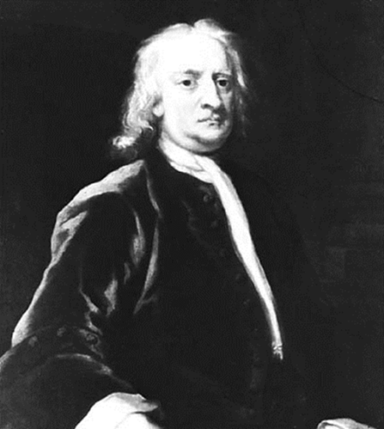
Force
Force is essential to motion
Internal force
External force
Generated by muscular contraction.
Generated by forces outside the body and acts upon it..
E.g. rectus Femoris to extend the knee in the 100m sprint.
E.G. weight, reaction
E.g.
E.G. Wind resistance, friction

Slide 4
So what can force DO penalty?
Action | Example in sport
Force can decelerate a body.
Force can create motion
Force can change the shape of a body
Force can change the direction of a body
Force can accelerate a body

Slide 5
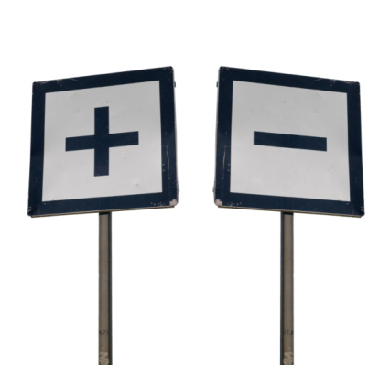
Unbalanced Net Forces
If net force is positive e.g. 1, the body will accelerate.
If net force is negative e.g. -1, the body will decelerate.

Slide 6
Weight
Reaction
Friction
Air Resistance

Slide 7
Horizontal Force - Friction
Friction is the force that opposes the motion of two surfaces in contact
Friction is measured in Newtons (N)
It is always present when two bodies are in motion and have contact
Friction is shown on a diagram by a horizontal arrow extending in the same direction as motion from the point of contact parallel to the sliding surface

Slide 8
Friction is affected by….
Roughness of the ground surface – this increases friction
Roughness of the contact surface – this increases friction
Temperature – by increasing the temperature of the ground friction is increased
Size of normal Reaction - by increasing normal Reaction, friction is increased

Slide 9
Air Resistance is affected by….
Velocity– increasing velocity increases air resistance
Shape – the more aerodynamic the shape, the lower the air resistance. Streamlining minimises air resistance
Frontal Cross-Sectional Area – by decreasing the frontal cross-sectional area, air resistance decreases
Smoothness of the Surface - by increasing the smoothness of the surface, air resistance decreases

Slide 10
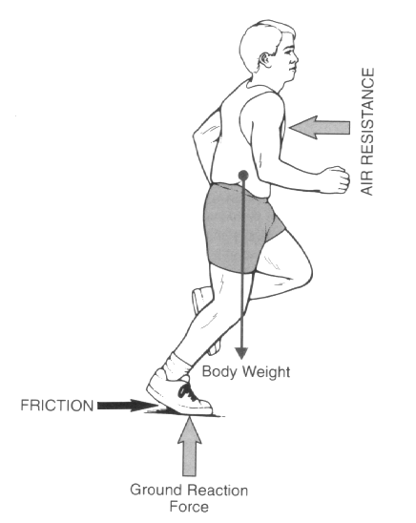
Free Body Diagrams
These are clearly labelled sketches showing all of the forces acting on a body at a particular instant in time
Think! What is happening in the picture?
Is Weight greater than Reaction (Vertical Forces)?
Is Friction greater than Air Resistance (Horizontal Forces)?

Slide 11
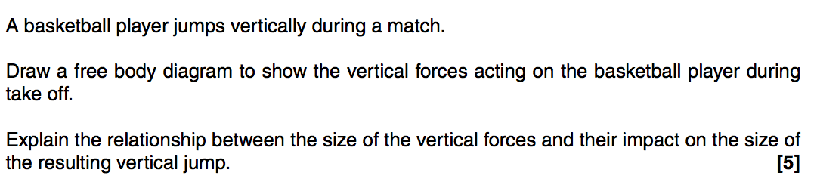
G453 June 2014 Q4 a)

Slide 12
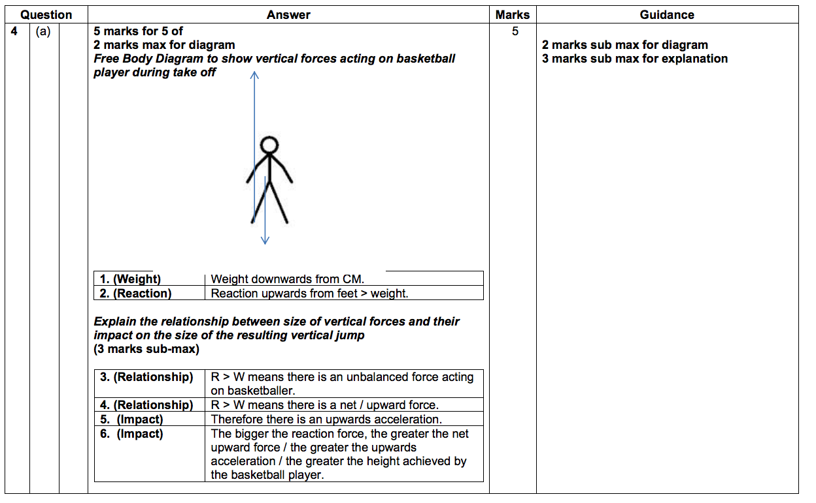

Slide 13
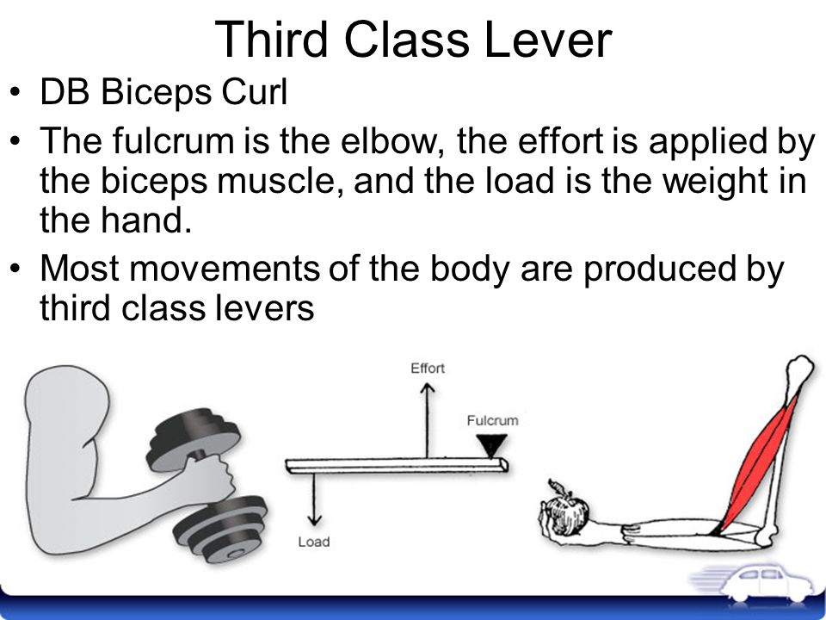
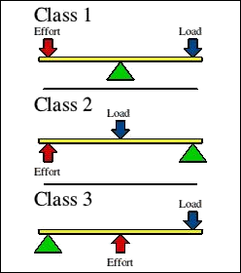
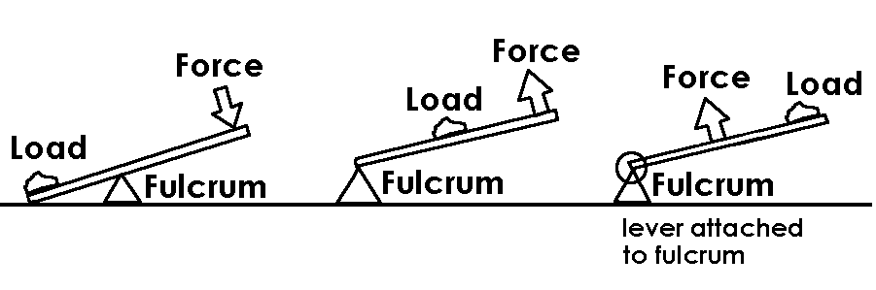

Slide 14
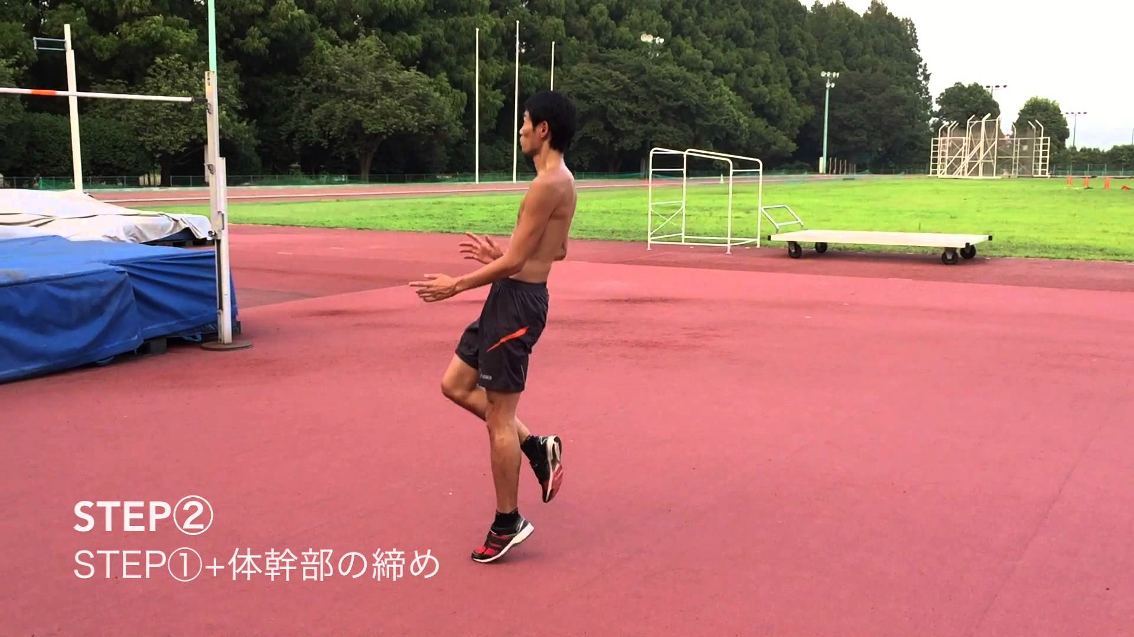
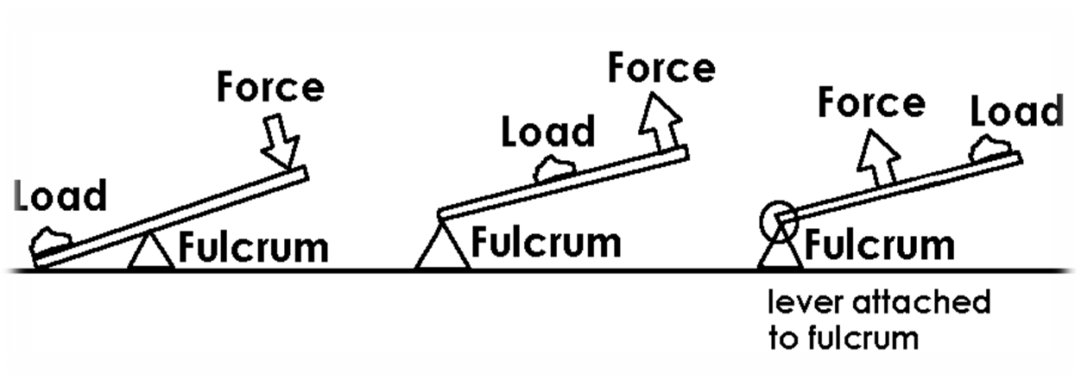
l
E
F
Example of a second class lever

Slide 15
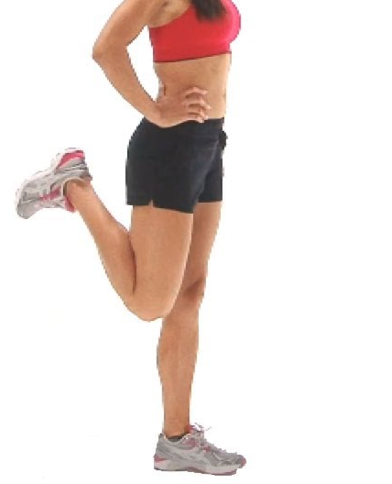

l
Example of a third class lever
E
F

Slide 16
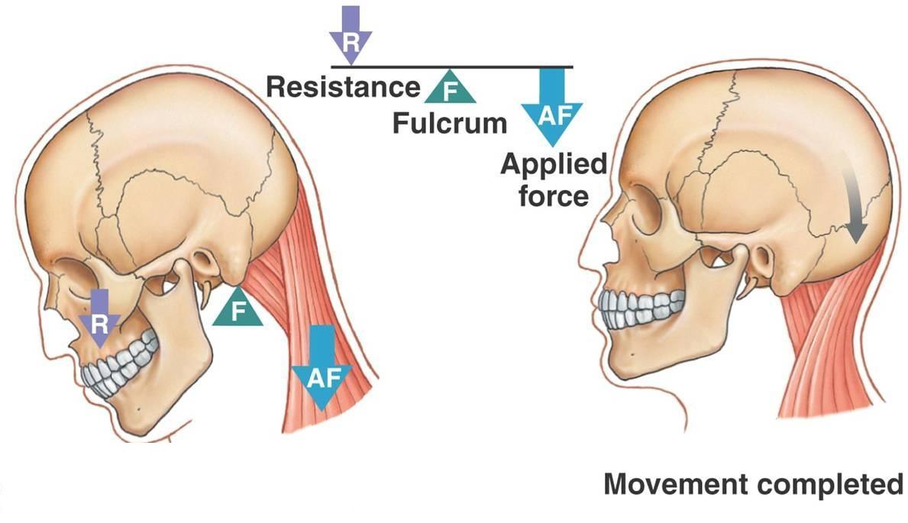
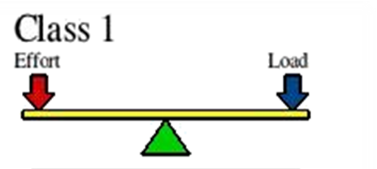
Example of a first class lever

Slide 17
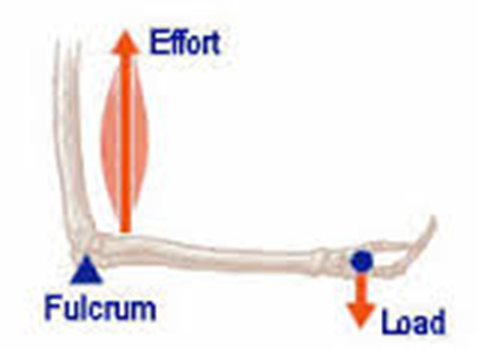
mechanical disadvantage third class lever
Where the load arm is greater than the effort arm, a large effort is required to move a relatively small load.
Bicep curl/ straight arm raise

Slide 18
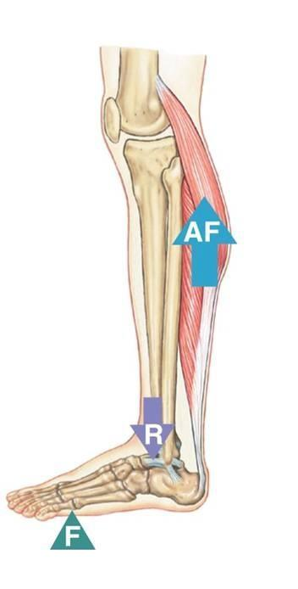
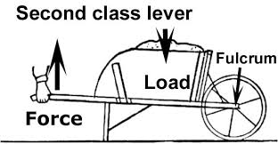

Second class
Where the effort arm is greater than the load arm , a large force can be moved with a relatively small force.
E
L

Slide 19
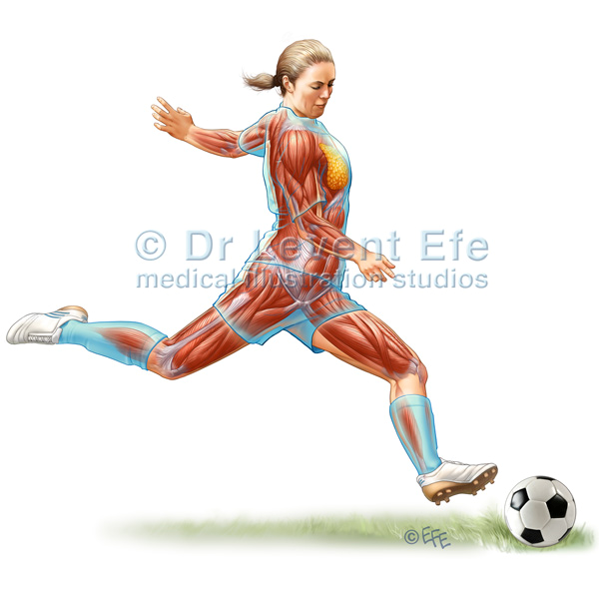


Mechanical advantage
E
l
E
Can increase velocity and acceleration if movement can be created.

Slide 20
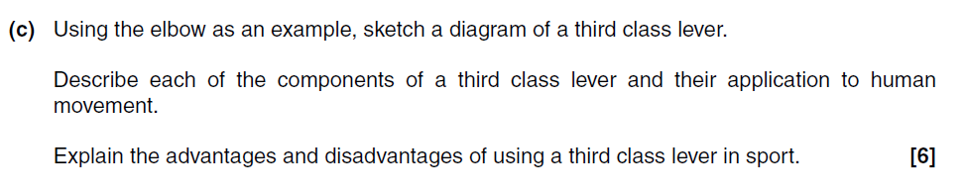
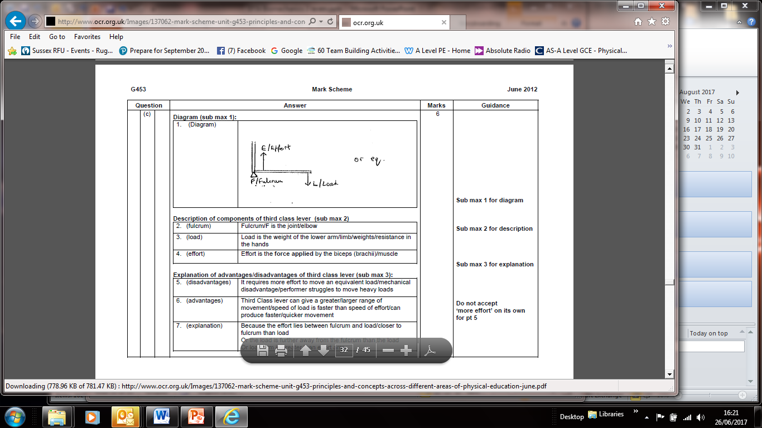

Slide 21
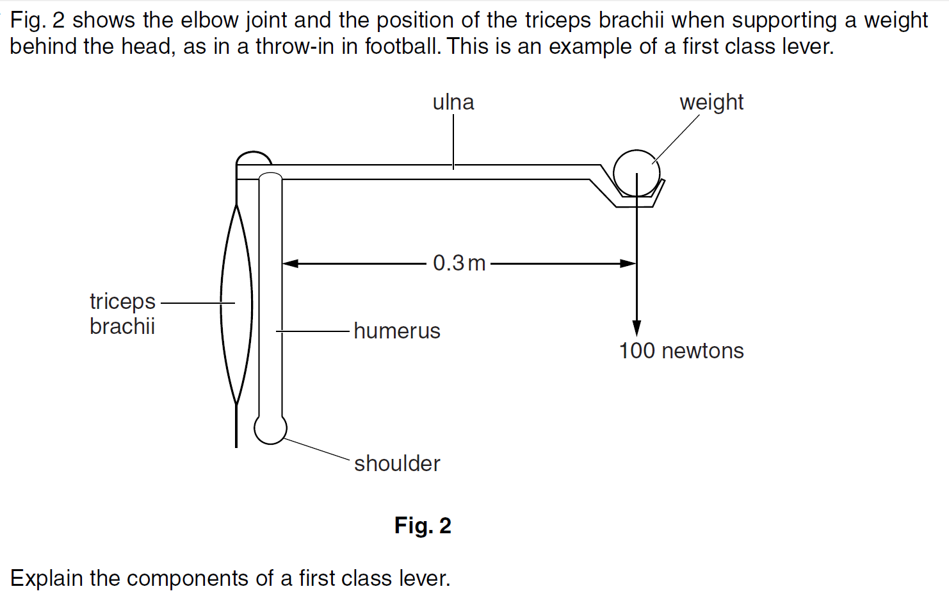

Slide 22
summary
1/2/3 class levers
Length of load are and effort arm will impact on movement and force needed.
2nd class 3rd class
THE GREATER THE EFFORT ARM THE LESS EFFORT IS NEEDED TO MOVE THE SAME LOAD.
Where the load arm is greater than the effort arm, a large effort is required to move a relatively small load.
However, if the effort is greater than the load, can increase velocity and acceleration.

