Slide 1
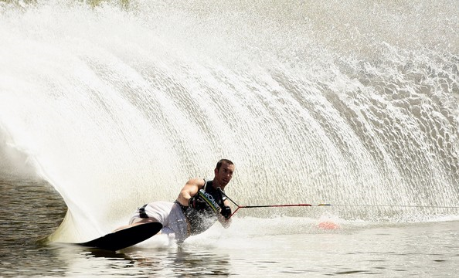
Biomechanics Linear motion

Slide 2
June 2013

Slide 3
June 2013

Slide 4
June 2013

Slide 5
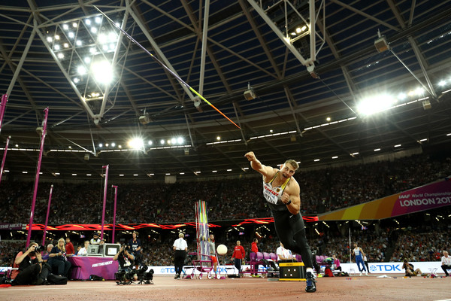
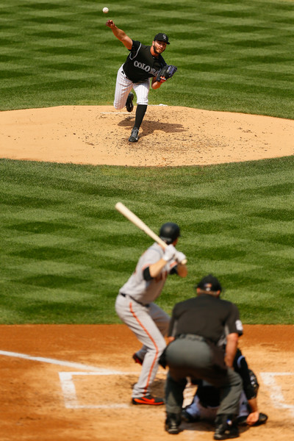
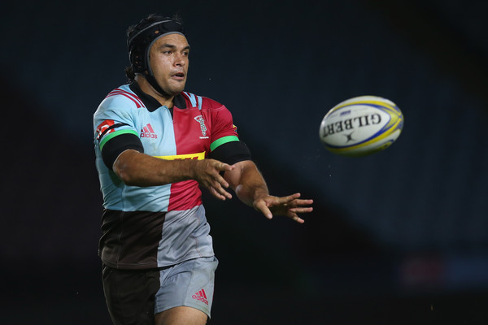
Pure linear motion

Slide 6
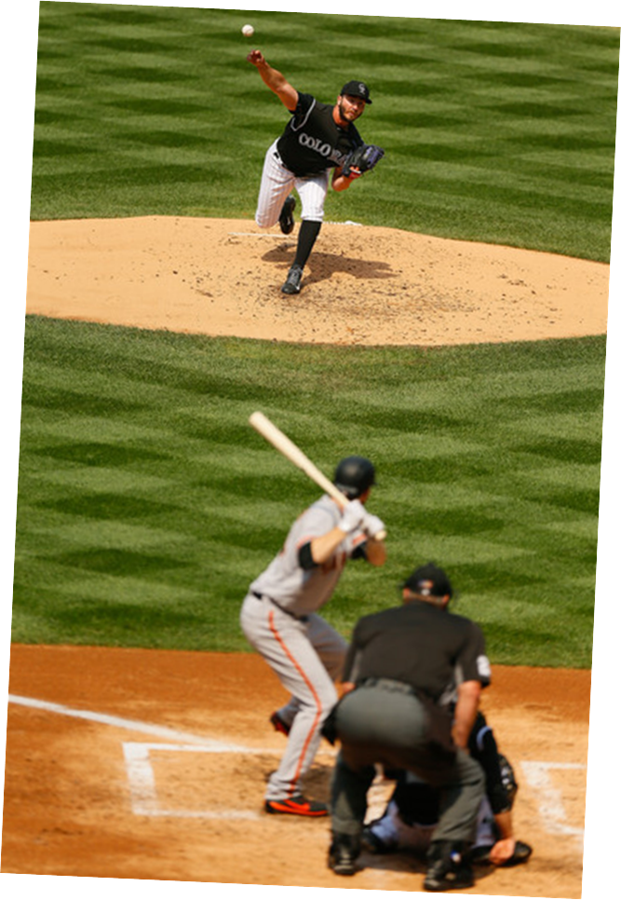
Linear motion
Linear motion movement of a body in a straight line or curved line, where all parts move the same distance, in the same direction over the same time.

Slide 7
starter
State the key concepts
Distance
Speed
Displacement
Velocity
Acceleration
Deceleration

Slide 9
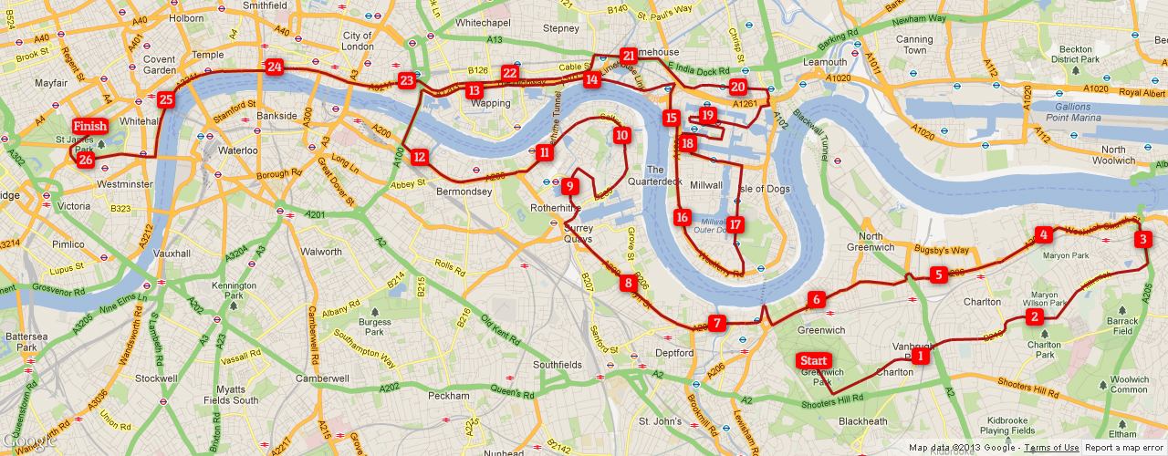
Distance
Total length of the path covered.
DISPLACEMENT
Shortest line from the start to finish.
As the crow flies.

Slide 10
Recap
How do we calculate?
Speed
Velocity
Acceleration

Slide 11
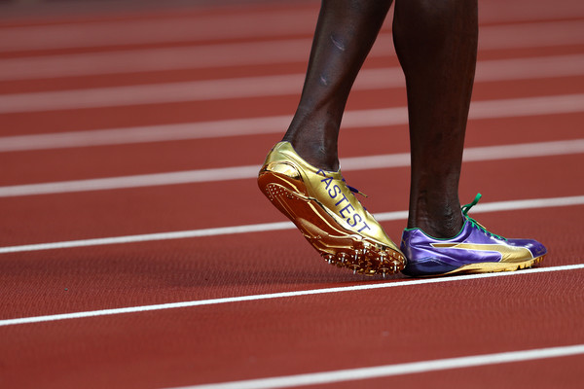
speed
SPEED
Speed = rate of change in distance.
Speed is measured in metres per second (m/s)

Slide 12
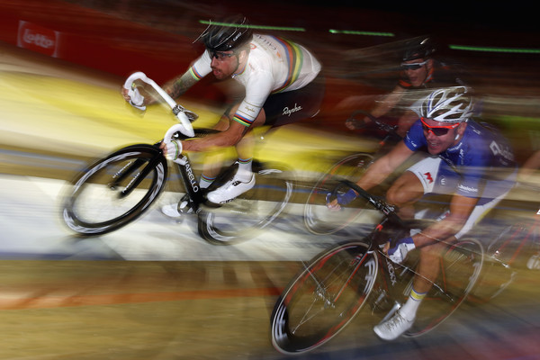
VELOCITY
Velocity = displacement / time taken
Displacement is measured in metres (m)
Time taken is measured in seconds (s)
Velocity is measure in metres per second (m/s)
Velocity is the rate of change in displacement.

Slide 13
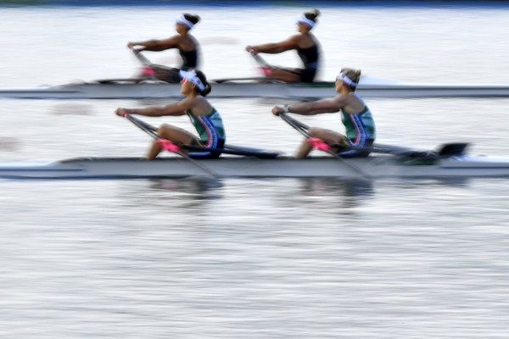
Acceleration = (final velocity – initial velocity) / time taken
Time is measured in seconds (s)
Change in Velocity is measured in metres per second (m/s)
Acceleration is measured in metres per second second (m/s/s)
Acceleration is the range of velocity.

Slide 14
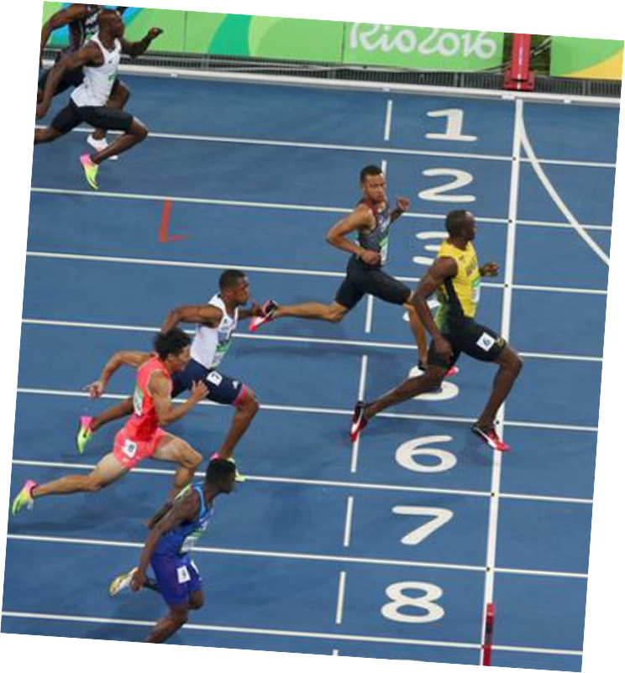
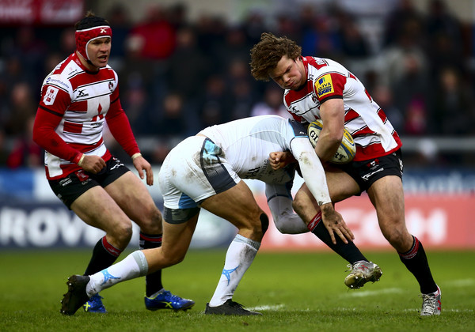
deceleration
Deceleration occurs when the rate of change is velocity is negative or there is a decrease in velocity over time.

Slide 15
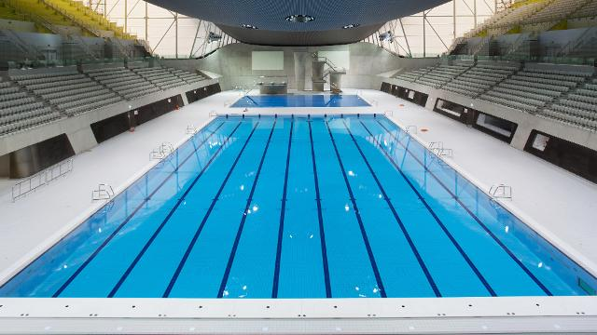
Distance: calculate the distance of 40 lengths of a 25m swimming pool.

Slide 16
Displacement- calculate the displacement of a 1km swim in the 25m pool.

Slide 17
Speed Dafne Schippers broke the 200m record with a time of 21.63s. The distance from the start to the finish. Calculate the average speed.

Slide 18
Velocity is measured in m/s Usain bolt broke the world record 100m in 2009, time 9.58s. Calculate the average velocity.

Slide 19
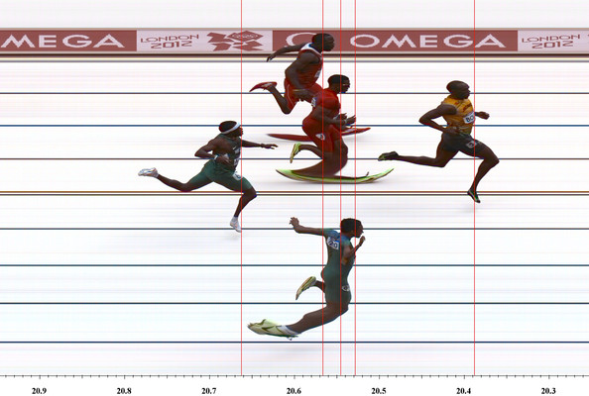
Acceleration is measured in m/s/s. When Usain Bolt ran the 100m his splits were 20m 2.98s. His velocity at 20m was 6.92 m/s his velocity at 0m was 0m/s. calculate the acceleration.

Slide 20
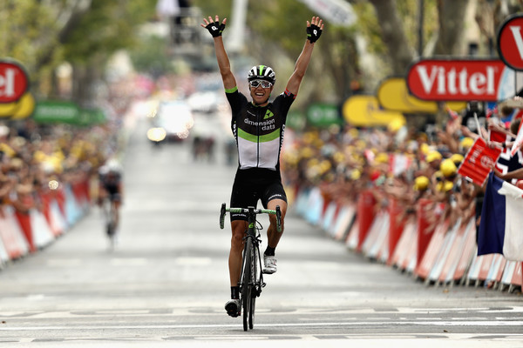
Deceleration as the sprinter crosses the line they slow up by sitting up and stop pedalling. When they cross the line they are travelling at 9m/s two seconds later they are travelling at 5m/s. calculate the deceleration as the rate of change in velocity.

Slide 21
Answers
Factor | Answer
Distance | = 1km (1000m)
Displacement | =0m
Speed | = (distance /time taken) (200m/21.63s) = 9.25m/s
Velocity | = (displacement / time taken) (100m/9.58s) 10.44m/s
Acceleration | = (Final velocity – initial velocity) / time taken = 2.39m/s/s/ (20m/2.89s) = 6.92 m/s (6.92 – 0.0) / 2.89s. = 2.39m/s/s
Deceleration | = (final velocity – initial velocity / time) 5 m/s – 9 m/s /2s = -2m/s/s

Slide 22
Graphs of Linear Motion
Graphs of Linear Motion can be recorded using three graphs:
Distance / Time
Speed / Time
Velocity / Time
With ALL Linear Motion graphs, time is along the horizontal axis

Slide 23
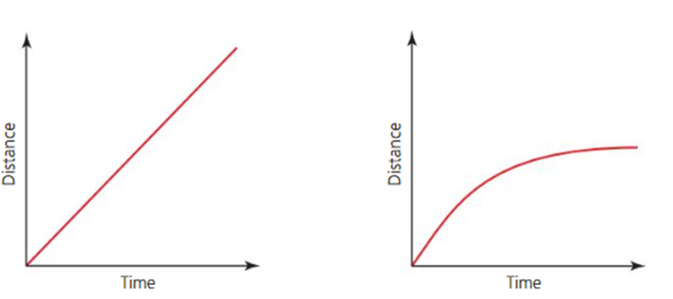
Graphs of distance time
REST
ACCELERATION
CONSTANT SPEED
DECELERATION

Slide 24
Distance time GRAPH

Slide 25
Speed time graphs

Slide 26
Speed time graph final velocity- initial velocity / time taken. Acceleration calculation (8m/s – 3 m/s / time taken =2.5m/s

Slide 27
Velocity time graph

Slide 28
Velocity/time graph

Slide 29
Describe what is happening in the diagram.

Slide 30
Task 2
Distance (m) | Bolt (time in seconds) | Fraser-Pryce (time in seconds)
0m | 0.00 | 0.00
20m | 2.88s | 3.03s
40m | 4.64s | 4.98s
60m | 6.31s | 6.88s
80m | 7.92s | 8.77s
100m | 9.58s | 10.73s
Using the table:
Plot a distance / time graph for the two athletes
Analyse the motion plotted
Compare the two sprinters

Slide 33
Task 3
Distance (m) | Bolt (time in seconds) | Fraser-Pryce (time in seconds)
0m | 0.00 | 0.00
20m | 2.88s | 3.03s
40m | 4.64s | 4.98s
60m | 6.31s | 6.88s
80m | 7.92s | 8.77s
100m | 9.58s | 10.73s
Using the distance / time graph created:
Compare average speed over 100m
Compare speed at 60m
Calculate velocity at each 20m interval for both athletes and draw a velocity / time graph

Slide 34
Bolt |  | Fraser
average speed over 100m | 10.44 | average speed over 100m | 9.31 m/s
speed at 60m | 9.5 m/s | speed at 60m | 8.7 m/s
20m | 6.9 m/s | 20m | 6.6 m/s
40m | 8.62 m/s | 40m | 8 m/s
60m | 9.5 m/s | 60m | 8.72 m/s
80m | 10.1 m/s | 80m | 9.1 m/s
100m | 10.4 m/s | 100m | 9.3 m/s

Slide 35
Average velocity
Time
Displacement

Slide 36
Task 4
Distance (m) | Bolt (time in seconds) | Fraser-Pryce (time in seconds)
0m | 0.00 | 0.00
20m | 2.88s | 3.03s
40m | 4.64s | 4.98s
60m | 6.31s | 6.88s
80m | 7.92s | 8.77s
100m | 9.58s | 10.73s
Using the velocity / time graph created:
Compare maximum velocity of Bolt and Fraser-Pryce
Compare the average acceleration over the first 20m of the sprint

Slide 37
SUMMARY
Component of linear motion | Description | Equation
Distance | The total path covered in m | N/A
Displacement | The shortest route from the start to the finish | N/A
Speed | The rate of change of distance | Distance/ time m/s
Velocity | The rate of change of displacement | Distance / velocity m/s
Acceleration | The range of velocity | Final velocity – initial velocity / time taken m/s/s
Force | A force is a push or pull upon an object resulting from the object's interaction with another object | Force is mass x acceleration
Deceleration | The range of velocity | Final velocity – initial velocity / time taken m/s/s

Slide 38
Jan 2011

Slide 39
Answer Jan 2011

Slide 40
Jan 2012

Slide 42
Jan 2013

