Slide 1
starter
Mallets mallet
Player A states an aid
Player B states benefit
Player A states an negative
Player B states an aid.
Player C (Buzz if you stall or say ‘erm’)
ABC based on confidence.

Slide 2
Exercise Physiology
DTA

Slide 3
training
Exercise physiology is the response of the body’s anatomy to exercise.
Training is concerned with how you can maximise the performance and maintain a active healthy lifestyle.
One method is to have an effective training programme

Slide 4
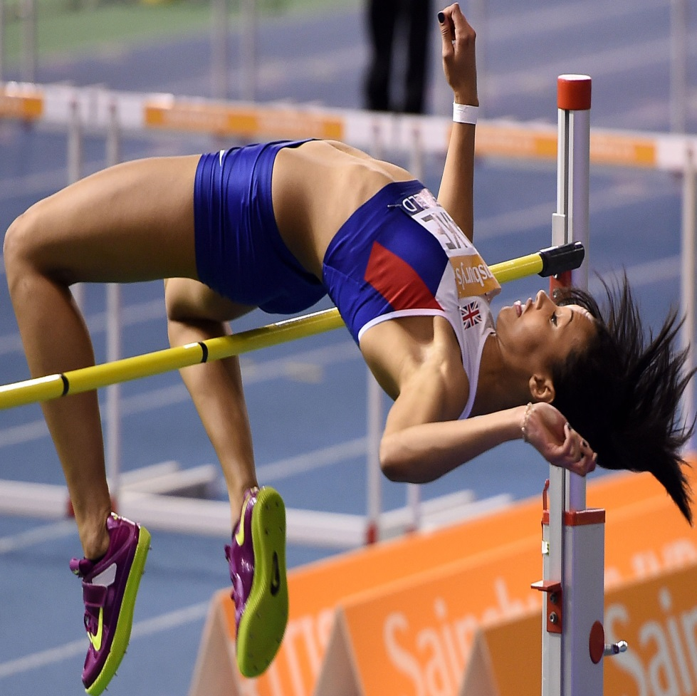
Principles of Training
The principles of training are rules that must be followed for the training to be beneficial and effective for the performer.
Easy to remember as:
MRS VOPP Testing WC

Slide 5
Task A – Jigsaw Task
When planning a training programme, what is meant by each word in MRS VOPP Testing WC?
Using each letter, provide a simple explanation of what is meant and a supporting example using a weight-training or exercise programme.

Slide 6
Principle of Training | Simple Definition | Application to a sporting example
Moderation | Training must be appropriate to the performer, giving time to adapt. If training is too intense or too frequent quality will be lost. | (rec) training twice a week at a moderate intensity. 50-70% max reps
Reversibility
Specificity
Variance
Overload
Progression
Periodisation
Testing
Warm-Up
Cool-down

Slide 7
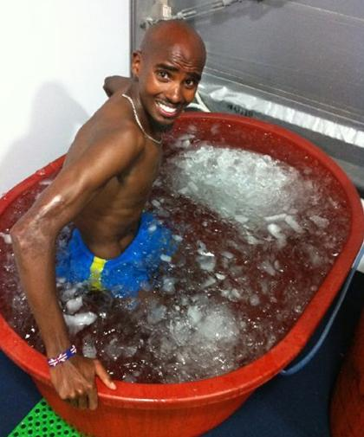
Task b Warm up/ cool down
Plan a warm up for your sport.
Write a summary of the benefits of a warm up.

Slide 8
Periodisation
Periodisation is an organised approach to training that involves progressive cycling of various aspects of a training program during a specific period of time.
The definition of periodisation is an organised division of training into a number of blocks, periods or phases to help an athlete reach their peak performance at a certain time.
It is a way of alternating training to its peak during season.

Slide 9
Task c
Complete a chronological overview of your years training.
How do you break up your season or is it all training?

Slide 10
In a nutshell...
Macro-cycle A long-term training plan or goal
Meso-cycle A block of training, typically between 4 and 16 weeks duration, with a medium-term goal
Micro-cycle A number of training sessions which form a recurrent unit. Typically 1-3 wks, short-term goals
Mega-cycle A macro-cycle which may last several years

Slide 11
Periodisation
Macro-Cycle
e.g. A Year Period
Pre-Season
Mesocycle 1
Microcycle 1
Wks 1-4 base endurance
Microcycle 1
e.g. Weeks 1-20
Transition
Mesocycle 3
Microcycle 1
e.g. Weeks 1-4 Rest
Competition
Mesocycle 2

Slide 12
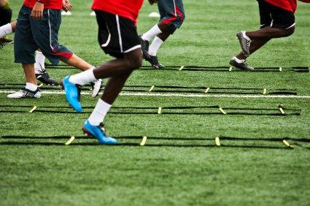
Task D
Complete a macro cycle
Choose one of the meso-cycles and note what is involved in that element.
What activity?
How long for?
What intensity?

Slide 13
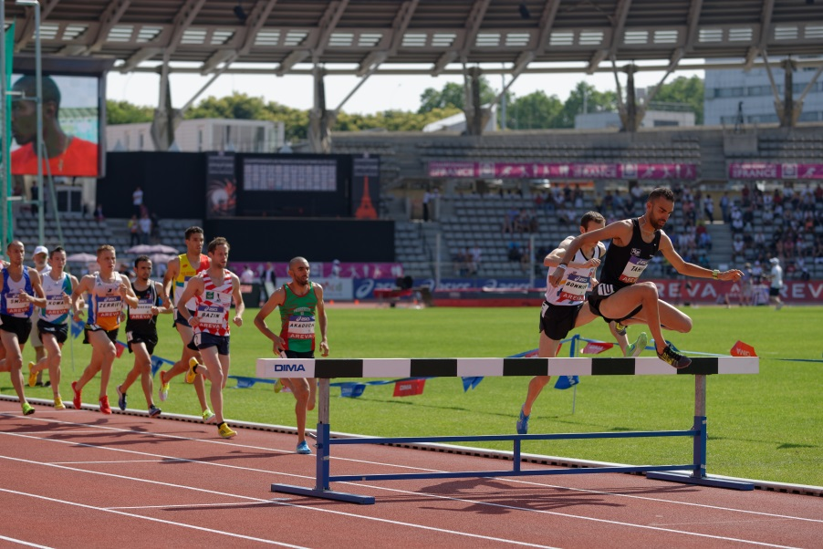
Mesocycles in the Phases
Thinking of Preparation phase (pre-season) ,
competition phase and
transition phase (off season):
How can mesocycle be developed within each of these three phases?

Slide 14
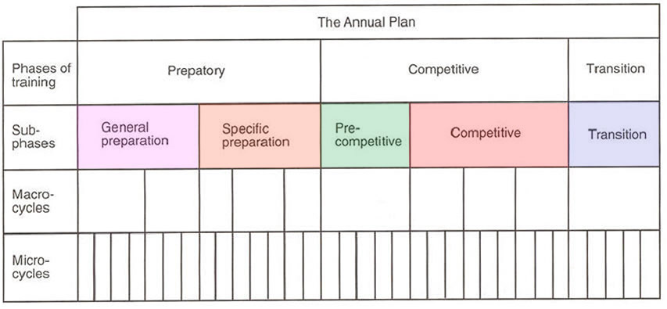
mesocycle
Mesocycle in a Mesocycle

Slide 15
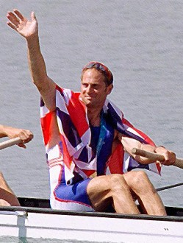
The Master Plan
When designing a training programme, an annual plan is important and uses the concepts of periodisation and training principles.
Preparation Phase
Competition Phase
Transition Phase (usually involves rest or recovery)
The aim is to provide a peak performance for an athlete.

Slide 16
Periods in Training
Jess Ennis article P84
Peak
Tapering and Peaking
Development of Competition Specific e.g. Speed and Power
Building an Endurance Base
8-12 Week Mesocycle
e.g. Over-distance training
Rest - 4-6 Week Mesocycle
Competition
Preparation 2
Preparation 1
Transition

Slide 17
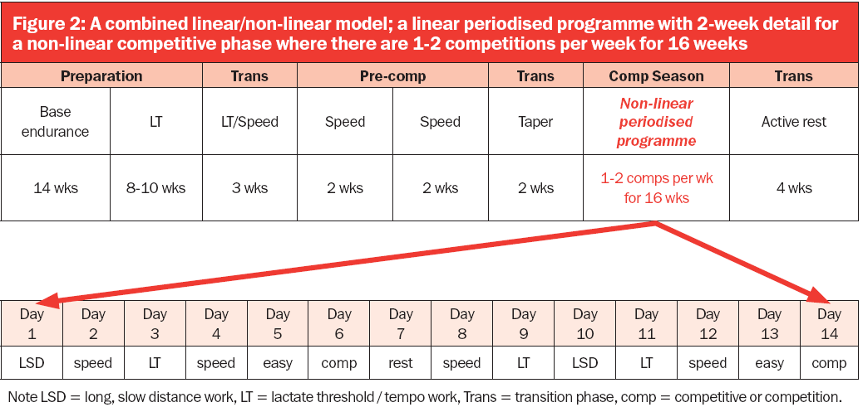

Slide 18
Benefits of Periodisation
Ensures the athlete reaches a peak performance at the correct time for their target
Ensures that the following principles of training are applied:
Specificity, Moderation / Reversibility, Variance / Tedium, Overload, Progression, Warm-Up / Cool-Down, Frequency

Slide 19
G453 June 2012
Explain the use of periodisation when planning a personal health and fitness programme.
[6 Marks]

Slide 20
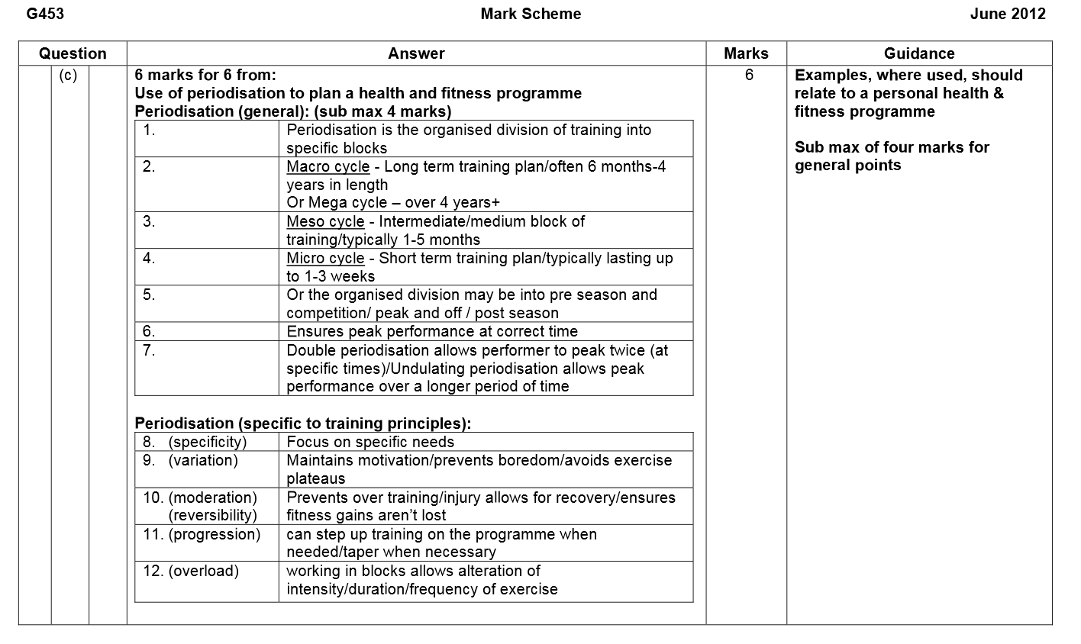

Slide 21
Task e
Looking at your season overview:
Add-in a microcycle
Within the microcycle, design a basic training session to support the microcycle (warm-up, main activity and cool-down)

Slide 22
Task F
Using any element of your overall plan, write a small paragraph to explain how the following principles are applied within it:
Specificity
Moderation / Reversibility
Variance / Tedium
Overload
Progression
Try to include reference to any macro, meso or micro cycles and any specific examples to back your points.

Slide 23
20 Mark Possibilities...
Plan a personal health and fitness programme that will promote sustained involvement in a balanced, healthy and active lifestyle; the plan should include the principles of training.

Slide 24
20 Markers – Aerobic Capacity
Devise a 6 month programme to develop aerobic endurance.
Justify your programme by referring to the theory of periodisation and the principles of training.
[20 marks]

Slide 25
20 Markers – Aerobic Capacity
Interval training is a versatile type of training in which periods of work are interspaced with periods of recovery.
Outline a series of interval training sessions that are designed to stress the lactic acid system. Explain how you would apply the training principles of overload, specificity and reversibility to ensure your sessions remain effective throughout the training programme.
[20 marks]

Slide 26
20 Markers – Aerobic Capacity
Identify, define and give a method of evaluation for aerobic capacity.
A carefully planned training programme is required to improve a specific component of fitness.
Using the following terms: macrocycles, mesocycles, microcycles (alongside principles of training) design a training programme to improve cardiovascular endurance for a sedentary adult.
[20 Marks]

