Slide 1
Exercise Physiology Nutritional aids
Performance enhancement is also know as ergogenic aids.

Slide 2
Types of Ergogenic Aids
Pharmacological Aids
Physiological Aids
Nutritional Aids

Slide 3
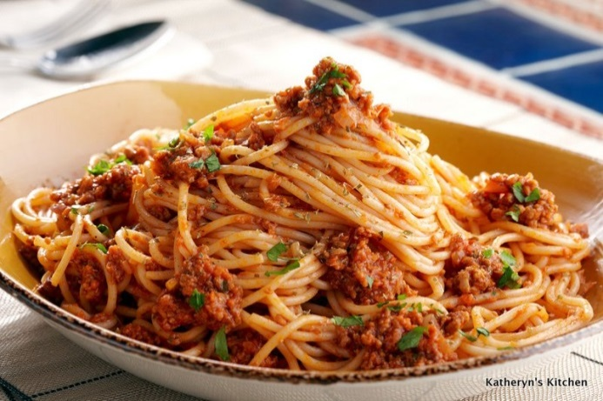
Dietary Manipulation
Dietary manipulation comes in two main forms:
Food
Fluids
This can affect, pre-, during and post-competition.

Slide 4
CHO Loading? How can you do it?
Pre
During
After

Slide 5
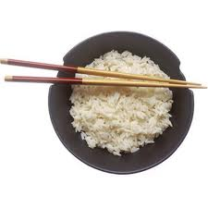
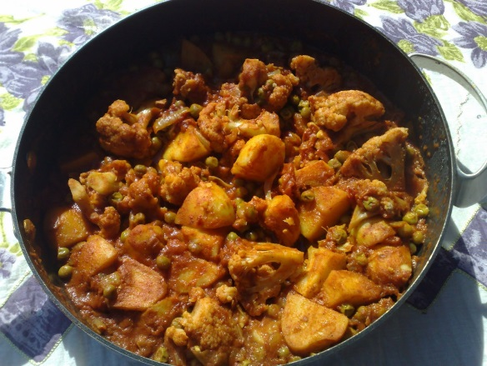
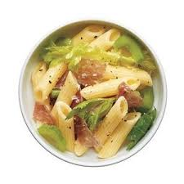
Pre-Competition: CHO Loading
Carbohydrate (CHO) Loading is a strategy used by athletes to increase the body’s glycogen stores prior to an event.
This is a pre-competition strategy.

Slide 6
How to CHO load
Basic idea is a 10-day outline:
High intensity exercise for 7 days before an event to deplete the glycogen stores massively...
...followed by consuming high fat and protein diet for 3 days to continue to deprive the body of glycogen.
3 days before the event, the athlete consumes a diet high in CHO’s and fluid
This diet will also be low in protein and low in fat.
This loads the muscles with glycogen and therefore increases glycogen storage.

Slide 7
What DID SHEREMAN AND ASTRAND SUGGESTS FOR CHO LOADING?
One week prior to a race,
two hours or 20 miles (32.2km) of running — the intention being to get the body to a state of carbohydrate depletion, with minimal muscle glycogen stores.
For the next three to four days
60 to 100g per day.
By denying the body its preferred source of fuel, glycogen synthase activity (the natural resynthesis of glycogen) is accelerated.
Around 3 days prior to the race, the runner increases their carbohydrate intake 10 fold (400 to 600g), which along with greater resynthesis, led to an increased glycogen uptake by the muscles in comparison to pre-bleed-run levels.
In such an instance, it followed on that the distance runner maintained performance for longer.
SHERMAN
Athletes to taper
several days and rest on the day before competition
ingesting a carbohydrate-rich diet for three days prior to competing.

Slide 8
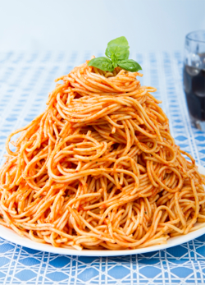
Competition Day: CHO Loading
It is also possible to CHO load on the day of the event.
3 hours prior to the event, a performer can eat slow-digesting CHO meals containing 1-4g of complex CHO’s.
1-2 hours before the event, a small and fast digesting simple CHO meal will increase liver glycogen stores.
It is vital that high volumes of food and fibre intake should be avoided as this could cause digestive problems with this strategy.
What would be the problem of this strategy if used an hour before the event?

Slide 9
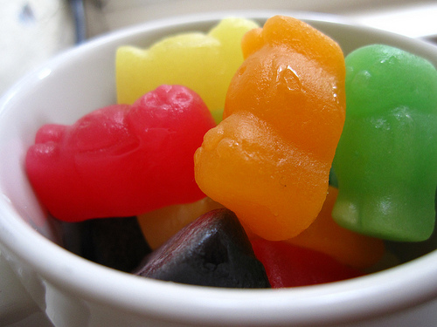
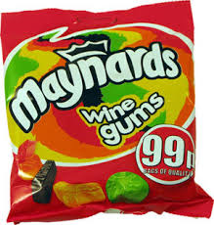
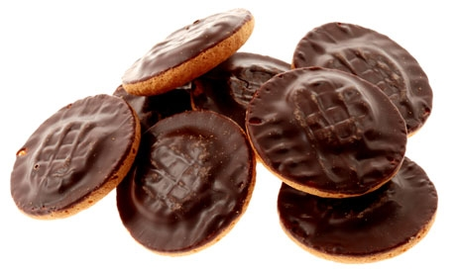
CHO Intake During Exercise
Recommended that performers eat small amounts of food (or drink high CHO fluids) during activity of 45mins or more.
This helps replenish the glycogen stores
The body can absorb 60-90g of CHO’s per hour
If the activity is less than 45mins, this will have minimal effect.

Slide 10
Post Competition Specifics
Within 30mins of exercise, you should aim to:
Eat CHO’s (1.5g per kg per hour) and Proteins
10-20% of your daily calorie intake
This can aid your carbohydrate stores that have been used during short-duration exercise, or intense work. Hypertonic drinks!
Longer duration activities will take longer to recover as more glycogen stores are depleted – this may require repeated eating of CHO’s every two hours.

Slide 11
Think!
How would the pre and post meals differ for athletes trying to increase their muscle mass and strength?

Slide 12
Strength Training Meals Overview
5-6 small meals per day, every few hours
Up to 30% lean protein to enhance muscle building
Complex CHO’s required to provide slow energy release
Limited fat intake – but its required for energy and hormone production

Slide 13
Strength Pre- and Post- Training
Pre-training meal
Post-training meal
30-60mins before training
Small meals, consisting of fast-digesting CHO’s and protein
White bagels, rice, whey protein, egg whites
Within 2hrs after exercise
Meal consisting of fast digesting CHO’s and protein
Replaces glycogen and increases protein in the body for muscle gain
Protein shakes, liquids

Slide 14
Fluid Intake During Exercise
If you feel thirsty, it’s already too late!
Best to consume more fluid than your thirst needs prior to exercise.
Water intake during prolonged exercise reduces the risk of dehydration and optimises performance.
Dehydration coupled with increase in temperature could lead to heat exhaustion and decreased performance.

Slide 15
Changes in Hydration due to Exercise
During exercise, decreasing body water
Decreasing plasma volume
Decreasing SV, increasing HR leading to circulatory distress and postural hypertension!

Slide 16
Hypertonic
Isotonic
Hypotonic
Types of Sports Drinks
http://www.youtube.com/watch?v=I1Yth0TzABM

Slide 17
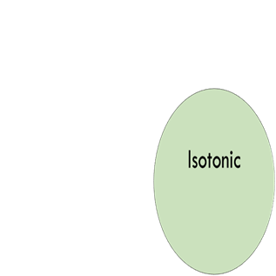
Hypertonic
Hypotonic
Increase in sugar/ energy supply, fluid as well as salt
Replenish fluid and a little energy
Same as the body balance

Slide 18
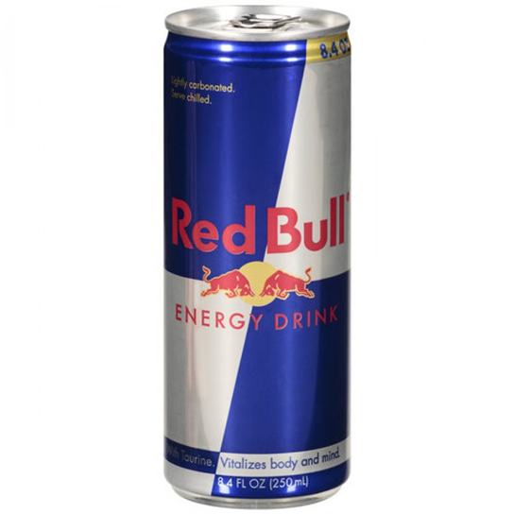
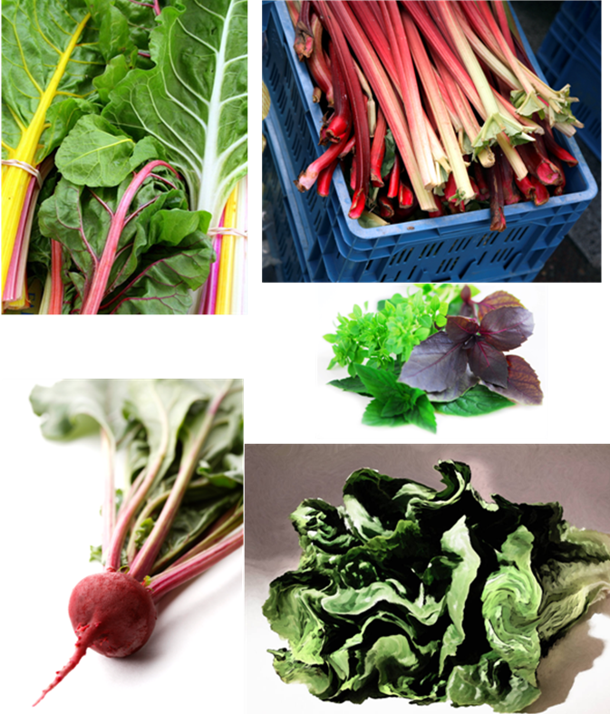
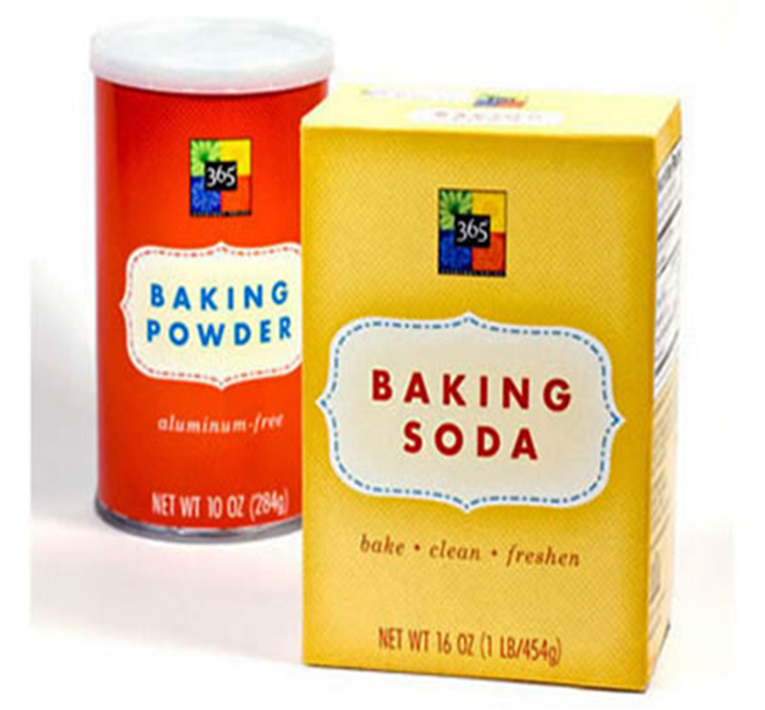

Slide 19
Caffeine
Caffeine is a stimulant used to heighten the CNS and increase the breakdown of fat as a fuel for energy production.
Tea, Coffee, Energy drinks, and Tablet forms
Consuming 3-9mg per kg of body weight 1 hour before performance increases the aerobic capacity of endurance performers.
Helps to preserve glycogen!

Slide 20
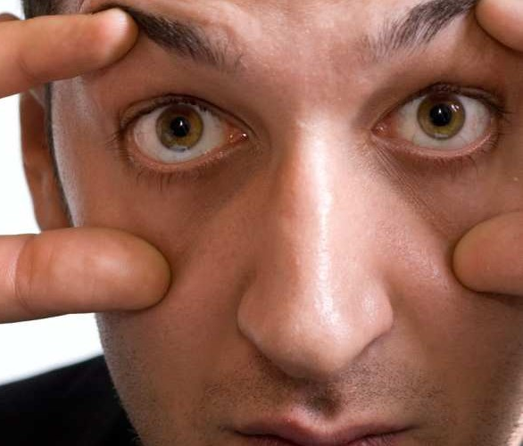
Caffeine
Caffeine increases:
Alertness
Concentration
Reaction time
BUT…can also develop:
Digestive problems
Insomnia
Anxiety
Dehydration

Slide 21
Bicarbonate
Bicarbonate is an alkaline which acts as a buffer to neutralise the rise in lactic acid associated with anaerobic activity
0.3mg of sodium bicarbonate per kg of mass taken 1 hour before competition will increase the body’s tolerance to lactic acid

Slide 22
Nitrate
Nitrates are inorganic compounds consumed by eating root vegetables
Starting 6 days before an event, 6-12mg per kg per day can be added to the diet
A final dose is then taken 1 hour before exercise
This reduces blood pressure and therefore delays fatigue

Slide 23
How does this work?
The inorganic compounds are stored as nitrates
In a low oxygen and acidic condition (exercise) they convert to nitric oxide
Nitric oxide plays an important role in vascular and metabolic control
This helps to dilate the blood vessels and increase blood flow to the muscle tissues

Slide 24
G453 June 2011
Outline and justify the advice you would give to an endurance performer about the content and consumption of the pre-competition meals.
[6 Marks]

Slide 25
Answers
Any carbohydrate example e.g. Muffins/crumpets with jam/honey/oatcakes/pasta with tomato based sauce/baked potato/cereal with low fat milk/banana/creamed rice and fruit etc
Any other carbohydrate example
Drink approx 500ml of fluid (water/sports drink/diluted fruit juice)
Sub max 5 for justification
Prevent dehydration
Prevent depletion of glycogen
Maintain blood glucose
Maintain electrolyte balance
Avoid an upset stomach
Have high carbohydrate meal (+200g) approx 3 hours before event
Preferably eat carbohydrates with low GI / complex for slow release of energy
Smaller/simple carbohydrate 1-2hours before event
Choose foods you like and that you tolerate
Reduce fat / spicy food content in pre comp meal (avoids upset stomach)
Decrease the amount of fibre in pre comp meal (avoids upset stomach)
Liquid meals empty more quickly from the stomach
Continue to drink small amounts of fluid until start time to remain hydrated

Slide 26
summary
nutritional aids:
amount of food
composition of meals
timing of meals
Hydration
glycogen/carbohydrate loading
creatine
caffeine
Bicarbonate
nitrate.

