Slide 1
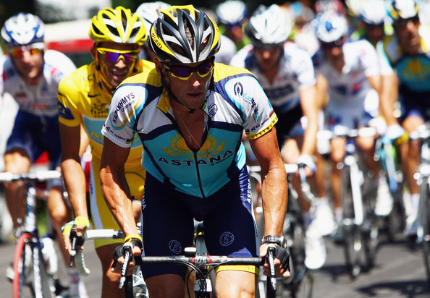
Ethics and Deviance in Sport part 1

Slide 2
Deviance
Deviance in sport is often a result of the drive to win.
Ethics rules that dictate an individual conduct.
Gambling in sport has become more sophisticated.
Violence behaviour of players and spectators a feature of modern sports.

Slide 3
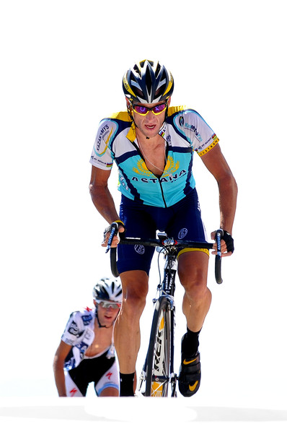
Performance enhancing drugs
Blood doping:
Anabolic steroids:
Beta Blockers:
Stimulants:
Narcotic analgesic
Anabolic agents
Diuretics
Masking agents (pain killers)

Slide 4
Performance enhancing drugs
Performance enhancing drugs | Sport suited
Blood doping: | Endurance events (cycling)
Anabolic steroids: | Increase in muscle size (weight lifting)
Beta Blockers: | Steady nerve (snooker)
Stimulants: | Caffeine (tennis)
Narcotic analgesic | Pain relief (rugby, football)
Anabolic agents | Sprinting events
Diuretics | Boxing
Masking agents (pain killers) | Rugby, American football
Performance enhancing drugs | Sport suited
Blood doping: | Endurance events (cycling)
Anabolic steroids: | Increase in muscle size (weight lifting)
Beta Blockers: | Steady nerve (snooker)
Stimulants: | Caffeine (tennis)
Narcotic analgesic | Pain relief (rugby, football)
Anabolic agents | Sprinting events
Diuretics | Boxing
Masking agents (pain killers) | Rugby, American football

Slide 5
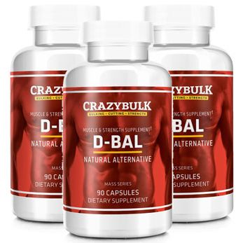
Legal supplements
Supplement
Vitamins / Minerals
Bicarbonate
(HMB) Beta Hydroxy- Beta methyl butyrate
Energy bars
Carbohydrate Powder
Liquid meal replacement
Sports drinks
Creatine
Freely available, however, conflicting research.
Some supplements may not be safe.
Philosophy of sport is fair play so taking legal supplements are still within the bounds of acceptable behaviour.

Slide 6
Advantages of legal supplements
Dietary supplements
Can enhance performance
Supplements
Claim to build muscle, stamina, weight control.
Sports Drinks
Aid recovery, maintain hydration, sodium helps to hold water.
Carbohydrates in fluid increase energy store.
Reduction in threat of ban.
Increase in performance
Increase in recovery speed

Slide 7
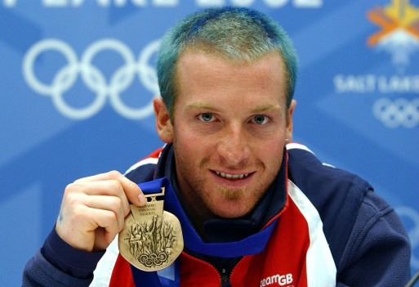
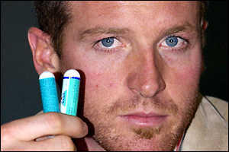
Disadvantage of legal supplements
Risk of ban:
Some drinks can contain banned substances.
Health concerns raised over long term use,(e.g. Creatine, digestive system.

Slide 8
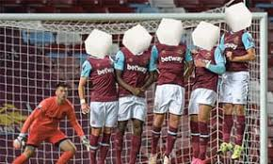
Disadvantage of legal supplements
"A significant percentage of our top footballers are affected by dental decay, tooth erosion and gum disease"
Professor Ian Needleman, UCL
High sugar linked to health and teeth issues.

Slide 9
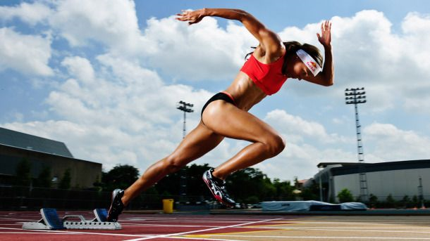
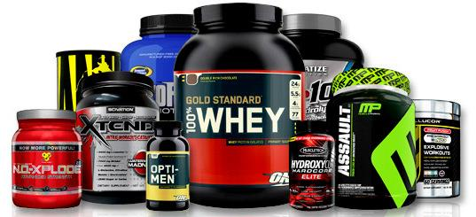
Philosophical debate
Can we say that there is an even playing field?
Does everyone have access to supplements and sports science to support them as athletes?

