Slide 1
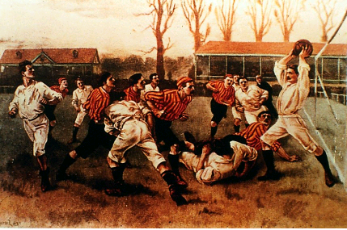
Sport and Physical Activity as a reflection of the culture in which it exists.
DTA AS physical education

Slide 2
Lesson Objective
By the end of the lesson you should understand: How sports and games reflect the society in which they exist.
Understand how ethnic games and sports have survived
The characteristics of ethnic games.

Slide 3
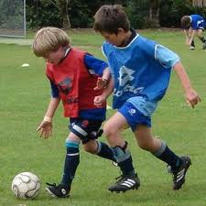
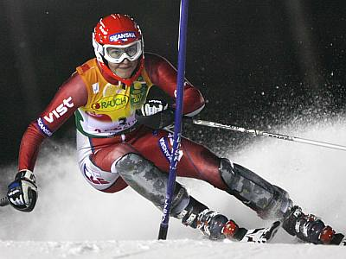
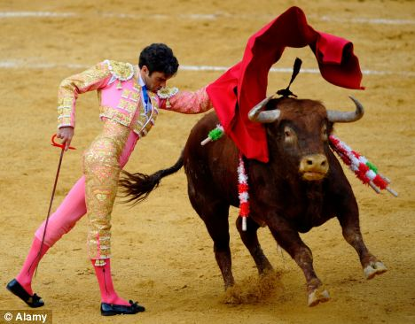
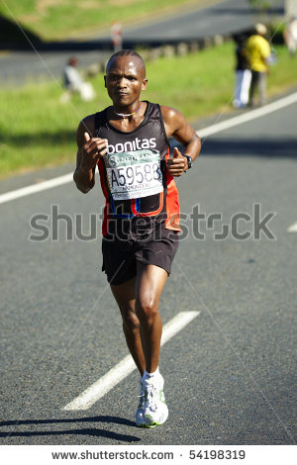
Characteristics of a country are reflected in their sports. Can you guess the country?

Slide 4
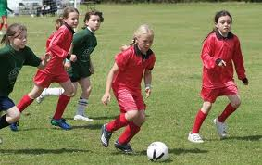
Characteristics
Organised (kit, lines, rules)
Physical
Popular
Originated from England

Slide 5
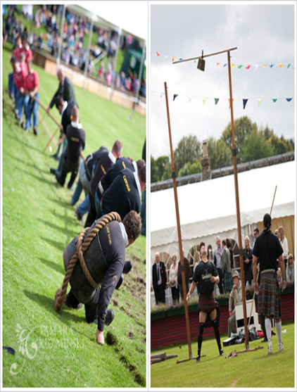
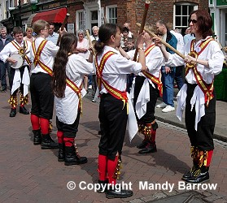
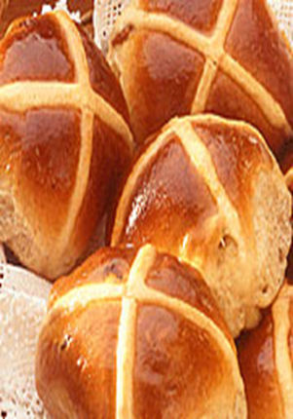
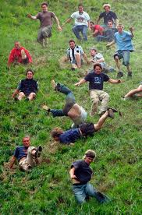
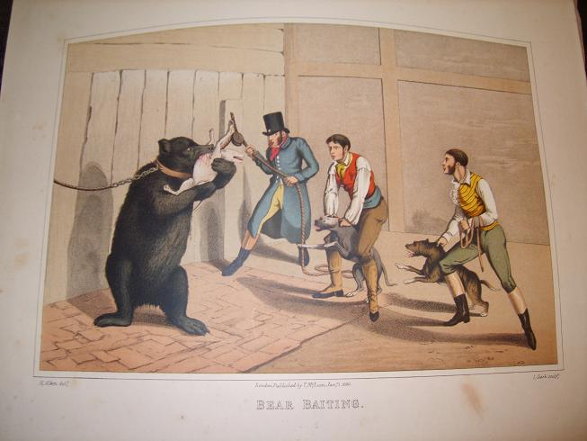
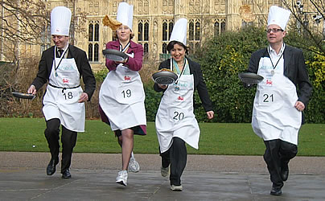
Do these festivals reflect society today?
Traditional festivals that reflect celebrations of older times?

Slide 6
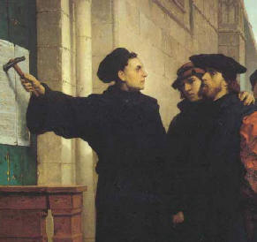
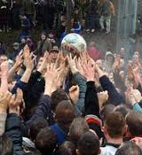
Characteristics of the traditional sports and festivals in the UK
Mob football
Identify the characteristics
Cheese rolling
Cooper Hill Gloucester
“I’m opposed to these rowdy games that are unholy. There is too much drinking and promiscuity,”
Mob football was only played by the poor
The rich and royalty attempted to ban the sport.
King Edward 1314, followed by several of Kings in the 14th C
I was seen as unchristian like behaviour.

Slide 7
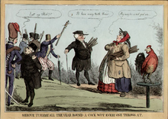
Cock fighting
Medieval links
Considered an upper class sport (maybe a reason why it lasted so long)
Significant gambling took place
It was made illegal in 1849.
Cock throwing!

Slide 8
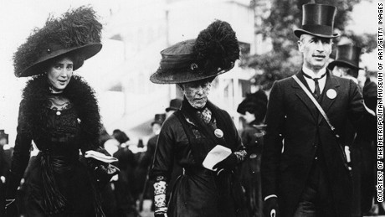
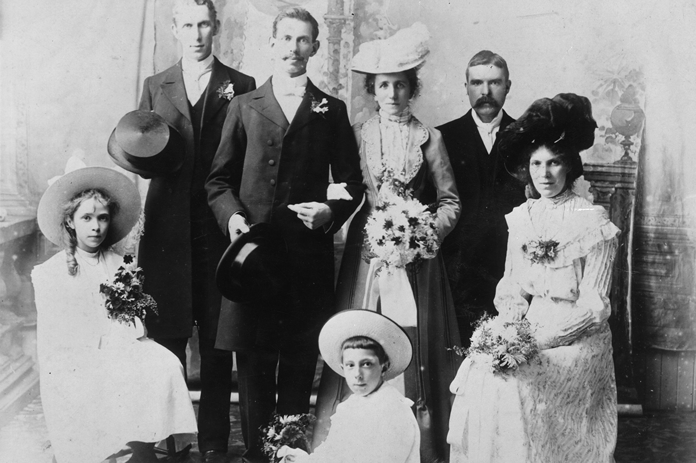
Social class
In pre-industrial Britain society was split into two. The class was dependent on birth
Upper class
Activity for upper class
Real tennis
Fox hunting
More sophisticated and more rules
Money, education, means of transport to help them develop sophisticated activities.

Slide 9
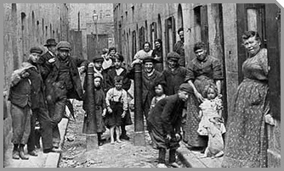
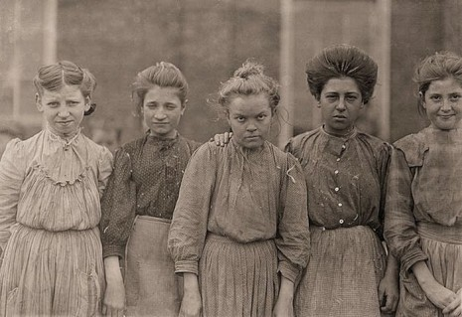
Social class
lower class
Activity for lower class
Mob football, dog fighting, prize fighting
Simple activities quite often cruel and violent to persons or animals.
Good opportunity to win some money.

Slide 10
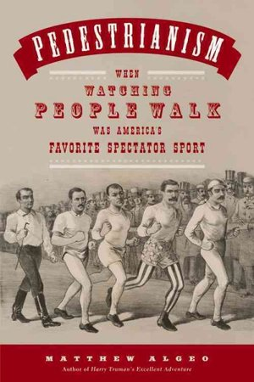
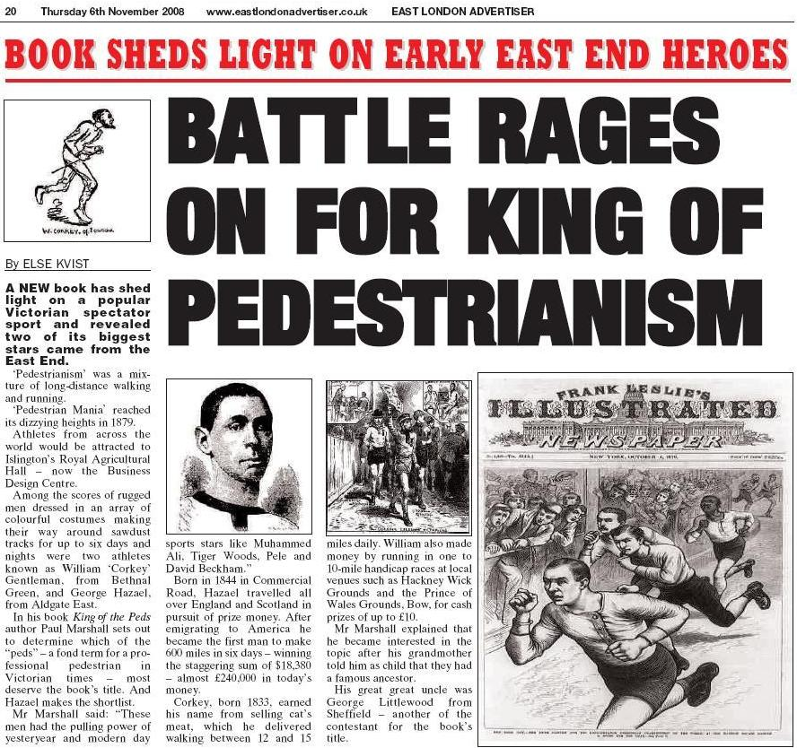
Social class
Activities for both classes
There were a few examples where both classes played the same game, however, the role was different.

Slide 11
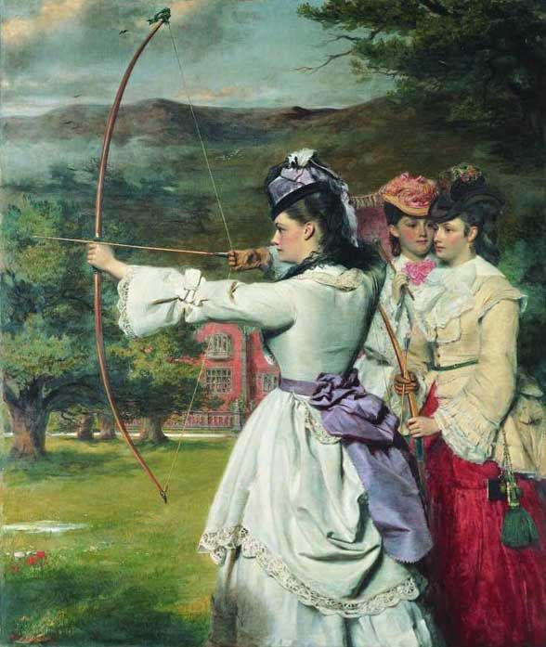
gender

Slide 12
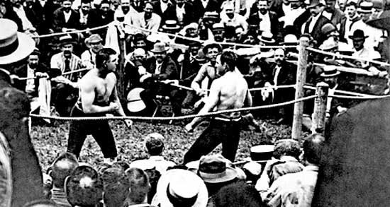
Law and order
If sport reflects society, what does this say about the law and order of the time?
Lack of order, so peasant class involved in violent activities.
Despite cruel sports were frowned upon, there was no one to stop them taking place.
Not until 1829 that ‘modern’ police force was created by Robert Peel.

Slide 13
Education and literacy
Literacy and Education

Slide 14
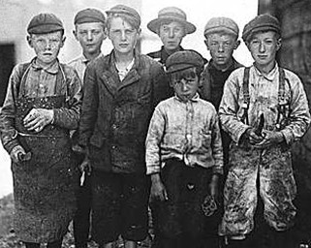
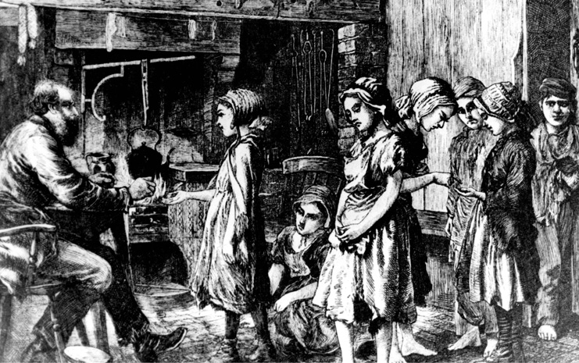
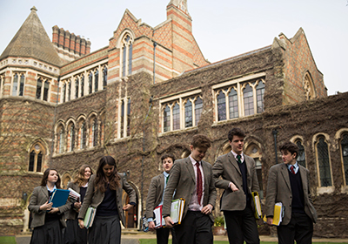
Literacy and Education
RULES OF REAL TENNIS
The ball can be given spin either by the player or by contact with the wall, and the action of this spin can be even more deadly than Shane Warne; reading the spin is an important part of the game; initially one is totally bewildered by the spin but soon one begins to judge where the ball will move after contact. Service is from one end of the court and there are about a dozen different types of serve - and each has a few variations....
The scoring is intricate but not complicated. Games and sets are scored as in lawn tennis (lawn tennis, a comparative newcomer, took its scoring system from real tennis).

Slide 15
Lower class.
Worked long hours.
Exhaustive work labouring on the land.
Recreation was confined to festivals, holy days.
Mostly based around the public house, the creation of drinking games.
Short lived as had to return to work
Upper class
Time was not an issue so could take part in longer events, further away,
E.g., Fox hunting
Lower class
No transport so activities had to be ones that could be completed locally.
Pig catching/ variety of throwing contests,

Slide 16
Houses, horses, equipment, clothing for activities like hunting.
Land ownership meant hunting could take place on your land.

Slide 17
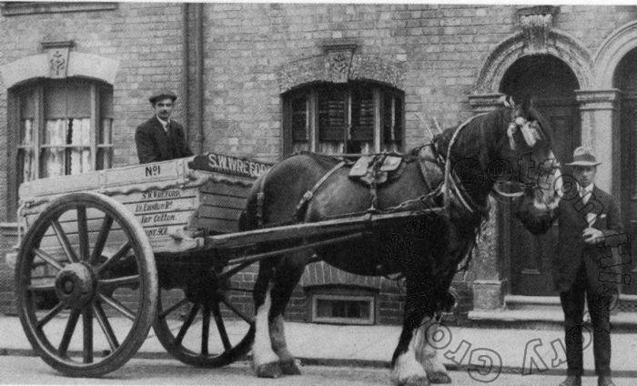
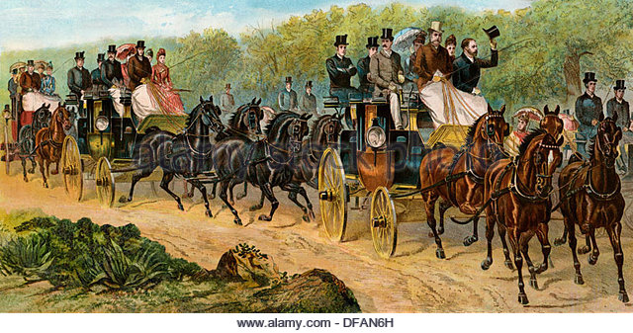
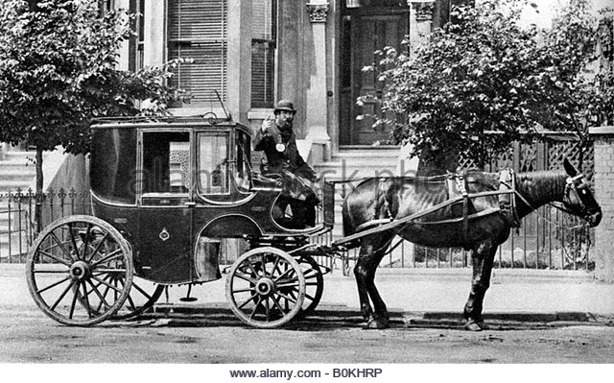
transport
Upper class
Greater ability to travel to facilities, e.g. real tennis courts
Visit others estates to play games, hunt.
What is the impact on participation?
Stayed local as transport was walking or horse and cart.
Creation of local festivals and games, Lewes Fireworks

Slide 18
Pre-industrial revolution
society
Social class influences
Gender
Law and Order
Education and lieteracy
Time
Money
Transport

Slide 19
Examples of influence for each element of society
Society factors | Lower class | Upper class
Time | The lower class had no time…..due to long hours labouring on land. Activities had to be local due to lack of time to travel. | Had more time… involved in activities were longer lasting, fox hunting.
Money
Transport
Social class
Law and order
Education and literacy
Gender

Slide 20
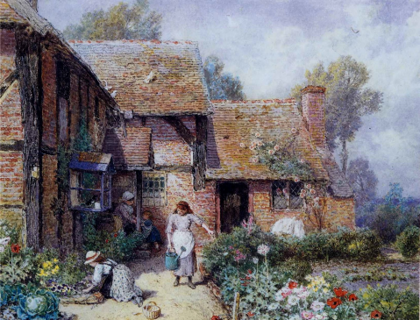
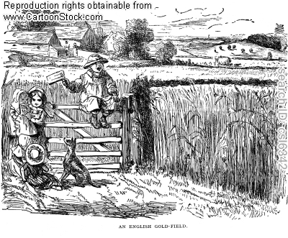
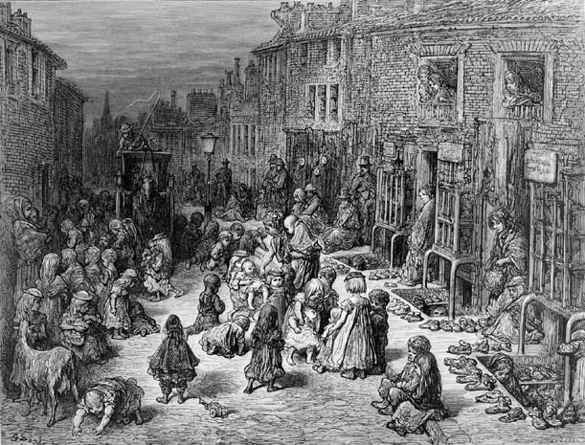
Changing face of society and recreation

Slide 22
Map the changes to the key elements of sport and pastimes
Amateurism and professional
Gender and the changing status of women
Law and order
Education and literacy
Availability of time, money and transport

Slide 23
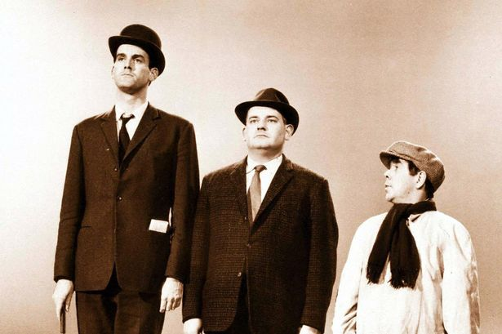
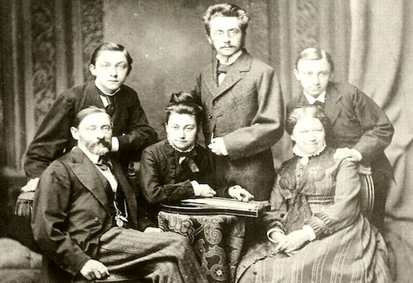
Social class
Middle class
Factory managers
Store owners
More free time
More money
Didn’t have large estates as did the rich.
Became educated and some went to public schools.

Slide 24
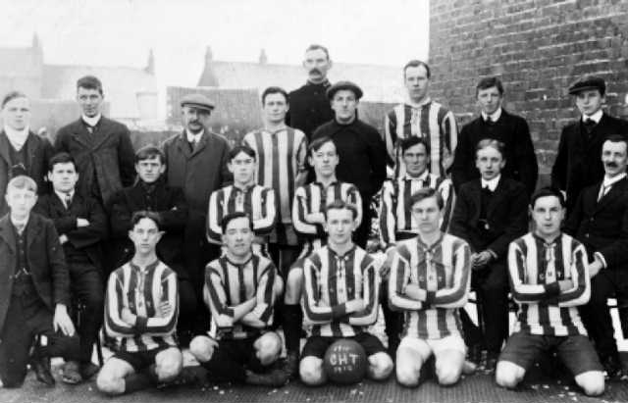
A Victorian professional
A Victorian Professional was working class.
Can you think why?
Football increased in popularity
Football came from the mob, the working class.
They couldn’t afford time of to play sport.
Creation of broken time payment.
This gave birth to the first professionals, paid to play the game.

Slide 25
A Victorian professional

Slide 26
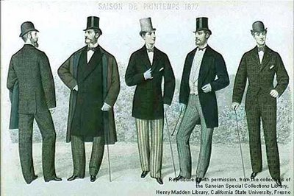
Victorian Amateur
A Victorian Amateur was wealthy and considered upper class who excelled at games
Can you think why?
Had gone to public school and had high level coaching
Loads of time to practice.
He played for the love of the game.
He didn’t need to be paid to play because he was that rich he didn’t work.

Slide 27
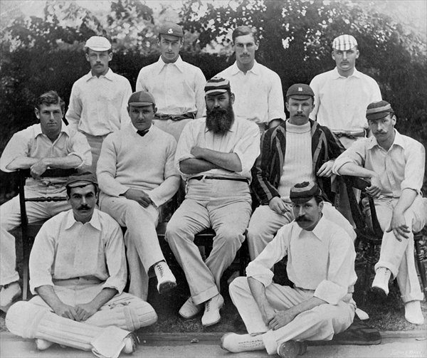
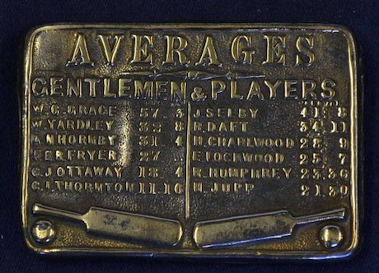
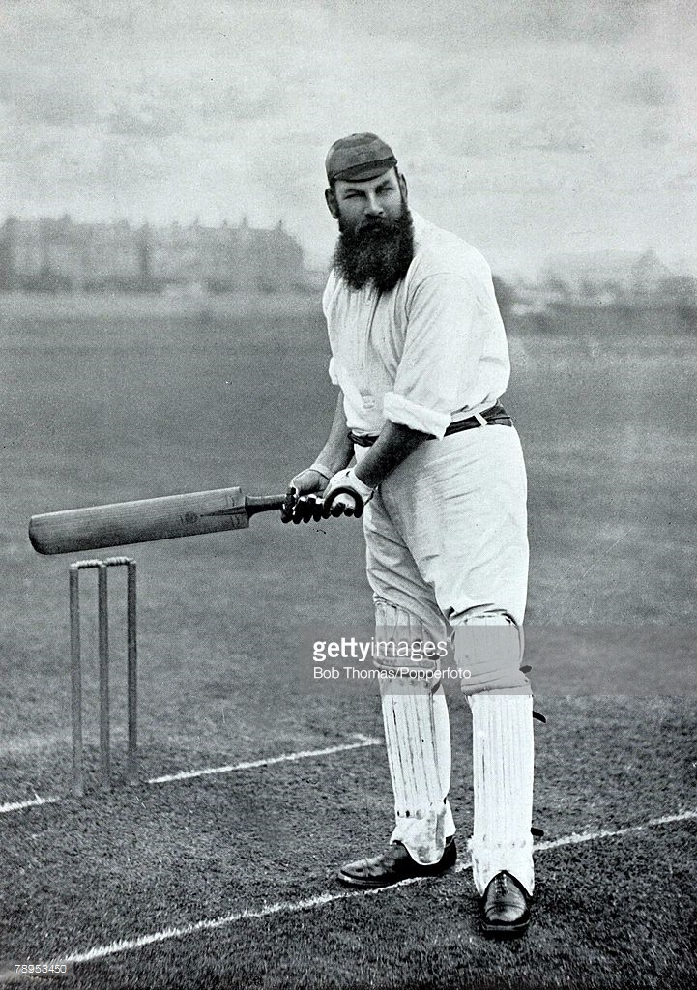
Apply it
In Victorian cricket both ‘gentlemen amateurs’ and working class professionals played on the same team. However,
They had different entrances to the grounds
They had different roles. Hard working bowlers for the working class and stylish batting for the upper class

Slide 28
Time
Where does your football club come from?
Who were the founding fathers of your club?
What social reform took place to allow this to happen?
Change to length of working week.
Saturday half day.
Factory owners recognised happy workers were better workers.
Day excursion to the sea side.
Numbers: 72 hr working week beginning of industrial revolution.
1965 40-45hr working week.

Slide 29
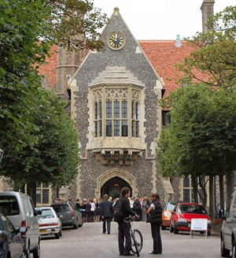
Public schools were a place of education of old standing. The sons of gentlemen traditionally attended in large numbers. Ages 8-18 usually boarding.
Now attended by some middle class
Rugby school
Bedford school

Slide 30
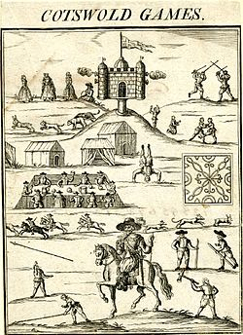
. Beginnings of the Modern Olympic movement
Gloucestershire By Robert Dover
Robert Dover Cotswold Games., was one of the main multi sport games.
It was an annual event until 1851
Disrupted by hooligans.
Some suggest the games declined into a drunken village brawl.
It was restarted in 1963 and still goes on today.

Slide 31
Public schools 19th century.
How did public schools influence the promotion of sports and games?

Slide 32
Society and culture
Read through page 236 and the first two paragraphs of page 237.
Identify on the white boards the main changes to society.
Put them in order of the influence on changing sport.
The one that you think would have had the most influence on the development of sport.
You must state why.
Which one would have had the least influence and state why.
Rural to urban
Reduction in working hours from 70-52
Transport link
Public baths
RSPCA – Banned cruel sports

Slide 33
Changing face of society and recreation
Illness, poor working and living conditions.
A huge divide between the rich and poor.
Working hours
Free time.

Slide 34
Acting class
You have two scripts that need two characters as well as a narrator.
Act out the passages, then identify and explain the characteristics of the public schools that would have aided the development of sport.
Do you see any of these influences today?

Slide 35
Victorian Schools Working class
Narr: An old and angry looking teacher is flapping some papers around while looking at his watch.
The door opens and in comes a scruffy thin boy out of breath.
Boy: Sorry I’m late sir.
Teacher: “Silence boy! Where have you been? I haven’t got time to be standing around for scruffy dirty faced boys who can’t tell the time”
Boy: “Sorry sir please, I finished my shift late last night and my baby brother is still sick. It wont happen again”.
Teacher: “I’m not surprised your family are always ill living in that tiny house like mice. Go and sit down while I wait for the others to return from their play in the yard.”
Narr; The teacher ushers the boy towards the back of the room.
Boy: “Please sir, can’t I go out and play in the yard?”
Teacher: “NO, it’s only a small yard and Mr smith is struggling to control so many children in such a small space. You only have a ten minute break to stretch your legs anyway.”
Narr: The teacher moves towards his desk and shuffles some papers.
Teacher: If it was up to me you wouldn't get a break, I don’t see the point in it.”
Boy; “Please sir” (boy looks up from his desk.)
Boy: “Running around keeps us fit and strong, I hear they play games in the public schools.”
Teacher: “rubbish, you will learn nothing from ‘playing games’, now open your book and get on with some work”.
Boy: “please sir we only have one book and you have it at the front”.

Slide 36
Upper class
Nar: Billy, a smart dressed upper 6th form boy is stood on the edge of the rugby pitch.
A small boy is struggling with his boots as he runs along and bumps into the 6th form boy.
Billy Sixth form boy: “ Steady on little man what’s the rush?”
Tom: “Sorry sir I'm late for cricket practice, I didn’t know what kit to wear. Can you help me please. I don’t know which pitch to meet on.”
Billy: That’s fine little man I coach the first year cricket side as well as Mr Rigby so you wont get lost. I just need to go put up the team sheets for next week and then we can go.”
Tom: “Oh thanks you sir”.
Nar: Both boys begin to walk towards the pavilion and the sixth form boy places the sheets on the notice board.
Tom: “Do you coach all the teams?”
Billy: “ No the paid coaches do that during out afternoons off of course, i just help out and organise the house competition.”
Tom; “what’s that?”
Billy: “It’s where all the years get to play against each other to see who’s the best. It helps us develop our skills as well you know.”
Tom: “forgive me but won’t all the rules be different as all the boys come from different places?”
Billy: No we’ve written a rule book so that everyone can play the same game. Look there is Mr Rigby.”
Rigby: “Ah master Billy, what have we here?”
Billy: “he’s a new boy for the cricket team I believe. He got lost, not used to so many pitches apparently.”
Rigby: “Well you better get used to it at public school boy, now what are you like at cricket?”
Tom; “we played a bit in the village and I was the best bowler .”(said enthusiastically)
Rigby; “well we shall see and don't worry you will have plenty of time to practice your skill during the afternoons..”
Tom: “amazing, thanks you so much sir.”
Nar: Tom ran off and joined the others who were warming up by the pavilion.

Slide 37
Main features of Public school life and the development of sports.
Money
Academic Staff assisted games
Professional coaches
Free time
Space
House system
Could we put these into categories?
O
P
E

Slide 38
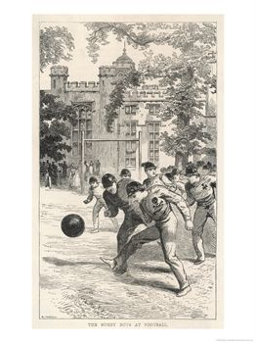
Looking at the film can you write down what characteristics you think you would develop from playing these type games?
Courage,Endeavour, Bravery, Teamwork.

Slide 39
Looking at the two films again and identify the technical developments of the game.
Lines/Pitches Uniforms Rules (foundation of NGB) Playing in the house system
Developed leagues.

Slide 40
Village mob football
Boys attend private school
Learn new ways to play.
Boys attend university and all the rules are developed and written. (Foundation of rules and NGB)
Known as the melting pot

Slide 41
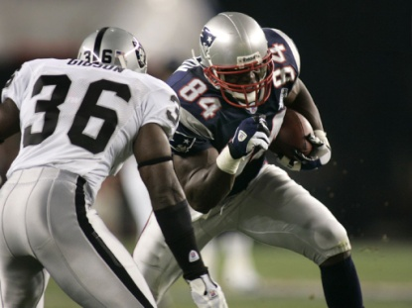
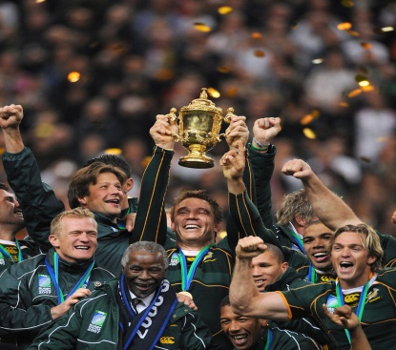
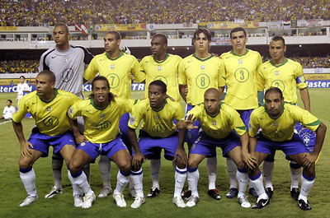
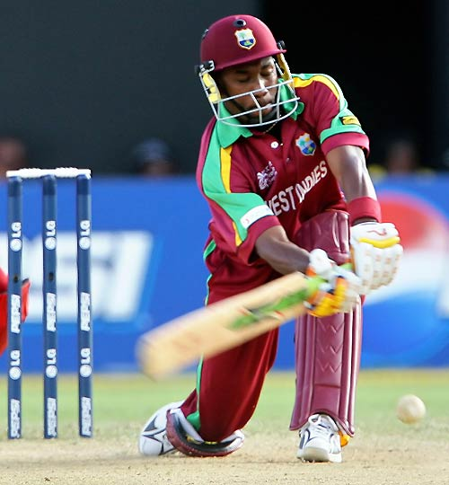
In pairs using the pictures below, try and explain the influence of public school on sports and the rest of the world.

Slide 42
public school boys spread the ethos and rules of games.
T
O
P
V
I
C
Teachers
Officers (military)
Parents
Vicars
Industrialists
Colonies

Slide 43
RTFQ
In pairs using the pictures, try and explain the influence of public school on sports and the rest of the world.
Command word explain
Subject sport and the rest of the world
Subject qualifier
Influence of public schools
How many marks do you think you could come up with?
Bullet point your answers on the white boards

