Slide 1
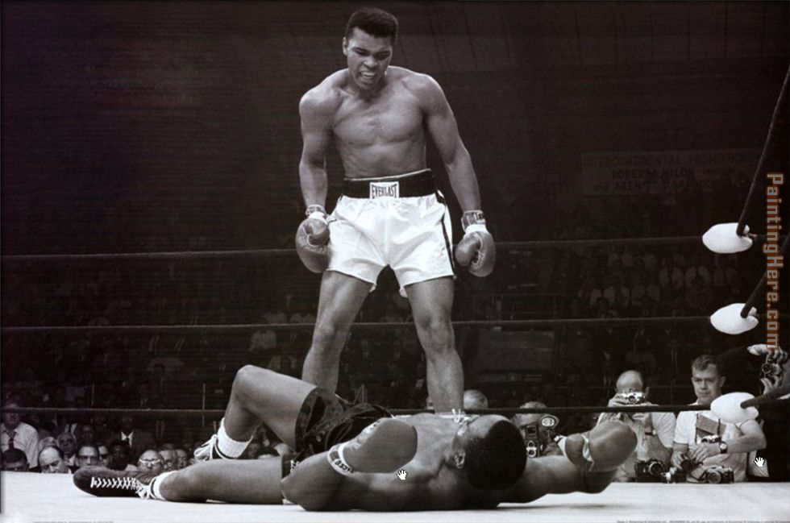
Sport and society twentieth century

Slide 2
Class
Social class was still a feature of 20th Century Britain and still influenced the sport you took part in.
Grade | Occupation
A | Higher manager
B | Intermediate manager
C1 | Supervisor
C2 | Skilled manual
D | Semi-skilled or unskilled
E | Casual or low grade worker

Slide 3
Gender
While there were improvements in the access for women and sport this was still relative to the class. Working class women had less time to take part in sport than the middle class counterpart.
Growing crowds of spectators were dominantly male

Slide 4
education
Physical development a crucial element of the 1944 education act.
IT shall be the duty of each local authority…”towards spiritual, mental and physical development”.
Grammar
Secondary
Secondary technical
All now had PE
Provisions varied:
Grammar followed Public school
,extensive provision
Secondary: also ran a range of sports, extra curriculum.
Q why is the year relevant? What do you think the motivation may have been behind increasing the fitness of the nation?

Slide 5
Time, money and space
Increase in leisure time and money, men played more sports as well as watch.
Towns provided more opportunity to take part.
From quits, darts billiards, dominoes flourished as the pub was central to some recreation
Space was a key elements of most sport and it was at a premium in most towns

Slide 6
transport
Much more available
Increased participation
Spectators
Increase in popularity of rugby, football, cricket and boxing attracting huge numbers
Empire shrinking
International competition became opportunity to showcase your country around the world.
1953 Everest was conquered only made possible by the advancements in transport.

Slide 7
Summary
Huge technological development
Sport maintained it’s shape until the 1960’s – 1970’s and the arrival of the television
Spectators swelled in huge numbers and Saturday became the day of sport.
Part of the curriculum was now dedicated to physical activity
Transport had a huge impact on the availability for everyone and spectators could travel to watch their teams internationally.

