Slide 1
Gas exchange internal and external respiration.
Know how 02 and C02 transfer from the atmosphere to the working muscles.

Slide 3
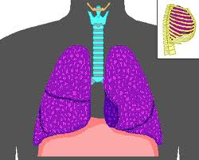
Pulmonary ventilation
Process by which 0xygen and Carbon dioxide enters and exits the alveoli.

Slide 4
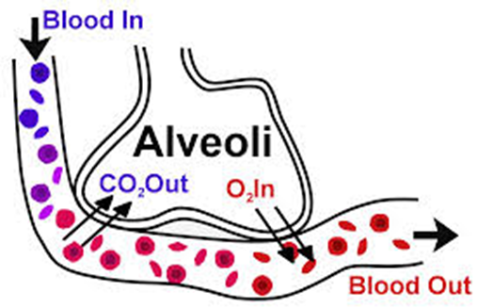
Respiration
Gas exchange
Process by which oxygen and carbon dioxide diffuse in and out of the blood.

Slide 5
External respiration
Occurs at the respiratory membrane in the lungs at the site of the alveoli

Slide 6
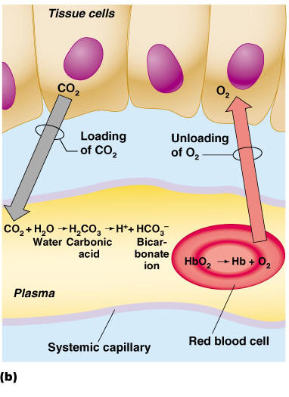
Internal respiration
Occurs at the respiratory membrane in the tissue. From the capillaries to the working muscles

Slide 7
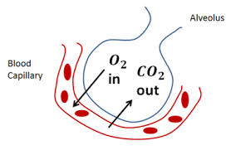
HIGH to LOW
Diffusion
(PP) The partial pressure of a gas is the pressure it exerts within a mixture of gases.
Partial pressure of 02
Partial pressure of CO2

Slide 8
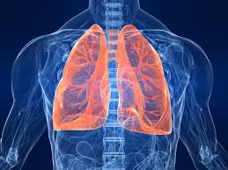
External respiration
High PP of 02
Low PP of C02
Compared to PP values in the capillaries surrounding alveoli
These pressure gradients cause diffusion of 02 from the alveoli to the capillaries
and diffusion of Carbon dioxide from the capillaries into the alveoli

Slide 9
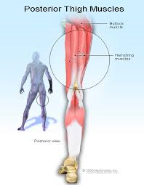
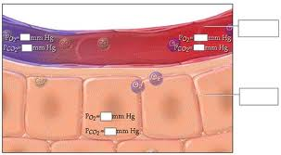
Internal respiration
High PP of 02 in blood
Low PP of C02 in blood.
(Compared to muscle tissue)
These pressure gradients cause diffusion of 02 from the blood to the muscle tissue.
And diffusion of Carbon dioxide from the muscle tissue to the blood.

Slide 10
PP 02 100 mm hg C02 40 mm hg
HIGH to LOW
PP O2 40 mm hg
PP C02 46 mm hg

Slide 11
Internal respiration
PP 02 100 mm hg C02 40 mm hg
PP O2 40 mm hg
PP C02 46 mm hg

Slide 12
Partial pressure - Alveoli air – direction of diffusion Alveoli capillary blood
02 100 (h) 40
Diffusion gradient is 60

Slide 13
Partial Pressure Capillaries muscle tissue
02 100 (h) 40
Diffusion gradient = 60

Slide 14
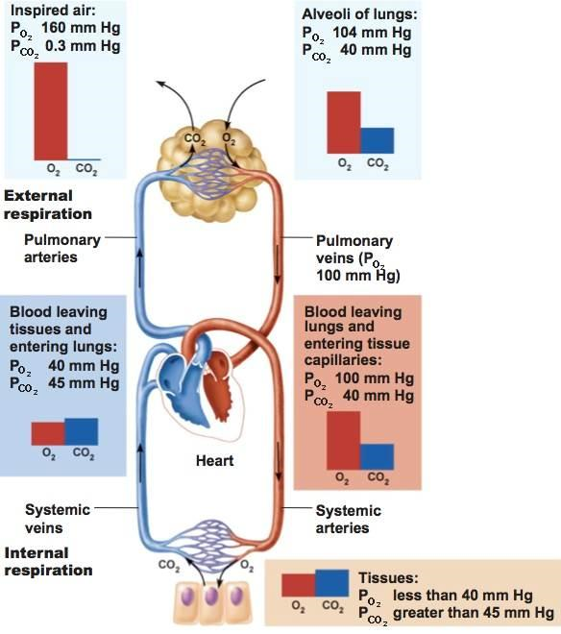

Slide 15
End

Slide 16
Respiration
Occurs at the respiratory membrane
Internal
External

Slide 17
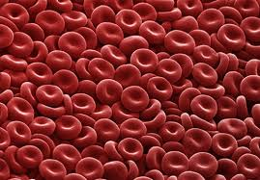
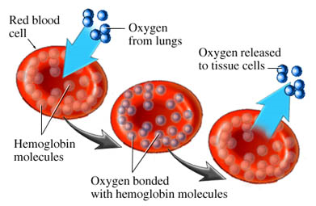
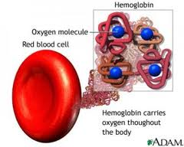
Haemoglobin is the binding site for the 02 which is transported in the blood.
High concentration of 02 there is a high saturation of the haemoglobin which is then called
oxyhaemoglobin

Slide 18
Site of Alveoli air PP 02 100 (h)
Haemoglobin in Alveoli capillary blood attract 02
Causing a saturation or association with 02.

Slide 19
Site of muscle tissue there is a low PP of 02
There is a dissociation of the 02 from the Haemoglobin

Slide 20
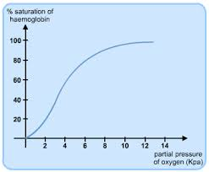
At lungs while at rest high 02 concentration High saturation of haemoglobin in the alveoli capillary blood.

Slide 21
At muscle tissue low concentration (PP of 02) This causes a dissociation Low saturation of haemoglobin in the capillary blood.

Slide 22
So the ideal situation is that we have an association at the alveoli capillaries
disassociation at the muscle tissue.

Slide 23
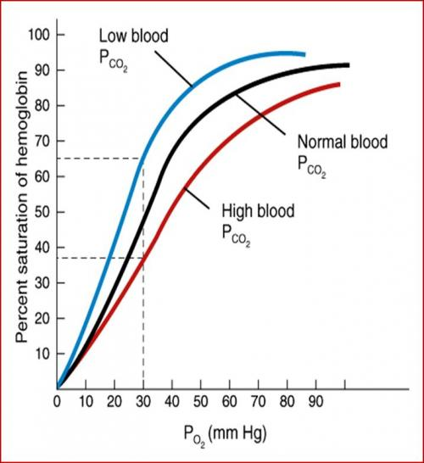
Several factors that affect the association or dissociation
Increase in PP CO2
Increase in temp
PH (lactic acid) Bohr effect
Decrease in PP of 02
Right shift= Known as Bohr shift

Slide 24
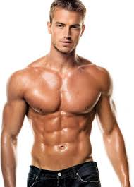
Describe the effect of smoking on the transport of oxygen in the blood.
Key term: Carbon monoxide.

Slide 25
Describe the effect of smoking on the transport of oxygen in the blood.
Give two ways in which oxygen is transported in the blood. Describe the effect of smoking on the transport of oxygen in the blood.

Slide 26
2. 2 marks for first part of question, 1 mark per point.
1(Combines) with or in haemoglobin / as oxyhaemoglobin or HbO2
Do not accept carried in red blood cells = Vg
2(Dissolved) in blood plasma
3 marks for second part of question, 1 mark per point.
3(CO) Smoking produces (high levels of) carbon monoxide
Do not accept cigarettes contain carbon monoxide
4(gas ex) less efficient gaseous exchange / decreased diffusion gradient of O2 or between O2 in alveoli and O2 in blood
Do not accept build up of tar in alveoli = less gaseous exchange
5(affinity) haemoglobin has a greater affinity for CO than O2 / carbon monoxide has a greater affinity for haemoglobin than oxygen
Accept Hb for haemoglobin
6(less O2) Less O2 is transported in the blood / Less O2 is absorbed or carried (by the haemoglobin) / haemoglobin is not fully saturated with O2 / PO2 (PPO2) decreases in the blood
Do not accept less room for O2 in Hb
[5]

