Slide 1
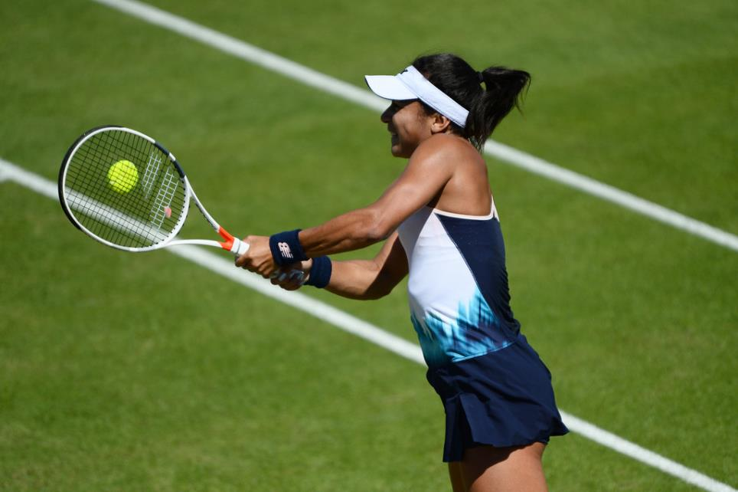
Evaluation and Analysis of Performance for Improvement (EAPI)

Slide 2
Important!
Progression Exam (70%)
EAPI (10%)
UCAS Predicated Grade for References
Practical Assessment (20%)
June 20th – Progression Exam Results Day
3rd – 7th July – EAPI Assessments (1:1)
10th July – Practical Assessments (non-video)

Slide 3
To Start….
Again, using an observation of an amateur performance you have seen…
Highlight strengths of any the skills that you observed (min x3)
Highlight weaknesses of any of the skills that you observed (min x3)
Highlight strengths of the tactics that you observed (min x3)
Highlight weaknesses of the tactics that you observed (min x3)
Highlight strengths of the physical attributes that you observed (min x3)
Highlight weaknesses of the physical attributes that you observed (min x3)
Discuss the overall effectiveness and success of the performance
Finally, discuss an Action Plan to improve the biggest weakness that you have observed!
This should last approximately 7-10mins!

Slide 4
Introduction and Overview
Quality of the range of acquired skills being performed (strengths and weaknesses)
Creating a development plan for improvement of the major weakness, justifying the plan
Appropriateness and application of strategies and tactics / compositional ideas (strengths and weaknesses)
The use of physical attributes during performance
The overall effectiveness and success of the performance, and identification of major weakness
In 15 minutes!

Slide 5
Physical Attributes
Physical Attributes (Fitness)
Fitness Components
Speed
Strength
Power
Flexibility
Aerobic Endurance
Muscular Endurance
Balance (Dynamic / Static)
Co-ordination
Reaction Time
Agility

Slide 6
Physical Attributes Discussion
Identify the Strength / Weakness
Explain WHY it was a strength / weakness
HOW did it affect their performance?

Slide 7
Overall Effectiveness / Success and Identifying Weaknesses
Look at the skills, tactics and physical attributes strengths and weaknesses you have discussed
Identify what you think is the biggest (and most important) weakness
What was effective? What was successful?

Slide 8
Factors you MUST Explain First…
You must highlight aims and a time-frame for your training programme. As a general rule:
To improve skills – 8-10 weeks
To improve components of fitness – 8-10 weeks
To improve tactics – 8 weeks
Always start the training programme section with your intended time frame – think about how many sessions per week and how long the sessions are.

Slide 9
Assessment
The assessor is looking for:
Why it is appropriate to spend this much time on improving this one area
Frequency, duration and focus of the sessions
Detailed progressive practices
Detailed coaching points
Potential adaptations to the action plan dependent on progress
How improvement can be measured and is continually measured

Slide 10
 | START: | Week 1 | Week 2 | Week 3 | Week 4 | Evaluation Period
Detailed Practices (FITT, MRS VOPP Testing WC) | Aims: SMART Targets: Method of Testing: | Session 1: Session 2: | Session 1: Session 2: | Session 1: Session 2: | Session 1: Session 2: | Method of testing:

Slide 11
 | Week 5 | Week 6 | Week 7 | Week 8 | Evaluation Period
Detailed Practices (FITT, MRS VOPP Testing WC) | Session 1: Session 2: Session 3: | Session 1: Session 2: Session 3: | Session 1: Session 2: Session 3: | Session 1: Session 2: Session 3: | Final Method of testing: Any other Method of Evaluating:

Slide 12
Justification
Now that your training plan has been created, you need to justify it
You must justify WHY this area can be improved in 2-3 months
Justify WHAT you have chosen to do through physiological and psychological theory learnt in A-level PE
Explain adaptations (physiological and psychological) that should be occurring depending on the progress of the performer

Slide 13
Example
Psychological justification
Physiological justification
In the first week, in order to improve the backhand in tennis I have used small practices using massed practice. This would enable the learner to being to groove the skill, and so that this becomes a dominant response or habit.
In week three, the deadlift exercises increase in repetitions and sets. This refers to the principle of Overload, which will encourage the rectus femoris to become stressed and therefore would encourage adaptations such as hypertrophy of the muscle faster.

Slide 14
Psychological Theory Justification Topics
Task Analysis (skill continuums)
Types and Methods of Practice – What methods you used and why?
Transfer – have you encouraged it? How?
Theories of Learning – did you use any? Why?
Will the performer move from associative to autonomous in any aspect? How has your plan helped?
Guidance – have you used any? Why?
Individual differences – Personality / Motivation – How have or will these affect your training plan?
Short or Long-term attitude changes?
Control of Arousal – did you aim to get the athlete into the zone? Why?
How have you reduced stress levels for the performer? Somatic and cognitive? Why may this help the outcome?
Social Facilitation – any effects used or theories?
Group Dynamics – did you use any teamwork or group exercise? What may this encourage?
Goal Setting – did you use this in any way? Why?

Slide 15
Physiological Theory Justification Topics
Diet – how you may have used it to support and why?
Ergogenic aids – how any could be used to supplement and support training
Training principles – MRS VOPP Testing WC
Periodisation – How it has been used and why
Heart Rate Training Zones
Methods of training (Fartlek, Continuous, Interval, Circuits, weight Training, Plyometrics, PNF, Ballistic, Static, Dynamic)

Slide 16
Adaptations to Discuss
Impact of training on lifestyle diseases (CV and Respiratory System)
Flexibility training adaptations (muscle, connective tissue)
Strength training adaptations (muscle, connective tissue, metabolic function, neural pathways)
Aerobic training adaptations (respiratory system, cardiovascular system, muscular-skeletal system, metabolic function)
Venous return mechanism adaptations
Changes in motivation
Changes in attitude
Personality changes
Phase of learning changes – from associative to autonomous for certain skills
Changing group dynamics – increased cohesion, working together, group effectiveness
Increased focus and concentration
Increased control of arousal levels

Slide 17
 | Week 5 | Week 6 | Week 7 | Week 8 | Evaluation Period
Detailed Practices (FITT, MRS VOPP Testing WC) | Session 1: Session 2: Session 3: | Session 1: Session 2: Session 3: | Session 1: Session 2: Session 3: | Session 1: Session 2: Session 3: | Method of final testing:
Justification (Psychological and Physiological) |  |  |  |  | Long-term Physiological adaptations that may have occurred? Psychological Changes?

Slide 18
 | Week 1 | Week 2 | Week 3 | Week 4 | Evaluation Period
Detailed Practices (FITT, MRS VOPP Testing WC) | Session 1: Session 2: | Session 1: Session 2: | Session 1: Session 2: | Session 1: Session 2: | Method of testing:
Justification (Psychological and Physiological) |  |  |  |  | Short-term Physiological adaptations that may have occurred? Psychological Changes?

