Slide 1
Public schools 19th century.
How did public schools influence the promotion of sports and games?

Slide 2
Acting class
You have two scripts that need two characters as well as a narrator.
Act out the passages, then identify and explain the characteristics of school for the poor and public schools.
What on earth is fagging?
work hard, especially at a tedious task.
Fagging was a traditional practice in British boarding private schools (nearly all "public schools" in the English sense) and also many other boarding schools, whereby younger pupils were required to act as personal servants to the most senior boys.

Slide 3
Victorian Schools Working class
Narr: An old and angry looking teacher is flapping some papers around while looking at his watch.
The door opens and in comes a scruffy thin boy out of breath.
Boy: Sorry I’m late sir.
Teacher: “Silence boy! Where have you been? I haven’t got time to be standing around for scruffy dirty faced boys who can’t tell the time”
Boy: “Sorry sir please, I finished my shift late last night and my baby brother is still sick. It wont happen again”.
Teacher: “I’m not surprised your family are always ill living in that tiny house like mice. Go and sit down while I wait for the others to return from their play in the yard.”
Narr; The teacher ushers the boy towards the back of the room.
Boy: “Please sir, can’t I go out and play in the yard?”
Teacher: “NO, it’s only a small yard and Mr smith is struggling to control so many children in such a small space. You only have a ten minute break to stretch your legs anyway.”
Narr: The teacher moves towards his desk and shuffles some papers.
Teacher: If it was up to me you wouldn't get a break, I don’t see the point in it.”
Boy; “Please sir” (boy looks up from his desk.)
Boy: “Running around keeps us fit and strong, I hear they play games in the public schools.”
Teacher: “rubbish, you will learn nothing from ‘playing games’, now open your book and get on with some work”.
Boy: “please sir we only have one book and you have it at the front”.

Slide 4
Pre Arnold reform
Watch the video and note the characteristics you may learn at a public school

Slide 5
Arnolds influence
What did arnold notice in his first few days as headmaster?
What characteristics did Arnold want to instil?
9.25

Slide 6
Organisation and promotion
Describe the characteristics
That you could learn playing the game.
10:23

Slide 7
Main features of Public school life and the development of sports.
Money
Academic Staff assisted games
Professional coaches
Free time/boarding
Space
Inter House system
Rules
Melting pot

Slide 8
What does melting pot mean?
Village mob football
Boys attend private school
Learn new ways to play.
Boys attend university and all the rules are developed and written. (Foundation of rules and NGB)
Known as the melting pot

Slide 9
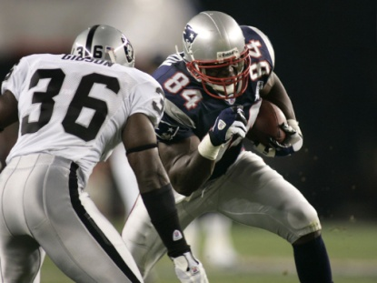
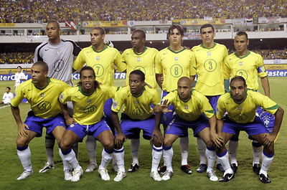
In pairs using the pictures below, try and explain the influence of public school on sports and the rest of the world.

Slide 10
public school boys spread the ethos and rules of games.
T
O
P
M
V
I
C

Slide 11
Time line
Research and create a time line of the key moments in the creation of the national governing body of:
Football
Rugby
Cricket

Slide 12
Exam Q

Slide 13
Exam q
Explain how these schools and their ex-pupils influenced the emergence of rational sport. [5marks]
(Rules) Melting pot/development of rules
Structure) Organisational development/fixtures/kit/areas to play
(Time/Compulsion) Regularity of games afternoons/house sport/compulsory games
(Respectability) Curtailment of violence/cruelty/responsibility
(Values) Importance/values attached to team games
(Other schools) Influenced other schools e.g. Malvern/Cheltenham/Clifton founded as middle class copies of the gentry/Clarendon schools.
Ex-pupils:
Teaching Teaching back in original school next generation influenced
Army/colonial Army/colonial service/taking passion for games abroad service)
Church As parsons/social Christians/needs of parishioners met
Industry As industrial leaders/keen to give sport to their workers
Family Family/upbringing of own children
Community As community leaders/provision of facilities/knowledge
Clubs Formation of sports clubs/National Governing Bodies

Slide 14
Exam q
Describe the characteristics you could learn while at public school. Explain how these were developed within the school (5)
Cult of muscular Christianity/ a gentleman with Christian values
The development of character through sport cult of athleticism
Physical endeavour, trying hard
Moral integrity
Being honourable, truthful/ decisions
Good sportsmanship
Through playing games
Through 6th form supporting new students/ reduction in fagging
Through inter house competition/ playing as a house
Through games against other schools/ development of school identity
Reduction in betting/ horses/ dogs/ focus on team games/ cric/rugby.

