Slide 1
Sport and society 21st Century

Slide 2
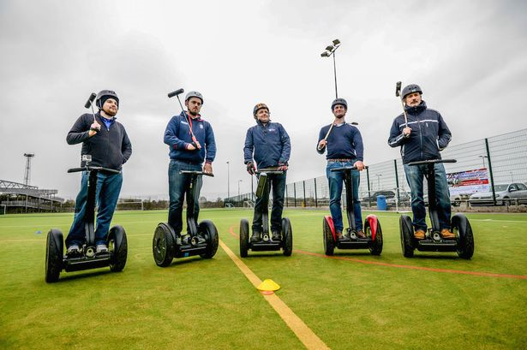
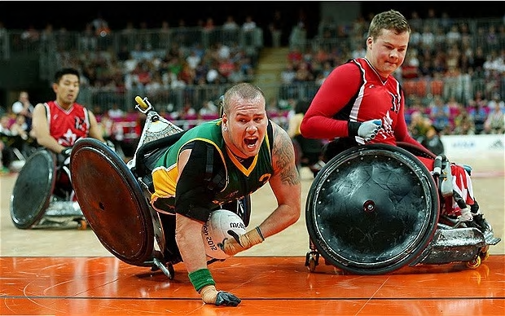
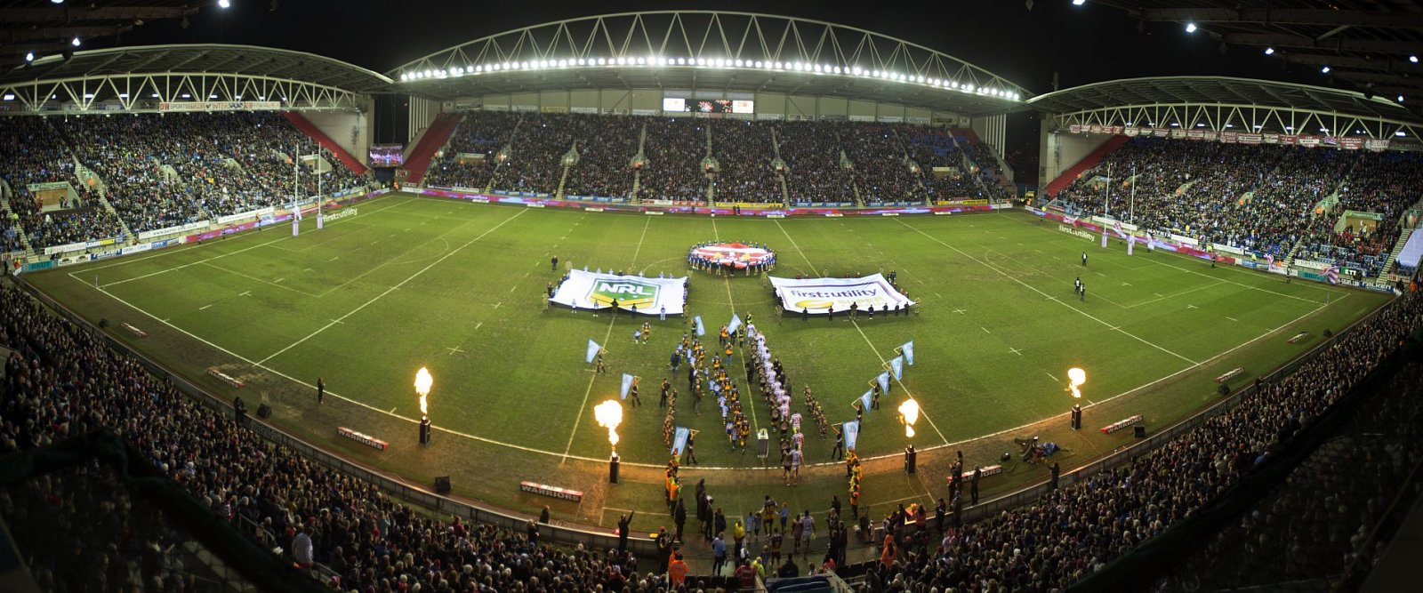

Slide 3
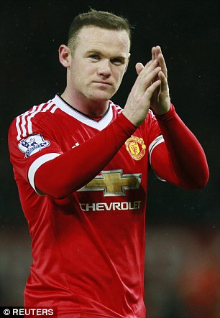
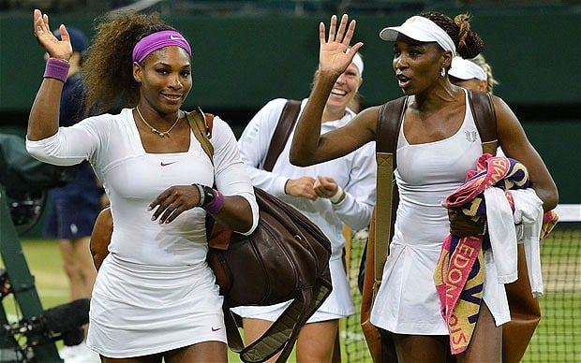
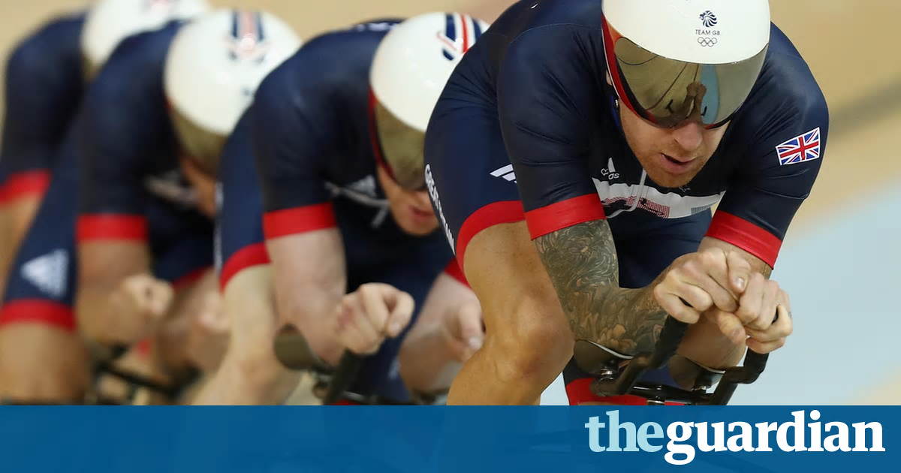
class
Class system was less pronounced and more fluid than ever before, but there was still social division.
Lower class could gain social mobility.
The term used to describe this is rags to riches.
Creating fame and fortune, however, is this really the case?
Is tennis just for the middle class?
How many of the GB medals were made in private schools?

Slide 4
Class
research
Sport/issue | Class issue
Tennis | Top 120 male players 37% were from middle class background.
Young males participate in equal measures compared to the middle/upper class. | Women in lower class participated in less sport than the middle/upper class women.
16+ there is less participation for lower class | In 2015 there was 38% participation from higher socio-economic groups, compared to 25% for lower class groups.

Slide 5
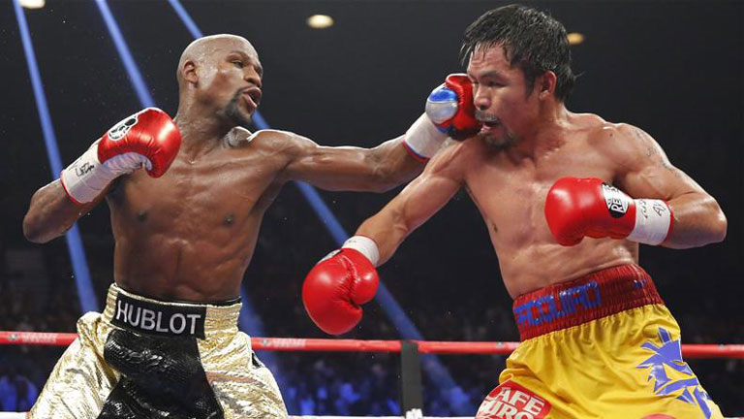
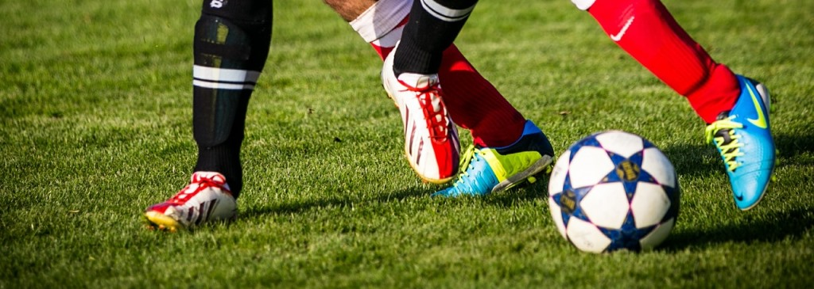
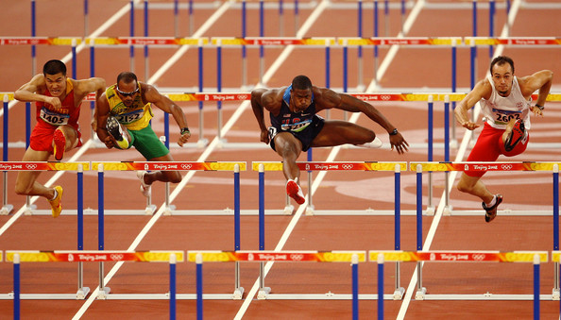
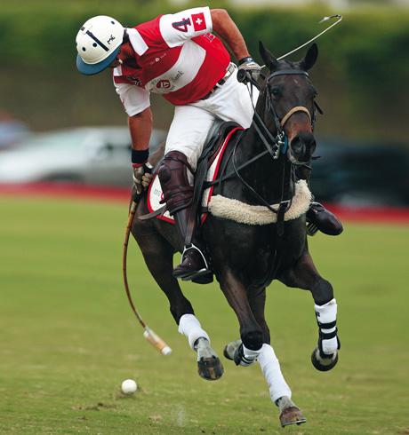
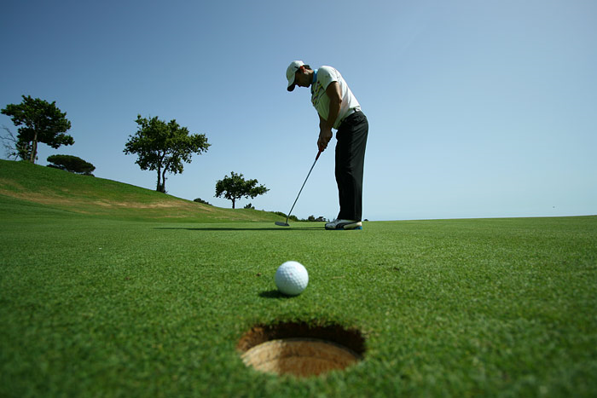
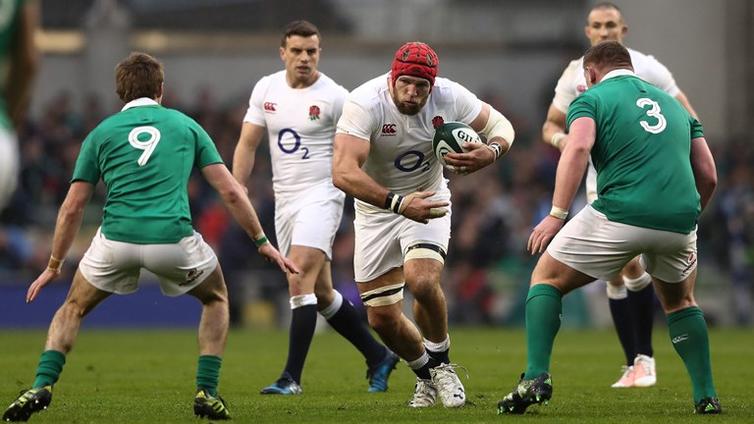
The association of sport are still similar. Have a look at these pictures and determine the class.

Slide 6
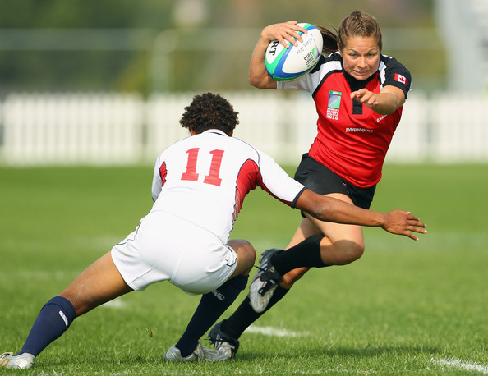
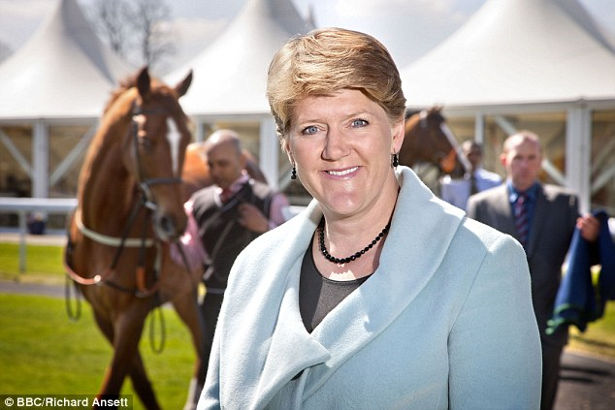
More gender equality
Still differences in women and male participation, however, more women involved in sport and sport coverage.
Participation in football and rugby for women is large and still growing.
FACT
Twenty rugby players were handed professional contracts, women’s hockey, cricket are already professional

Slide 7
More gender equality
Debate:
There is an increase in women presenters however, there is a debate whether this is a positive thing.
“it is no coincidence that the majority of women presenters, are very young attractive people with one or two exceptions”.
26 women over 50 on air out of 481 presenters!

Slide 8
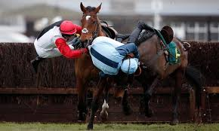
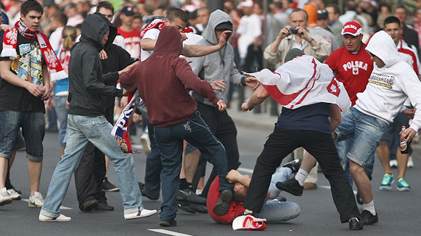
Law and order
Legislation affected sport.
Negligence was accountable by players, officials and clubs.
Law used increasingly to protect players, spectators.
Duty of care.
Football banning order

Slide 9
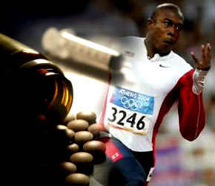
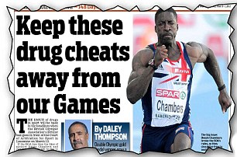
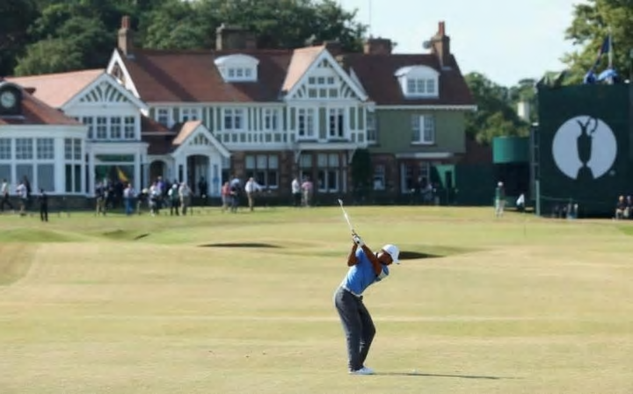
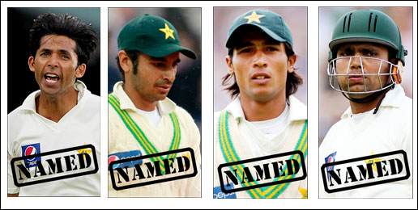
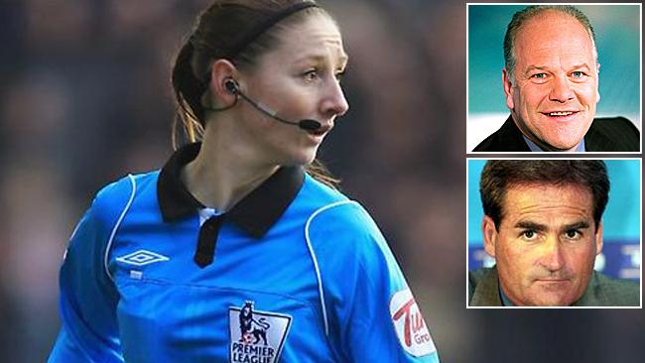
Law and order
The law has been involved in misuse of drugs?
Can you think of examples?
How else has the law been used in sport?
Match fixing?
Discrimination/ comments or policies

Slide 10
education
Describe the basic outline of the education structure that you have just been through.
AGE | QUALIFICATION/ESTABLISHMENT
5-11 | PRIMARY SCHOOL
11-16 | COMPREHENSIVE SCHOOL (GCSE)
16+ | (GCE)
PE
Examinations and qualifications in PE and sport have increased in the 21st Century.
GCSE
GCE
BTEC Sport
BTEC Sport science
Degree in sports/ sports science
Public schools accounted for more than a third.
State comprehensive accounted less than a third.
Grammar school rest.
88% of pupils attend state school.
7% of population public school

Slide 11
Time money transport
Participation rates are higher than rest of Europe 41% 48% in UK.
Not as high as the highest 70% Sweden.
Increase in technology most people better off.
Some still struggle to make ends meet.
Real terms, less people participation in sport.
125,000 down on 2013.
Transport: Cars and trains now provide the opportunity to access more sports, either to take take part or watch.

