Slide 1
Muscles
Anatomy and Physiology

Slide 2
Muscle Facts 1
Smallest muscle in the body?
Stapedius: the muscle that activates the stirrup, the small bone that sends vibrations from the eardrum to the inner ear. It measures just 0.05 inch (0.13 centimeter) in length.
Largest muscle in the body?
Latissimus dorsi: the large, flat muscle pair that covers the middle and lower back.
Longest muscle in the body?
Sartorius: the strap-like muscle that runs diagonally from the waist down across the front of the thigh to the knee.

Slide 3
Strongest muscle in the body?
Gluteus Maximus: the muscle pair of the hip that form most of the flesh of the buttocks.
Fastest-reacting muscle in the body?
Orbicularis oculi: the muscle that encircles the eye and closes the eyelid. It contracts in less than 0.01 second.
Number of muscles used to make a smile?
Seventeen ☺
Number of muscles used to make a frown?
Forty-three ☹

Slide 4
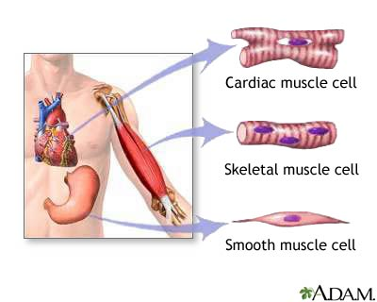
Three Types of Muscle Tissue (Task 20)
Heart (cardiac) Muscle
Involuntary Muscle
Voluntary
Structure and function of these muscle tissues are very different and controlled by very different methods

Slide 5
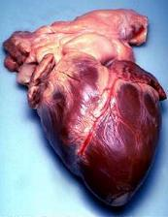
1) Heart/Cardiac Muscle
Built in Pacemaker
Myocardium ONLY
Heartbeat is involuntary
Does not tire
Average adult 60-80 bts pm

Slide 6
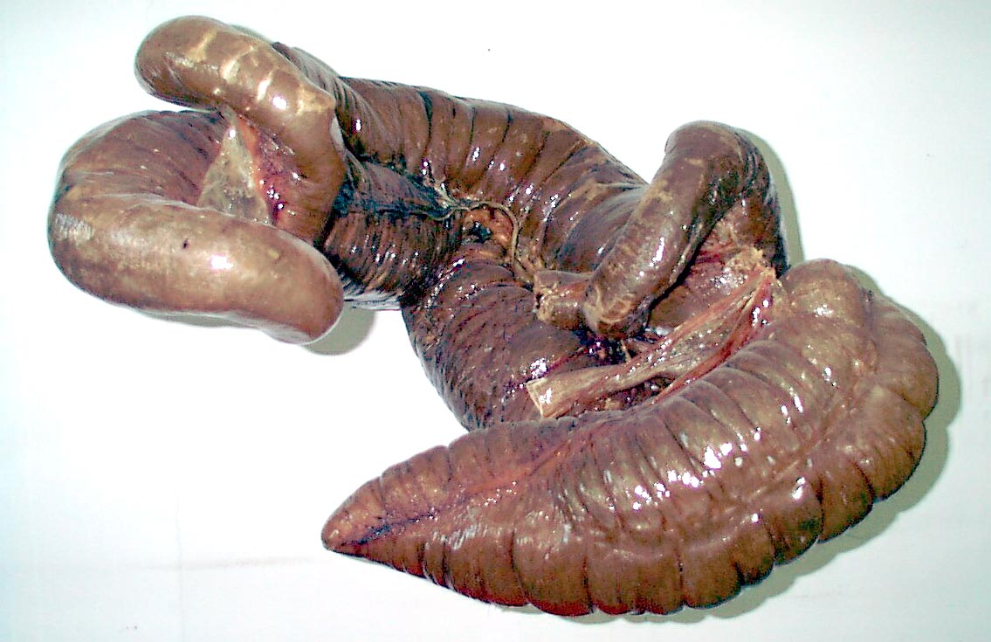
2) Involuntary (Smooth) Muscle
Found in visceral organs
(Hollow organs)
Not under conscious control – ANS
Does not tire
Name three Locations where you would find Smooth muscle?

Slide 7
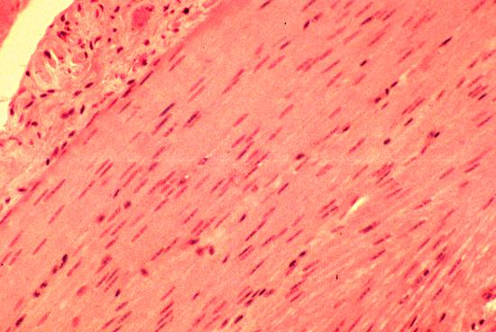

Muscle Structure
Smooth
Striated

Slide 8
Muscle Structure
Muscle type | Muscle Structure
Heart (Cardiac) | Striated and Smooth
Involuntary Muscle | Smooth
Skeletal Muscle | Striated

Slide 9
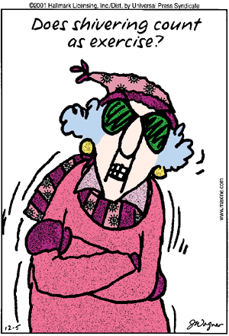
Functions of Skeletal Muscles (Task 22)
Producing movement
Maintaining posture
Generating heat
Storage of muscle glycogen

Slide 10
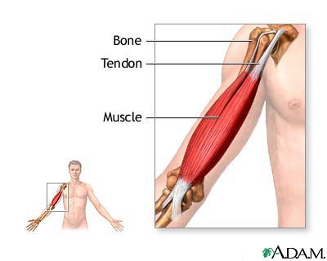
Voluntary (skeletal) Muscle
Skeletal muscle is attached to bones by tendons
REMEMBER
Ligaments -Bone to Bone
Tendons – Muscle to Bone

Slide 11
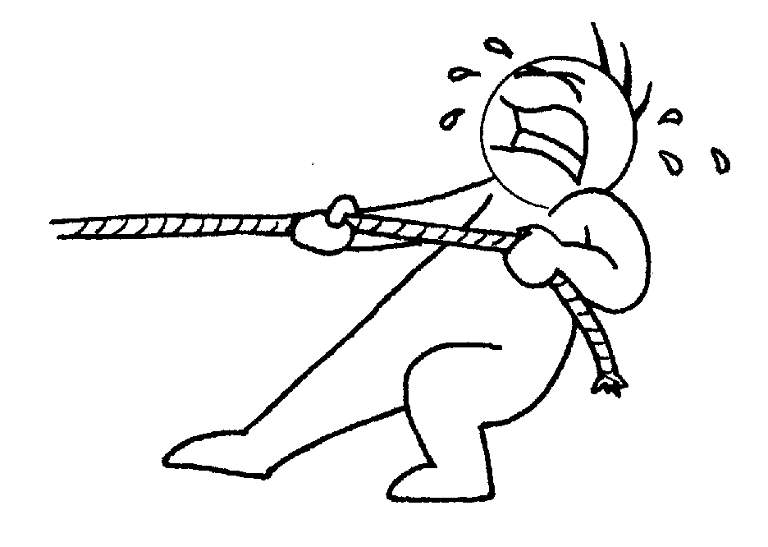
On the Pull!
Muscles can only pull
During contractions muscle pull on bone to cause movement

Slide 12
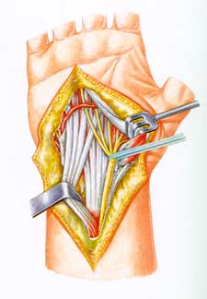
Tendons
Tough but flexible tissue that connects muscle to bone
Tendon transmits the force of muscle contraction to the bone
The white, cord-like structures are the tendons in your wrist that move your fingers

Slide 13
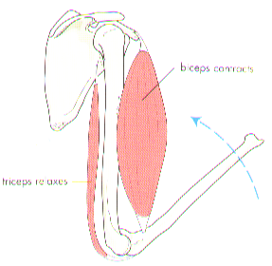
MUSCLE ATTACHMENT P30
TENDONS attach muscle to bone
There are two ends to a muscle:
ORIGIN
INSERTION
The insertion moves towards the origin

Slide 14
ORIGIN
The end of the muscle attached to a relatively immovable bone, as a sort of anchor point
Bicep
Tricep

Slide 15
INSERTION
The other end of the muscle that is attached to the bone that is moving

Slide 16
The biceps muscle bends or flexes the arm at the elbow. The biceps is attached at the scapula which acts as the anchor point.
It is also attached to the radius bone, which is the bone being moved.

Slide 17
SYNERGISTS & FIXATORS
Synergists - when other muscles assist the agonist in creating a movement = HELPER MUSCLES
Modify or alter the pull of the agonist to the most advantageous
Fixators – stop any unwanted movement throughout the whole body by fixing or STABILISING the joint or joints involved
Help with posture

Slide 18
Key terms p30
ORIGIN - attachment of a muscle that remains - Point of relatively fixed during muscular contraction
INSERTION – Point of attachment of a muscle that tends to move toward the origin during muscular contraction.
AGONIST MUSCLE – The muscle directly responsible for the movement at a joint.
ANTAGONISTIC MUSCLE – The muscle that has an action opposite to that of the agonist and helps the movement occur.
SYNERGIST – A muscle that ‘assists’ the agonist create the movement.
FIXATOR – A muscle that stabilises the body so maximise efficiency of the intended movement – prevents unwanted movements.

Slide 19
Antagonistic Pairs (Task 24)
Prime mover (agonist)
This muscle determines the movement of an action –by contracting & shortening
Antagonistic (partner)
This muscle works with the prime mover but is an ‘opposing’ (necessary) action – by relaxing & lengthening

Slide 20
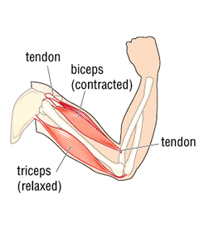
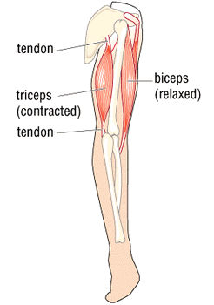
Antagonistic pairs – Bicep Curl
Biceps – Prime mover
Triceps – Antagonistic
Biceps – Antagonistic
Triceps – Prime Mover

Slide 21
AGONIST WORK CARDS

Slide 22
Muscle Pairings

Slide 23
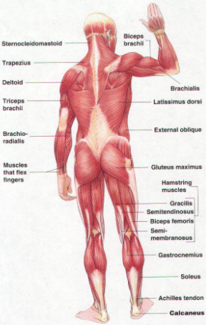
The BACK
Include :
Gluteus Maximus
Errector Spinae
Trapezius
Latissimus Dorsi

Slide 24
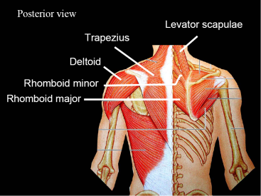

Slide 25
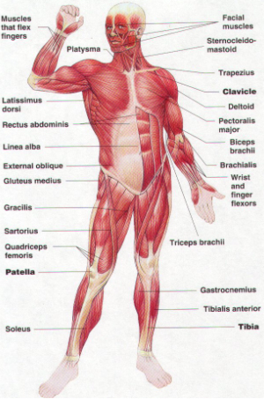
The FRONT
Include :
Pectoralis major
Rectus Abdominus

Slide 26
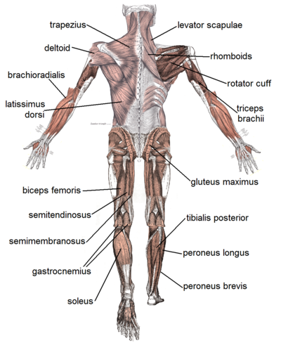
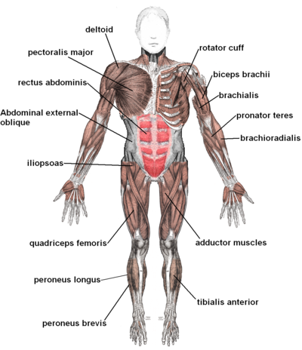
The LEG
Include :
Quadricep group
Hamstring group
Anterior Tibialis
Gastrocnemius
Soleus

Slide 27
The ARM
Include :
Deltoid
Biceps Brachii
Triceps Brachii
Teres major

Slide 28
Muscle PAIRS - 1
Antagonistic Pairings
Middle Deltoids | Latissimus Dorsi
Anterior deltoids | Posterior deltoids
Trapezius | Deltoids
Rectus abdominis | Erector spinae
Quadriceps Rectus femoris Vastus medialis Vastus intermedius Vastus lateralis | Hamstrings Biceps femoris Semimembranosus semitendanosus
Wrist flexors | Wrist extensors
Pronator teres | Supinator

Slide 29
Muscle PAIRS - 2
Antagonistic Pairings
Biceps brachii | Triceps brachii
Pectoralis major | Trapezius
Teres minor & infraspinatus | Teres major & subscapularis
Rectus abdominis | Erector spinae
External obliques | Internal obliques
Iliopsoas | Gluteus maximus
Gluteus medius & minimus | Adductors Longus, brevis and magnus
Tibialis anterior | Gastrocnemius & soleus

Slide 30
TASK
Analyse the following 4 movements to determine the agonist and antagonist muscles
BBall set shot – ball execution phase - arm
Kicking in rugby – preparation back and strike forward - legs
Rowing – arms – pull and push phase
Backhand in tennis – shoulder – preparation backswing and striking forward phase

Slide 31
Types of contractions.

Slide 32
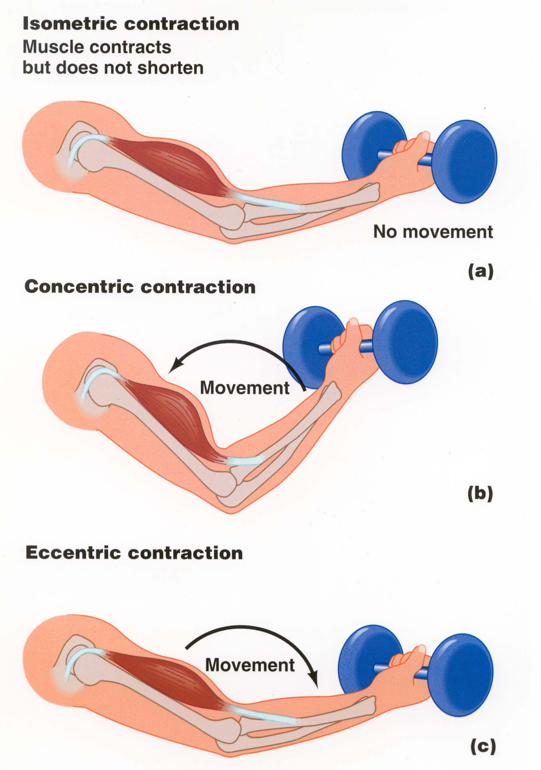

Slide 33
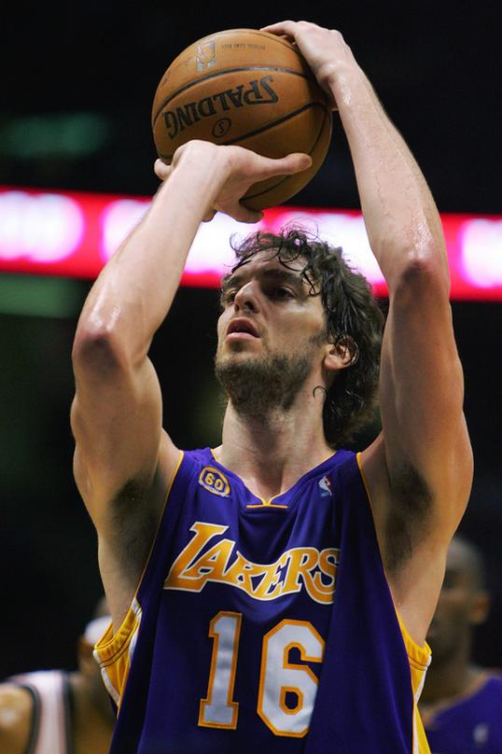

Concentric Contraction
This where the muscle shortens when performing an action
Muscle ends get CLOSER
Name other SPECIFIC sports actions where isometric contraction occurs?

Slide 34
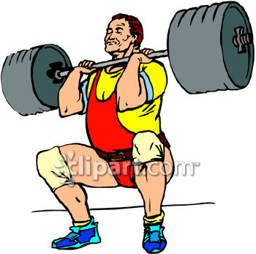
Eccentric Contraction
Where the muscle lengthens under tension – ends of the muscle move further away during an action
Muscle ends EXTEND apart
Name other SPECIFIC sports actions where isometric contraction occurs?

Slide 35
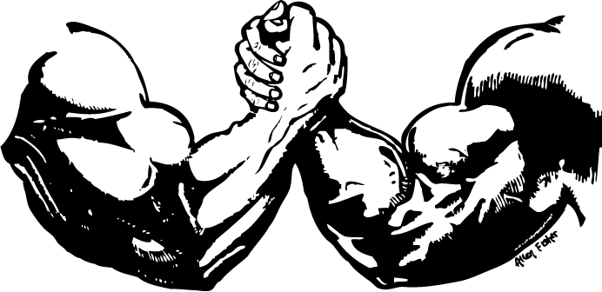
Arm Wrestle challenge (Task 34)

Slide 36
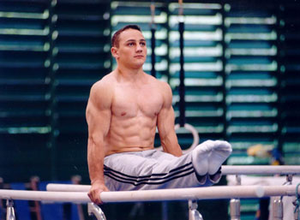
Isometric Contraction (Static)
Muscle stays the same length during contraction.
Name other SPECIFIC sports actions where isometric contraction occurs?
METRIC = LENGTH

Slide 38
TYPES OF CONTRACTION (Task 32)
ISOTONIC movement / dynamic |  | ISOMETRIC static
CONCENTRIC | ECCENTRIC | ISOMETRIC
Contraction – muscle length shortens against a resistance (Closer) | Contraction – muscle lengthens against a resistance (Extends) Often controlling or lowering – negative phase of contraction Good for strength gain | Contraction – muscle length stays the same (equal length) – no movement Rapidly fatigues Strength gain at that angle only
Eg – UP phase of bicep curl | Eg – DOWN phase of bicep curl | Eg – wall sit or tug of war

Slide 39
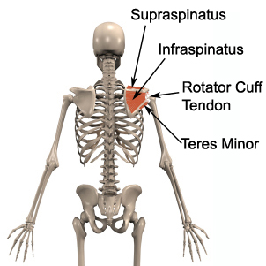
Rotator Cuff Muscle group (Task 25)
The SUPRASPINATUS, INFRASPINATUS, TERES MINOR and SUBSCAPULARIS muscles make up the rotator cuff.

Slide 40
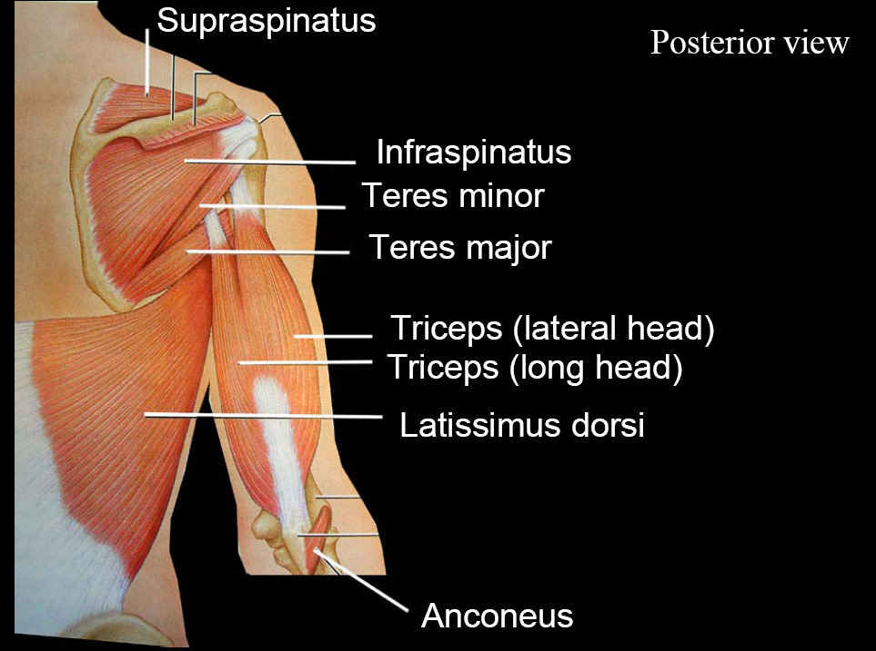

Slide 41
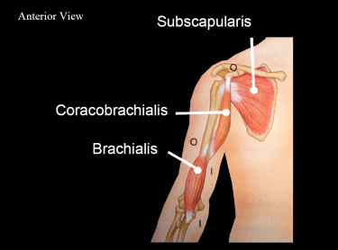

Slide 42
Generic role of rotator cuff muscles
Provide shoulder joint with ‘dynamic’ stability – helping control the joint during ‘rotation’ (hence ‘rotator’ cuff)
Important = throwing events (massive force during throw – then suddenly resistance gone = stress on joint to slow limb movement down
Need training to maintain strength & stability

Slide 43
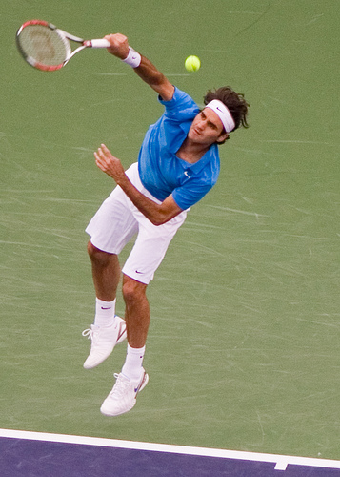
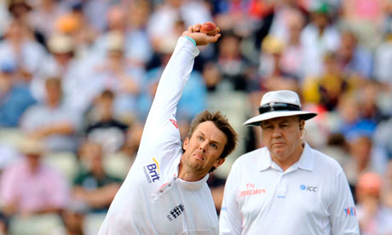
USE OF Rotator Cuff Muscles
Eg. Bowling, softball, swimming, table tennis

Slide 44
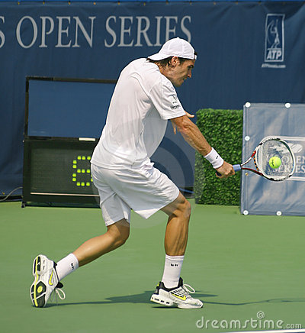
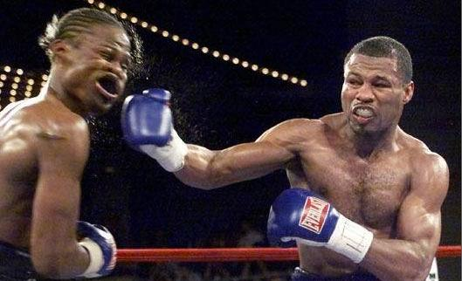
In sport ...
Act as stabilisers, prior to arm and leg movements, to help stabilise the trunk / pelvis.
More stable platform so movements are more efficient for arms / legs
Can transfer more muscular force to the action.
Rotator cuff muscles need to be strengthened for sports requiring regular rotational / throwing / hitting pulling actions (rackets, cricket)

Slide 45
Muscles Fibre types

Slide 46
Muscle Fibre Type
Squat Jumps FAST vs squats (1 per 10
Half – 1 every 10 seconds
Half – 1 every 5 seconds
Til failure!

Slide 47
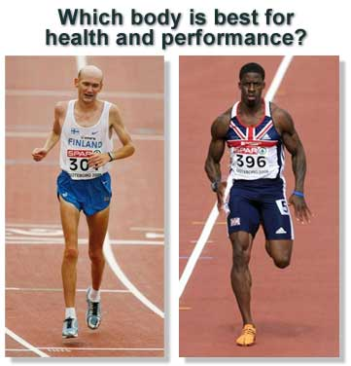
What differences are there in physique and event demand between these 2 athletes?

Slide 48
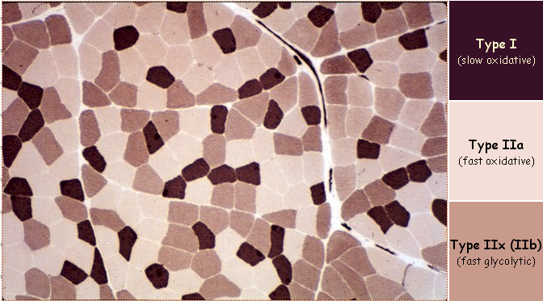
Muscle Fibre Type (Task 29)
Fibres under a microscope.
Dark = SO
Light = FG

Slide 49
MUSCLE FIBRES
TYPE of MUSCLE FIBRE | SUMMARY
SLOW OXIDATIVE ST / Type I | Smaller and contract less rapidly. More resistant to fatigue. Used under aerobic conditions. Better capillary supply. More mitochondria, myoglobin and respiratory enzymes. Endurance events. Smaller motor neurone serving them.
FAST OXIDATIVE GLYCOLYTIC FOG / Type IIa | Greater myoglobin content than Fast twitch, so more fatigue resistant than FT. Don’t contract as forcefully as Fast Twitch. Capacity to contribute in both ways.
FAST GLYCOLYTIC FT /; Type IIb | Greater creatine content than Slow twitch. Explosive events and speed. Fatigue rapidly due to poor capillary supply, low myglobin and mitochondria. Large in diameter Used under anaerobic conditions More fibres in a motor unit means more fibres contracting per stimulus and greater force generated.

Slide 50
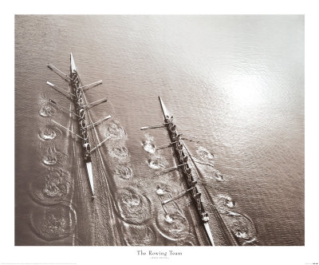
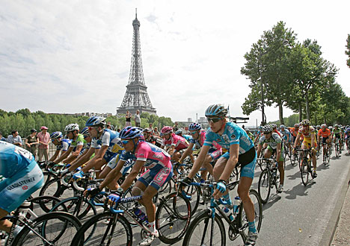
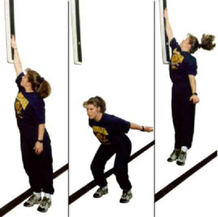
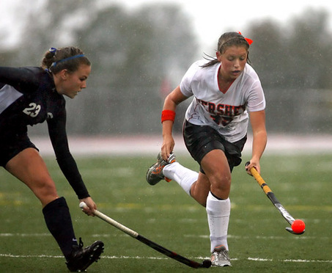
Muscle Fibre Recruitment? (Task 31)

Slide 51
TASK
Identify the muscle fibres being recruited predominantly in these sporting actions and be able top justify WHY you think this :
Javelin
Marathon running
Triple jump
Cross channel swim
100m sprint
800m
Kicking ball in football
Rowing a mile

Slide 52
Posture alignment and The impact of physical activity on the muscular skeletal system

Slide 53
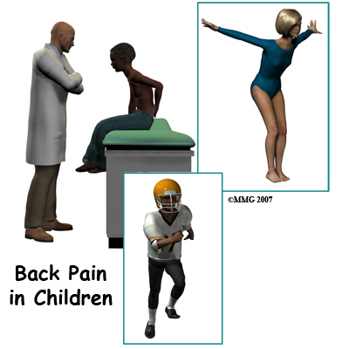
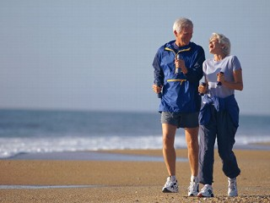
Posture & Lifelong BAHL
Even at rest, there is ‘partial contraction’ of these muscles = MUSCLE TONE
Greater tone = better core stability and greater protection and posture
Prevents excessive stress and pressure on lumbar spine – pain – throughout a lifetime of activity!

Slide 54
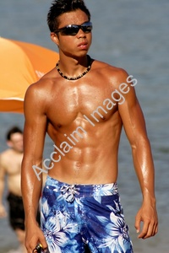
Muscle Tone
Muscle tissue never really relaxes and is in constant partial contraction – this gives muscle its shape or tone.

Slide 55
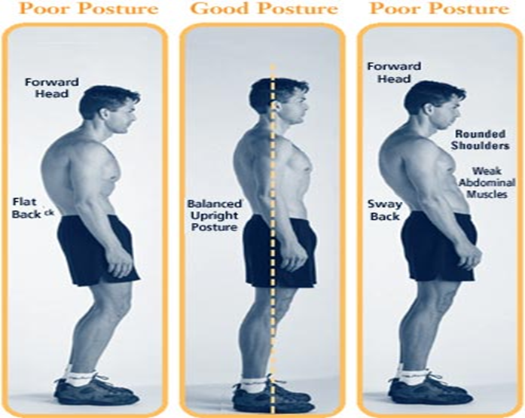
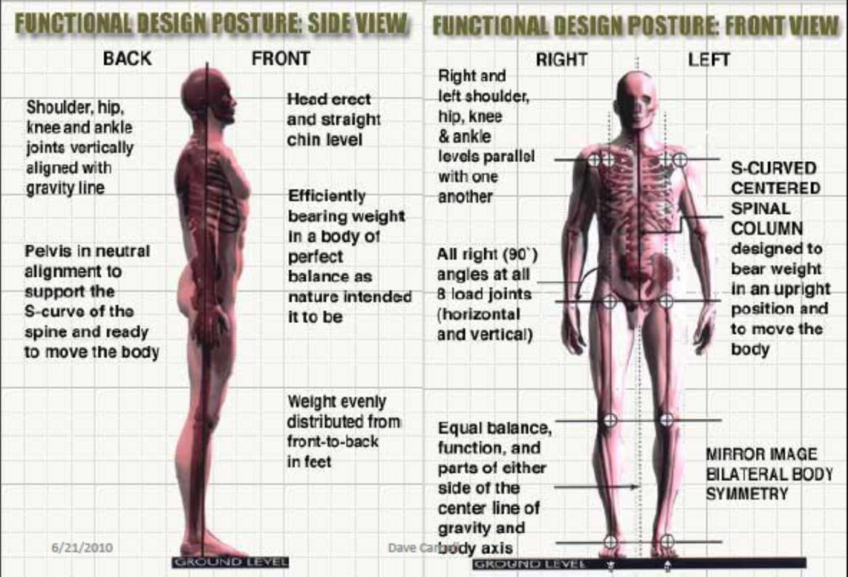
Working at a desk
Sedentary lifestyle
Excessive exercise of a group of muscles
In groups note the things that can impact on your posture or alignment.

Slide 56
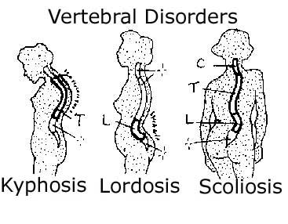

Slide 57
What is ‘core stability’?
What - Core stability muscles contract to act as stabilisers, prior to arm / leg movements.
Where - They help stabilise the trunk, pelvis and lower vertebrae
Your body’s core = area around your trunk and pelvis – where your CENTRE OF GRAVITY is.

Slide 58
Core Stability (Task 26)

Slide 59
Deep muscles | Superficial muscles
Tranverse abdominus (internal weight training belt!) Multifidis (spine) Pelvic Floor Muscles | Rectus abdominus Internal obliques External obliques Erector Spinae

Slide 60
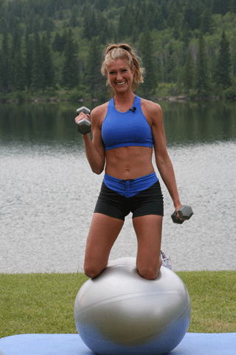
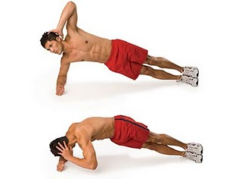
Exercises to train ‘core stability’?

Slide 61
Benefits of a strong ‘core’
Stable centre of gravity
Reduced risk of injury and pain (lower back)
Improved posture and body / spine alignment
Weak core muscles can make you susceptible to poor posture and muscular instability, nerve irritation and lower back pain.

Slide 62

Impact of Repetitive / Low Impact Activities on MUSCLES
General Positive Impact | General Negative Impact
Less load-bearing and therefore less stress on muscles to maintain position Core strength training (swiss ball can greatly improve core strength of multifidis and transverse abdominus and general posture) Yoga and flexibility training or Pilates | Make sure actions and muscles are used BOTH sides of body – not just dominant side (imbalance) – many daily actions DON’T work the pairs! Effect on organ function and movement

Slide 63
Impact of High Impact Activities on MUSCLES
General Positive Impact | General Negative Impact
Hypertrophy – thickening of muscle fibres and therefore muscle mass Thicker, stronger tendons Hyperplasia – splitting and increase of muscle fibres Increase in muscle elasticity | Can damage muscle tendons Risk of tearing or straining muscles
To avoid damage – progressively overload muscle demands in training.
Plan to spread out demanding sessions
Flexibility training to avoid poor RoM and tears of soft tissues & muscles
Ensure train EQUALLY on BOTH sides

Slide 64
Exam Question
Explain the importance of good posture and alignment to lifelong involvement in an active lifestyle.
(5 marks)
Complete bullet points
Then PEEE on the paragraphs.
Core to support stability during skills
Core stability to aid posture (state names of muscles)
Sedentary lifestyle can reduce muscle tone/ stability.
Can develop spinal issues i.e kyposis.
Excessive activity can cause tendon damage.
Excessive unbalanced activity can increase strain on bones,

Slide 65
H.W
Complete notes on Short and long term affects of exercise on muscles.
Complete both movement pattern sheets on Ashpe.weebly.com
Complete
Complete screencast and notes on skill application.
Complete 5 mark Q on posture and alignment.

Slide 66
Effects of Warm-up on Performance
Increase in core / muscle temperature (muscles by-product)
Controlled stretching to lengthen muscles and tendons – improve extensibility and maintenance flexibility for full RoM – so better performance
Decrease muscular tension so faster contraction and nerve transmission possible
Produce synovial fluid to lubricate joints
Increased blood flow to muscles - so O2 and fuel available for contractions
More enzyme activity (better speed and strength of contraction)

Slide 67
Effects of Cool Down on Recovery
Increased speed of removal of LA and CO2 (cause increased acidity and pain)
Decrease DOMS (Delayed Onset Muscle Soreness) = muscular pain 24-48hrs after intense exercise (microscopic tears in muscle fibres)

Slide 68
ST & LT EFFECTS OF EXERCISE ON MUSCLES
SHORT TERM EFFECTS
Increase in temperature and metabolic activity
Greater demand for O2 – via respiratory and circulatory system
Blood temperature increase = muscles are more pliable
LONG TERM ADAPTATIONS
Depends on training
Muscle strength and bulk increased – more contractile proteins – thicker fibres = HYPERTROPHY
Flexibility – increased ROM at joints
Endurance – work longer before fatigue. Better tone, shape and posture
ATROPHY??

Slide 69
Muscular Adaptation
Health related benefits
Everyday function
Static posture
Stability of joints
Bone density
Lean body mass

Slide 70
Muscular Adaptation
Anatomical
An increase in the cross sectional diameter of muscle fibres (hypertrophy)
Increased number of myofibrils (actin and myosin)
Increased strength and cross sectional diameter of ligaments and tendons
An increased bone mineral density

Slide 71
Muscular Adaptation
Physiological Adaptations
More efficient recruitment patterns of motor units
Increased CNS activation
Improved intramuscular synchronisation of motor unit activation
Improved reciprocal inhibition of antagonists and inhibition of GTO
Increased levels of enzymes within the muscles to aid re-synthesis of ATP
Increased levels of ATP, CP and glycogen fuel within muscles

Slide 72
Muscular Adaptation
Health related benefits
Everyday function
Static posture
Stability of joints
Bone density
Lean body mass

Slide 73
TASK
Analyse the following sporting actions and to determine what type of contraction is performed by which muscles
Press-up – preparation position, downward and upward movements
Chin-up – holding preparation position, upward and downward movement
Squat – downward, holding half way and upward movements

Slide 74
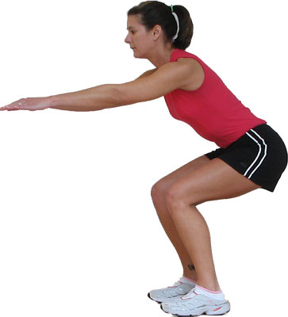
Squats

Slide 75
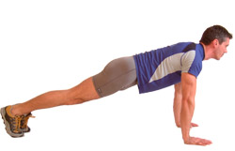
Press-ups

Slide 76
Task
Hurdle jumps
Bench jumps
Press ups
SVJ & SBJ
Dumbell biceps curls
Barbell squats
Lunges
Pull ups

