Slide 1
USA – Historical & Cultural Background

Slide 2
Learning Objectives
By the end of this section of the unit, students will have a good specific knowledge of the USA, and will understand:
The historical background to sport in the US
The factors that shaped the development of sport throughout history
The impact of industrialisation on society and sport
The ethics that are present in US culture and how they affect sport
The influence of topographic factors on sport

Slide 3
Young country
World’s 4th largest country
51 Autonomous states (each looks after itself)
Very rich mineral resources
Capitalist
Notes:
NOTES

Slide 4
Young country
200 years ago only owned a small strip of land on the east coast of America.
With the promise of lots of land between 1800-1900 large amounts of Europeans settled in the land of opportunity.

Slide 5
Large Population
U.S. 312,739,572
http://www.census.gov/main/www/popclock.html
Immigrants from Ireland after famine,
Jewish immigrants fleeing persecution.
What would be the knock on effect to sports?
New sports adapted and adopted by the new settlers.

Slide 6
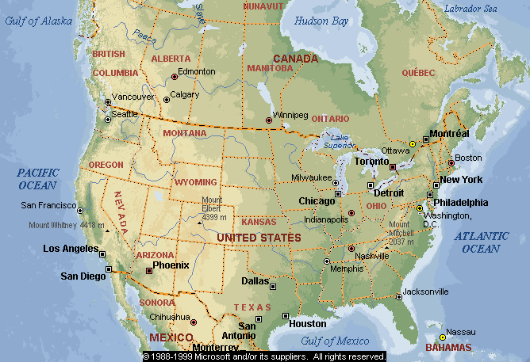
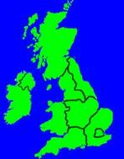

Slide 7
51 autonomous states
The country is too large to have a centralised system like the national curriculum.
De-centralised system with each state looks after itself.
What are the implications on sport?
TOWNS TOO FAR APART SO HARD FOR FIXTURES
A STATE MAY NOT BE INTO SPORTS SO REDIRECT FUNDING TO A DIFFERENT AREA.

Slide 8
Capitalist
What is a capitalist?
An economic term referring to the gain of capital. Property, land but mainly money.
America developed the ideal that the more you can gain the higher your status in society. Wealth, and the means of producing wealth, are privately owned and controlled.
This includes their sports teams, each one is owned.
An owner moved his team from LA to Oakland, why, because he could!

Slide 9
Capitalism
Creation of profit:
Milton Keynes Dons
Used to be Wimbledon

Slide 11
Nature of Sport in USA today.
Now lets look at their sports.

Slide 12
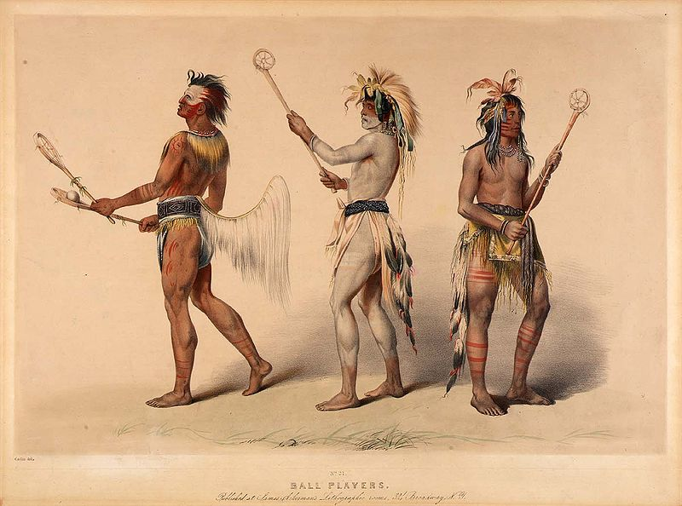
NAME THREE SPORTS THAT ORIGINATE IN THE USA
Ice Hockey- Canada Basketball – 1891 Lacrosse – (bagatoway)

Slide 13
Name sports that originated from the settlers
American Football (gridiron)
Came from – Rugby.
Baseball – came from rounder's 19th century, was developed from earlier folk games.
Golf – Scotland.

Slide 14
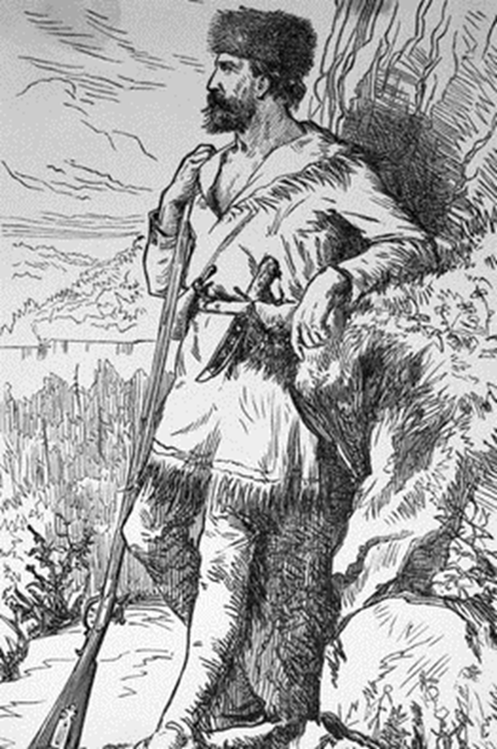
Frontier Spirit
As the new settlers arrived there was a desire for new land.
A drive for land began from the East across to the ‘wild west’.
People who set out for land were seen as pioneers.

Slide 16
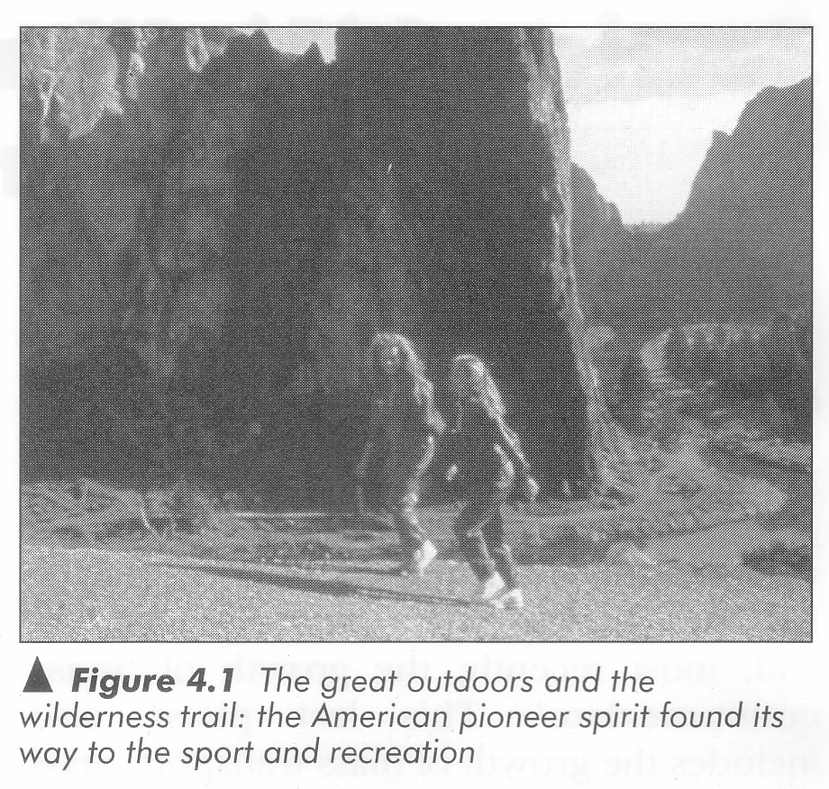
There have always been frontiers in American life. The taming of the WILD WEST, the CROSSING OF THE ROCKIES and SURVIVAL IN HARSH ENVIRONMENTS.

Slide 17
CHARACTERISTICS OF THE ‘FRONTIER SPIRIT’
Romantic view of US history - built the nation with their own ‘sweat and blood’
Toughness
Endeavour
Courage
Physicality
Where else would you see these characteristics?

Slide 18
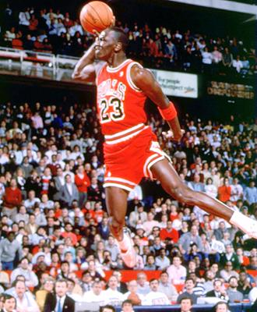
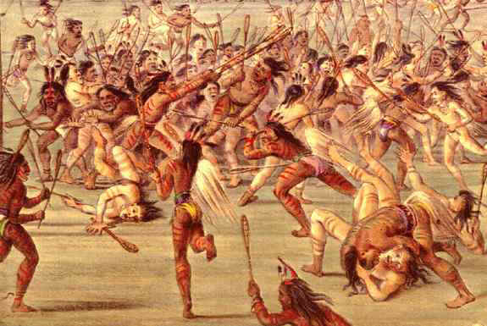
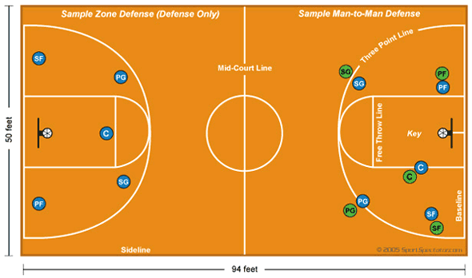
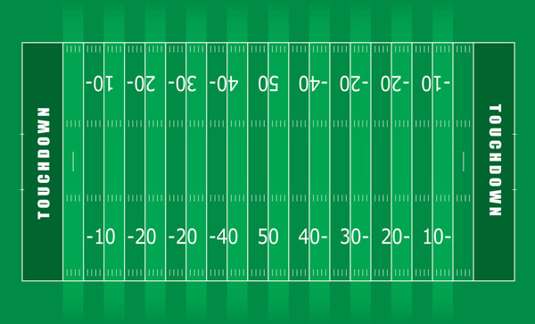
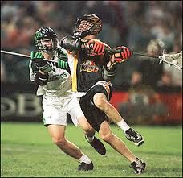

Slide 19
Slowly the native American sports were wiped out and the settlers sports became accepted as ‘American sport’.

Slide 20
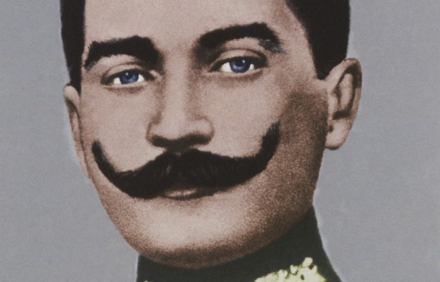
INFLUENCES ON CHANGES IN SPORTING ATTITUDES
Originally American ethics in sport were the same as UK.
Ethics have changed.
‘It’s about the taking part and not the winning that counts”

Slide 21
American Football

Slide 22
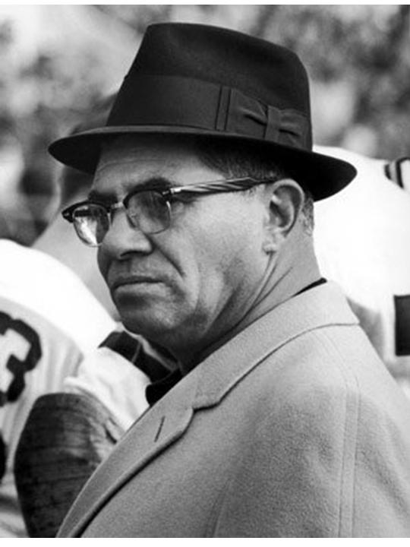
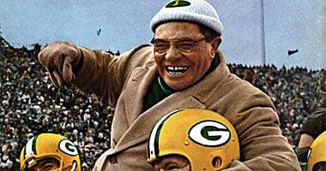
Vince Lombardi,
National football league coach of an American football team.
Winning isn’t everything,
IT’S THE ONLY THING!!!!!!!!

Slide 23
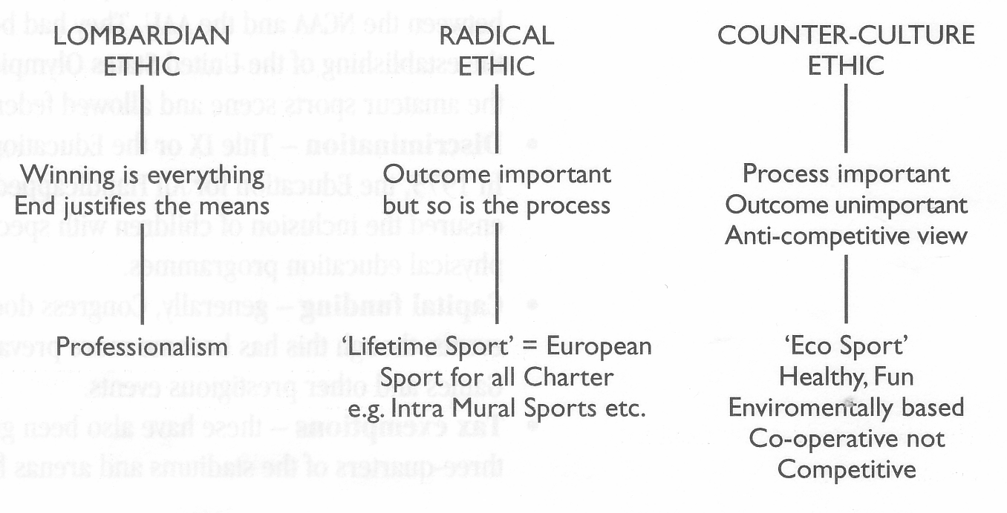

Slide 24
Which sport goes with which ethic?
Booklet task

Slide 25
Essay Question
Winners Takes all!
There ain’t no prizes for second!
Nice guy’s win nothing!
How do these statements reflect the attitude in American society? (6)
Can this Lombardian attitude be seen in sports in UK? (4)
One side of A4

Slide 27
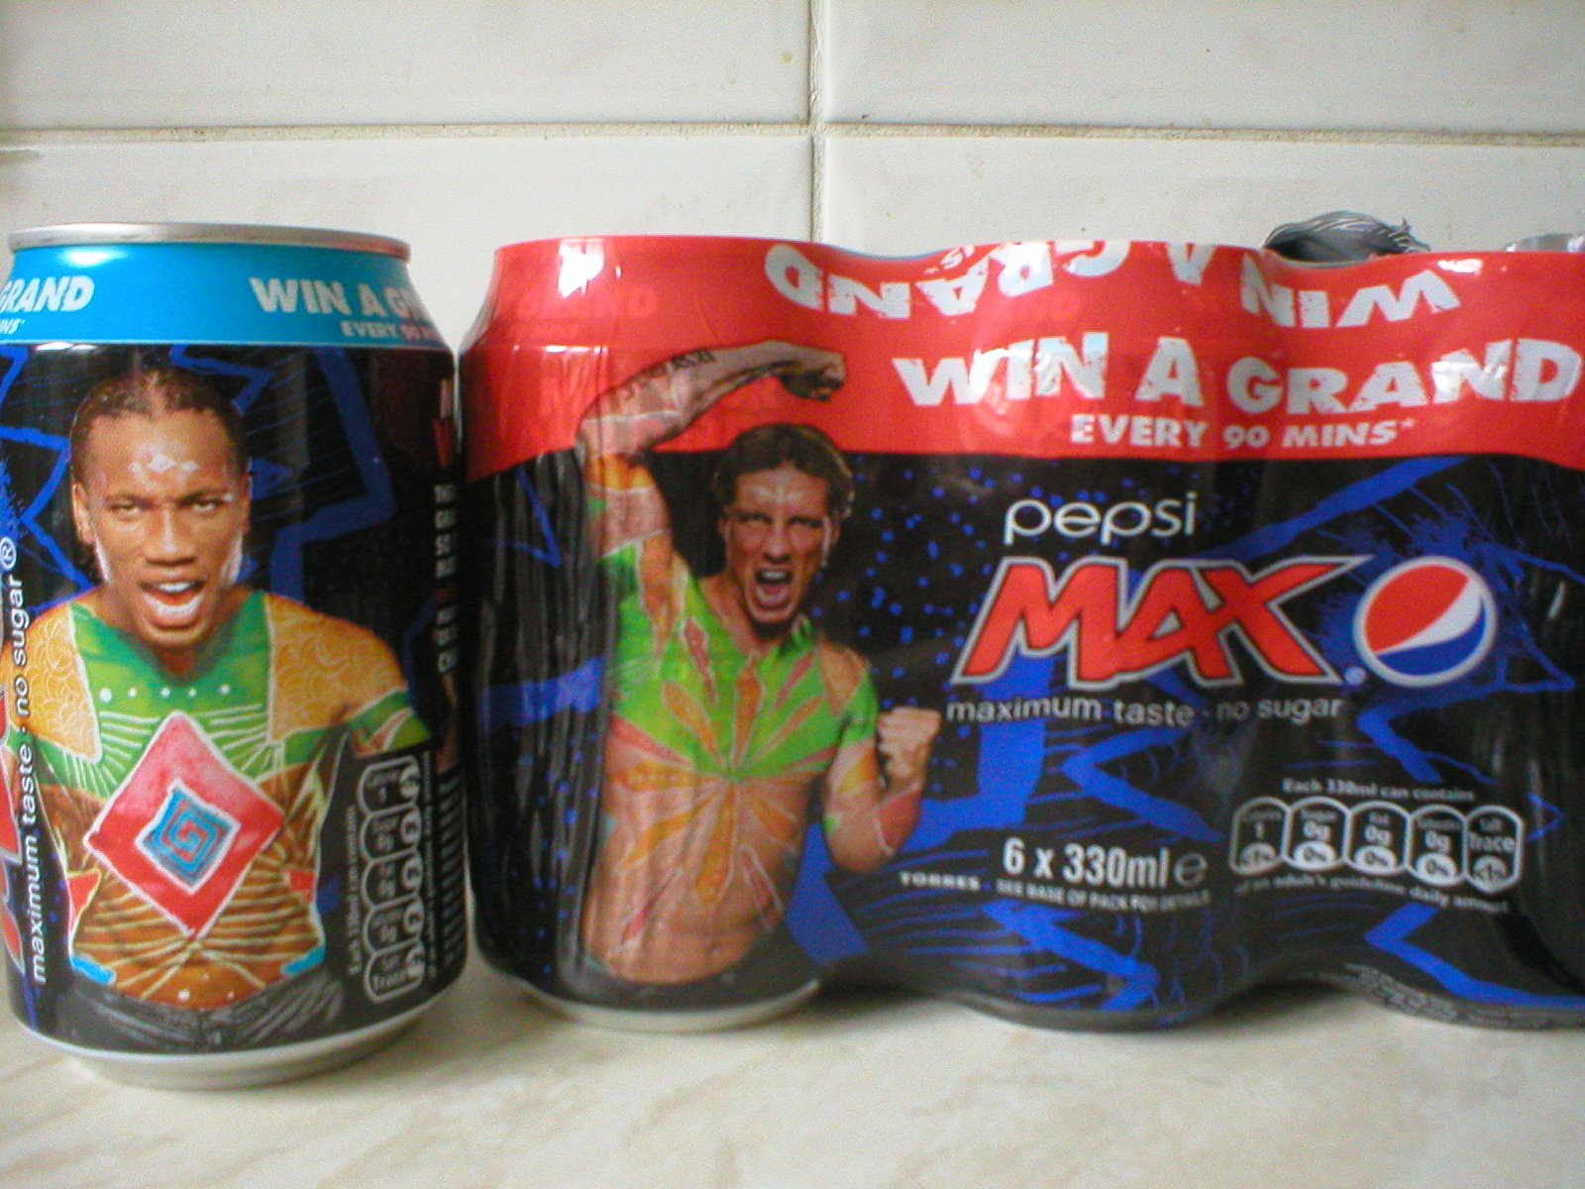
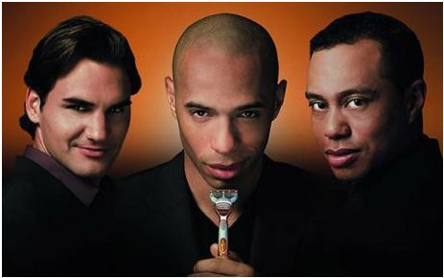
Commercialism
http://www.youtube.com/watch?v=6o03FDBx8wQ
Stars endorsing products.
Are our stars now just walking advertising boards.

Slide 28
We have a Win ethic, and a desire to create profit (capitalism) and a desire to turn everything into a profit (commercialism)! No wonder they are very competitive.
Spartan news and sponsor/ facilities.
http://www.msuspartans.com/index-main.html
http://www.youtube.com/watch?v=No87oVr_rtE&feature=related
NBA Draft.

Slide 29
Commercialism gives us….What do you think? Pairs task come up with a list of Advantages as well as disadvantages.
Advantages
Funding which gives athletes a better chance at success
Promotes events that might not happen
Performers can earn huge amounts of cash
Disadvantages
Only very few sports get seen.
Do athletes just become walking adverts?
Loss of traditional values of sports

Slide 30
Friday night lights
“You may not matter as much as you do know”. (coach)
“The hopes and dreams of a town are resting on your shoulders”. (coach)
“Why can’t you just give me one touch down?” (girlfriend)
“Why can’t you hold onto the football?” (Father).
“Some of you will never play football after this game.” (coach)
http://www.youtube.com/watch?v=Qzyp4qOW0F0
Friday night lights

Slide 31
AMERICAN DREAM (theory)
New competitive, capitalist economy aimed at providing opportunity to those with drive, determination and talent.
Not class system based success – anyone can!
Regardless of social class = ‘rags to riches’ in ‘land of opportunity’. (little league to pro and Olympics)
American Dream – Will Smith as Chris Gardner http://uk.youtube.com/watch?v=vO0BJMv58fc

Slide 32
Sporting examples of rags to riches
Michael Jordan
Michael Johnson

Slide 33
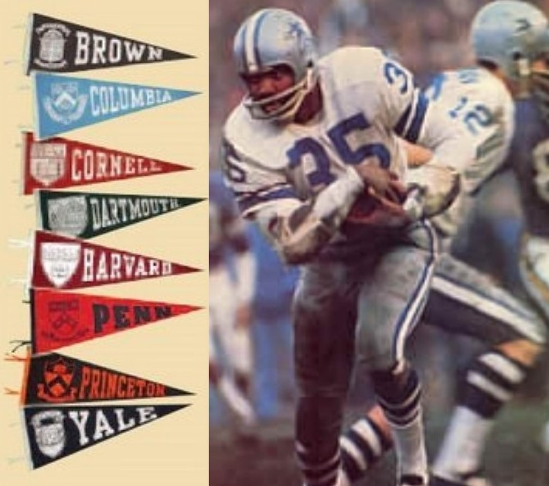
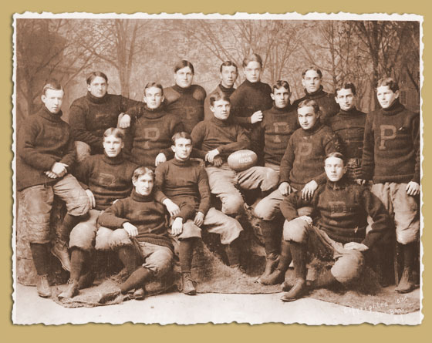
American football Ivy League
Injuries due to the brutal nature of the game
1910 six players were killed
The rules had to be changed.
The president at the time stepped in to ensure that game was cleaned up.

Slide 34
How tough is American Football?
http://www.youtube.com/watch?v=Fqo3PzcpiEc
In the beginning it was rough
Serious injury and even death were not uncommon.

Slide 35
Characteristic's to play American Football
Toughness
Endeavour
Courage.
The same characteristics as the………
Frontier spirit.

Slide 36
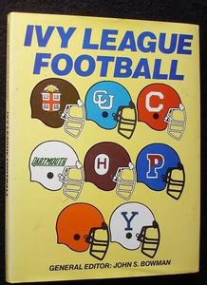
American Football
University football teams.
Very rough
Simple rules
Originated from Mob football
Adapted to suit America

Slide 37
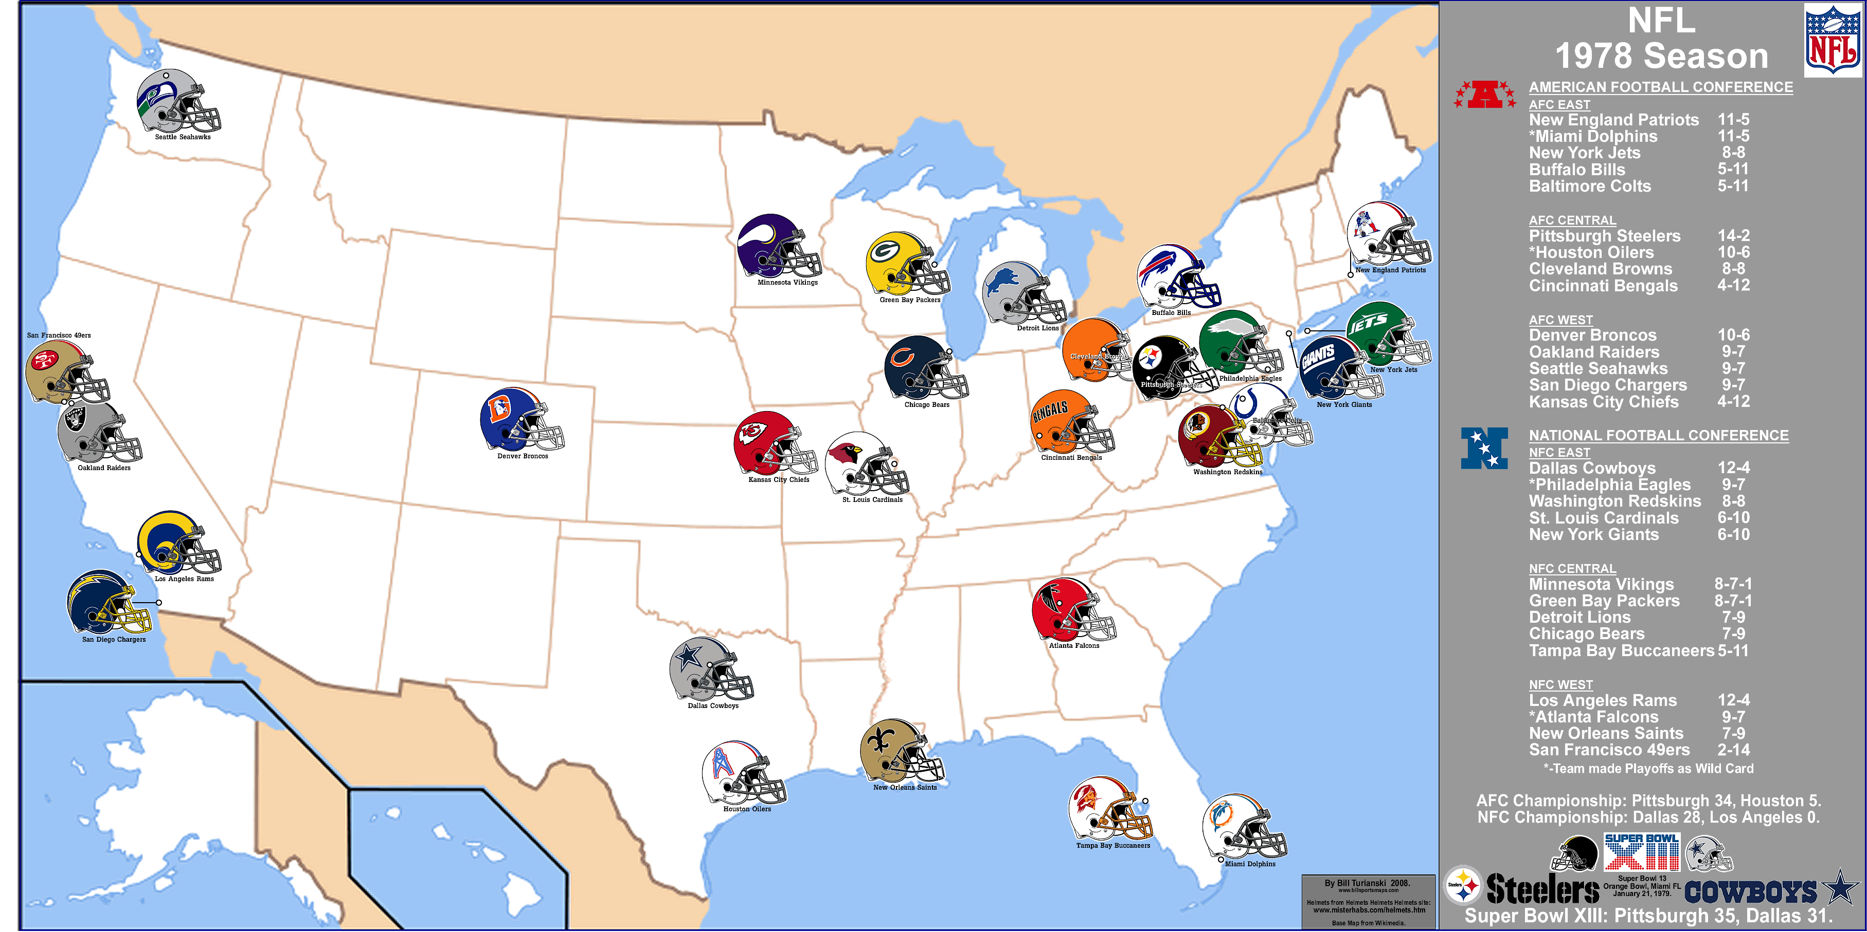
American Football
Two conferences (leagues)
Split into four sections.

Slide 38
Super Bowl
Half time show.
http://www.google.co.uk/#q=superbowl+half+time+show&hl=en&safe=vss&prmd=imvnsu&source=univ&tbm=nws&tbo=u&sa=X&ei=f3bgTojmDYX-8gPRrMTcBA&ved=0CD0QqAI&bav=on.2,or.r_gc.r_pw.,cf.osb&fp=487d19b4fcfbadef&biw=1280&bih=705

Slide 39
Largest consumption of food other than thanksgiving.
How much for a 30 second advert?
2.6 million for a 30sec advert.

Slide 40
Summary
Basic understanding of the origins of USA
The nature of sport (win ethic)
Commercialism and sport
American Dream
American football origins and nature of the game
American football and commercial impact.

