Slide 1
Vascular shunt

Slide 2
Distribution of Cardiac Output at Rest
15-20% resting Q is supplied to the muscles
80-85% is supplied to the body organs

Slide 4
Vascular shunt
http://www.youtube.com/watch?v=x_-eDv7qSrc&feature=related
As she increases the intensity how does the blood know it needs to go to the working muscles?
How does the body distribute the blood?

Slide 5
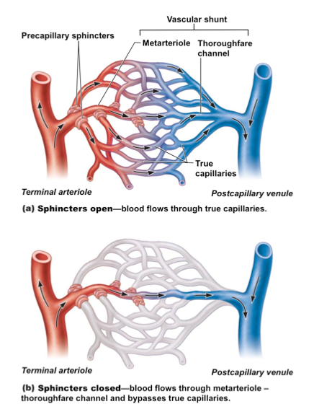
Distribution of Cardiac Output
Cardiac Output increases during exercise, but how does the cardiovascular system re-distribute the blood to the working muscles when they need more oxygen?
The distribution of Q is controlled by the Vascular Shunt mechanism.

Slide 6
Distribution of Cardiac Output During Exercise
80-85% Q is supplied to the working muscles as exercise increases
15-20% is supplied to the body organs
Blood supply to the brain is maintained
Increased blood supply to the skin surface for lighter work

Slide 7
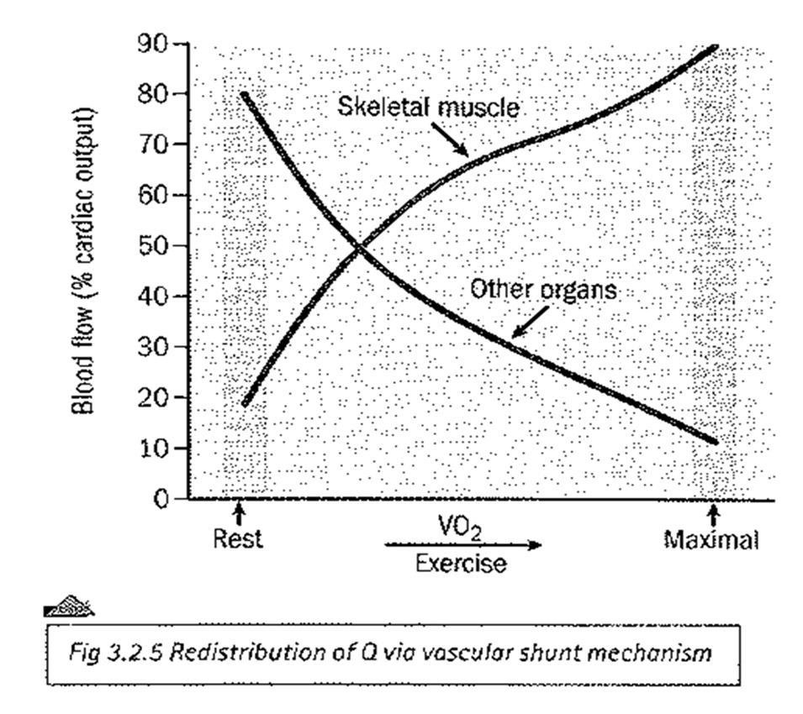

Slide 8
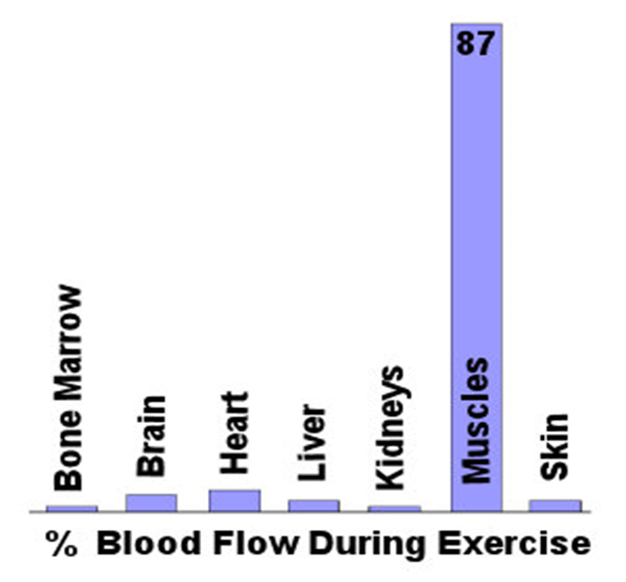

Slide 9
Vasomotor Control Centre
The VCC works in a similar way to the CCC:
The VCC receives info from:
Chemoreceptors – Lactic Acid / CO2 or O2 and PH
Baroreceptors – Systolic Blood Pressure (increase or decrease)

Slide 10
Vasomotor Control Centre
The Vascular Shunt mechanism redistributes Q (Cardiac Output) during rest and during exercise.
This is controlled by the Vasomotor Control Centre (VCC)
The VCC is located in the Medulla Oblongata (the brain).
The VCC stimulates the sympathetic nervous system to vasodilate or vasoconstrict blood vessels.

Slide 12
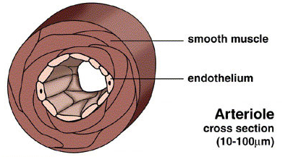
Sympathetic Nervous System
The VCC only sends information via the sympathetic nervous system
Arterioles are the blood vessels primarily responsible for the vascular shunt mechanism
The smooth muscle in the arterioles are always in a state of contraction, known as vasomotor tone

Slide 13
Pre-Capillary Sphincters
Q can be redistributed due to:
Arterioles vasodilating or vasoconstricting to increase / restrict blood flow
Pre-Capillary Sphincters opening / closing up the capillary beds
The Pre-Capillary Sphincter is a ring of smooth muscle at the junction between the arterioles and capillaries

Slide 14
VCC Control
VCC controls the blood flow to both the organs and the muscles
Organs (during exercise) – The VCC increases sympathetic stimulation. This vasoconstricts the arterioles which decreases blood flow away from the non-essential capillaries of the organs.
Muscles (during exercise) – The VCC decreases sympathetic stimulation. This vasodilates the arterioles and therefore increases the blood flow to the working muscles.

Slide 15
The skeletal pump mechanism is one way of helping to maintain venous return. (5 marks)

Slide 16
G451 May 2011 (p2) Q(c) The skeletal pump mechanism is one way of helping to maintain venous return. (5 marks)

Slide 17
Explain how the body controls the increased distribution of blood to the working muscles during exercise

Slide 18
Rethink
Watch the following three clips:
Zoe Smith: https://www.youtube.com/watch?v=MvGUnmKP6WQ
Christine Ohuruogu:
https://www.youtube.com/watch?v=VXT1vGX8gt8
Sun Yang:
https://www.youtube.com/watch?v=T5FlDy3YmDQ

