Slide 1
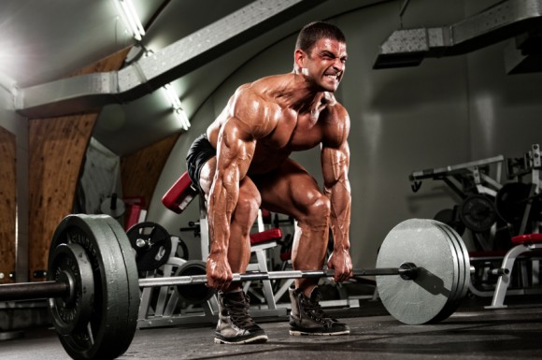
Applied Anatomy and Physiology

Slide 2
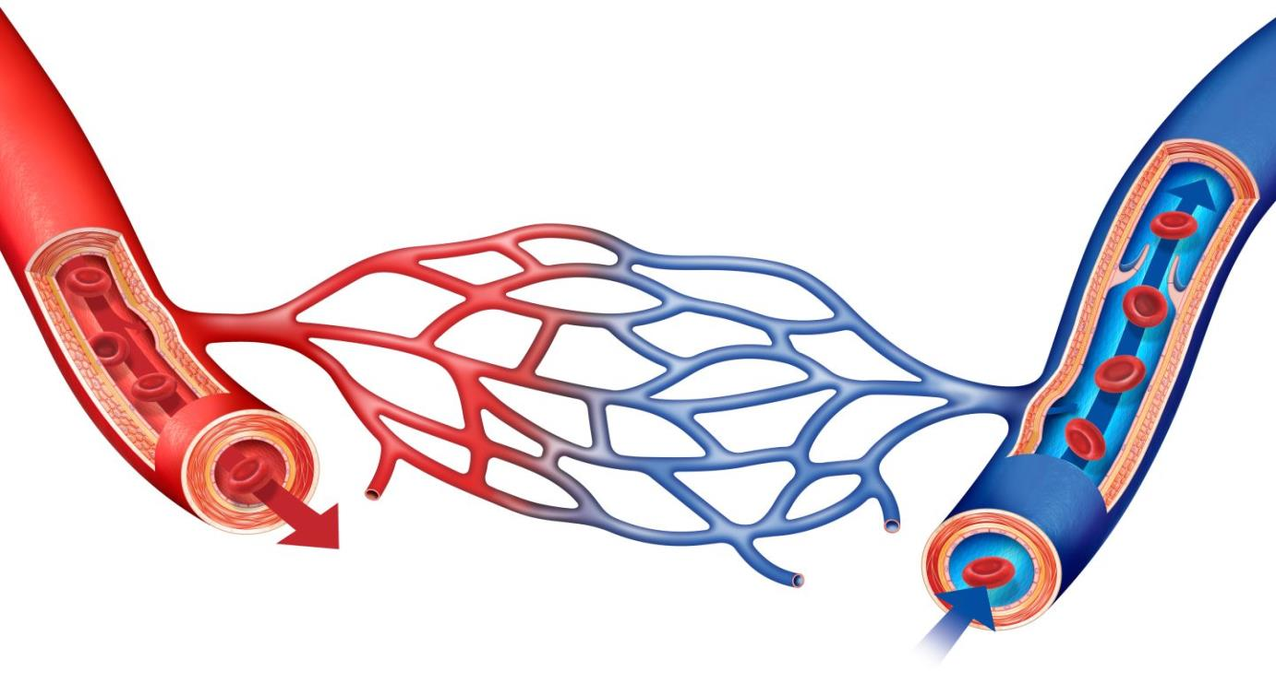
Cardiac control recap

Slide 3
Venous Return
Venous Return (VR) is the transport of blood from the capilleries through venules, veins back to the right atrium of the heart.
At rest, VR is maintained by blood pressure and the structure of the veins.

Slide 4
Venous Return During Exercise
During exercise, the pressure of the blood in the veins is too low to maintain VR, and SV and Q therefore decrease.
The body needs extra help to push the blood against gravity through the veins to increase VR and SV.

Slide 5
Venous Return is Supported by…
Muscle Pump
Pocket Valves
Respiratory Pump
Smooth Muscle
Gravity

Slide 6
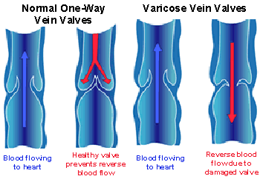
VR Mechanisms - Pocket Valves
These are valves in the veins to prevent backflow of blood and direct it towards the heart.

Slide 7
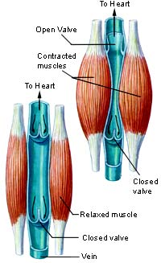
VR Mechanisms – Muscle Pump
Veins are situated between skeletal muscles.
When the muscles contract, this helps to push or squeeze blood back to the heart.
http://www.youtube.com/watch?v=HNuPWdfjDoc

Slide 8
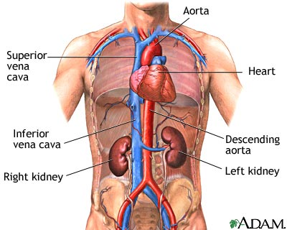
VR Mechanisms – Respiratory Pump
During exercise, breathing becomes deeper and faster.
This causes pressure changes in the thorax and abdomen, squeezing large veins and thus blood back to the heart.

Slide 9
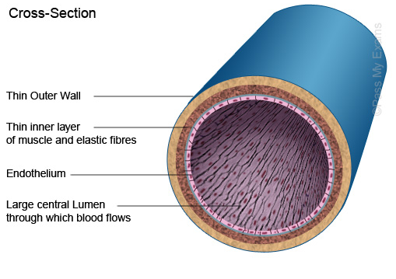
VR Mechanisms – Smooth Muscle
Contraction and relaxation of smooth muscle in the middle layer of the vein walls also help push the blood through the veins and towards the heart from the heart.

Slide 10
VR Mechanisms – Gravity
Blood from the upper body is aided by gravity as it descends from the heart.

Slide 11
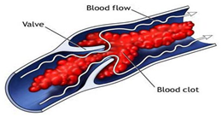
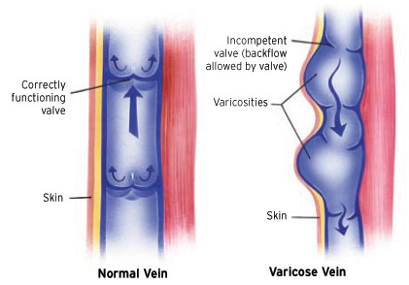
Blood Pooling
VR requires a force to push the blood back towards the heart.
If there isn’t enough pressure, the blood will sit in the pocket valves of the veins
This is called blood pooling, and is often associated with the feeling of heavy legs.

Slide 12
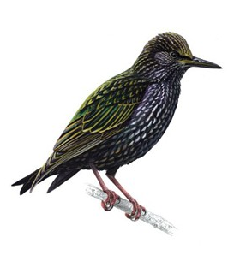
Starlings Law
A decrease in Venous Return = A decrease in stroke volume, which = a decrease in Q
And
An increase in Venous Return = An increase in stroke volume, which = an increase in Q

Slide 13
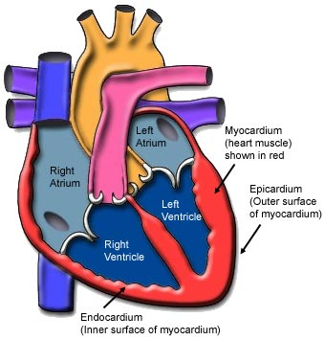
Starlings Law
Starlings Law suggests that stroke volume can increase in response to blood filling the heart
It is therefore dependent on venous return
Stroke Volume can also increase due to greater contractions of the cardiac muscles during exercise.

Slide 14
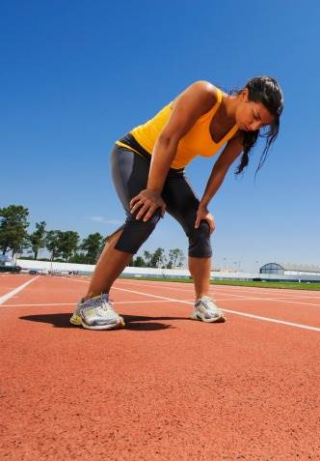
VR and Quality of Performance
VR is important to performance because it affects SV and Q! Remember Starling’s Law!
What would happen if VR is reduced? How would it affect sporting performance?

Slide 15
Reduction in SV / Q decreases blood / O2 to the working muscles
Performance is reduced - muscles fatigue if they continue without O2
Good VR will speed up recovery and allow performers to work anaerobically for longer!

Slide 16
Venous Return Mechanisms | Respiratory Pump | Pocket Valves | Smooth Muscle | Gravity | Muscle Pump
Describe how this assists Venous Return!

Slide 17
Feinting!!!
http://www.youtube.com/watch?v=x_-eDv7qSrc&feature=related
Watch the following cycling clip of Victoria Pendleton.
As she gets faster, can you discuss what is happening to her Q?
Finally, if she physically stopped immediately after the race, she may feint. What happens, step-by-step, in this process?

Slide 18
Cyclist Stops Moving (standing)
By stopping, muscle pump and respiratory pump deactivated
Venous Return decreases = Q decreases = SV lowers – this reduces blood pressure + creates feinting!
Blood pooling occurs in the pocket valves of the legs
Not enough pressure from gravity to supply venous return

