Slide 1
Biomechanics

Slide 2
Key Descriptors of Angular Motion
Angular Momentum

Slide 3
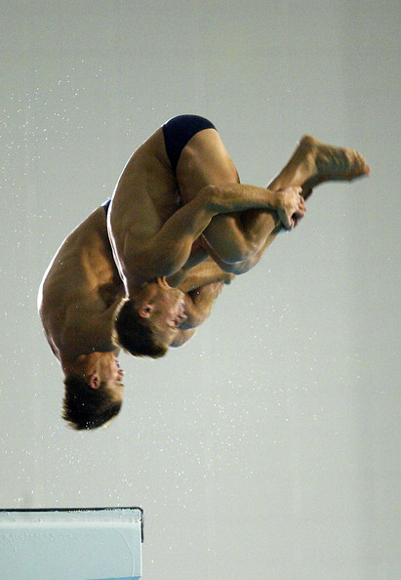
Angular Momentum
Angular Momentum is the quantity of angular motion possessed by a body (momentum)
Angular Momentum (kgm2 rad/s) = moment of inertia (kgm2) x angular velocity (rad/s)

Slide 4
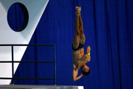
Think!
A 55kg gymnast performs a tucked front somersault
In the tucked phase, their MI is 12kgm2, and they rotate with an Angular Velocity of 7.0 rad/s
What is their Angular Momentum?
12 x 7
= 84kgm2 rad/s

Slide 5
Angular momentum
Is the quality of the angular motion.
Angular momentum = moment of inertia x angular velocity.
Angular momentum = kgm2 rad/s
60kg performer
Tucked phase = MI is 15kgm2
With an angular velocity of 8.0 rad/s
(15kgm2 x 8.0 rad/s)
120kgm2 rad/s

Slide 6
Task
Using the image describe how:
Angular momentum is generated.
(key terms)
Eccentric force/ COM, reaction force, angular motion, angular momentum.
R
COM

Slide 7
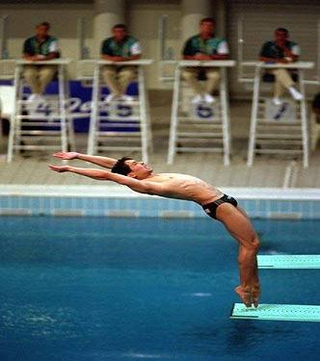
Task: How do you start rotation? (P88)
R
Momentum must be generated by an eccentric force, or torque.
Leaning back makes reaction force outside the COM.
This generated angular momentum.
The greater the size of the eccentric force the greater the quantity of angular momentum.
COM

Slide 8
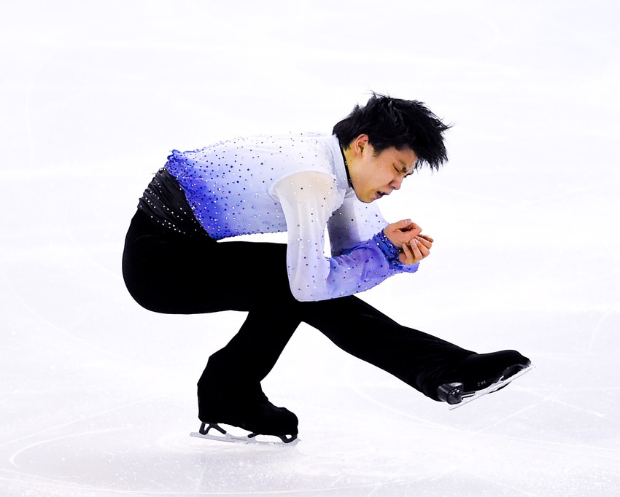
Important Points of Angular Momentum
Angular Momentum is a product of MI and Angular Velocity
If MI increases, Angular Velocity decreases
If MI reduces, Angular Velocity increases
Angular Momentum once generated does not change throughout a movement…
Therefore an ice skater can continue rotating, increasing or decreasing spin for effect

Slide 9
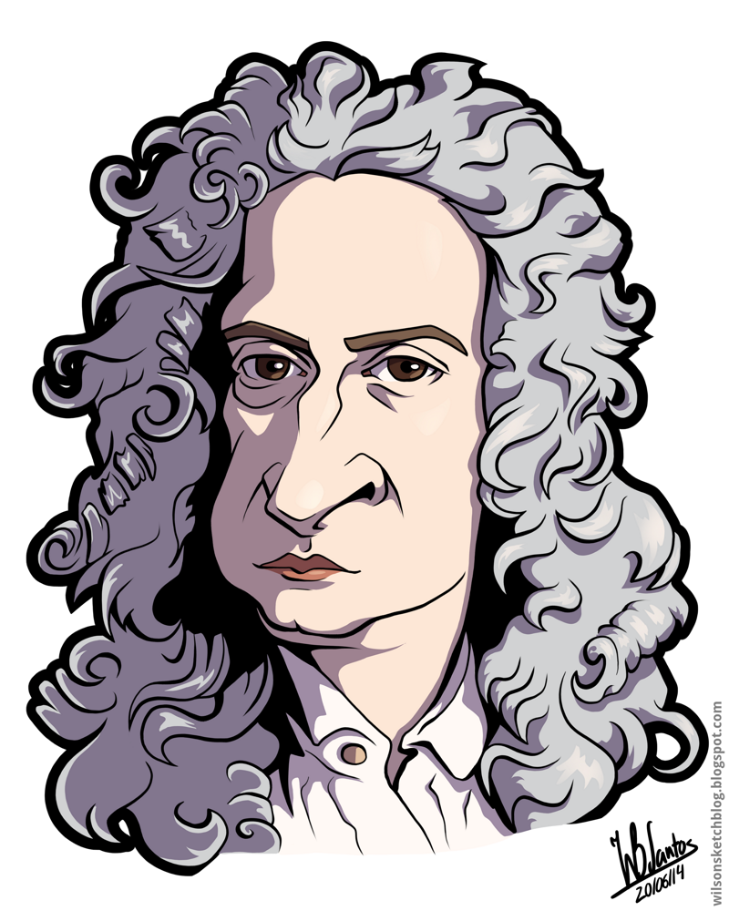
Angular Analogue of Newton’s First Law
Recap – what is Newton’s 1st Law of Motion?
“A rotating body will continue to turn about the axis of rotation with constant momentum unless acted upon by an eccentric force or external torque”

Slide 10
Physics behind a skater spinning
How is Angular momentum created?
.
How can a skater go from a curve to a spin so quickly?
What happens in the spin?
How does radius impact on MI?
L = angular momentum
W = angular velocity
I or MI = moment of inertia

Slide 11
Physics behind a skater spinning
How is Angular momentum created?
By using a curve on approach to increase speed.
How can a skater go from a curve to a spin so quickly?
The distance from the axis of rotation is decreased, therefore reducing the MI
What happens in the spin?
The MI is decreased therefore, there is an increase in the angular velocity (w)
How does radius impact on MI?
The radius reduces, which reduces the MI therefore, increase the W = increase in L
L = angular momentum
W = angular velocity
I or MI = moment of inertia

Slide 12
How does an ice skater create Angular Momentum?
How do they create an eccentric force?
What axis do they rotate around?
What is their Distribution of Mass like before they enter the spin? How does this affect MI and the Angular Velocity? What speed is the spin at this point?
What does the performer do as they jump to reduce MI? What happens to Angular Velocity and speed of the spin in mid-air?
As they prepare to land, what does the performer do in order to increase stability? How does this affect MI and Angular Velocity?
Why does the spin reduce as they land? Think about the change in Newton’s 1st Law here..

Slide 13
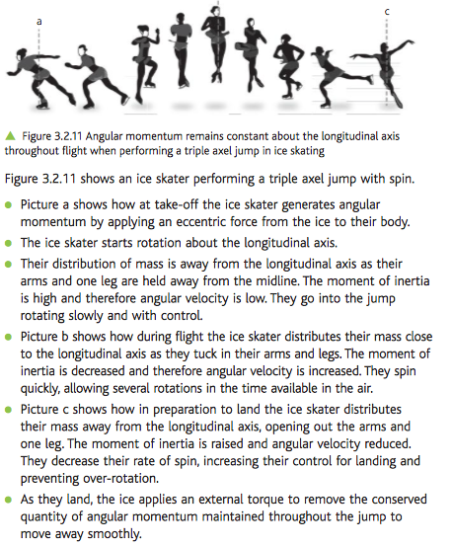

Slide 14
G453 June 2013
Define the analogue of Newton’s First Law of Motion.
Explain how a figure skater controls angular velocity when performing a multiple spin around the longitudinal axis.
[6 Marks]

Slide 16
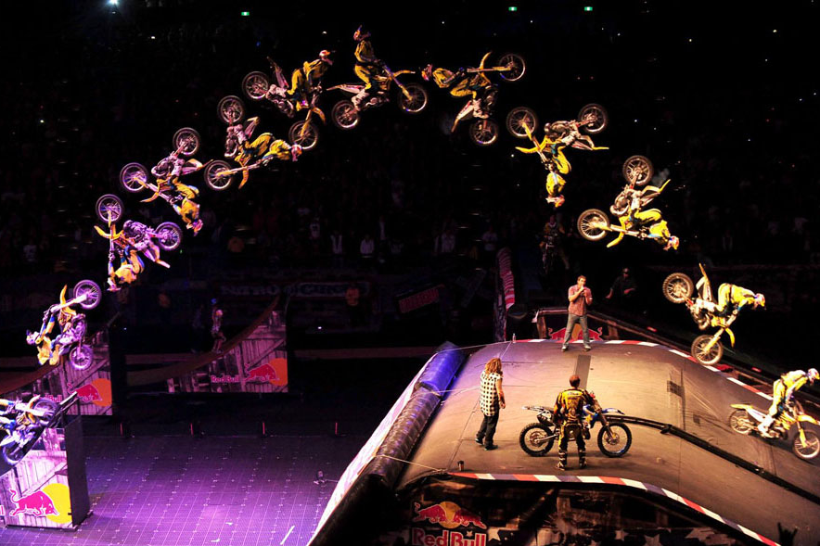
Travis Pastrana
Why is this so difficult to achieve?
Consider mass and potential to change the distribution of mass

Slide 17
How have they created Angular Momentum?
What is the Axis of Rotation?
What is happening to the Distribution of Mass BEFORE the spin?
What does this mean for MI and Angular Velocity?
What is happening to Distribution of Mass DURING the spin?
What does this mean for MI and Angular Velocity?
What is happening to the Distribution of Mass AFTER the spin?
What does this mean for MI and Angular Velocity?
What happens in relation to Newton’s First Law to stop the spin?

Slide 18
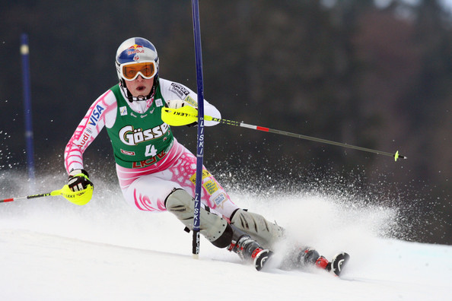
Task
A slalom skier rotating around the pole to change direction:

Slide 19
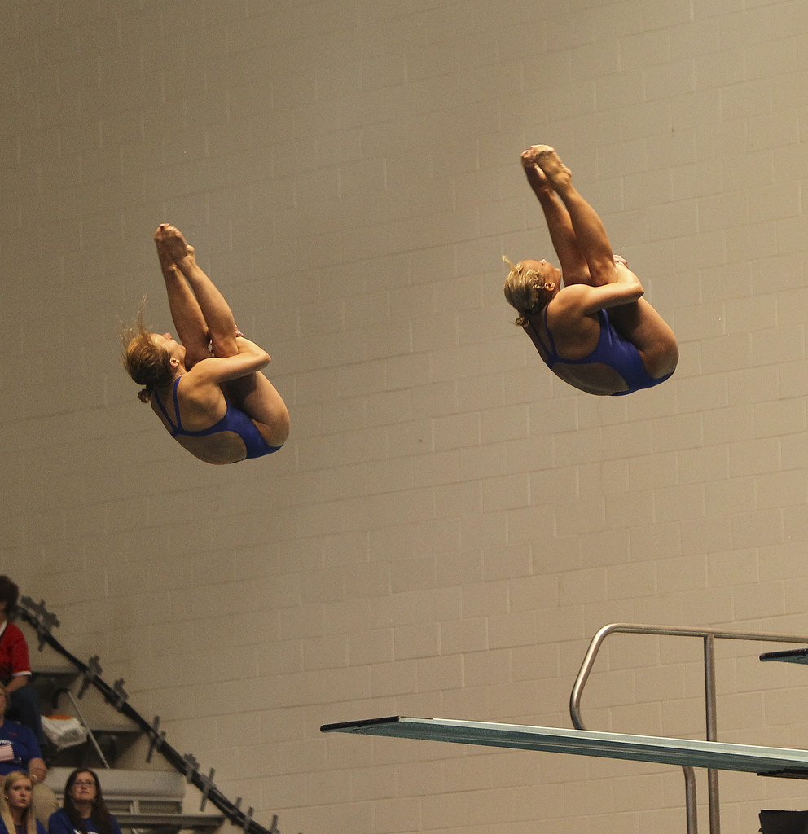
Task
A diver performing a tucked front or back somersault:

Slide 20
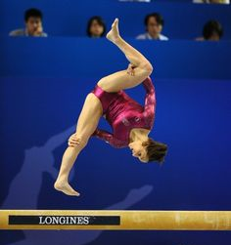
Task
A gymnast performing a side-somersault on the beam:

Slide 21
Key Descriptors of Angular Motion
Moment of Inertia
Angular Velocity
Angular Momentum

