Slide 1
Exercise Physiology

Slide 2
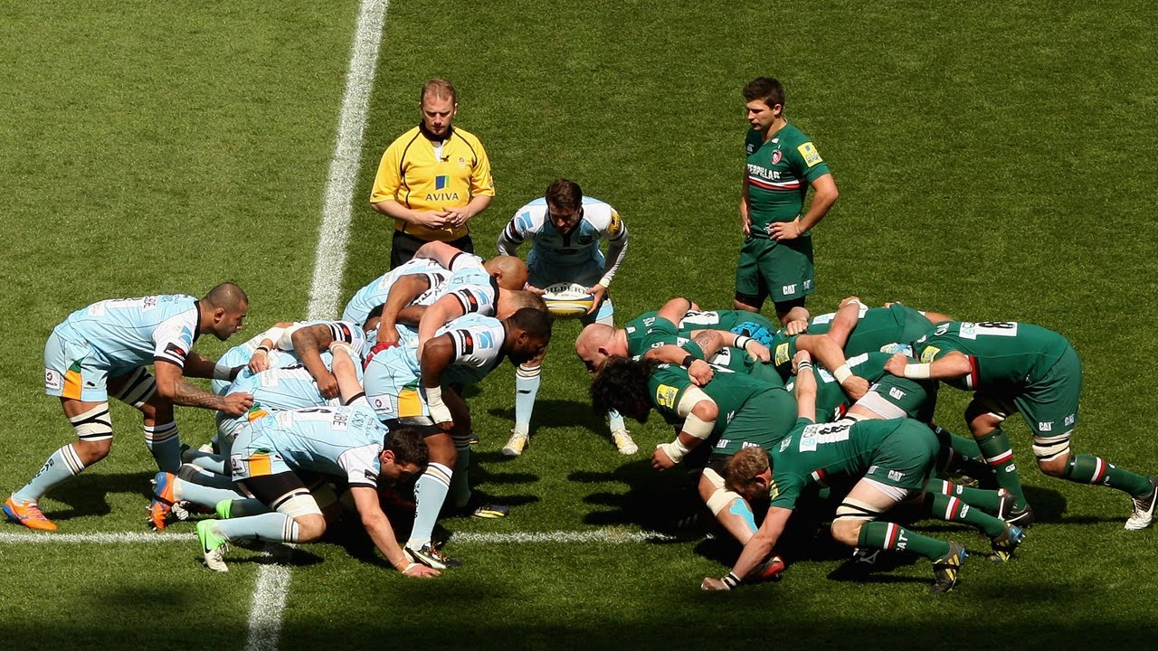
Strength
What is Strength
the application of force against a resistance.
There are five different types of strength, and each have their own method of evaluating them.

Slide 3
Type of strength
Strength Endurance
Maximal strength
Explosive/ elastic strength
Static and dynamic strength
Describe each of the types of strength

Slide 4
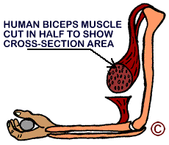
Factors that affect strength
Fibre type.-+
Cross sectional area of the muscles.
Gender
Age

Slide 5
FACTORS | EFFECT ON STRENGTH | EXPLANATION
Cross-sectional area | The greater the cross section of the muscle, the greater the strength
Fibre Type | The greater the percentage of fast glycolytic and fast oxidative glycolytic fibre, the greater the strength over a short period of time.
Gender | Males have higher muscle mass than females
Age | Peak strength is reached in females at 16-25 and males at 18-30. Strength development peaks at 20-30. Strength thereafter decreases with age

Slide 6
Chart analysis
FORCE
TIME

Slide 7
Testing for strength
If strength is an important component of fitness for a performer, it’s important to establish a baseline test to ensure relevant training programmes are in place.
Standing broad jump
MAXIMAL STRENGTH
Vertical jump test
STRENGHT ENDURANCE
DYNAMIC STRENGTH
Dynamometer grip strength
EXPLOSIVE STRENGTH
Abdominal curl test
THERE IS NO TEST FOR STATIC
Press up test
STATIC STRENGTH

Slide 8
Testing for strength
What type of strength is it MEASURING?
Name a sport that this would be linked to?
Note the advantages and disadvantages of the test?
Note the key points of this type of strength.
Standing broad jump
Dynamometer grip strength
Abdominal curl test

Slide 9
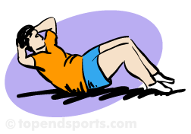
Tests
https://www.youtube.com/watch?v=RW6OssVmJBI
Abdominal curl test.
See page 98 for normative data.
What type of strength is it MEASURING?
Name a sport that this would be linked to?
Note the advantages and disadvantages of the test?
Note the key points of this type of strenght

Slide 10
TABLE
Type of strength | Type of test | Adv./dis of the test | Key points/ link to a sport example.
Strength endurance | Sit up/curl test Press up test | Can do more than one client, Simple and cheap Abdominal muscles can be isolated therefore, it’s a valid test. | Links strength endurance with aerobic capacity - it is the ability of the muscles to use and transport oxygen to the muscles cells. Strength endurance is essential in prolonged sub-maximal type exercise. Requires a high % of slow twitch fibres, and is dependent on the aerobic energy system.

Slide 11
Strength Endurance
Strength Endurance is the ability of a muscle to sustain or withstand repeated muscle contractions or a single-static action.
Push-up Test
NCF Abdominal Sit-Up Test

Slide 12
Key Points - Strength Endurance
Links strength endurance with aerobic capacity - it is the ability of the muscles to use and transport oxygen to the muscles cells.
Strength endurance is essential in prolonged sub-maximal type exercise.
Requires a high % of slow twitch fibres, and is dependent on the aerobic energy system.
ADVANTAGES
DISADVANTAGES

Slide 13
Maximum Strength
Maximum strength is the maximum force the neuromuscular system can exert in a single voluntary muscle contraction.
Represents the amount an individual can lift just once (1 Rep Max).
http://www.youtube.com/watch?v=1YZ5Hv_2GiY
Dynamometer (hand and leg)
1 Rep Max (using leg press and bench press)

Slide 14
Key Points Maximum Strength
Few sports depend on maximum strength.
Weight-lifters use explosive strength rather than 1RM.
Best examples can be seen during ‘World’s Strongest Man’ event.
For sedentary individuals, maximal strength training can be high risk - why do you think this is?
ADVANTAGES OF THE TEST
DISADVANTAGES OF THE TEST

Slide 15
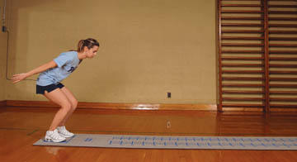
Explosive / Elastic Strength
Explosive / Elastic strength is the ability to expand a maximal amount of energy in one or a series of of strong, sudden high intensity movements or apply a successive and equal force rapidly.

Slide 16
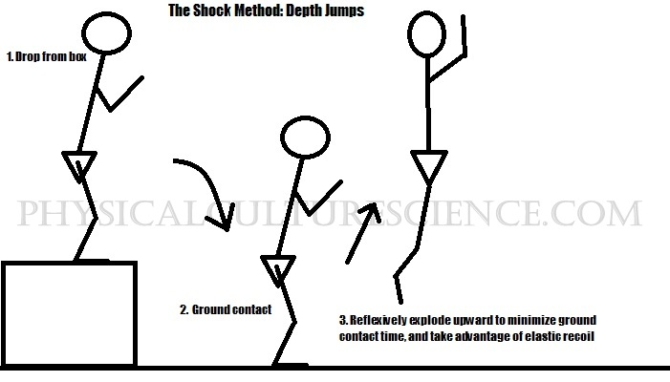
Key Points - Explosive / Elastic Strength
Elastic strength is very similar to power, but uses the ATP-Pc system.
It is an anaerobic movement, but represents movements of a higher intensity but shorter duration than dynamic strength.
Explosive strength eccentrically lengthens a muscle before concentrically contracting.

Slide 17
Normative data standing broad jump
Age | Excellent | Above average | Average | Below average | Poor
14 | > 2.11m | 2.11 - 1.96m | 1.95 - 1.85m | 1.84 - 1.68m | <1.68m
15 | >2.26m | 1.26 - 2.11m | 2.10 - 1.98m | 1.97 - 1.85m | <1.85m
16 | >2.36m | 2.36 - 2.21m | 2.20 - 2.11m | 2.10 - 1.98m | <1.98m
>16 | >2.44m | 2.44 - 2.29m | 2.28 - 2.16m | 2.15 - 1.98m | <1.98mThe following table is for female athletes (adapted from: Hede et al. 2011)[2]:
Age | Excellent | Above average | Average | Below average | Poor
14 | >1.91m | 1.91 - 1.73m | 1.72 - 1.60m | 1.59 - 1.47m | <1.47m
15 | >1.85m | 1.84 - 1.73m | 1.72 - 1.60m | 1.59 - 1.50m | <1.50m
16 | >1.83m | 1.83 - 1.68m | 1.67 - 1.58m | 1.57 - 1.45m | <1.45m
>16 | >1.91m | 1.91 - 1.78m | 1.77 - 1.63m | 1.62 - 1.50m | <1.50m

Slide 18
Dynamic Strength
Dynamic strength is the ability of the neuromuscular system to overcome a resistance with a high speed of contraction.
It is most often referred to as ‘anaerobic capacity’ and uses the Lactic Acid system.
Dynamic strength = Strength and Speed (which represents Power).

Slide 19
Measuring Dynamic Strength
Wingate Cycle Test
This tests can be advantageous to cyclists, and so the RAST (Running-based Anaerobic Sprint Test) test can also be used.

Slide 20
Static Strength
Static strength is the force exerted by the neuromuscular system while the muscle length remains constant / static.
This type of strength is also known as isometric.

Slide 21
Measuring Static Strength
There is no single or generic test for static strength.
This is because strength varies and can be specific to any joint angle.
Maximum static strength is measured at specific joint angles that are the most favourable for a muscle group.

Slide 22
Exam question
1 (a) A performer carries out a number of fitness tests. Table 1 gives the results of two of these tests.
Table 1
Component of Fitness | Test | Result | Evaluation by comparison with norm tables
Aerobic Capacity | Test A | Predicted VO2 max = 50ml/kg/min | HIGH
Fitness Component B | Abdominal Curl Conditioning test | Stage 6 | VERY GOOD
(i) Identify test A and fitness component B. [2]
(ii) Explain three physiological factors related to the heart and skeletal muscle that enable the performer to score so highly on test A. [3]

Slide 23
Training strength

Slide 24
(test A)
NB: Any suitable test that gives a "predicted" VO2 max score, so direct gas analysis would be incorrect.
(NCF) multi stage fitness test/(any) step test/Cooper/12 minute run test/PWC170 test
fitness component B)
Muscular/strength endurance

Slide 25
3 marks in total Answers MUST be explained Both heart and muscles must be addressed submax 2 for either [3]
Reason | Explanation
HEART
1. large/strong heart/hypertrophy | able to contract with more force/contractility of myocardium improved/greater efficiency at pumping blood/O2 to the muscles
2. low resting heart rate/bradycardia | greater efficiency at pumping blood/oxygen to the working muscles
3. larger stroke volume/(maximal) cardiac output | more blood/oxygen pumped per beat into the systemic circulatory system/per unit of time
SKELETAL MUSCLE
4. large myoglobin stores | more efficient transport of oxygen (from the blood capillaries to the mitochondria)
5. many mitochondria | allows greater use of aerobic respiration/less time spent on anaerobic respiration
6. high enzyme activity | increases rate of glycogen/fat breakdown (making aerobic system more efficient)
7. large stores glycogen/fats | more fuel available to break down for ATP/resynthesis/energy
8. large number of slow twitch/type I muscle fibres | More suited to aerobic/endurance work

Slide 26
Identify and explain three physiological adaptations that take place [6] after a strength training programme. 6 marks in total Max 3 available for identifications only-cannot have explanation marks alone
Neural
Muscular
Metabolic

Slide 27
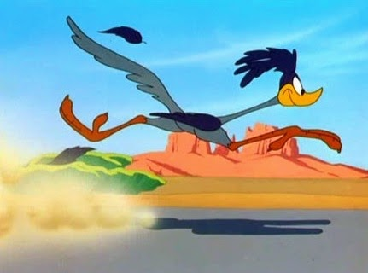
We can have more now.

Slide 28
Identify and explain three physiological adaptations that take place [6] after a strength training programme. 6 marks in total Max 3 available for identifications only-cannot have explanation marks alone
See page 104 for adaptations.
Neural pathways
Structural adaptations | Functional effect
Increase recruitment of FG and FOG fibre types | Increase in force of contraction Improved co-ordination and stimulation of motor units.

Slide 29
Factors Affecting Strength
There are four key factors that affect strength:
Fibre type.-+
Cross sectional area of the muscles.
Gender
Age

