Slide 1
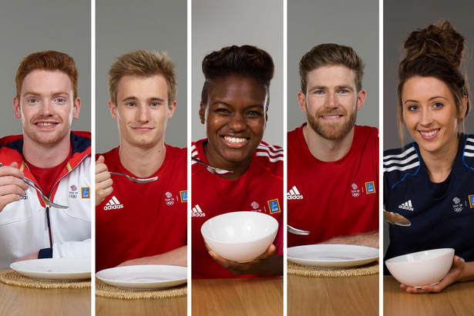
Exercise Physiology

Slide 2
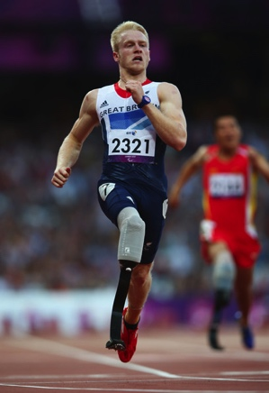
Energy
It is crucial that performers meet their energy needs during periods of training
If not, this can result in:
Muscle loss (atrophy)
Decreased intensity and duration of performance
Slow recovery rates
Increased risk of injury, fatigue and illness

Slide 3
Energy
Energy is the ability to perform work (measured in joules)
4.18 joules = 1 calorie
But what does calorific requirement depend upon?

Slide 4
Individual energy requirements
(daily calorific need)
Age
Gender
Size
Environment
Lifestyle
Metabolic Rate

Slide 5
Energy Expenditure – Basal Metabolic Rate (BMR)
The minimum amount of energy needed to sustain the body’s essential physiological functions whilst at rest
(accounts for 75% of total energy expenditure)

Slide 6
Calculating Energy Expenditure
BMR
Physical Activity
(METs)
Total Calorific Requirement
Thermic Effect

Slide 7
Calculating Basal Metabolic Rate (BMR)
MALES
FEMALES
Write the answers to these equations first!
13.7 x weight in kg = a
5.0 x height in cm = b
6.8 x age = c
Then use them for the calculation:
66 + (a) + (b) – (c) = Kcals
Write the answers to these equations first!
9.6 x weight in kg = a
1.8 x height in cm = b
4.7 x age = c
Then use them for the calculation:
655 + (a) + (b) – (c) = Kcals

Slide 8
Metabolic Equivalent Task (METs)
Calculates the energy expenditure of physical activity
The ratio of a performer’s working metabolic rate relative to their resting metabolic rate
Uses oxygen consumption per unit of body weight per minute to estimate exercise intensity (ml O2/kg/min)

Slide 9
Calculating Energy Expenditure
BMR
Physical Activity
(METs)
Total Calorific Requirement
Thermic Effect

Slide 10
Metabolic Equivalent Task (METs)
1 MET = 3.5 ml/kg/min or 0.0175 kcal/kg/min
This is your resting VO2 (volume of oxygen consumed)
2 METS indicates the energy expanded is twice that at rest and so on…….

Slide 11
Calculating the Calories
BMR Divided by 24 = Hr BMR
8 hrs sleep ( 62 x 8 = Hr BMR x hours sleep) = 496
Use the MET list to establish the value for each activity using.
Golf Activity = (MET value = 4.5 x hours taken = 4) so 4.5 x.4 = 18 METS
Once the whole day is complete then complete the equation below
Energy expenditure = 496 + (62 which is hr BMR X total MET
= calories per day.

Slide 12
Therefore…
BMR
METs
Daily Energy Expenditure
(Kcals)

Slide 14
MICHAEL PHELPS' 10,000 kcal diet
Breakfast: Three fried egg sandwiches; cheese; tomatoes; lettuce; fried onions; mayonnaise; three chocolate-chip pancakes; five-egg omelette; three sugar-coated slices of French toast; bowl of grits; two cups of coffee
Lunch: Half-kilogram (one pound) of enriched pasta; two large ham and cheese sandwiches with mayonnaise on white bread; energy drinks
Dinner: Half-kilogram of pasta, with carbonara sauce; large pizza; energy drinks
http://www.youtube.com/watch?v=QXRvXtcSu14

Slide 15
Energy Balance
You are in energy balance if the amount of energy you take in equals the amount of energy you expend.

Slide 16
Calorie Counting
Split down into percentages of food sources of a balanced diet
Then split further into different energy yields from food sources
Complicated?

Slide 17
Calorie Counting – Percentages
Using your
BMR+METS
total
Calculate:
Carbohydrates required
Fats required
Protein required

Slide 18
Energy Yields
These food sources provide different energy yields in calories per gram:
Carbohydrates provide 4 Calories (per gram)
Fats provide 9 Calories (per gram)
Proteins provide 4 Calories (per gram)
Using your Carbohydrates / Fats / Proteins totals, calculate the amount of grams of these you would require!

Slide 19
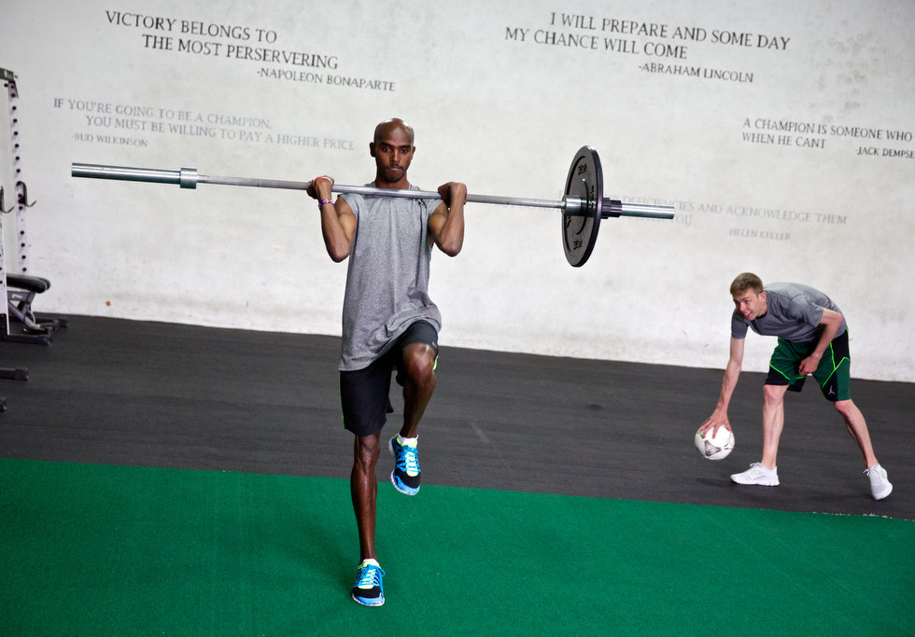
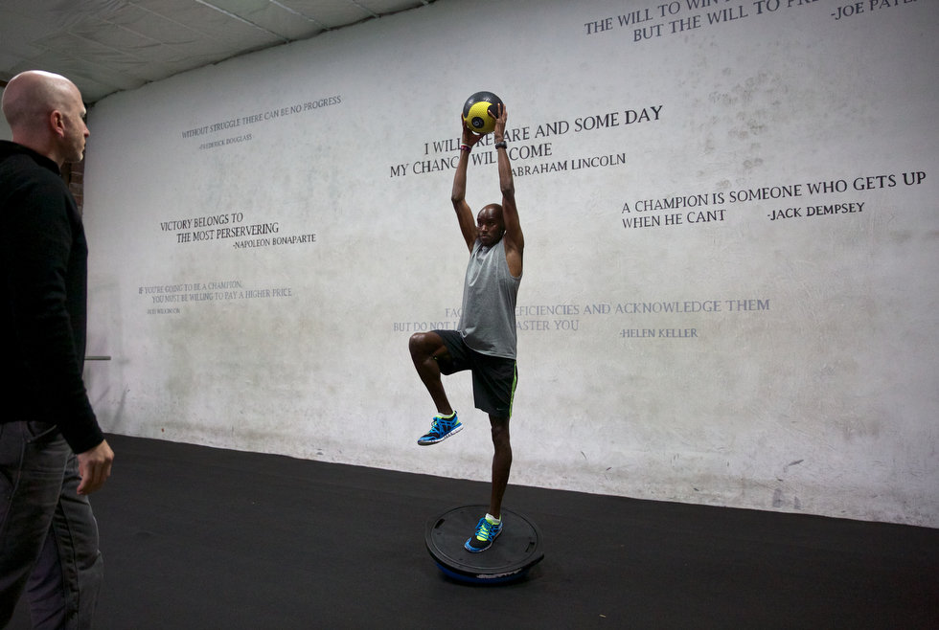
Mo Farah Training
http://photos.oregonlive.com/photo-essay/2013/04/a_day_in_the_life_with_long_di.html
http://www.oregonlive.com/trackandfield/index.ssf/2013/04/for_mo_farah_and_galen_rupp_it.html#incart_m-rpt-2

Slide 20
Name | Age | Weight (kg) | Height (cm) | Basal Metabolic Rate (Kcals)
Activity Performed | METs Rate | Kcals burned (METs calculation)
 | TOTAL =

Slide 21
Exam Question 2013
Evaluate the dietary intake of the recreational endurance performer in table 1 below.
Include recommendations for improving the dietary intake in your answer.
State one way in which the diet of an elite endurance athlete should contrast with the recreational endurance performer from table 1.
[5 Marks]
Dietary Component | % of Dietary Intake
Protein | 15
Fats / Lipids | 45
Carbohydrate | 40

