Slide 1
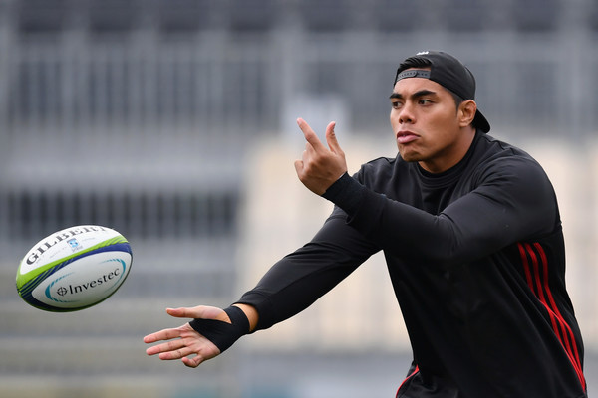
Biomechanics
Why spin a rugby ball?

Slide 2
Recap - Linear Motion Descriptors
Distance
Displacement
Speed
Velocity
Acceleration / Deceleration

Slide 3
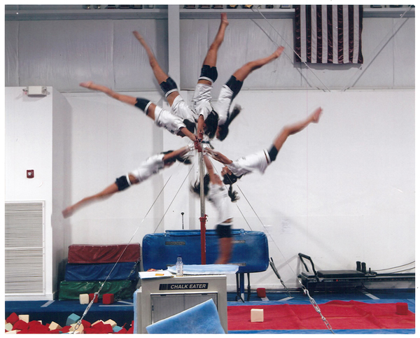
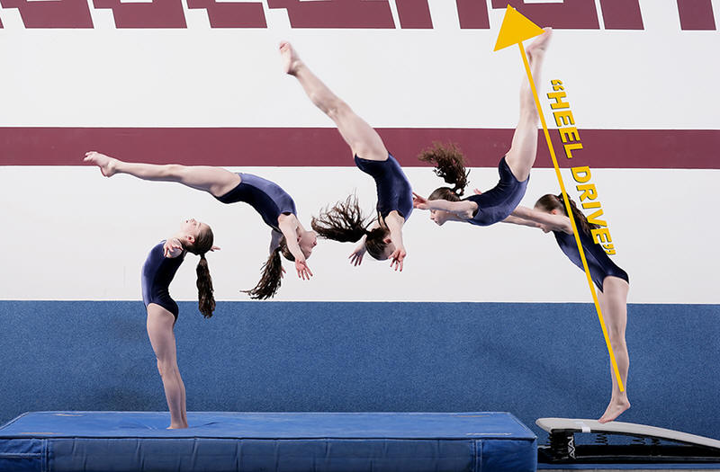
Introducing Angular Motion
Angular motion is the movement of a body (or a body part) in a circular path about an axis of rotation.

Slide 4
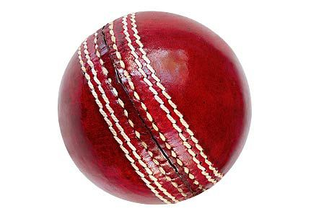
Angular Motion and Force
Think…how do we create Angular Motion using Force?
This results from an Eccentric Force being applied to a body
An Eccentric Force is a force applied outside the Centre of Mass, which results in Angular Motion
Torque is a measure of the turning force applied to a body

Slide 5
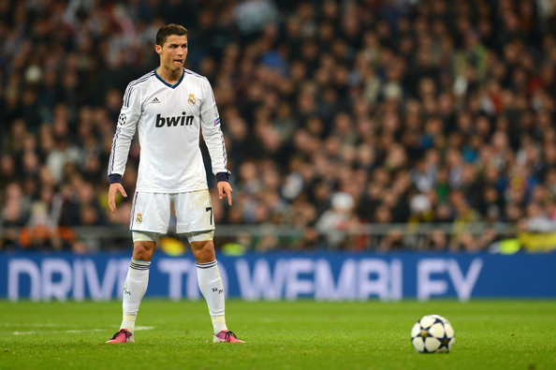

Slide 6
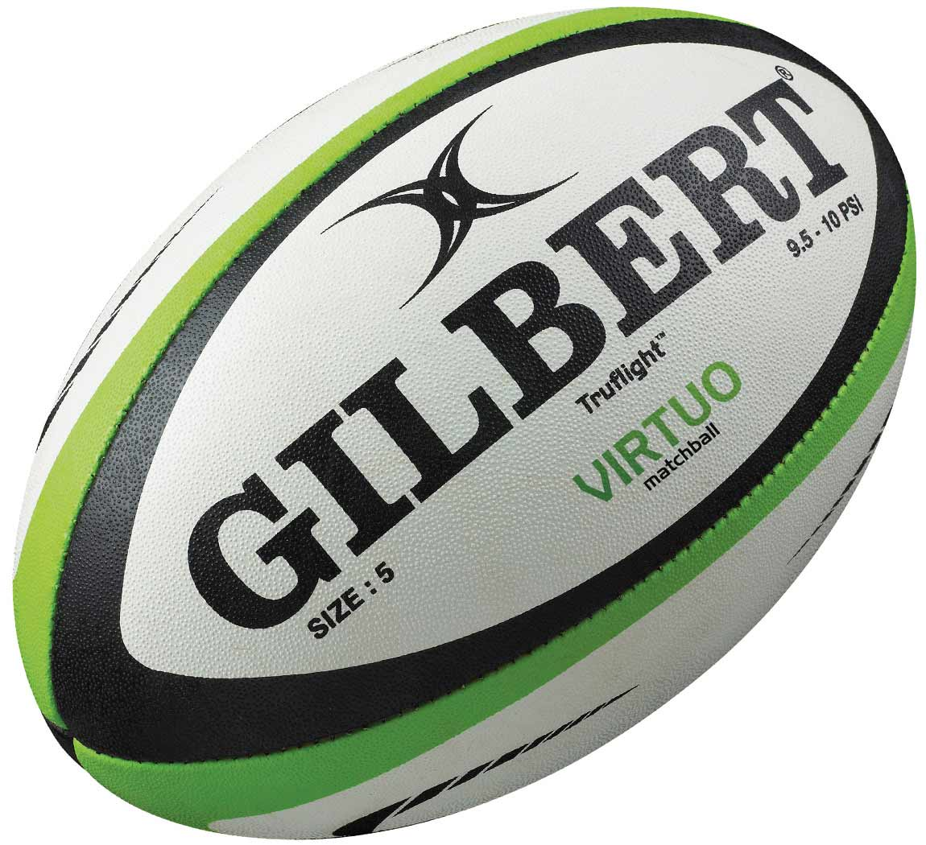
Practical
How can we describe the movement?

Slide 7
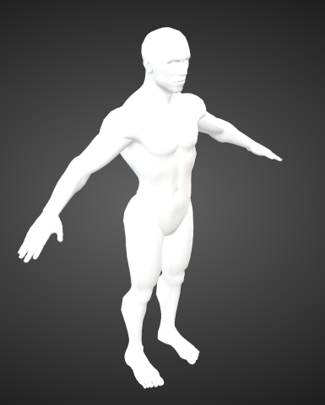
Principal Axes of Rotation
If an eccentric force is applied to a body, it will rotate around one or more principal axes of rotation.
A principal axis of rotation is an imaginary line that passes through the CoM about which the body rotates.

Slide 8
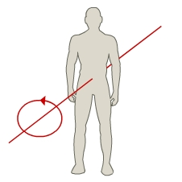
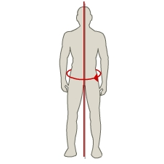
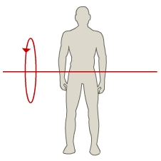
Longitudinal
transverse
Medial

Slide 9
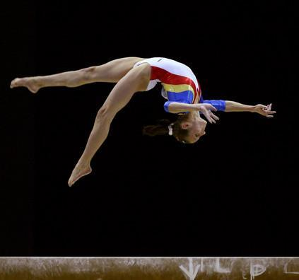
Think!
Using the pictures, identify which principle axis of rotation is being used…

Slide 10
Angular Motion Descriptors
Correct angular motion descriptors can be used to analyse technical aspects of performance
3 Key descriptors for angular motion are:
Angular Velocity
Moment of Inertia
Angular Momentum

Slide 11
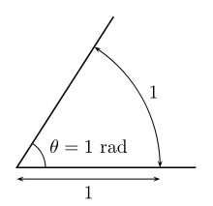
Measurements
Angular Motion is measured in radians
1 radian = 57.3 degrees
Angular Distance and Angular Displacement are both measured in radians
Angular Speed and Angular Velocity are both measured in radians per second (rad/s)

Slide 12
Angular Velocity
Angular Velocity is the rate of change in angular displacement
It’s the rate of rotation or rate of spin!
Angular Velocity (rad/s) = Angular Displacement (rad)/ Time Taken (s)

Slide 13
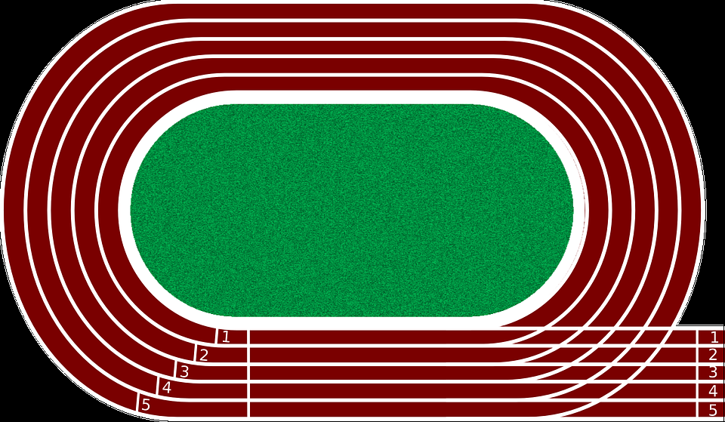
Angular displacement
The angular displacement is defined as the angle through which an object moves on a circular path. It is the angle, in radians, between the initial and final positions.
1) A runner goes around a circular track that has a diameter of 8.5 m
(radius)r = 4.25 m.
If he runs around the entire track for a distance of 60 m, what is his angular displacement?
θ = s/r
θ = angular displacement through which movement has occurred
s = distance travelled
r = radius of the circle.

Slide 14
How to work out the angular displacement?
θ = s/r
θ = angular displacement through which movement has occurred
s = distance travelled
r = radius of the circle.
1) A runner goes around a circular track that has a diameter of 8.5 m. If he runs around the entire track for a distance of 60 m, what is his angular displacement?
Answer: The linear displacement of the runner, s = 60 m. The diameter of the curved path, d = 8.5 m = 2r, so r = 4.25 m. Solve the equation for θ.
θ = s/r
θ = 60m /4.25 m
θ = 14.12 radians

Slide 15
How to work out the angular displacement?
The cake has a radius of 0.5 m. A bee lands on the cake and walks around the edge for a distance of 80 cm. What is the angular displacement of the bee?
Answer: The distance travelled by the bee
s = 80 cm = 0.08 m. The radius, r = 0.5 m.
θ = s/r
θ = 0.08m/0.5 m
θ = 0.16 radians

Slide 16
Angular Velocity
In physics, the angular velocity of an object is the rate of change of its angular displacement with respect to time. They rotate their legs around the
transverse axis anticlockwise at
2.18 radians in 0.4seconds.
What is their average Angular Velocity?
Angular Velocity (rad/s) = Angular Displacement (rad)/ Time Taken (s)
Angular Velocity (rad/s) = 2.18 (rad)/ 0.4 (s) = 5.45 rad/s

Slide 17
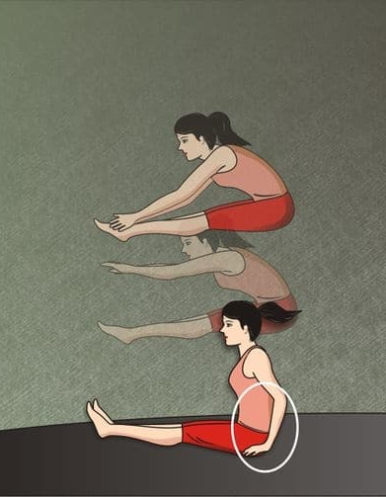
Angular Velocity
A trampolinist performs a seat drop.
They rotate their legs around the transverse axis clockwise at 1.69 radians in 0.3 seconds.
What is their average Angular Velocity?
5.63 rad/s

Slide 18
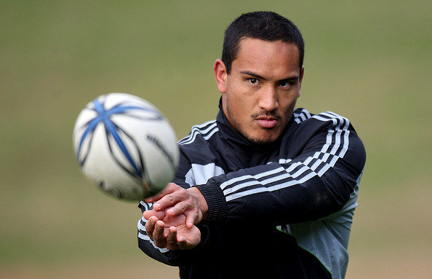
Create Angular Velocity
How can we, using a rugby ball and a marker, create and record the angular velocity?
Time
Radian

Slide 19
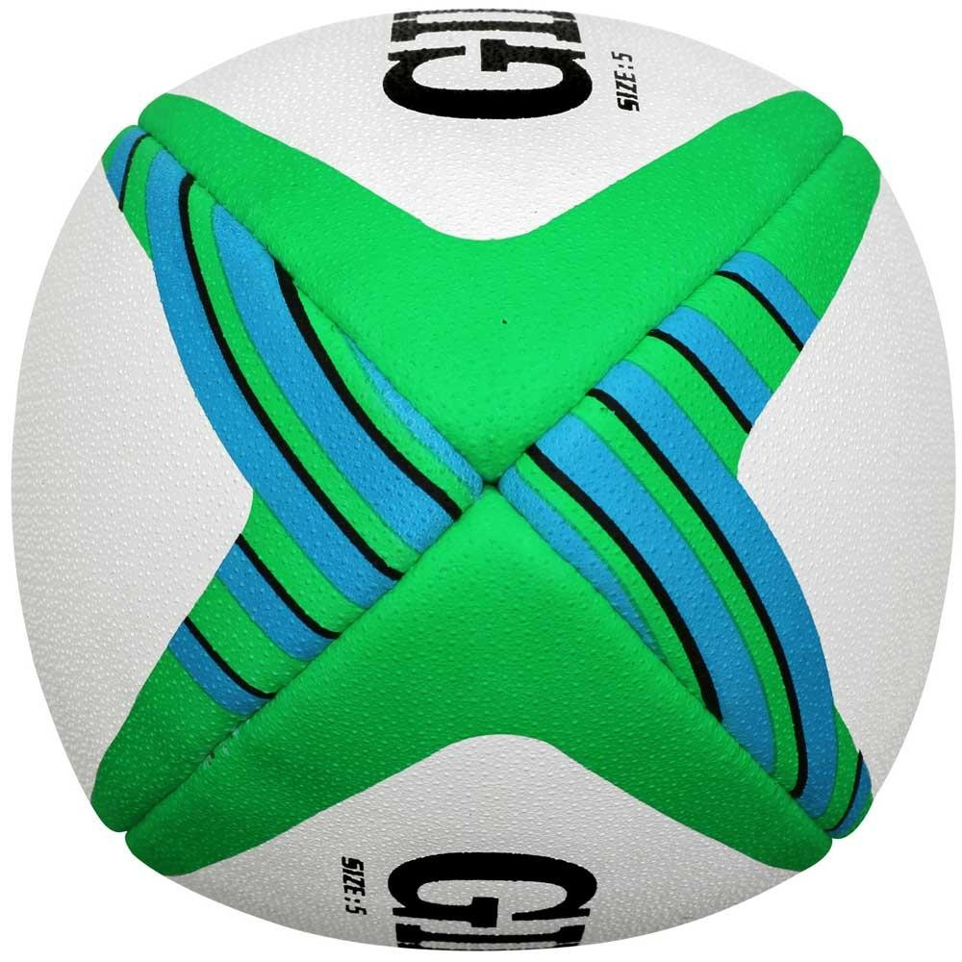
Angular Velocity
Radius = 10 cm
Distance travelled= 57cm
θ =
θ =5.7 (rad)
The ball rotates round the medial axis anticlockwise at …..
The ball rotates round the medial axis anticlockwise at ….. 5.7 (rad) in 0.2 secs
Angular velocity = 28.5 Rad/s

Slide 20
Angular Velocity
Radius = 10 cm
Distance travelled= 57cm
θ =
θ =5.7 (rad)
The ball rotates round the medial axis anticlockwise at …..
The ball rotates round the medial axis anticlockwise at ….. 5.7 (rad)
Angular velocity =

Slide 21
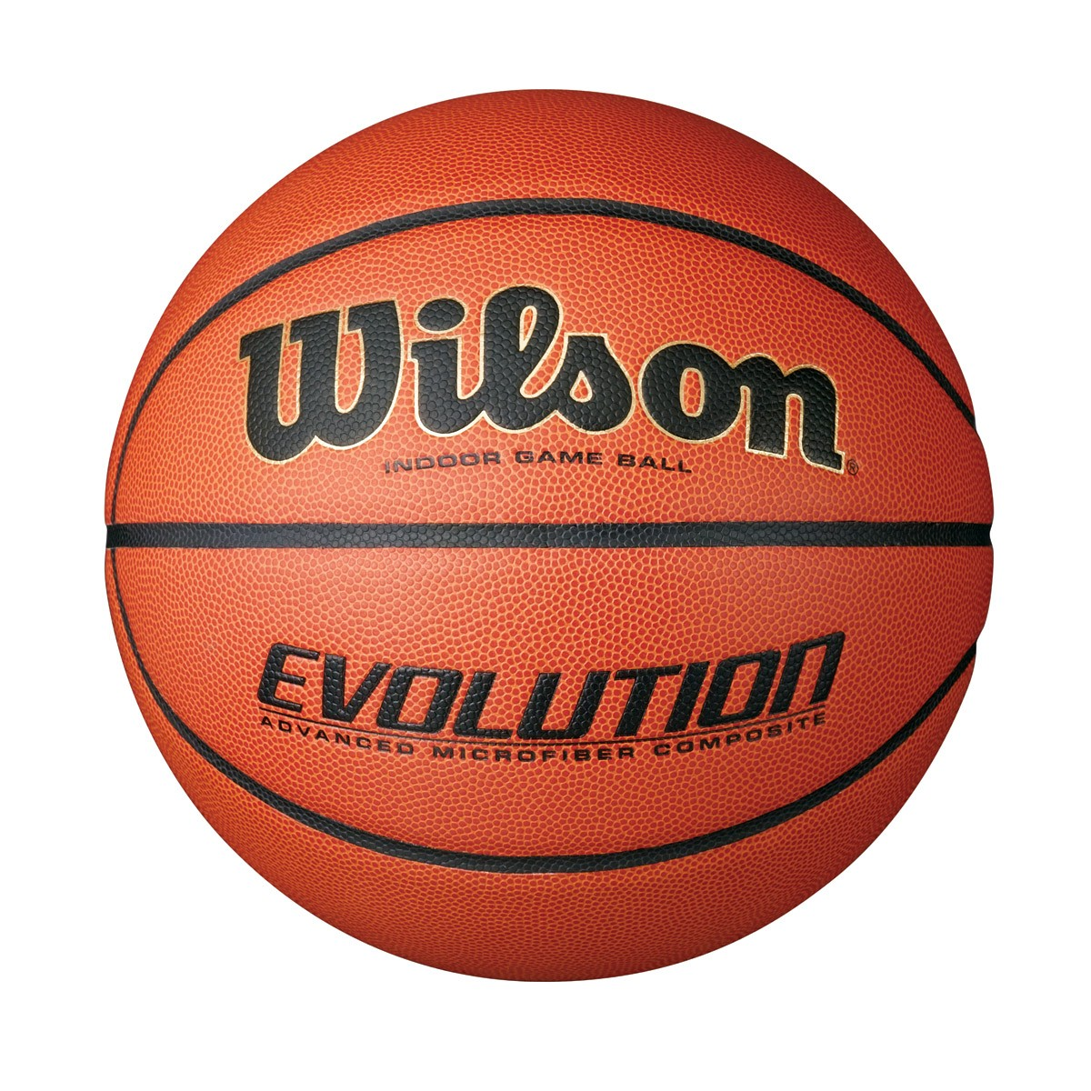
Angular Velocity
Radius = ……… cm
Distance travelled= ……..
θ =
θ = (rad)
The ball rotates round the ……………………anticlockwise at …..
The ball rotates round the medial axis anticlockwise at …..
Angular velocity =

Slide 22
Task
Using the data, draw a graph of Angular Velocity against Time for a somersault.
Explain the curve produced!
\\FUJI\Staff$\Sport\2016 - 17\Teaching Areas\A-Level PE 2016-18\trips\video of A level\Bounce trip
Time Taken (s) | Angular Velocity (rad/s)
0.00 | 0.0
0.05 | 6.0
0.10 | 12.0
0.15 | 17.5
0.20 | 21.5
0.25 | 24.0
0.30 | 25.0
0.35 | 24.0
0.40 | 21.0
0.45 | 13.0
0.50 | 4.0

Slide 24
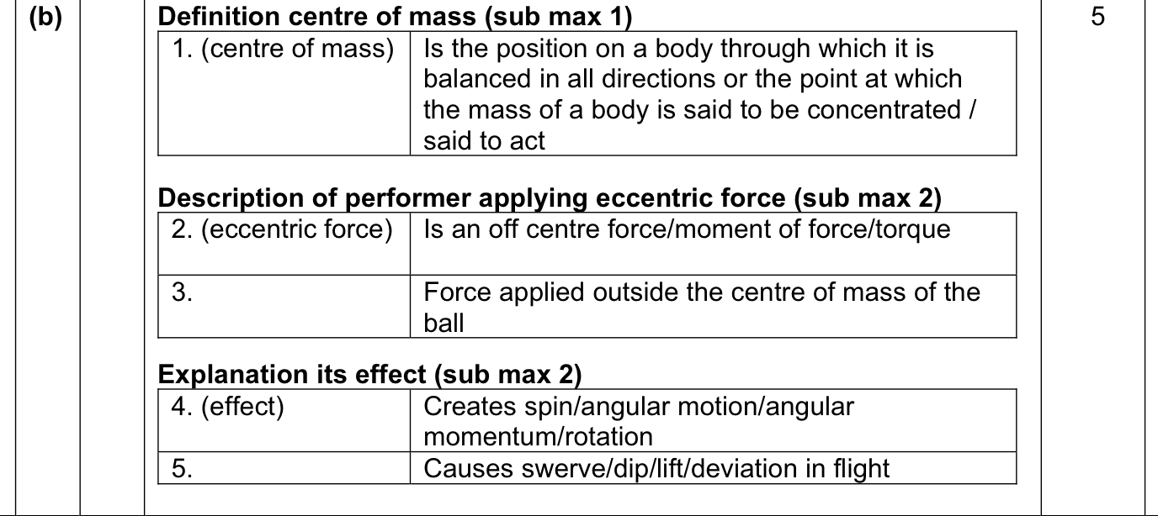
Exam Question

Slide 25
Exam Question

Slide 26
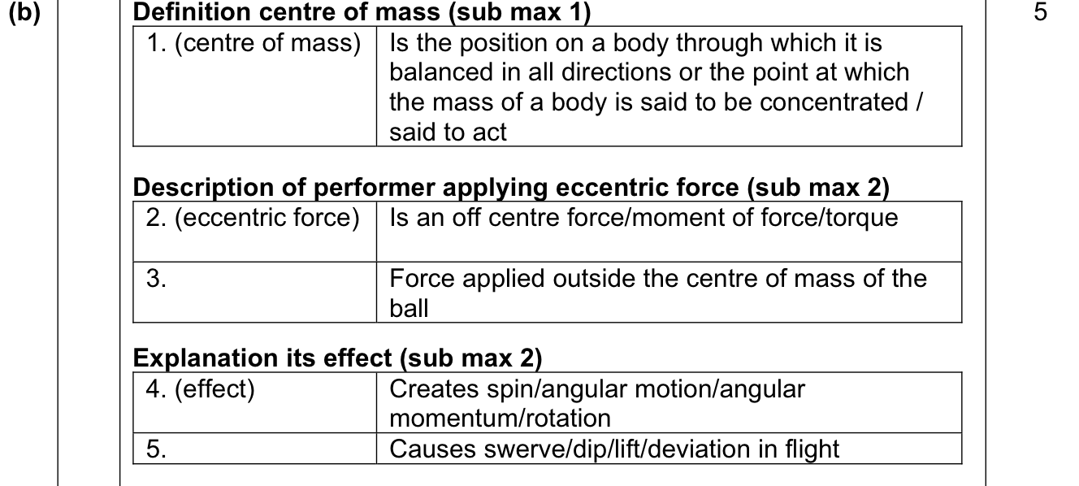

Slide 27
Why spin a rugby ball?
Angular momentum conservation.

