Slide 1
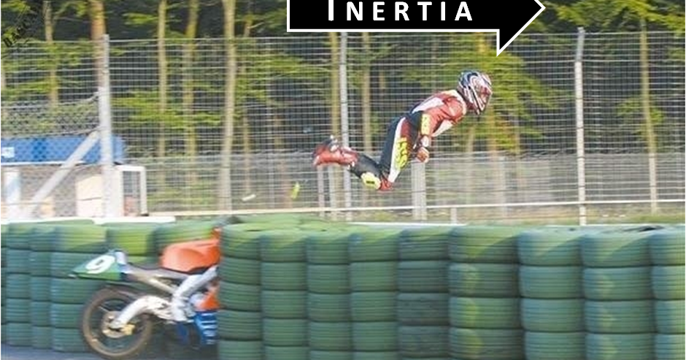
Biomechanics moment of inertia

Slide 2
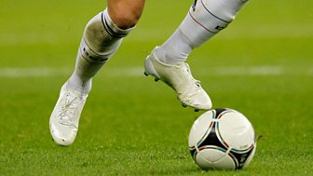
Recap
Calculate the angular velocity
Dis = 0.68m
r-= o.21m
Speed of rotation =0.6 secs
Angular velocity =
Angular velocity = 5,4 rad/s

Slide 3
Angular Motion Descriptors
Correct angular motion descriptors can be used to analyse technical aspects of performance
3 Key descriptors for angular motion are:
Angular Velocity
Moment of Inertia
Angular Momentum

Slide 4
Why spin a rugby ball?
Conservation on angular motion.
Reducing the affect of rotation in other axis.
Maintains aerodynamic shape.

Slide 5
How can a skater spin for so long?

Slide 6
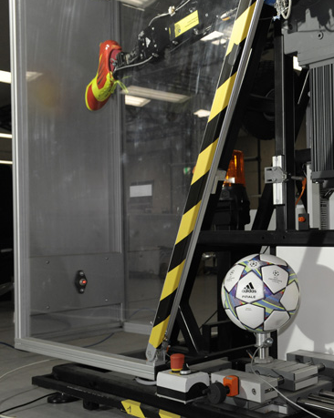
Moment of Inertia (MI)
MI is the resistance of a body to change its state of angular motion or rotation.
A resting body will not want to start rotating around an axis and a rotating body will not want to change it’s angular motion. It will resist increases and decreases in spin.

Slide 7
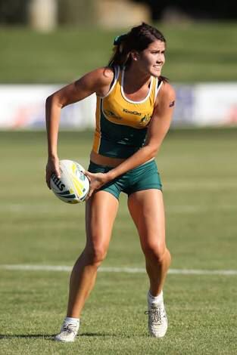
Moment of Inertia (MI)
MI is the angular equivalent of inertia.
Moment of Inertia = sum of (mass x distribution of the mass from the axis of rotation)
MI (kgm2) = ∑m (kg) x r2 (m2)

Slide 8
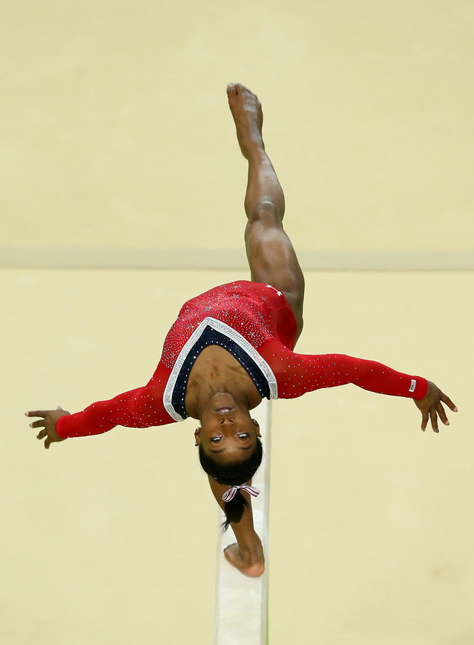
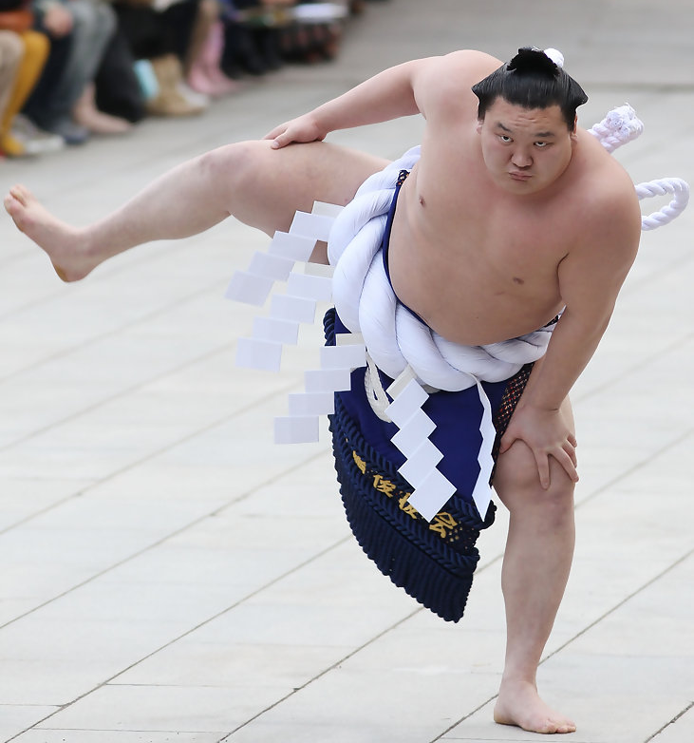
Mass
Think…why do gymnasts and divers not have high body mass?
The greater the Mass of the body, the greater the MI
Low Mass decreases MI and so rotation is easier (starting, stopping and changing rate of rotation)

Slide 9
Factors Affecting MI of a Rotating Body
Mass (kg)
Distribution of Mass from the axis of rotation

Slide 10
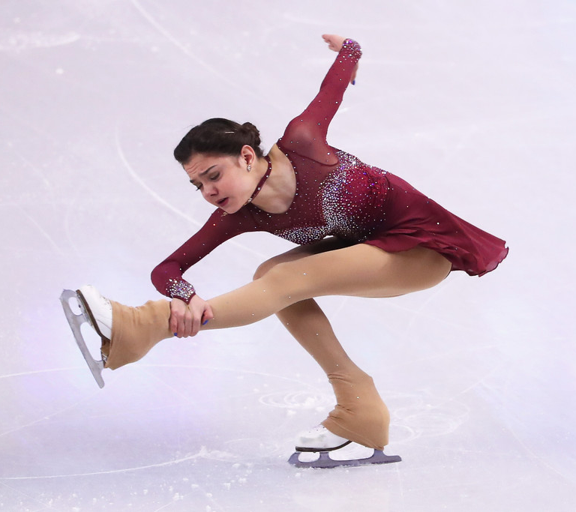
Distribution of Mass from the Axis of Rotation
The further the mass moves from the axis of rotation, the greater the MI
Close mass distribution decreases MI and so rotation can be quicker around the transverse axis

Slide 11
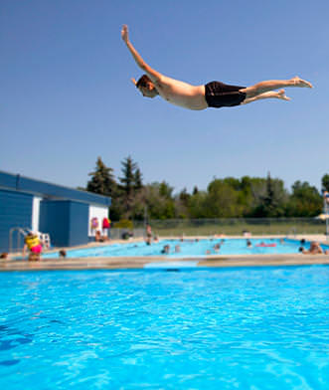
Distribution of mass from the axis of rotation

Slide 12
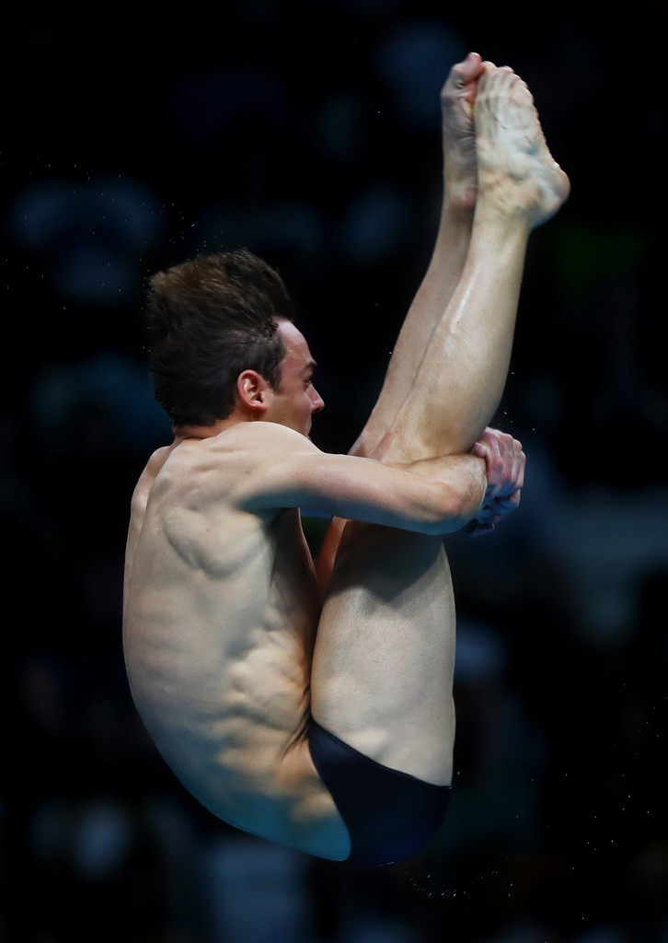
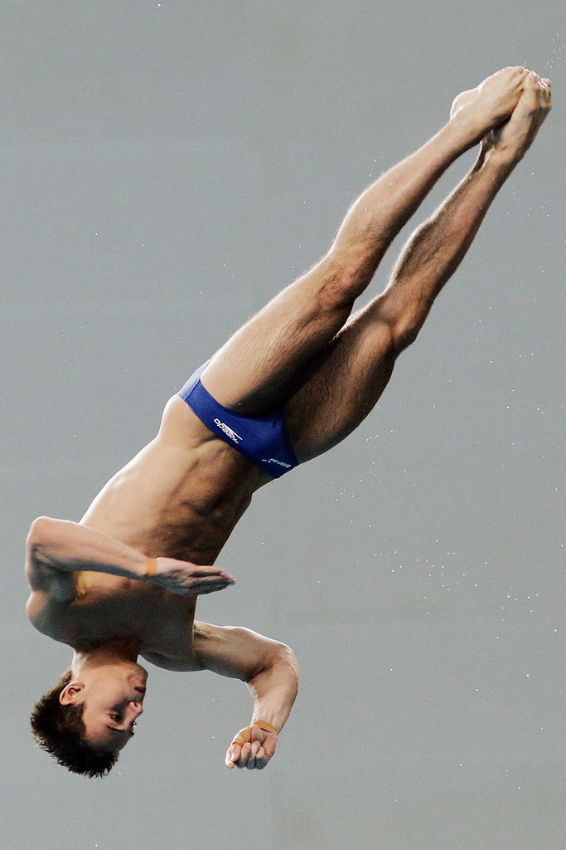
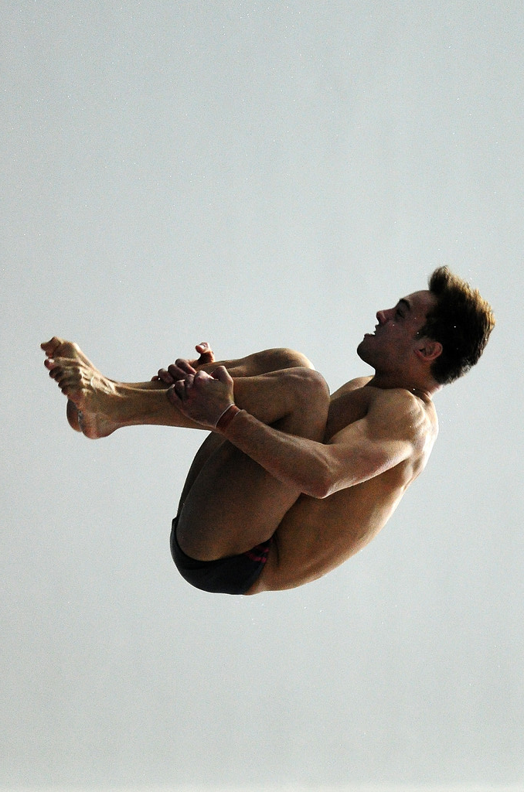
Think…
Look at the three pictures. Which one has the lowest Moment of Inertia (MI)? What is MI affected by?

Slide 13
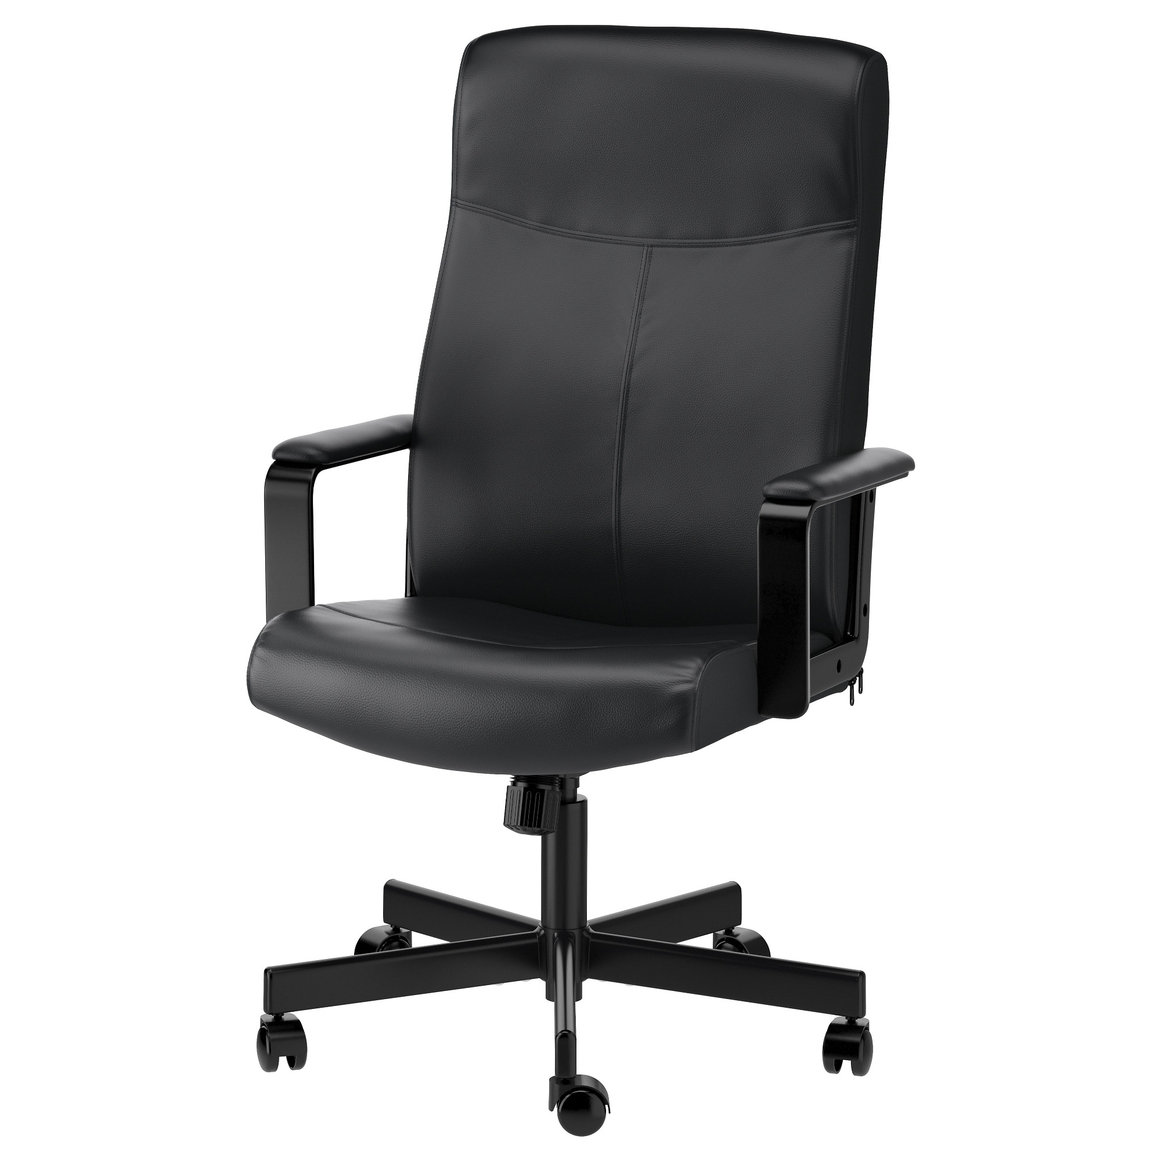
What is the relationship between MI and angular velocity?

Slide 14
Moment of Inertia (MI) and Angular Velocity =(W)
MI has a direct effect on Angular Velocity…
If MI is High, resistance to rotation is high and so Angular Velocity is low (spin slowly)
If MI is Low, resistance to rotation is low and so Angular Velocity is high (spin fast)

Slide 15
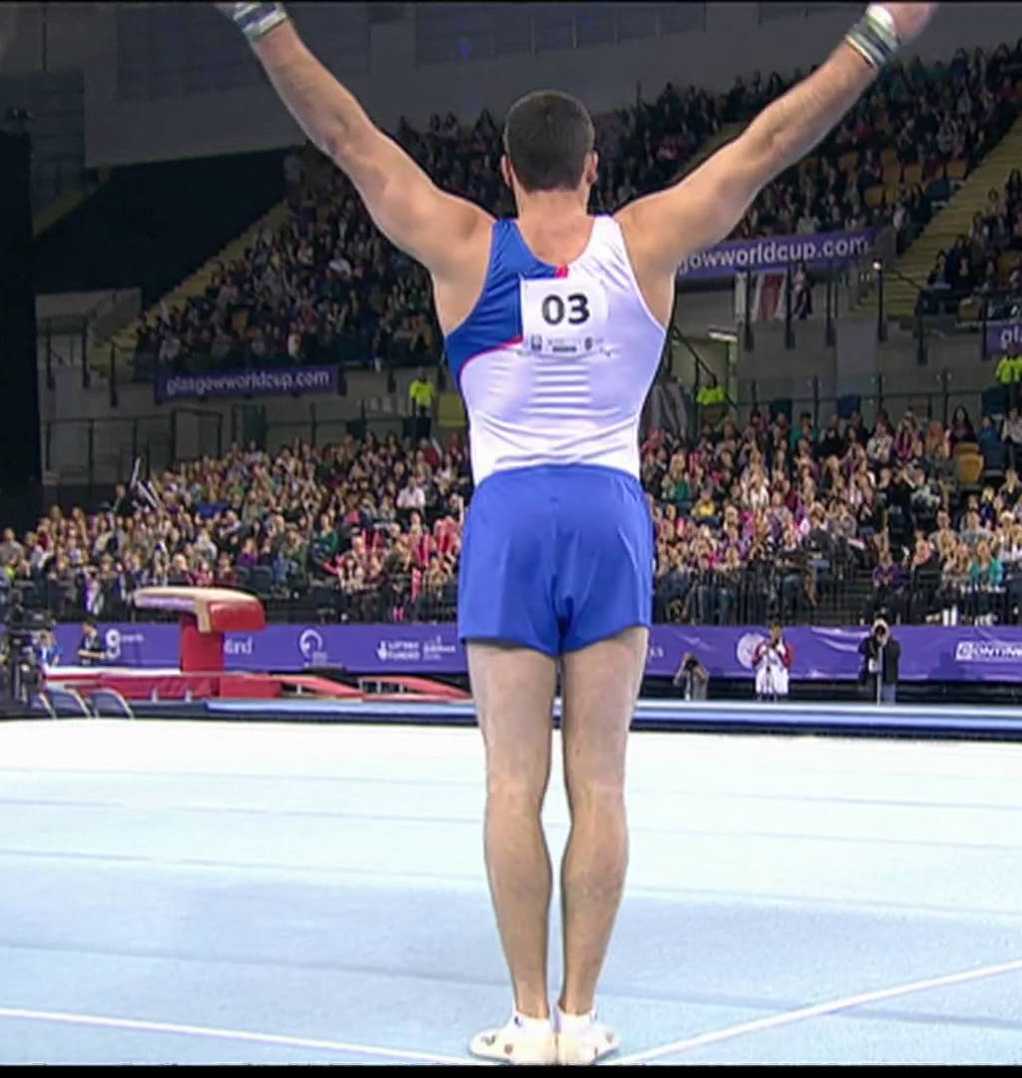
Manipulating the Moment of Inertia
Can you think of any specific movements, techniques of actions that have high or low MI?
How can gymnasts / skaters / divers manipulate MI to perform more complicated movement patterns?

Slide 16
MI and angular velocity
Describe what is happening through the 1 ½ somersault.

Slide 17
MI and angular velocity

