Slide 1
Acquiring Movement Skill
Classification of Motor Skills and abilities

Slide 2
Objective: Classify movement skills by placing them on a variety of continua.
Task 1 booklets
Guess the sport: List five skills for a specific sport.
They need to be really specific so we can immediately identify which sport is being described.
Sport_____________
Passing,
Too vague.
Rucking
Mauling
Drop kicking
Place kick
Spin pass

Slide 3
Task 2: List five words that describe the performance

Slide 4
Task 2: List five words that describe the performance

Slide 5
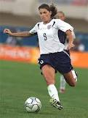
list five words that reflect this performance

Slide 6
Definition of Skill
The learned ability to bring about the predetermined result with the maximum certainty often with the minimum outlay of time energy or both.

Slide 7
Skill characteristics
Consistent
Aesthetic
Learned
Goal directed
Predetermined
Organised
Recognisable
Efficient

Slide 8
Consistent
Able to execute action with maximum certainty
Learned
Through practice and experience
Aesthetic
Looks controlled, effective and effortless
Goal directed
Intention to do it not just luck
Organised
Predetermined
Have an aim to achieve
Efficient
Minimum of time and energy
Recognisable

Slide 9
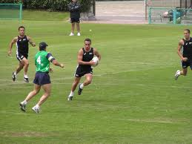
Intellectual Skill
Skills that involve thought process.
E.g., problem solving, planning, strategies, tactics to outwit your opponent.
In pairs come up with two examples in your own sport.
Deciding to kick over instead of run through as the opponent is slow to turn.
Other examples could be ………
Formation.

Slide 10
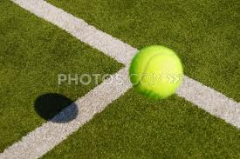
Perceptual skill
Perception
Detecting and interpreting, making sense of information in the environment.
I.e., interpreting the speed of the support player you need to pass to.
Detecting the speed and direction of a ball as it comes over the net in tennis.
Position of others players in a netball game, to judge the flight of a ball.

Slide 11
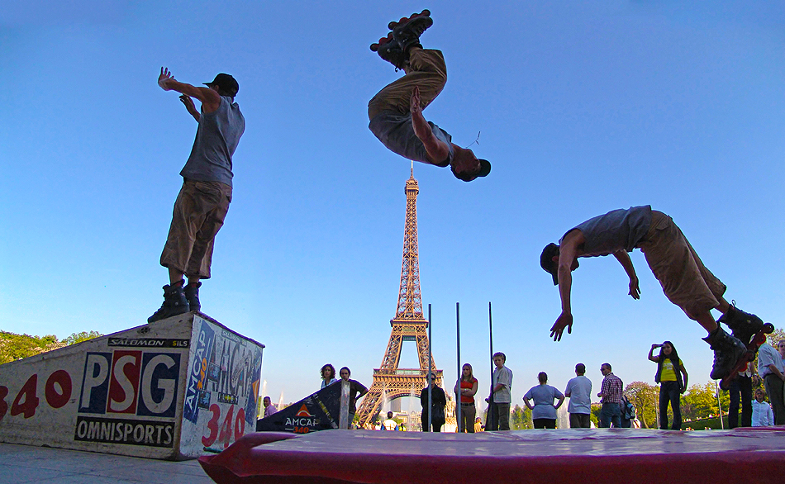
Motor Skill
When you see this term think of movement.
Skill which involves physical movement and muscular control.
Smooth executing movement
E.g., passing the ball, shooting, completing a forward roll.

Slide 12
Task 4 Look at this video of the number 10/19 and see if you can identify different types of skills.

Slide 13
Classification of motor skills

Slide 14
Classification of motor skills
Many skills have similar characteristics
But some skills can also depend on the circumstances so to overcome these as problems in classifying skills we use a continuum.
Continuum
An imaginary line between two extremes which shows a gradual increase/decrease in the number of characters.

Slide 15
Left handed Right handed
Left footed Right footed
Play team sport Play individual sport
Skill fitness
Which sports have large muscle movements and which have fine?

Slide 16
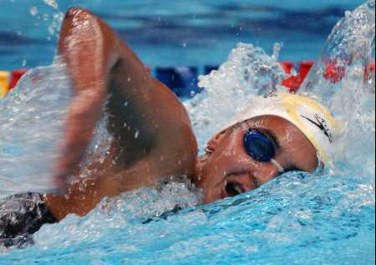
Muscular involvement- Gross- Fine Continuum.
This is based on the degree of the bodily involvement and the precision of the movement needed to execute the skill.
Gross skill
Describe what this is.
Involves large muscle movement and little need for precision.
Large muscle groups

Slide 17
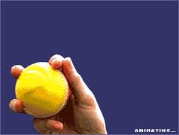
Muscular involvement- Gross- Fine Continuum.
Fine Control
Involves intricate movement using small muscle groups.
Can you think of sports or action that need this fine control?
Involves accuracy and emphasis, hand-eye co-ordination.
Wrist, finger action of spin bowler, shooting, throwing a dart.

Slide 18
Your sports.
Look at the continuum on page 8 and place a skill from your sport on the continuum
Draw the continuum on the white boards and then place each of the 7 skills.
Pick two of the skills and justify the reason you have placed them in that position on page 8.

Slide 19
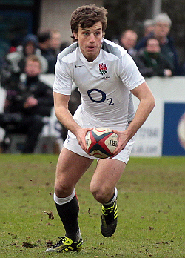
Environmental
OPEN CLOSED
We are concerned with how environmental conditions affect the movement skill.
Taking into account surroundings, team mates, opponents. This can also be weather.
So take the actions and place them on the continuum.
Remember to justify why you have places them where you have.
PASSING IN RUGBY

Slide 20
Criteria for Environmental Influence
Involves motor skills affected by environment
Perceptual and involve decision making
(adaptations and variations)
Externally paced in an unpredictable environment.
E.g., Passing in rugby, receiving a ball in netball.
Motor skill not affected by environment
Skill habitual-aim is to reproduce same technique model.
Self paced
Forward roll, gymnastics through vault, tennis serve.
Open Skill
Closed Skill

Slide 21
Task on page 9.
Justification for selection using the right terminology.
Ensure you are specific with example and justification.
If it’s vague you won’t get marks.

Slide 22
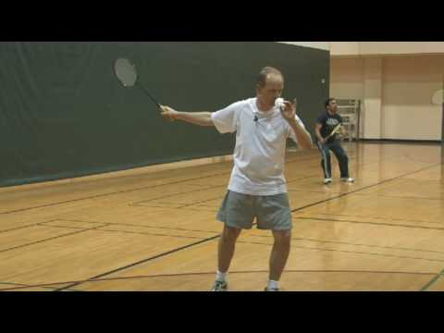
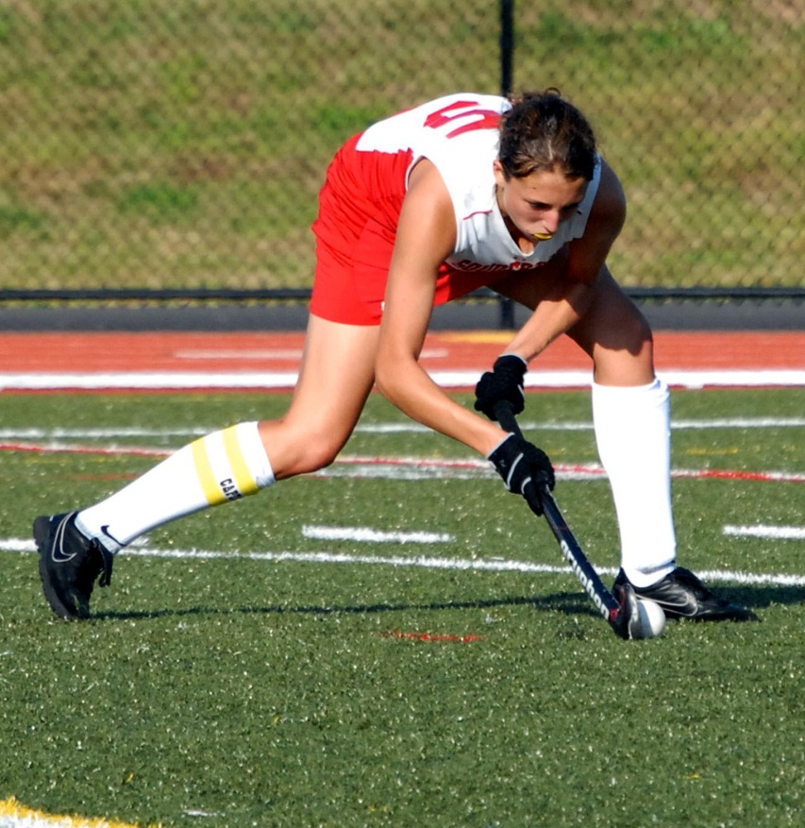
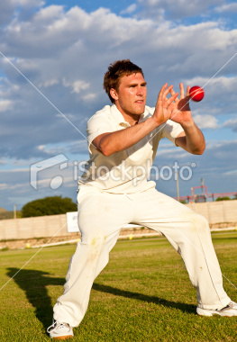
Continuity Continuum Discrete, serial, continuous
Discrete Skill
Motor skill that has a clear start and finish.
To be repeated it must start again, (single brief skill)
E.g.,……..

Slide 23
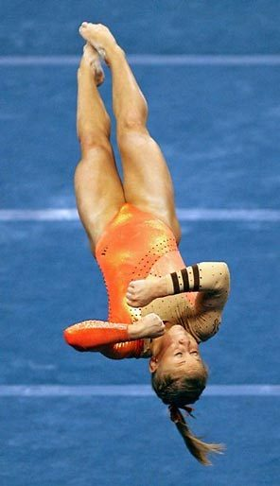
Serial Skill
A motor skill that has a number of discrete skills put together in a set order to make the sequence.
What example can you think of?

Slide 24
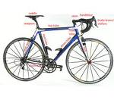
Continuous
Motor skill with no definite beginning or end
End of one cycle of movement is start of next.
Movement to be repeated several times to mean anything.
E.G.,………….

