Slide 1
Sports Psychology
anxiety

Slide 2
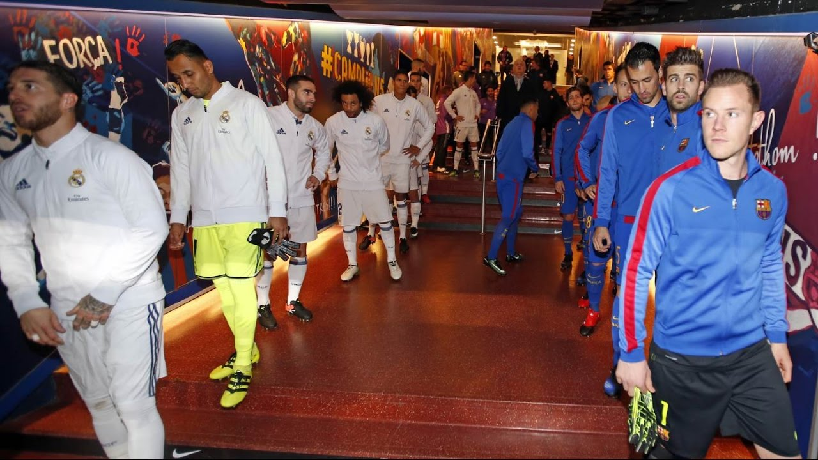
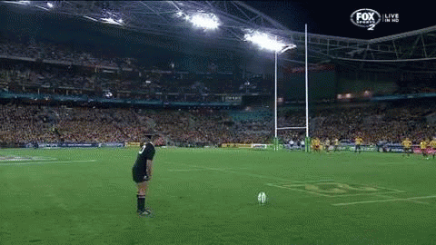
Anxiety is a negative experience of stress and can be caused by worry or apprehension. Perhaps due to the fear of failing in a competitive situation.

Slide 3
Forms of Anxiety: Second Dimension
In addition to the somatic and cognitive dimensions of anxiety, there is a second dimension relating to the stability of anxiety:

Slide 4
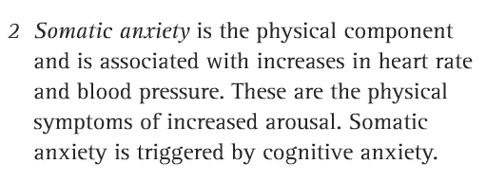
Two Forms of Anxiety

Slide 5
Task a
What would make you anxious in a sporting competition?
Can you relate any of these factors to any other models / theories / explanations within the Sports Psychology unit?

Slide 6
Factors Affecting Competitive Anxiety
Fear of failure / making mistakes
Fear of evaluation / fear of crowd
Fear of competition importance
Fear of injury / danger
Lack of control of the opposition / referee / pitch
Type of task involved

Slide 7
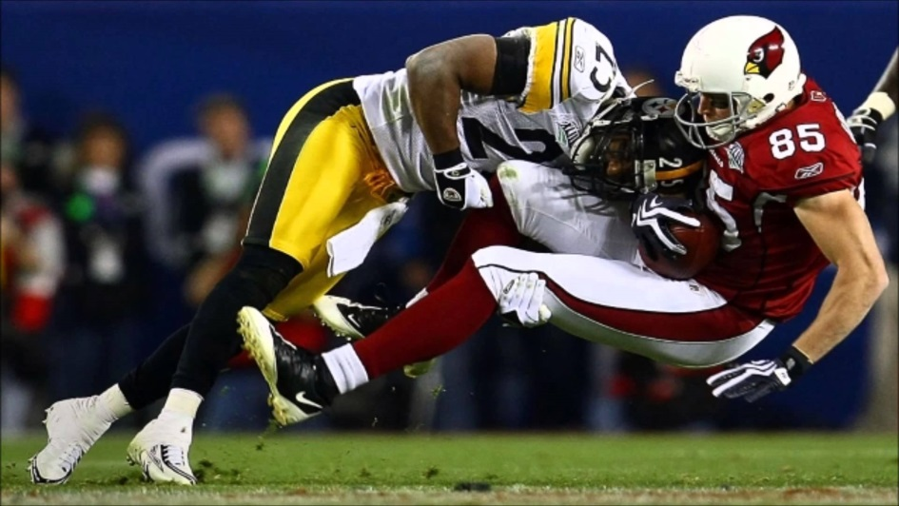
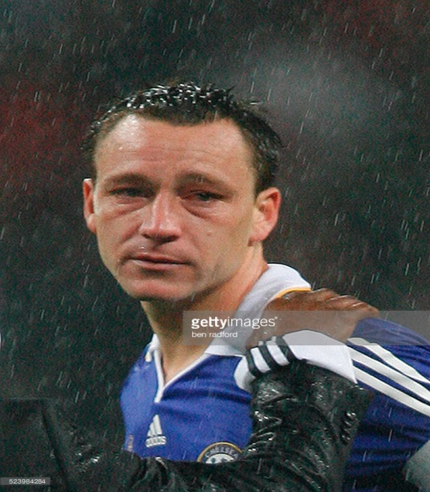
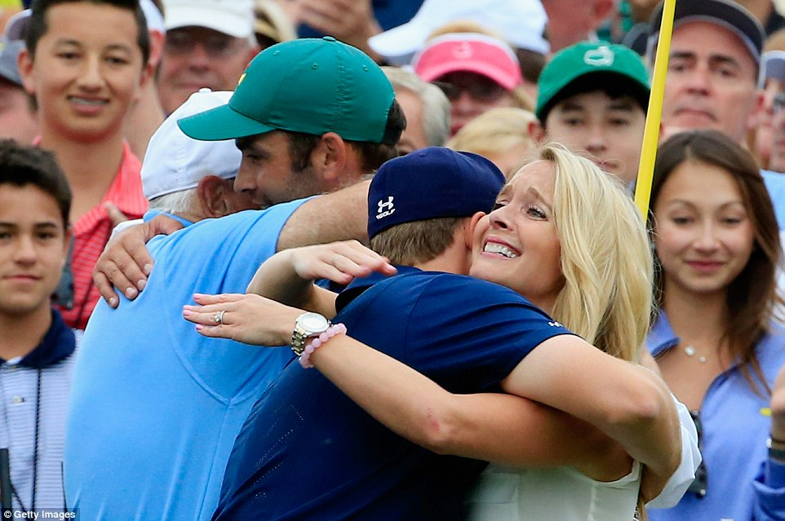
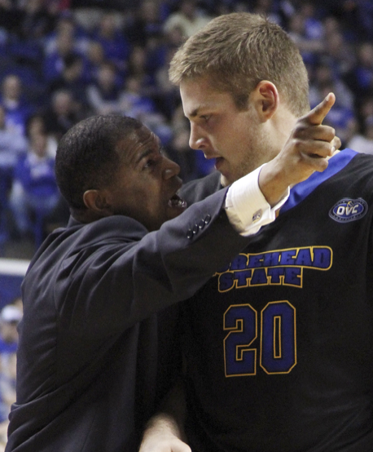
anxiety
Describes our feelings of being threatened.
Threat of physical harm
Threat to self esteem
Threat of letting other people down
Threat/fear of being punished.

Slide 8
anxiety
Situational differences
Friendly vs Cup Final
Some appear to be able to cope with anxiety and remain calm. others which includes some experts can become extremely stressed.
Trait anxiety
High trait means more likely to experience high anxiety in a situation, other situations can also cause high anxiety.
Competitive anxiety worry and fear experienced during or about competitive experiences
Competitive trait anxiety
Experience anxiety in perceived competitive situations.
The competition process
Interaction between, situational, trait, and competitive anxiety.

Slide 9
A league game for the college side
A game in training
A league game for the college side
A training game
A cup final for the college side (competition
A non-competitive game
The competition process
Interaction between, situational, trait, and competitive anxiety.
If trait anxiety high, can, will have higher state anxiety, or in competition.
If trait anxiety low can, will have lower state anxiety, or in competition.

Slide 10
Explain state anxiety and trait anxiety using a practical example. (sub max 5)
9. Example showing de-motivation due to anxiety/giving up or avoidance
behaviour eg giving up playing tennis
10. Example showing lack of concentration or missing important cues eg
missing the ball in hockey
11. Example showing that it can lead to losing control or losing temper or
being overly aggressive eg losing your temper in a game of football
12. Example showing that worrying can lead to mistakes/poor techniques
or skill production eg putting technique fails in golf when anxious
State
1. (Situation) anxiety arising from a specific situation/
Incident/temporary situation/person/environment/cue.
2. (Fear of losing/trying to win) often due to fear of losing or failing/
Competition/competitive state anxiety/pressure of trying to win.
3. (Fear of injury) fear of being threatened/or actually threatened/fear of injury/harm
4. (Embarrassment) fear of being embarrassed/self-esteem being harmed/ fear of pride being hurt.
5. (Arousal) when arousal is high in any given moment then more
Likely to get anxious.
Trait 6. (innate) Anxiety that is innate / in-built/genetically determined or
born with it or natural anxiety/ a pre-disposition/ part of
your personality.
7. (generalised) Generalised / expressed/felt in most/many/all situations/circumstances or is predictable
8. (enduring or stable)
Enduring/lasting/more permanent or stable/unchanging.

Slide 11
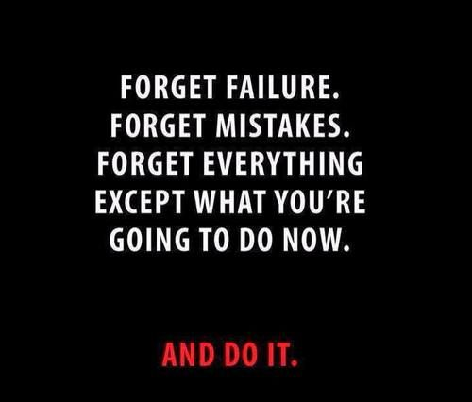
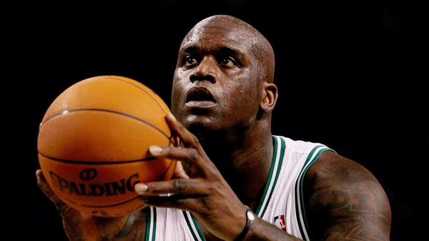
Measuring and reducing anxiety.
SCAT
Sports competition anxiety test.
SCAT measures the anxiety of a performer.
Results closely linked to State anxiety a performer feels before competition.
Valid prediction of competitive anxiety
Cognitive state anxiety increases as the competition approaches, although not just before the competition.
Somatic state anxiety tends to be low leading up to competition but increase shortly before the competition.
Catastrophe!

Slide 12
Anxiety Management
Essentially, there are two main types of anxiety management techniques:
Somatic Anxiety Management - relates to physical symptoms
Cognitive Anxiety Management - relates to thought processes and feelings
The controlling of anxiety can help to recreate circumstances where the performer feels confident and focused with their performance.

Slide 13
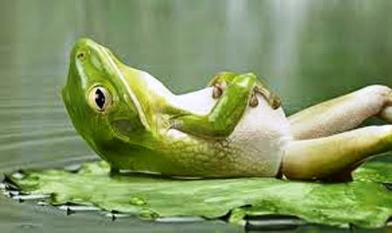
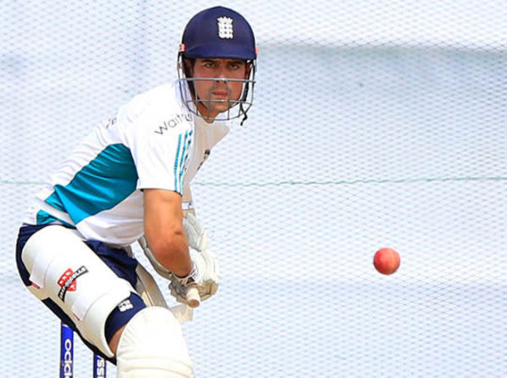
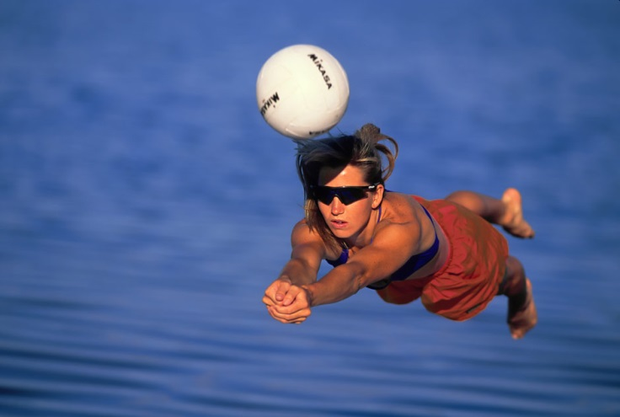
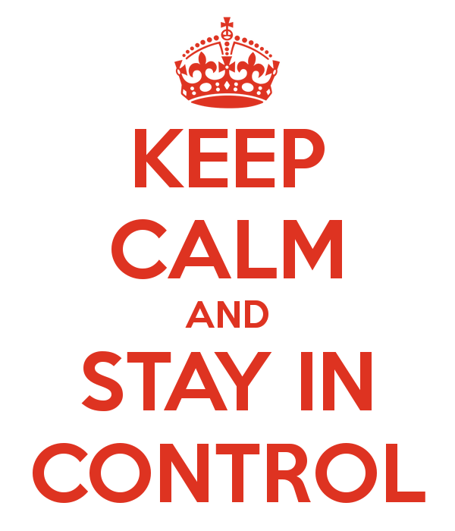
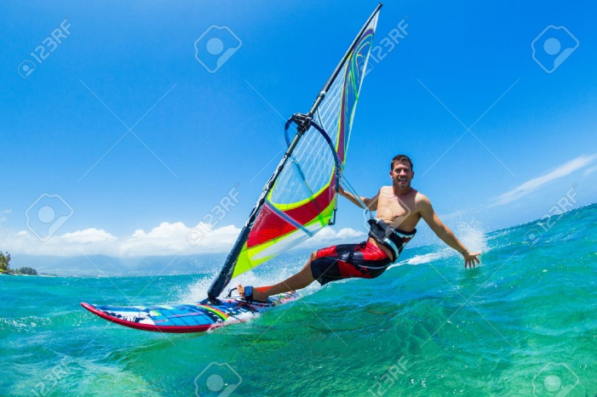
manage anxiety

Slide 14
Videos!
Imagery
https://www.youtube.com/watch?v=Htw780vHH0o
Biofeedback
https://www.youtube.com/watch?v=q9Nsm1U0CpY
PMR
https://www.youtube.com/watch?v=TwCITgdBzI4
Positive refocus
https://www.youtube.com/watch?v=0V5ZzXbWuq8

Slide 15
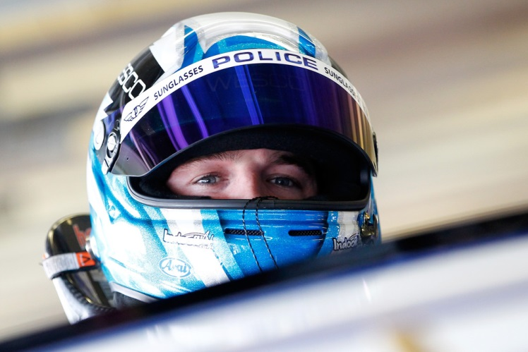
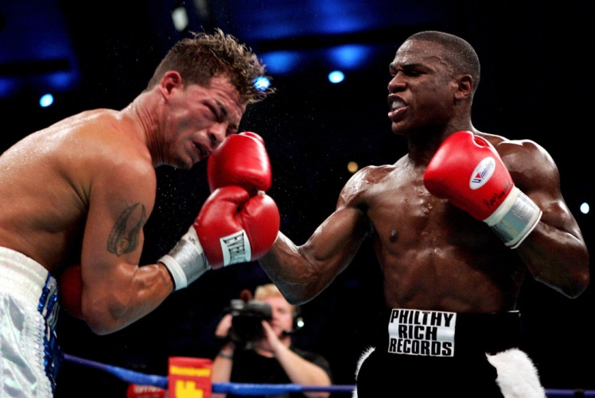
Think – Problems!
What are the main disadvantages of anxiety management techniques?
Can you use them in a live performance?
What equipment is necessary – cost factor?
Do they rely on internal or external factors? How does this affect its use?

Slide 16
Critical Points of Anxiety Techniques
Difficult to apply in quick sporting situations
Individual needs to want to use the technique
Personality can affect anxiety management
Anxiety may actually cause problems with the technique application
Some research suggests techniques actually work
Some equipment not realistic to use in a sports situation
Lack of time for PMR / Biofeedback

Slide 17
Task B
What factors can affect being in a peak flow state, or being in the optimal functioning state?

Slide 18
Anxiety – controlling this gives access to Peak Flow
Concentration – optimal arousal is achieved while keeping anxiety low
Confidence – developed trait confidence and self efficacy
Goal-Setting – success of goals, and tasks are difficult but attainable
Environmental Conditions – a comfortable environment!
Group Cohesion – common goals and good team realtionships
…would all increase chances / facilitate peak flow or optimal functioning!

