Slide 1
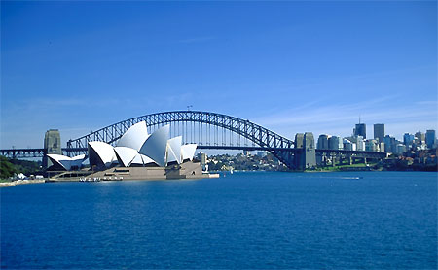
SPORT & CULTURE
AUSTRALIA

Slide 2
You are required to :
describe characteristics of Australia (young nation; sparsely populated; colonial influence and immigration);
• explain the nature of sport in Australia (social and cultural reasons for sport being a high status national pre-occupation);
• analyse the game of Australian rules football (origins; factors that shaped its development, including commercialism and impact of media).

Slide 3
Understand the characteristics of the country

Slide 4
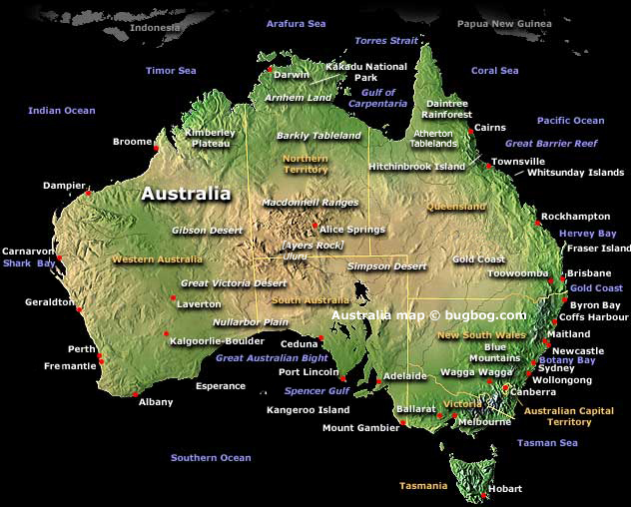

Slide 5
Vote with your feet.
Which do you prefer?
Australia England

Slide 6
Starter task
Note down on the white boards the characteristics of Australia
In other words what do you know about Aus.
Bullet point this onto the white boards.

Slide 7
Captain Cook
1770 first landed in Australia
10 years later an influx of British convicts were sent to Australia.
From this point forward (1800-1900) the population grew.

Slide 8
Young country
Not bad for 200 years old.
HOW DOES THIS RELATE TO SPORT?

Slide 9
True or false
All Australians stem from convicts.

Slide 10
Colonial influence
HOW DOES THIS RELATE TO SPORT?

Slide 11
COLONISATION
Colonisation =When a more dominant country takes over and rules the less dominant country. It also imposes it’s culture and sports, along with religion.

Slide 12
Sparsely populated
HOW DOES THIS RELATE TO SPORT?

Slide 13
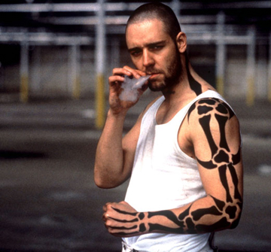
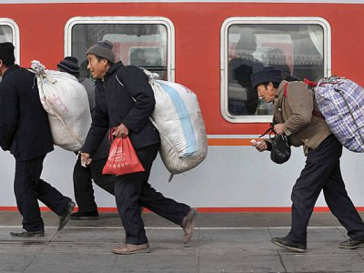
immigration
HOW DOES THIS RELATE TO SPORT?

Slide 14
Characteristics of Australia
Note which one the points will have the most influence on sport.
Colonisation?
Young population?
Sparse population? 21 million (same as in London)
Immigration?

Slide 15
Colonisation?
Young population?
Sparse population? 21 million (same as in London)
Immigration?
Influence of mother country sport e.g., rugby, cricket.
Want to be involved in sport, trendy, adventure seeking due to young age.
Plenty of space, genuine adventure opportunities, mountains, beaches, bush culture, variety of sports.

Slide 16
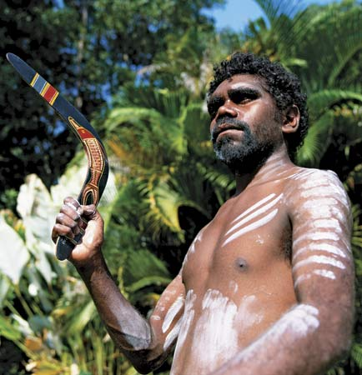
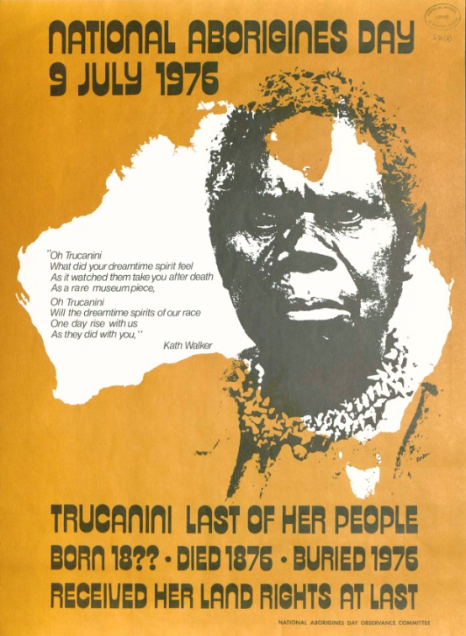
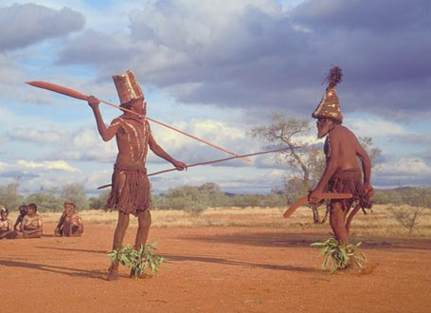
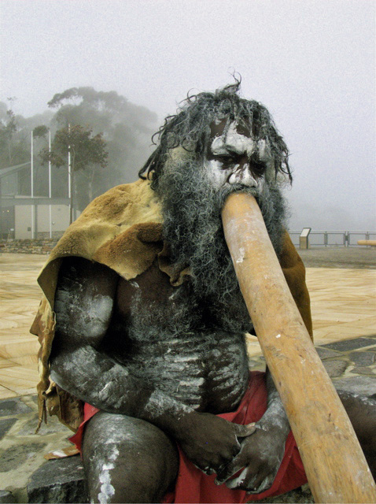
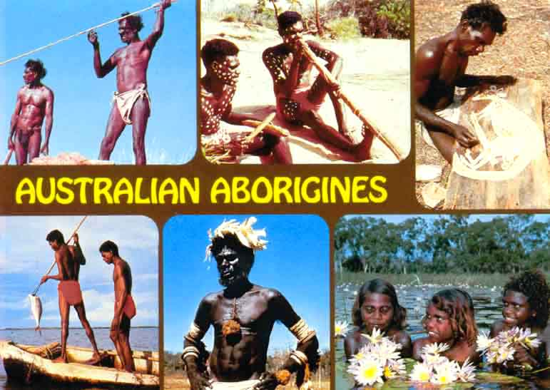

Slide 17
White Australian Policy
The White Australia Policy, the policy of excluding all non-European people from immigrating into Australia, was the official policy of all governments and all mainstream political parties in Australia from the 1890s to the 1950s, and elements of the policy survived until the 1970s

Slide 18
EFFECTS OF COLONISATION
Discrimination
Loss of old ways of playing
Ancient religions and rituals replaced by Christianity
Tribal hierarchical replaced by British systems of government and legislation
Schools vehicle for fostering British sporting pastimes
Administration/ organisation of sport

Slide 19
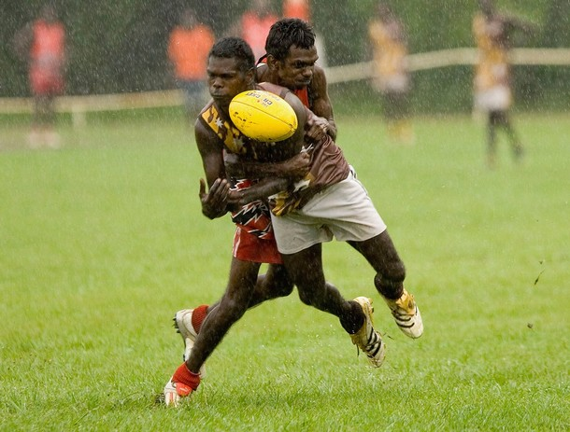
Indigenous sport
Aboriginal games lost due to suppression of indigenous populations in favour of colonial games
Tradition of discrimination against them from the early colonials and almost to the present day.

Slide 20
Aboriginal children assimilate into NSW local schools, if all other parents agree. This right of veto is removed in 1960.
Western Australia Aborigines Act is amended to permit Aboriginal people to be taken into custody without trial or appeal and to prevent them from entering prescribed towns without a permit

Slide 21
Attitude to the Aboriginals
What is being done by modern governments regarding the aboriginals?
Native Title Act 1994
Returning of some land rights back to aboriginals.

Slide 22
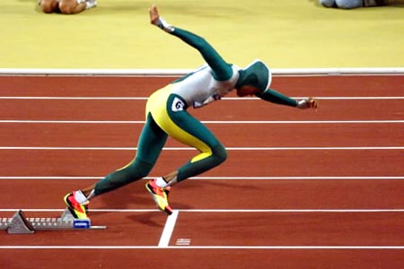

Slide 23
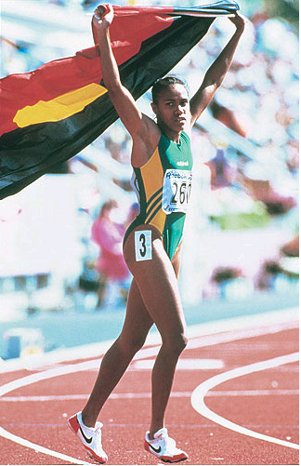
Cathy Freeman was this a
form of protest at the
treating of the aboriginals?

Slide 25
So what’s the nature of sport in Aus?

Slide 26
Sport as a national pass time
Sport has helped develop the identity of this young country.
Australians are obsessed with sports and competition.
90% of Australian take part in sport.
23% in England

Slide 27
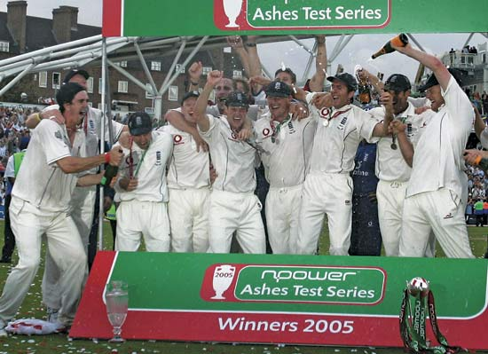
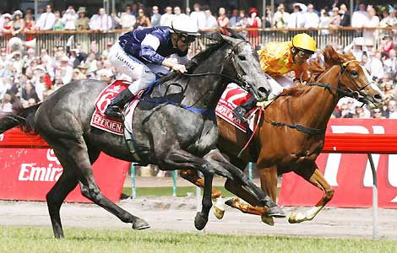
Sport as a national pass time
When we won the ashes 12.5% watched
When an Australian horse won a race in Melbourne 2004, 90% of Australia watched.

Slide 28
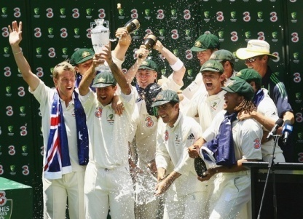
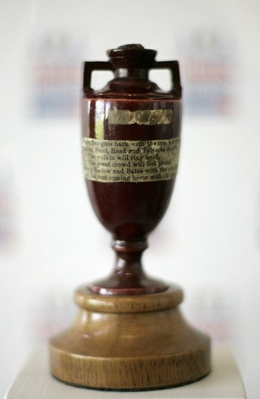
NEW IDENTITY
British colonies were ‘young countries’ & needed their own identity
Sport is clear way of establishing national identity
Test match = opportunity to prove themselves against their so-called superiors - victory against the Brits enhanced national pride

Slide 29
Why Australian sports have such high Status?
Read through the paragraphs on 248-249 on why sport has such a high status.
Which point do you think is the most important?
Can you explain your point and relate it to sport.
When making your point can you compare it against the UK to emphasise your point.

Slide 30
How to remember all of these.
S-
T-
R
E
T
C
H
Y
G
B
School sports
Topographic Trendy
Role models
Egalitarian
Tradition
Climate
Healthy economy
Young nation
Government support
Bush Culture

Slide 31
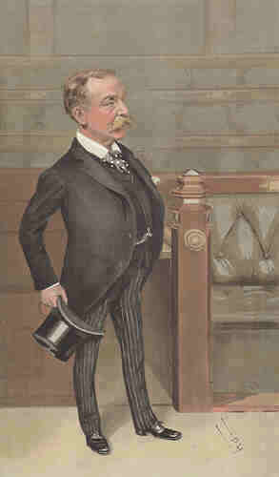
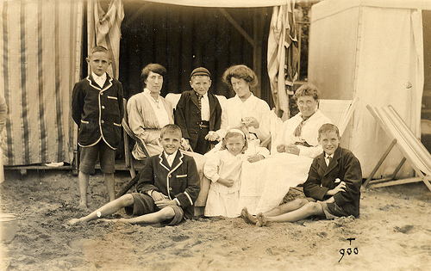
Egalitarian Society
Sports was and is for all, inequality of opportunity and provisions are lesson an issue than in the UK.
So everyone could play
There were no class restrictions
to play

Slide 32
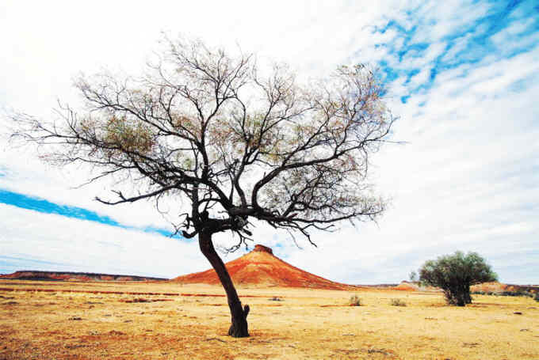
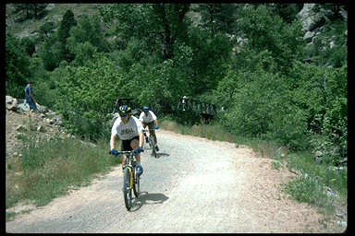
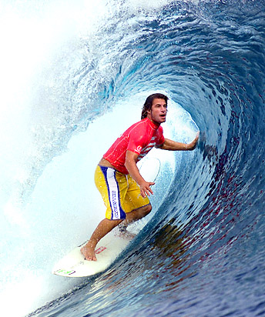
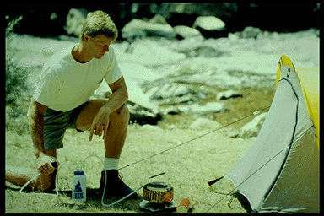
TOPOGRAPHY & SPORT
Australian land mass is largely uninhabitable and unsuitable for sport/ recreation
The landscape encourages Outdoor pursuits with residential camps being very popular – BUSH CULTURE
Lifestyle (outdoor/ farming/ active)
Climate
Coastlines – water sports
Terrain/ natural landscape (e.g. – beaches

Slide 33
The outdoor Life
Due to climate the norm is healthy conscious society adequate space and beaches.

Slide 34
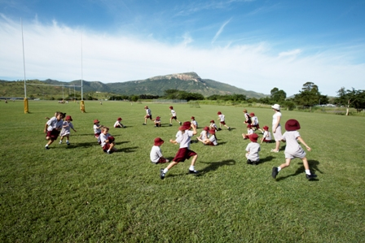
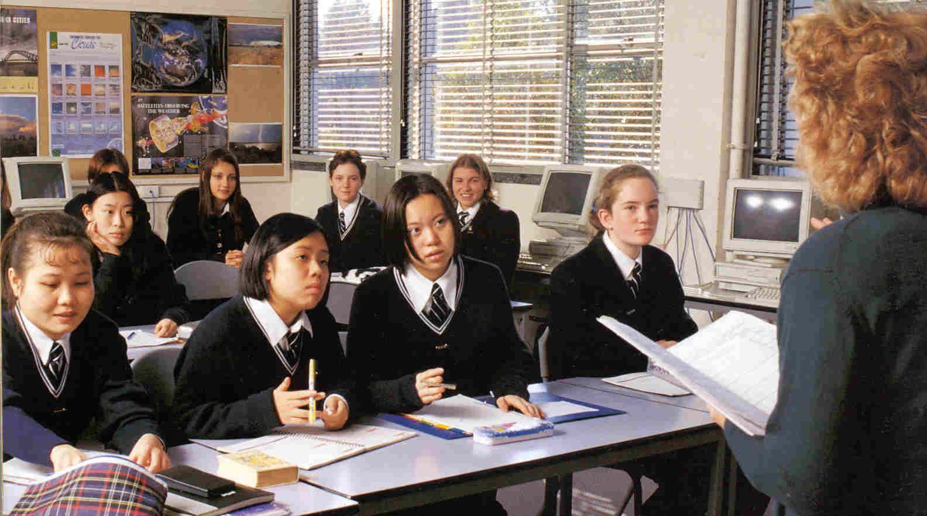
Compulsory in schools and has a high status. People are encouraged to do well.
SEPEP
Loose curriculum
Participation is priority/excellence is secondary.
Non-participants allowed not participant role, e.g., coach, ref.
Physical and Sport Education Courses (PASE):
professional development for teachers
Professional training courses in physical education
Guidance, helps teacher work better
PASE
WHAT IS SEPEP
The Sport Education in Physical Education Program (SEPEP) is a curriculum model for use in school physical education programs.
SEPEP relies on teachers and students to create a particular form of social system within physical education lessons known as student centered learning.

Slide 35
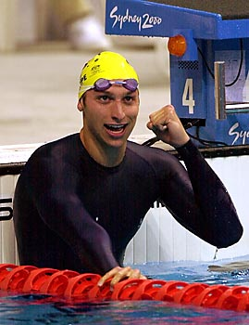
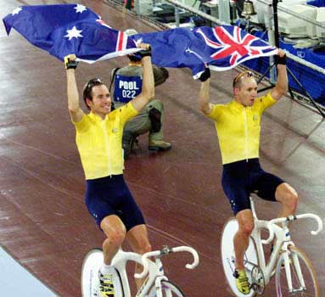
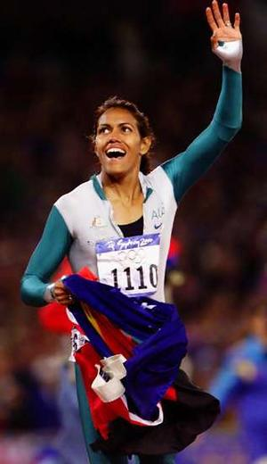
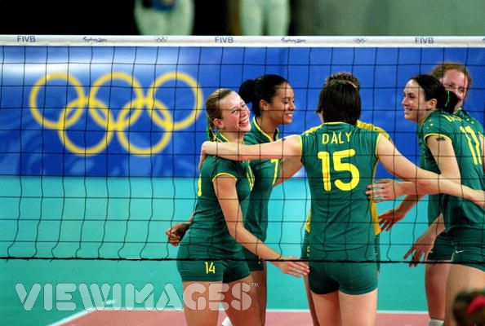

Slide 36
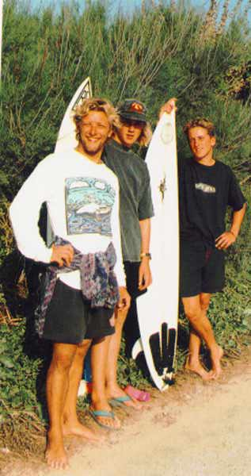
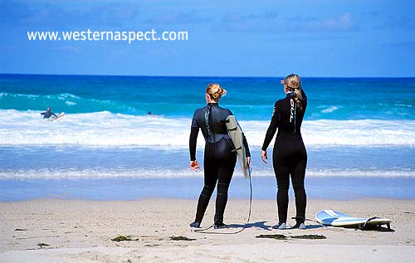
Trendy sports

Slide 37
GOVERNMENT
Sport is seen a vote winner so is actively encouraged by politicians.
Many photo shoots are taken with successful sports stars.
Politicians ‘should’ be seen at sports events to raise their status.
Comments
This is also happening with the olympics.

Slide 38
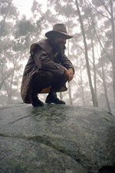
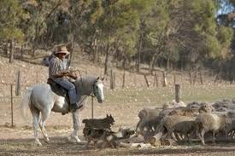
Bush Culture
The bush is the outback a harsh countryside that is unique to Australia.
The 1890s saw a continued increase in nationalism and with it the creation of the Australian bush legend.
Similar to the wild west of the USA.

Slide 39
How to remember all of these.
S-
T-
R
E
T
C
H
Y
G
B
School sports
Topographic
Role models
Egalitarian
Trendy
Climate
Healthy economy
Young nation
Government support
Bush Culture

Slide 40
10 mark guidance
Tradition- Adoption of British sports
Climate- better weather
Political – Gov funding
Economic – comparatively healthy economy.
Social – Health
Role models – Shane Warne/ Ian Thorpe.
Media – Sports has a high priority. (AIS)

Slide 41
10 mark guidance how to develop the points
Tradition- Adoption of British sports
Climate- better weather
Political – Gov funding
Economic – comparatively healthy economy.
Social – Health
Role models – Shane Warne/ Ian Thorpe.
Media – Sports has a high priority. (AIS)

Slide 42
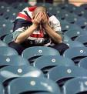
They weren’t always so good.
A poor performance in the 1976 Olympics in Montreal saw the set up of Australian institute for sport
A more professional approach was sought.
Scouting, recruitment and a scientific approach was adopted.

Slide 43
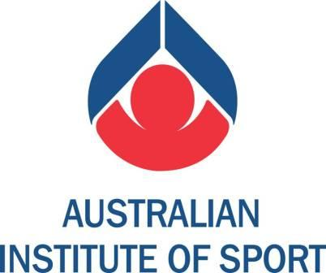

Slide 44
AUSTRALIAN INSTITUTE OF SPORT
What is the aim of the AIS?
aim = to develop elite level sport
Who runs the AIS?
ASC (Australian Sports Commission)
What are the main functions of the AIS?
organise training camps for national squads
provide grants to elite athletes and coaches
provide top facilities to the athletes
provide top quality coaching for athletes and national squads
deliver advisory & employment services to athletes

Slide 45
Footy (Fudy) How did it originate?
Questionable, but possibly Harrison and Wills – English born (1958) decided to create a game to help keep cricketers fit in winter purely and an Oz game to reflect Oz culture and society. Aussie Rules – Footy
Most say = genuinely Oz and reflects Aboriginal leaping game and public school sports
Some say – mix of rugby and Gaelic footy (but Gaelic footy not codified till 30yrs after Wills’ Melbourne rules were established!!
Had signs of cricket – oval pitch – cricket pitches used – 9 officials; 22 players who may run 15 miles a match; Gaelic football (played Irish troops) and rugby.
Melbourne cup = oldest (1858).
It is more popular than rugby union and rugby league and is growing on popularity.

Slide 46
Session 2 on Australia
Look at the clips and describe the characteristics of Aussie rules, or foody.
http://www.youtube.com/watch?v=X_hqosNvv5E
Q How does Footy reflect the characteristics of Australia?

Slide 47
CHARACTERISTICS OF ARF
Unique
Physical
Harsh
Commercial
Exciting

Slide 48
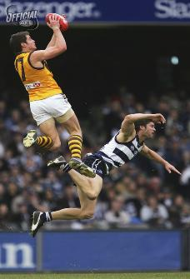

Slide 49
COMMERCIALISM
Most highly spectated sport and blossomed as result of commercialism – major interest in it now.
Multi-millions Aus$ business, with National comp and extensive Comp and network of local and regional leagues and comps
Good media promotion / commercial breaks product (like USA)
Business enterprise and financial backing – helped sport to produce high status sports stars who earn huge fees from advertising, sponsorships, endorsements and other commercial ventures.
Broadcast media rose rapidly to Aus%5.5million after the commission took over and put the rights to tender. Revenues soared to Aus$100million+ with new 5yr contracts with 7, 10 networks and Foxtel.
AFL that runs the Australian Rules competition has 1 broadcasting contract that earns it Aus$20million pa. Compared to 120 other sports bodies (out of 130), who get nothing through TV broadcasts.

Slide 50
Benefits of commercialisation
AFL keeps prices down
Media coverage boosts game at grass roots – future players and spectators
Facilities upgraded
More exciting competitions can be staged
Compare structure of ARF and AF – set pieces, restarts, tackles, violence, punishment and nature of the sport – scoring and pitch. Give cultural reasons.
Commercialism = threatening to destroy original nature of sport. Becoming more a spectacle engineered by public relations and mass consumption experts to market the game for the consumer-oriented society. The more local nature of the game changing to city or state conglomerations.

Slide 51
Popularity and development of Aussie Rules
Explain how the development of Aussie rules, and the commercial impact mirror the USA, and American football.
Research page 250 and explain the reasons for the development.

Slide 52
Break the question into sections
Development of Aussie rules
Commercial impact
How this is mirrored in the USA and American football.

Slide 53
Comparative
One point from Australia.
Use of linking word…… However,
Then make a point about USA.
Point from Australia…….Alternatively,
Point from American sports.

Slide 54
Commission agreed that since AFL came in 1990, harder to keep balance between ‘tribal’ interests and those new spectators seeking more thrill / excitement
Expansion of codes catchment and revenue has combined with higher media rights payments and sponsor revenue to boost AFL revenue from just under Aus$90 million in 1997 to about Aus$270 million currently.
About Aus$120million of that flows through 16 clubs and through them to player payments – risen from $22,000 to $220,000.
Some also allocated $5million special payments to financially weaker clubs for survival (Melbourne’s Western Bulldogs and the Kangeroos).
Also revenue supports AFL development programmes – the financially stronger AFL is both directly and indirectly underpinning the re-development of club facilities and games venues.

Slide 55
The media and the status of pro sport:
Role of media = same as in any other country in the free world
Status of pro sport is strong in all 3 new world cultures, especially Australia
Previously the media praised their ‘Afrikaner’ heroes (white)
Now the media is starting to present sport differently (minus the racism)
Professionalism is upon SA culture
In SA, growing media coverage of sport may be a useful nation-building tool, and mat help break the cycle of racial discrimination in the country
How can media coverage of sport help with integration of a culture and nation building?

Slide 58
Structure of Professional Sport

Slide 59
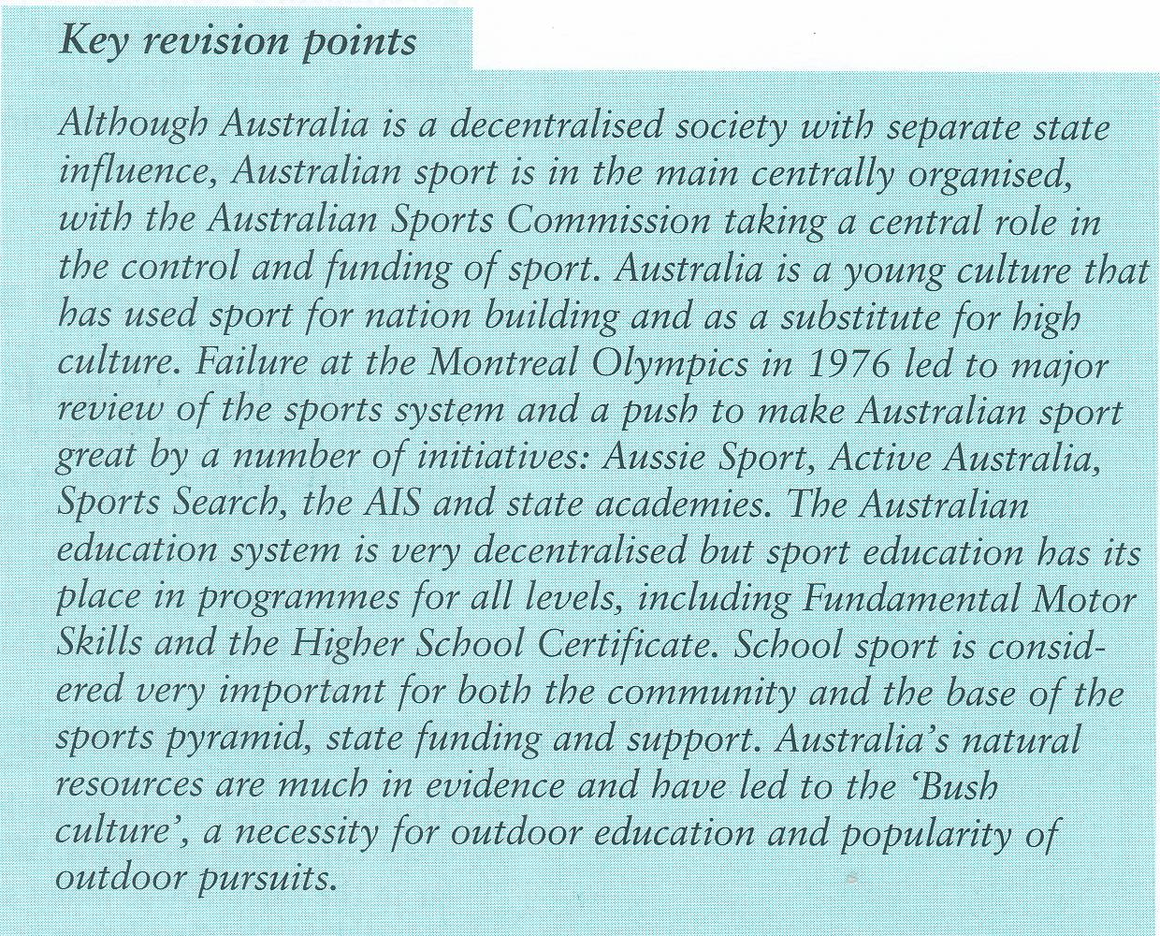

Slide 62
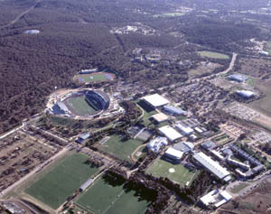

Slide 63
Programme | Explanation
(STEP) Sports Talent Encouragement Plan | Provides financial assistance to high performing athletes
Elite Coaching Scheme | Raise standards of coaching for elite athletes
(SAS) Sports Assistance Scheme | Assistance to NSO’s for training camps and technical seminars for athletes and coaches
(ITC) Intensive Training Centres | Commonwealth funded coaches work with national and state based coaches
(SportsLEAP) Life skills for Elite Athletes Programme | helps elite athletes in areas of employment, education & personal development
Scholarship Sports Programme | Main programme of AIS. Provides access to coaching, training, facilities, sports science, and medical services. Assistance with education & welfare. Spend = $11m per year on around 500 scholars
Australian Athlete Scholarship Scheme | Similar to SportAid in the UK, but has larger budget. AIM = give direct financial aid to elite athletes nominated by NSO’s
(OAP) Olympic Athlete Programme | 6 year $135m programme following successful Olympic bid

Slide 64
SUCCESSES
Commonwealth Games Brisbane (1982) – 36 AIS athletes competed in three sports and won 14 gold, 13 silver and 7 bronze medals
Commonwealth Games Edinburgh (1986) – 54 AIS athletes competed in five sports and won 17 gold, 11 silver and 14 bronze medals
Commonwealth Games Auckland (1990) – 86 current and former AIS athletes competed in six sports and won 25 gold, 28 silver and 28 bronze medals.
Olympic Games Sydney – 321 AIS Athletes competed in twenty sports and won 8 gold, 11 silver and 13 bronze medals

Slide 65
TALENT IDENTIFICATION
What is Sportsearch?
Sportsearch = Australia’s talent ID programme
How does it work?
Carried out by national coordinator & 8 regional officers
Youngsters screened for athletic qualities
Youngsters are tested in schools & then matched to a sport that their athletic skills and traits best match
When is testing done?
Tests initially done on 14-16 year olds (phase 1)
Top 10 % move to phase 2 of the testing
These children become part of the ‘talent ID programme’, and train at the AIS sites around the country
The state and NSO’s are then responsible for developing those athletes selected
Phase 1 = 100,000 children; phase 2 = 10,000; phase 3 = 1,000
What happens to those not selected?
Children who do not make the grade are encouraged to join local clubs to develop their talents
They are re-tested 1 year later

Slide 66
PARTICIPATION PROGRAMMES
Delivered through the ASC & ‘Active Australia’ & ‘Aussie Sport’ programmes
AUSSIE SPORT
National initiative aimed at young people is about:
supporting quality teaching/ coaching
making sport more accessible and enjoyable
developing essential skills in young people
fostering community involvement
modified games for children to help them pick up and develop new skills (e.g. – Kanga cricket)
utilising skills of coaches and teachers
Various schemes operate within the ‘Aussie Sport’ programme to suit different needs of the community:
(1) Sportstart
(2) ‘Sportit!’
(3) ‘Sport – Everyone’s Game’
(4) ‘CAPS’ (challenge, achievement & pathways in sport)

Slide 67
ACTIVE AUSTRALIA
Aussie Sport programme put under banner of ‘Active Australia’
WHY? – to give it more of a grassroots focus
‘Active Australia’ = a national programme run by the ASC with focus on ‘sport for all’ (participation) and aimed at foundation level sport
3 main aims of ‘Active Australia’:
increase lifelong participation
realise social, health & economic benefits
develop a quality infrastructure to support this goal
Principles of ‘Active Australia’ are:
ensure access & equity
lifelong involvement
enjoyment in activity
diversity and choice
encourage improvement and quality of experience
All states have Dept’s for Aborigine affairs, who aim to incorporate Aborigine culture
Success has been limited

Slide 68
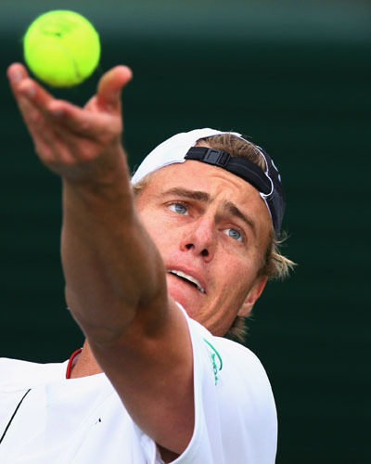
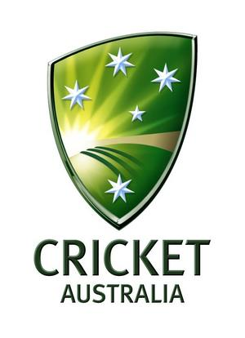
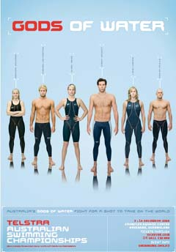
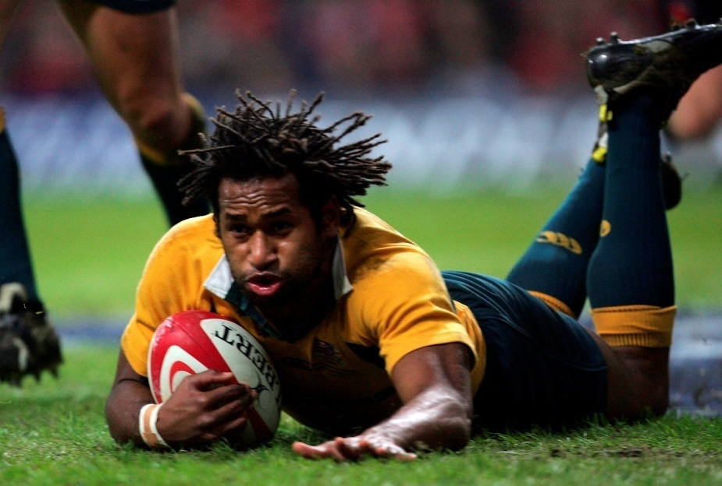

Slide 69
STATUS OF SPORT IN OZ
Sport = high status in Oz. It’s helped shape the identity of this relatively young country. National passion / obsession.
90% Oz participate in sport and sport = 15% TV time.
Ashes in 2005, 12.5% watched England win; BUT 90% watched Melbourne Cup in 2004!
Sport = front page news – national sporting success related to population!
Sydney 2000 Olympics – success / victories : cricket, hockey, netball, rugby league and union and cycling, rowing and swimming.
Report Australian Sports Institute Study Group (1975) – they spend enormous amount of time and money on sport – think, read, talk, watch, do.

Slide 70
SUMMARY – HISTORY OF OZ SPORT
Reflects developments in UK
The history of professional sport has some parallels with their colonial roots and similar patterns of development.
Middle class developments remained dominant because there was little industrial working class influence
Private clubs stimulated by school athleticism produced a decentralised sporting system
State teams dominate and no federal control till 1970’s

Slide 71
FUNCTIONAL & SURVIVAL ACTIVITIES – HUNT & FISH
FRONTIERS / WILD / NOMADIC TRIBES
RELIGIOUS AND RITUAL ACTIVITIES
INTER-TRIBAL TOURNAMENTS – SETTLE ARGUMENTS
MILITARY PROWESS – PLAY & FITNESS
FEW SIMPLE RULES, NO OFFICIALS, WINNERS NOT IMPORTANT
NATIVE AUSTRALIANS / ABORIGINES
BRITISH COLONISATION
EXILED; KILLED & DISEASED
Recently - ‘Aboriginal Sport and Recreation Programme’. Exclusive national competitions organised.
LOSS LAND RIGHTS – RECENTLY COMPENSATED (1994) & APOLOGY (2008)
WWII + = territories became independent from Empire and joined the Commonwealth of states – free association of independent states.

Slide 72
candidates should be able to:
describe characteristics of Australia (young nation; sparsely populated; colonial influence and immigration);
explain the nature of sport in Australia (social and cultural reasons for sport being a high status national pre-occupation);

