Slide 1
Motor Control of Skills and Transfer of Learning

Slide 2
Motor programme
Is a generalised series or pattern of movements stored in the long term memory.
Is the plan of a whole skill or pattern of movements.
Made up of generalised movements which are stored in the long term memory.
Every skill performed in sport is the product of a motor programme.

Slide 3
Sub routines
Small components are often called mini skills or the building blocks of the overall motor programme.
Sub routines are usually performed in sequence.

Slide 4
Tennis serve
If the EMP or the Executive Motor Programme is a tennis serve
What are the sub routines for that skill?

Slide 5
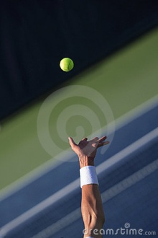
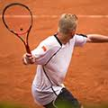
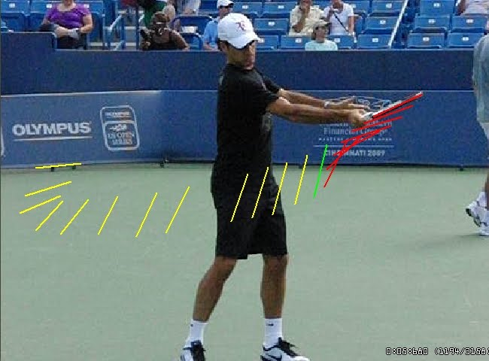
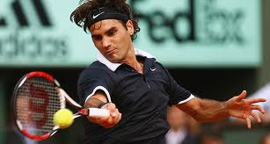
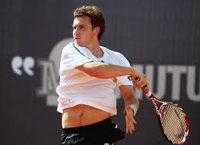
Sequential motor programme

Slide 6
Motor programme
Hierarchy-have an order of importance
Executive motor programmes higher status than sub routines.
Sequential- performed in a particular order.
Tennis- ball toss, back swing, forward swing, contact, follow through.

Slide 7
Motor Programme – Your example
From your favourite sport, list a motor programme and its sub routines.

Slide 8
Motor Programme – High Jump Example
High Jump
Approach
Take Off
Flight
Landing
Sub-routines

Slide 9
Q Why would it be important for a teacher of P.E to know that psycho-motor skills in sport are made up of sub-routines.

Slide 10
Open Loop Control
Open loop explains how rapid movements in sport are performed., a close catch.
Often thought to be instinct but it’s......
A rapid plan is triggered from the long term memory.
Memory trace
The plan or EMP stored in the LTM
The action of the working muscles

Slide 11
Open Loop Control
Open loop control is a system of subconscious control that does not use references or feedback.
The transfer of information (knowing what to do) is done through a memory trace.
A memory trace is formed when skill is learned, brought about by repetitive practice/experience, e.g. throwing, hitting, catching fast objects, jumping

Slide 12
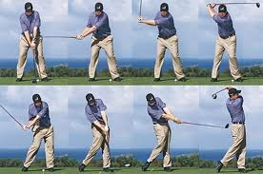
Open control
Open control is inflexible the movement can’t be changed during the movement.
Once the swing has been initiated it’s difficult to modify.
Open control does not have time for feedback
Seen as a level 1 and
Thought to initiate motor skills
Which phase can ben linked to the open loop?

Slide 13
Key characteristics of Open Loop
Open loop control is a system of subconscious control that does not use references or feedback.
A memory trace is formed.
Examples are fast movements, ballistic, for example a reflex catch.
Thought to initiate motor skills

Slide 14
Closed loop control
Memory trace
The plan or EMP stored in the LTM
The action of the working muscles (movement effectors)
Feedback via Kinaesthesis
Perceptual trace

Slide 15
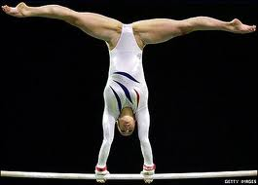
Closed Loop control level 2 control
At level 2 the loop is short
Allows quick feedback
Allows quick subconscious corrections.
Although these changes are subconsciously the adjustments are stored in the long term memory.

Slide 16
Closed Loop Control level 2
Closed loop involves feedback which is termed the perceptual trace.

Slide 17
Closed loop control level 3
Memory trace
Motor command
The plan or EMP stored in the LTM
The action of the working muscles
Perceptual trace
Conscious feedback from brain

Slide 18
The main characteristics of CLOSED LOOP CONTROL LEVEL 3
Feedback loop is longer because the information on performers is relayed to the brain.
The brain controls and modifies the movement by passing corrective messages back to working muscles.
Involves attention to external factors and conscious thought.
E.g., Can you give an example
Avoiding an opponent whilst controlling a ball.

Slide 19
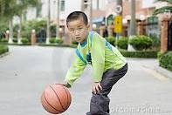
Using your understanding of Fitts and Posner stages of learning which stage do you think the closed level three would relate to?
“I need feedback from external factors as I've not developed my kinaesthetic ability for this skill.”

Slide 20
“At the associative stage of learning novices tend to operate by referring to the level three loop. There is a reliance on external feedback as they have not yet acquired the correct feel for the skills”.

Slide 21
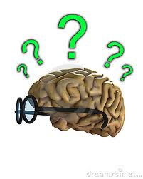
Draw backs of Adams Open and Closed system.
If it were possible to store all the motor programmes it would be difficult to recall the plan quickly enough to execute the skill.
Often responses in sport are creative, unusual. These usually arise in open skills and are called ‘novel responses’.
If the relevant motor programme does not exist, this theory can’t explain the ‘novel response’.
If a separate plan or memory trace is needed for each skill it would not be possible to store such an infinite number of motor programmes. Therefore, retention is a problem.

Slide 22
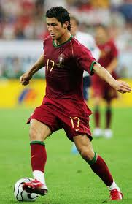
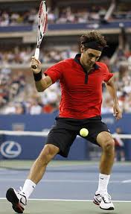
Novel response
Can you think of a novel response?
First time someone did a step over.
First time someone hit the tennis ball between their legs.

Slide 23
Observation of practical
Identify and discuss how the performance of each skill is influenced by open and closed loop theory.

Slide 24
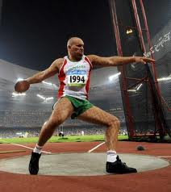
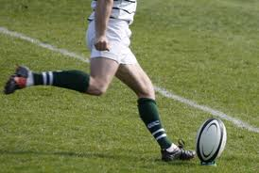
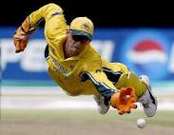
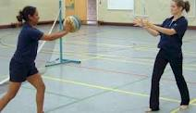

Slide 25
Feedback

