Slide 1
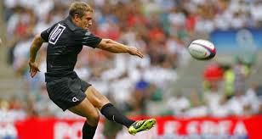
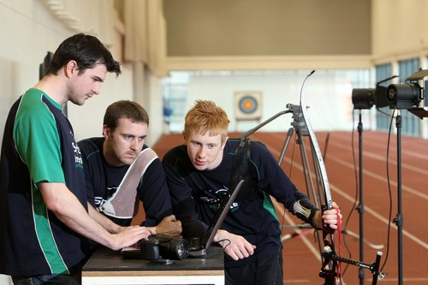
Biomechanics Principles

Slide 2
Laws of Motion
Sir Isaac Newton
3 Laws of Motion :
1 INERTIA
2 ACCELERATION
3 ACTION & REACTION

Slide 3
Laws of Motion
Newton's first law states that every object will remain at rest or in uniform motion in a straight line unless compelled to change its state by the action of an external force. This is normally taken as the definition of inertia.
The second law explains how the velocity of an object changes when it is subjected to an external force. The law defines a force to be equal to change. in momentum (mass times velocity) per change in time. Acceleration.
The third law states that for every action (force) in nature there is an equal and opposite reaction. In other words, if object A exerts a force on object B, then object B also exerts an equal force on object

Slide 4
jigsaw
A B C
A = inertia
B = acceleration
C = action / reaction
Use the pictures on your desks to enhance your understanding
Feedback and explain using examples to your group
Use notes to support if needed.

Slide 5
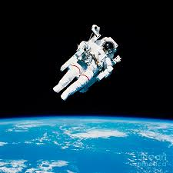
1 Newton's First Law of Motion - INERTIA
This is the law of inertia, and states:
‘Everybody at rest, or moving with constant velocity in a straight line, will continue in that state unless acted upon by an external force exerted upon it’
Objects tend to remain either at rest or in straight line motion.
Moving with constant velocity in a straight line,

Slide 6
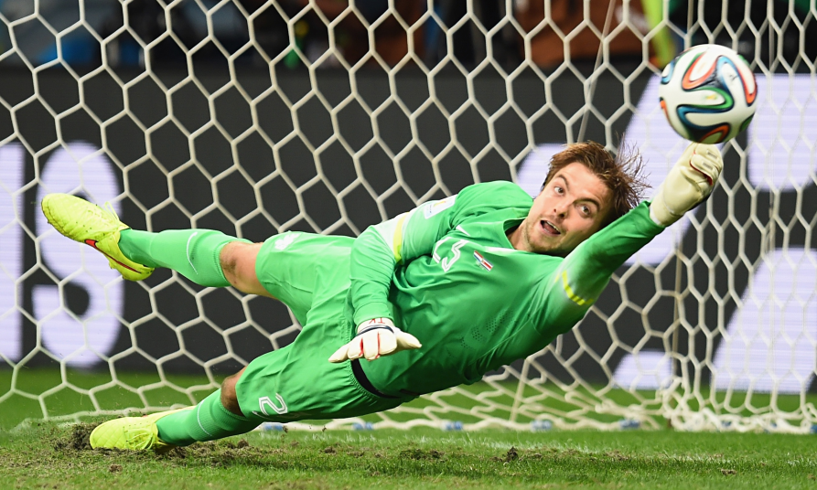
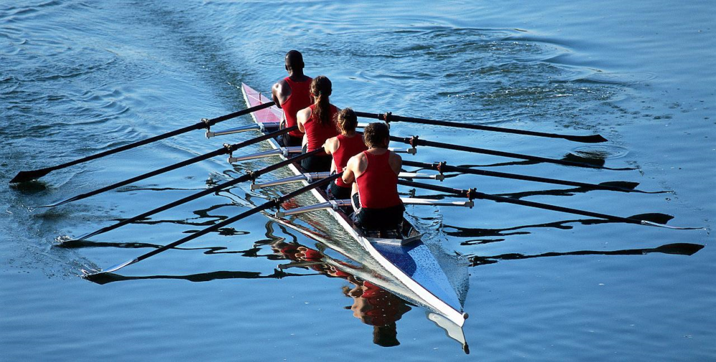
Examples of inertia

Slide 7
Jigsaw feedback
Feedback and explain using examples to your group
Use notes to support if needed.

Slide 8
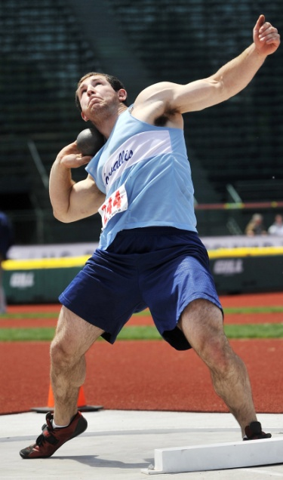
2 Newton's Second Law of Motion - ACCELERATION
This is the law of acceleration, and states:
‘The acceleration of a body is proportional to the force causing it and the acceleration takes place in the direction in which the force acts’
Often described as: F = MA
Force = mass x acceleration

Slide 9
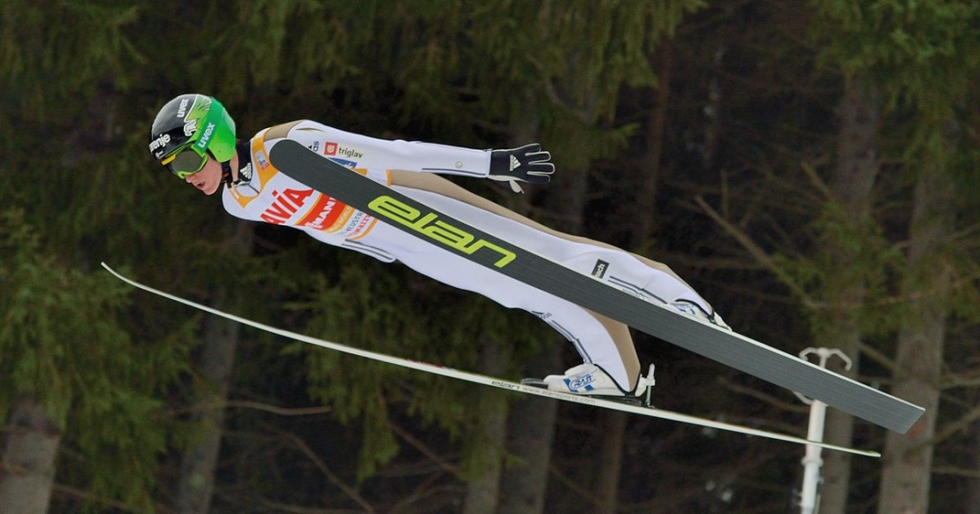
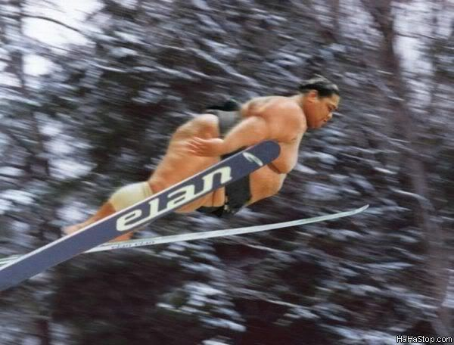
2 Newton's Second Law of Motion - ACCELERATION
This law suggests that the greater the mass of an object, the greater the force required to give the same amount of acceleration and also the greater the force applied the greater the acceleration
sporting examples

Slide 10
2 Newton's Second Law of Motion - ACCELERATION
More mass results in less acceleration when the same force is applied.
With the same force applied, the riders and the bike with twice as much mass will have half the acceleration, with all other factors constant.
Note that the second rider is not pedaling.

Slide 11
Jigsaw feedback
Feedback and explain using examples to your group
Use notes to support if needed.

Slide 12
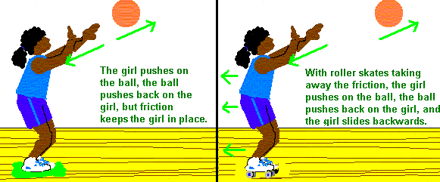
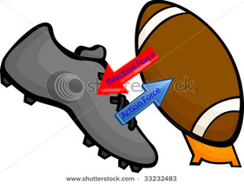
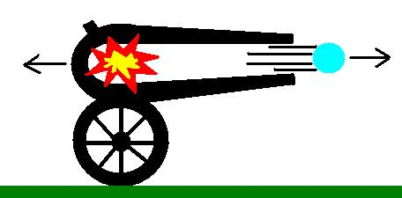
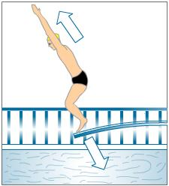
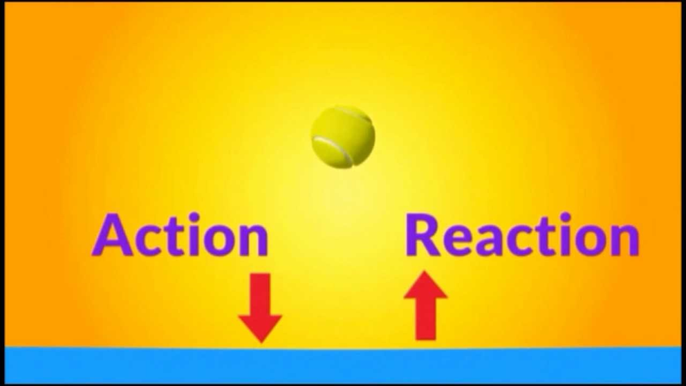
Newton’s third lawEvery Action has an Equal and Opposite Reaction.

Slide 13
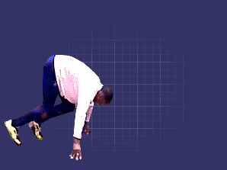
3 Newton's Third Law of Motion – ACTION & REACTION
The American football player's foot is pushing against the ground, but it is the ground pushing against the foot that accelerates the player forward to catch a pass.

Slide 14
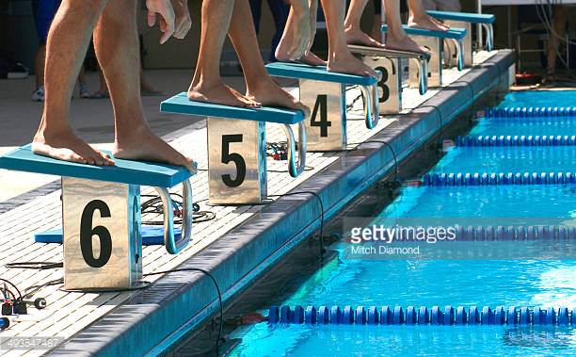
3 Newton's Third Law of Motion – ACTION & REACTION

Slide 15
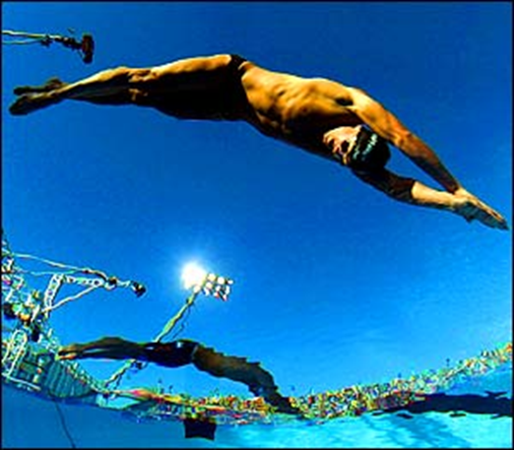
Pairs task
Use the swimming example to apply all three of the laws of newton.
State the law and then explain the motion.
Page 2

Slide 16
3 Newton's Third Law of Motion – ACTION & REACTION
Law of inertia
Swimmer will stay still until a force/muscle contraction acts upon the board.
Law of acceleration
The force applied to the board is greater than the resistance of the mass
Law of action reaction
The reactive force is equal to the force applied by the muscles to the board so motion occurs.

Slide 17
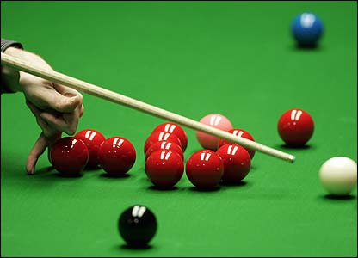
Student task
Own sport

Slide 18
What could we say to get a better answer?
1st Law – INERTIA - remains at set unless a force affects them
2nd Law – ACCELERATION - push harder to get more acceleration
3rd Law – ACTION & REACTION - action force is muscular force, reaction force pushes athlete off blocks

Slide 19
Applying Newton’s Laws – SPRINT START
1st Law – INERTIA - remains at set unless a force affects them.
Force of muscles holding in place.
Force of gravity
2nd Law – ACCELERATION –force is applied to block which is greater than the mass resistance/wind resistance so acceleration occurs.
3rd Law – ACTION & REACTION - action force is muscular force into the blocks is equal to the force, reaction force pushes athlete off blocks due to resistance of blocks on the floor.

Slide 20
Key concepts within the Laws of Newton.
Complete the key concepts worksheet.
Velocity
Momentum
Acceleration
Force

Slide 21
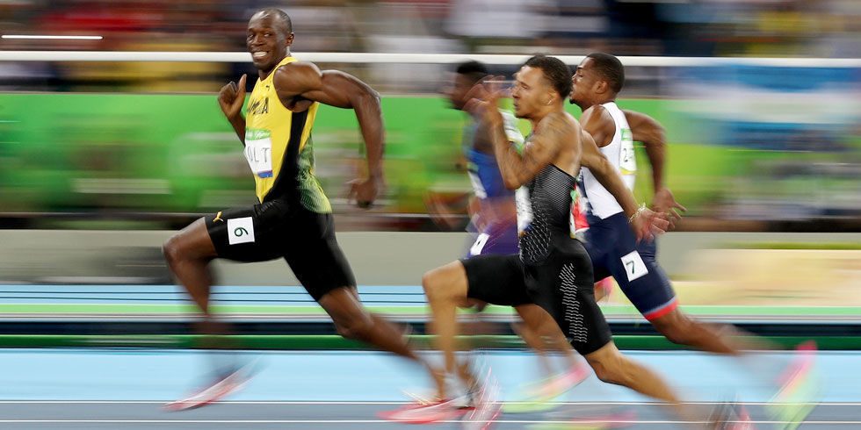
velocity
Velocity: rate of change in displacement the shortest route from A to B and can be calculated using the following equation.
Velocity = Displacement/ time taken.
Average velocity = 10.44 m/s
Velocity:
Average velocity = (distance divided by time)
Velocity:
Average velocity = (100m divided by 9.58s)
Page 3

Slide 22
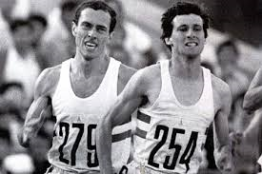
velocity
Displacement is distance Divide this by time taken.
1500m divided by 390 secs =
Average velocity = 3.8 m/s
The lower the score the slower you are.

Slide 23
momentum
Momentum: Is measured in kg m/s
This is the quantity of motion possessed by a moving body and can be calculated by using the following equation:
Momentum = Mass x Velocity
Momentum =( 94kg x 10.44 m/s)
Mass = 94kg x average velocity which is distance divided by time.
Momentum = 981.36kgm/s

Slide 24
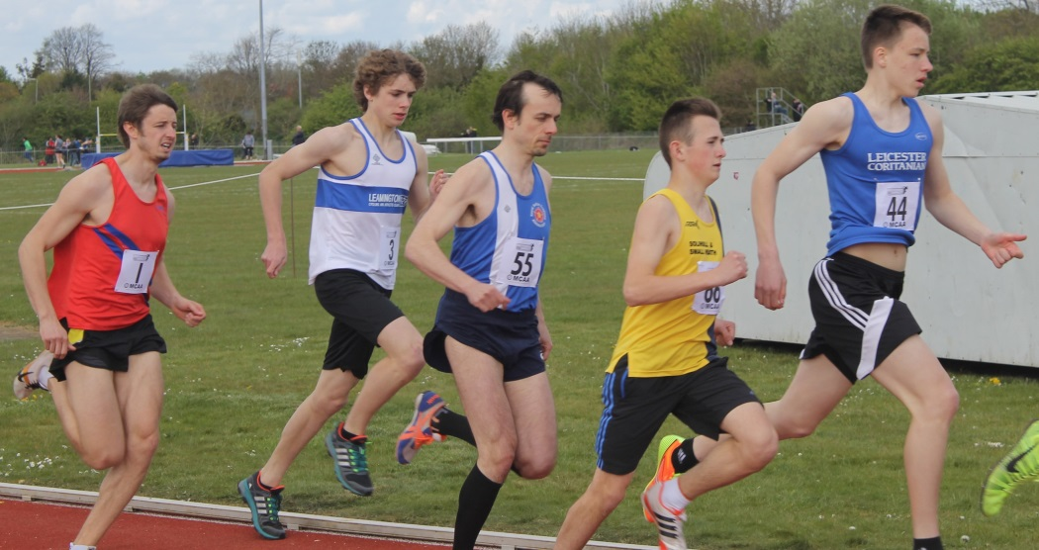
momentum
Momentum =( 65kg x 3.8 m/s)
Momentum = 247 kg m/s
Higher the number the more momentum you have.
Momentum = Mass x Velocity
Now calculate you own momentum.
Mass = your weight x average velocity which is distance divided by time.

Slide 25
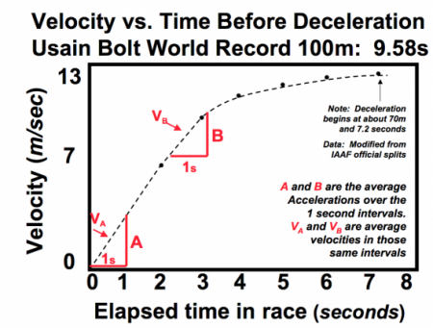
Acceleration:
Acceleration: Is the rate of change in velocity and can be calculated using the following equation.
Acceleration = (final velocity – initial velocity) / time taken.
Acceleration is measured in m/s change in velocity is measured in m/s and time taken in secs.
Usain example:
Velocity:
Average velocity = (20m divided by the time is took 2.88s)
= 6.94 m/s
= 6.94 m/s - initial velocity which from the start is 0.0
= 6.94 m/s
Divide that by the time taken to give you acceleration over 20m
= Acceleration over 20m is
2.41m/s/s

Slide 26
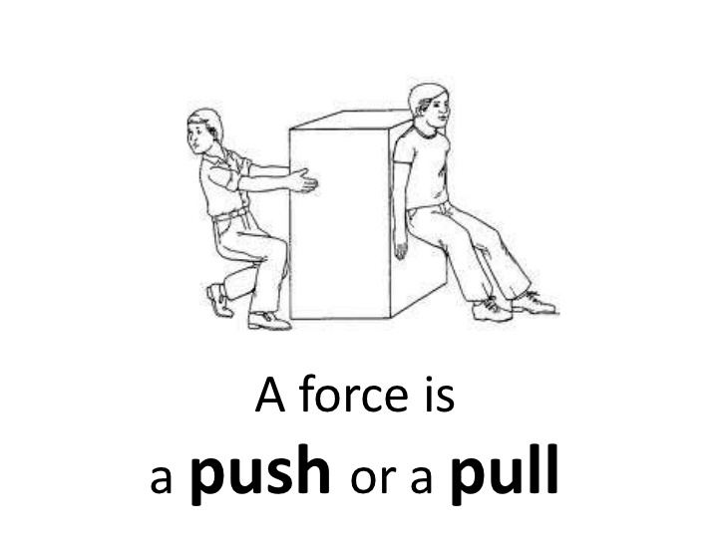
force
Force is a push or a pull that alters the state of motion of a body and can be calculated using the following equation:
Force = mass x acceleration. (f-ma)
Usain example
Mass = 94 kg
Acceleration 2.41 m/s/s
94x 2.41 =
226.5 N
Your force
Mass = your weight kg
Acceleration = ……….. m/s/s
Mass x acceleration
………..N

Slide 27
Class activity
 | MASS | 10M SPLIT | 100M
DWAIN CHAMBERS | 91KG | 1.87 S | 9.97S
MAURICE GREENE | 75KG | 1.86S | 9.80S
JASON GARDNER | 94KG | 1.89S | 9.98S
Which sprinter has the highest mass and therefore inertia? How should this impact on their first 20m?
What is Dwain Chambers acceleration?
What force does Maurice generate?

Slide 28
 | MASS | 10M SPLIT | 100M
DWAIN CHAMBERS | 91KG | 1.87 S | 9.97S
MAURICE GREENE | 75KG | 1.86S | 9.80S
JASON GARDNER | 94KG | 1.89S | 9.98S

