Slide 1
Biomechanics levers

Slide 2
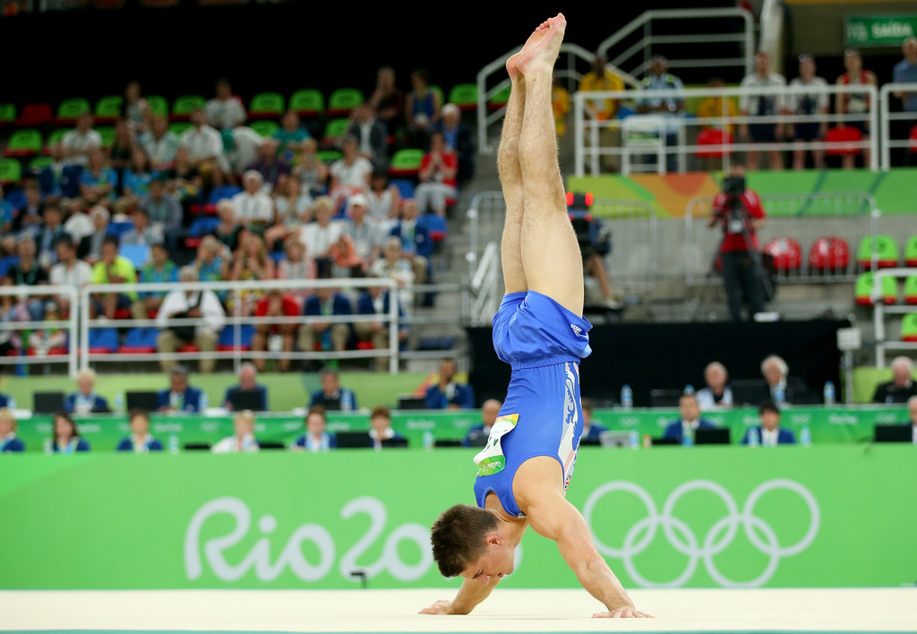
W
R

Slide 3
Levers systems are the coordination of our body, therefore our bones and muscles, primarily creating human movement.
Two main functions
To generate muscular effort
To increase speed of a given movement

Slide 4
Components of a lever are:
Lever (bone)
Fulcrum (joint)
Effort (muscular force)
Load (weight or resistance)

Slide 5
Levers- bones act as levers, rigid structures which rotate around a fixed point.
This fixed points is known as the fulcrum and in the human body are the joints.
The muscles that surround the joint are create internal forces that move the bones they are attached to. When a muscle contracts an effort is created.
If this effort is large enough to overcome any load placed on the lever, it will pull on the lever to create movement.

Slide 6
How to apply the components of levers
F
L
E
L
E
F

Slide 7
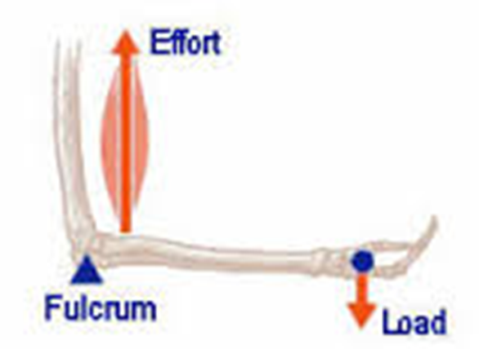
Component | Location | Diagram | Example/ bicep curl up
Lever | Bone | Line | Radius/ ulna
Fulcrum | Joint | Triangle | Elbow
Effort | Muscular force | Arrow E | Force created by bicep brachii
Load | Weight | Arrow L | Weight of forearm/ weight

Slide 8
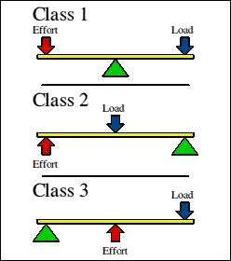

Slide 9
There is only one education for life
2 fled
And the third fell over.
There is only one education for life
2 fled
And the third fell over.

Slide 10
l
E
F
Example of a second class lever

Slide 11
l
Example of a third class lever
E
F

Slide 12
l
E
E
F
Example of a third class lever

Slide 13
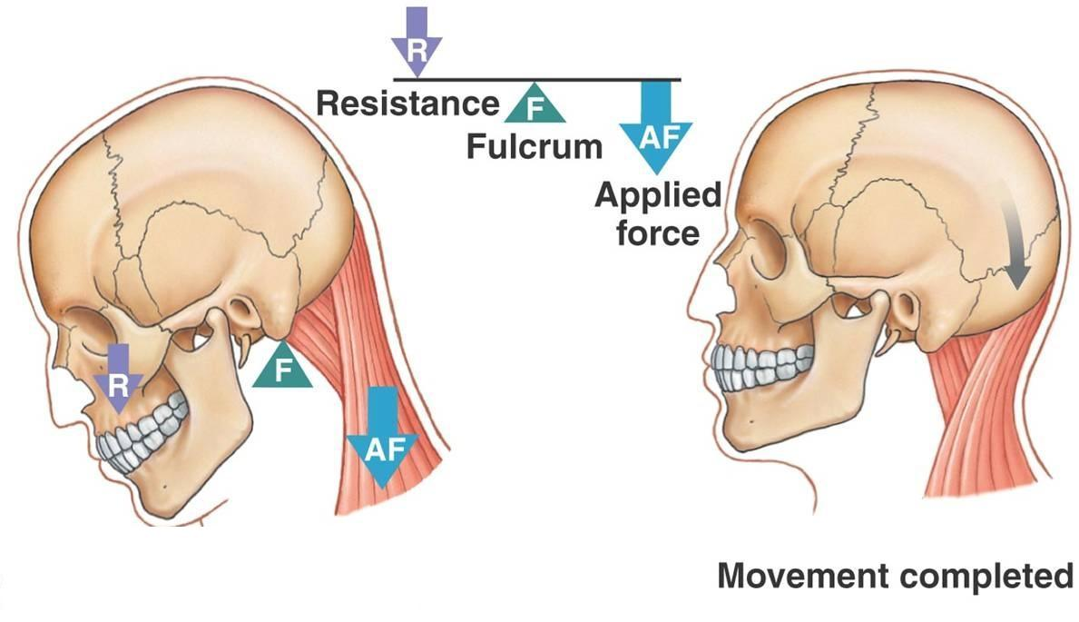
Example of a first class lever

Slide 15
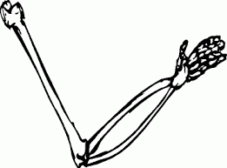
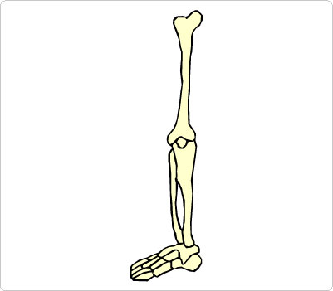
3 groups
Using the skeletons demonstrate three different types of levers.
What types do you find most in the body?

Slide 16
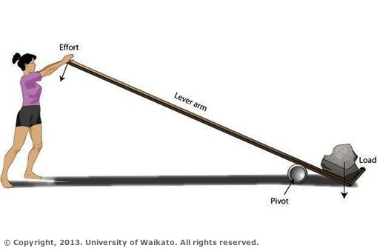
Efficiency of levers

Slide 17
Example of a first class lever
(EFL)
Distance from fulcrum to effort is known as effort arm.
Distance from fulcrum to load is the load arm.

Slide 18
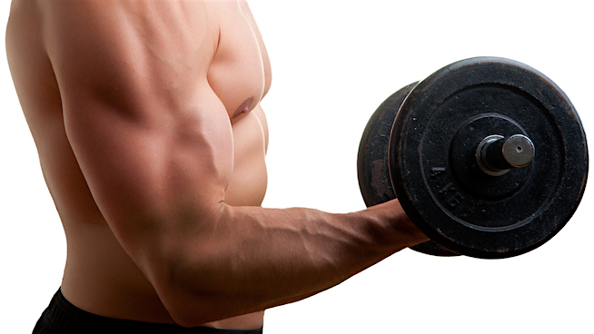
Distance from fulcrum to effort is known as effort arm.
Distance from fulcrum to load is the load arm.

Slide 19
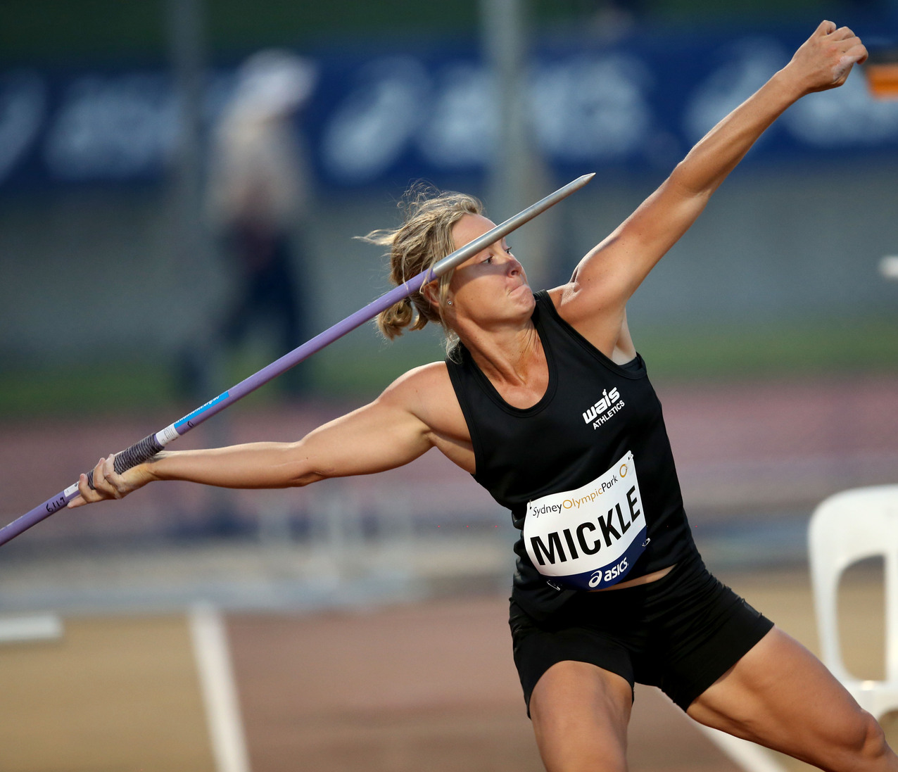
Efficiency of levers
How does the distance impact on the performance?

Slide 21
Longer levers generate greater force. The load arm becomes longer and can give greater acceleration to projectiles.
The greater the distance of the effort or the load from the fulcrum, the more significant the effort or load becomes.

Slide 22
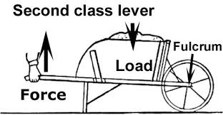
Second class
Where the effort arm is greater than the load arm , a large force can be moved with a relatively small force.
E
L

Slide 23
mechanical disadvantage third class lever
Where the load arm is greater than the effort arm, a large effort is required to move a relatively small load.
Bicep curl/ straight arm raise

Slide 24
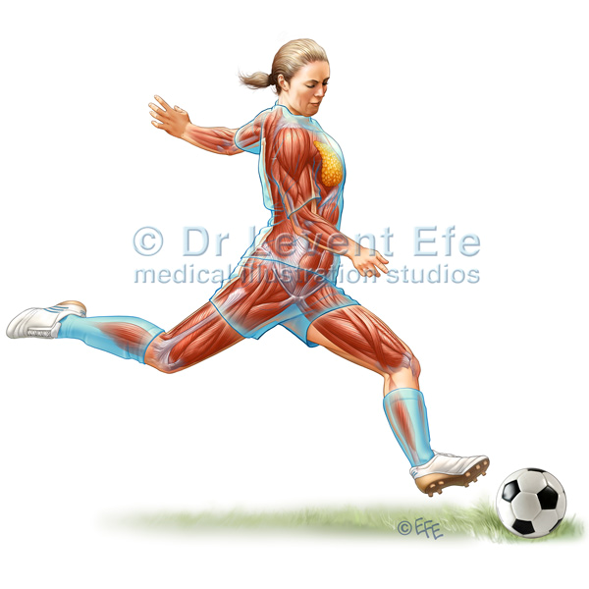
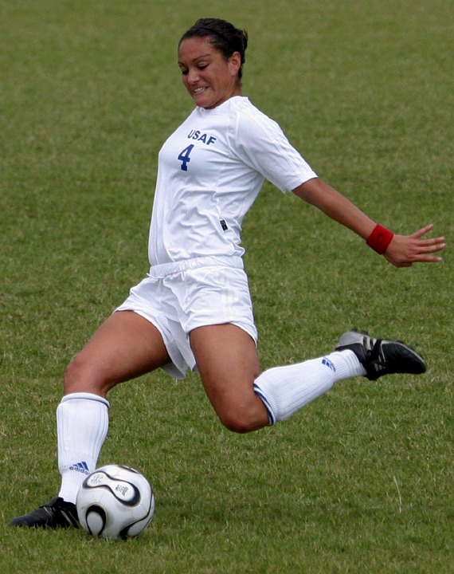
Mechanical advantage
E
l
E
Can increase velocity and acceleration if movement can be created.

Slide 26
