Slide 1
The Musculoskeletal System The SKELETAL system - BONES
Section 1

Slide 2
SKELETON (Task 1)
There are 206 bones in the body.
TASK: Use the lists below to name the bones indicated on the diagram. Check your answer by clicking on the speakers.
ULNA
CARPALS
Ilium and Ischium
PHALANGE
FIBULA
PATELLA
SCAPULA
TIBIA
CLAVICLE
STERNUM
METACARPALS
RADIUS
HUMERUS
RIBCAGE
HEAD OF FEMUR
CRANIUM
TARSALS

Slide 3
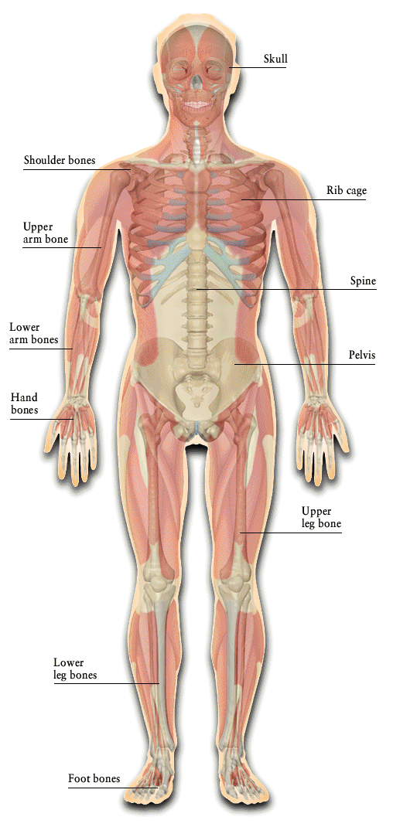
1. MOVEMENT
With the help of muscles, the skeleton provides movement.

Slide 4
2. PROTECTION
Parts of the body are delicate and could be easily damaged. The skeleton protects them.
The cranium protects the brain
The ribcage protects the heart and lungs

Slide 5
3. BLOOD CELL PRODUCTION
Red and white blood cells are produced in the long bone
Minerals and salts are also stored in the bones

Slide 6
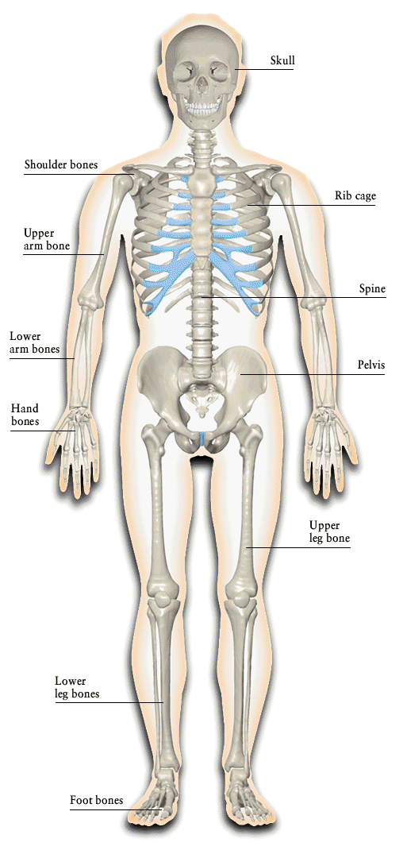
4. SHAPE & SUPPORT
The skeleton gives the body it’s shape otherwise it would be flabby and shapeless

Slide 7
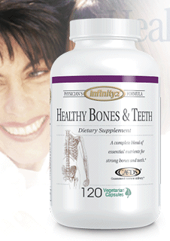
5. CALCIUM STORE
Calcium is a mineral essential for bones strength and density – 99% of body’s store is in bones.
This can help avoid osteoporosis along with regular weight-bearing exercise

Slide 8
Areas where this takes place include the:
humerus
ribs
femur

Slide 9
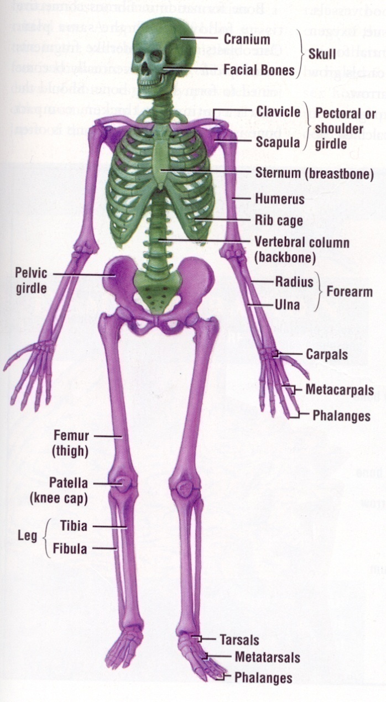
What do you know? (Task 2)
Function relates to Structure
What are the functions of the skeleton?
Axial Skeleton
Appendicular Skeleton
Complete booklet p2-3

Slide 10
DIVISIONS OF THE SKELETON
AXIAL | APPENDICULAR
CRANIUM VERTEBRAL COLUMN Thoracic Girdle : STERNUM RIBS | SHOULDER GIRDLE UPPER LIMBS PELVIC GIRDLE LOWER LIMBS

Slide 11
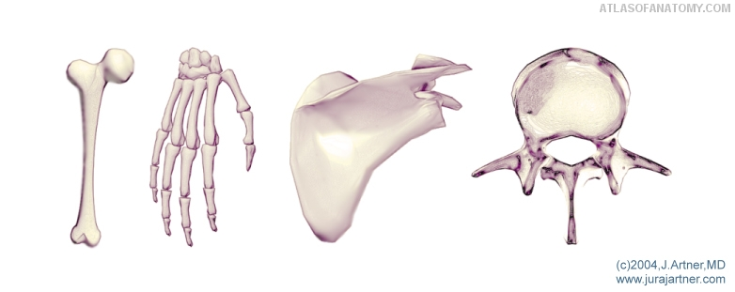
Types of BONES (Task 3)

Slide 12
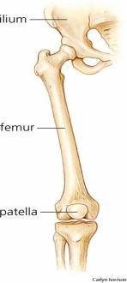
TYPES OF BONE
LONG BONES
Act as LEVERS.
Generally bones of the limbs.
Long bones work with joints to create movement when muscle pull on them.
EG
Leg - Femur, Tibia, Fibula, Metatarsal & Phalanges.
Arm – Humerus, Radius, Ulna, Metacarpals & Phalanges.

Slide 13
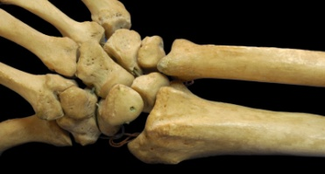
TYPES OF BONE
SHORT BONES
Small bones in the hand and feet.
Used for fine movement.
Can absorb large impact acting as shock absorbers.
EG
Feet – Tarsals
Hands - Carpals

Slide 14
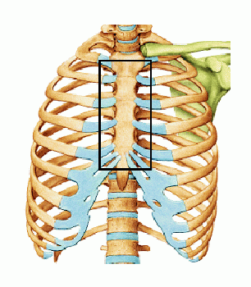
TYPES OF BONE
FLAT BONES
Provide a large surface area for muscle to attach to.
Protect organs of the body.
EG
Sternum – protects central chest / lungs & heart.
Scapula – Many muscle attach.
Cranium – protects brain.

Slide 15
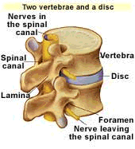
TYPES OF BONE
IRREGULAR BONES
Protect something.
Give shape.
EG
Vertebrae – protect the spinal cord.
Facial bones – give face shape.

Slide 16
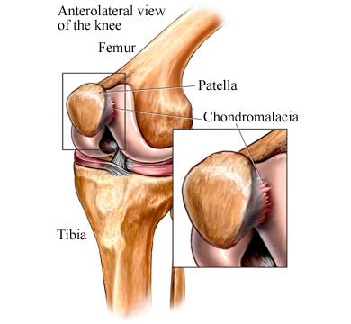
TYPES OF BONE
SESAMOID BONES
Sesamoid bones are found in locations where a tendon passes over a joint.
They act to protect the tendon and to increase its mechanical effect
EG
Patella

Slide 17
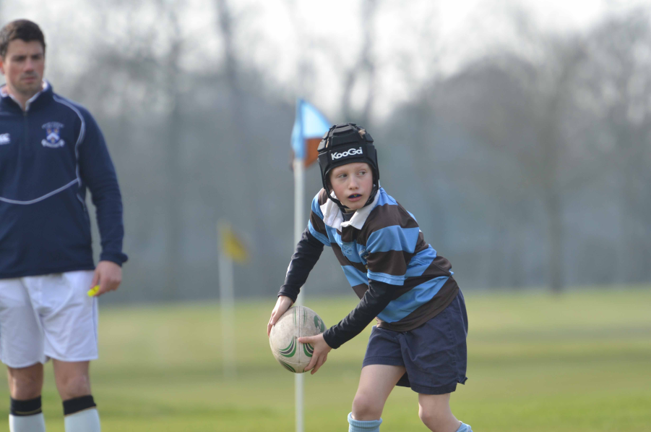
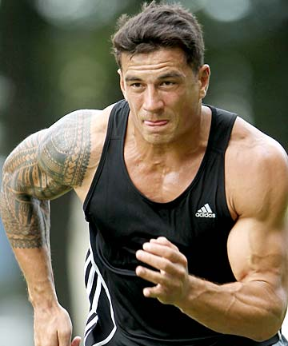
Related to bones is it ok for all these people to take part rugby (contact sport)

Slide 18
PAIRS TASK
Complete a paragraph that states the impact of participation in contact of high impact sports on a youth.

Slide 19
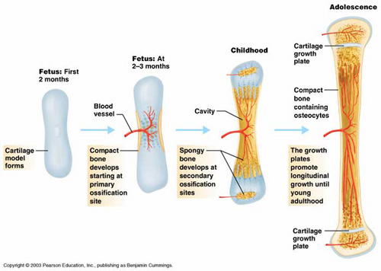
Bone Growth
State briefly or use the term bone growth.
Then state the issues.
Note it doesn’t say positive or negative.

Slide 20
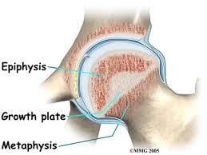
Key terms:
Epiphysis or growth plate.
Ossification
Adolescents

Slide 21
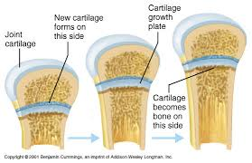

Slide 22
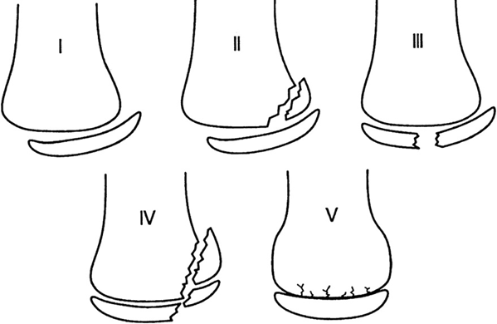
GROWTH PLATE INJURIES
Description – weakest area of skeleton in growth phase – pre-adolescence (as bones don’t harden fully – ossification – until late adolescence
Cause / Risk Factors – overstressing epiphyseal plate during growth phase
Effect – damage epiphyseal plate – stress fractures and displacement
Who is at risk? – younger participants in developmental stage

Slide 23
Injury to the growth plate can hinder growth

Slide 24
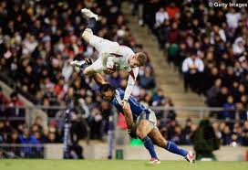
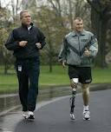
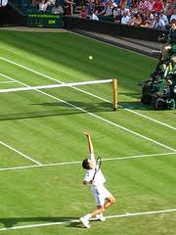
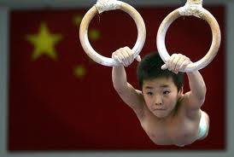
4 types of PHYSICAL
CONTACT
LOW IMPACT/
REPETITIVE
HIGH IMPACT
Rugby
Jogging
Tennis
Gymnastics

Slide 25
Can have a negative impact on growth plate- only done by adults or late adolescence.
Can be done by all and no impact on growth plate. However, repetitive can have impact on joint.
High impact can increase bone density, however, not good for growth plates in youth due.
CONTACT
LOW IMPACT/
REPETITIVE
HIGH IMPACT

Slide 26
Development of written format to include technical vocabulary
Each task will increase in difficulty or decrease in the level of support that is available.
Chilli task
Choose the one that is relevant to your confidence of the knowledge.

Slide 27
State the impact of physical activity on bones within young athlete.
The weakest area of skeleton in the growth phase which is during pre-adolescence as bones don’t harden fully. Ossification isn’t complete until late adolescence.
Due to the growth site at the epiphyseal plate not being solid bone there is a greater increase in the risk of fracture or displacement at this site.
Due to the nature of rugby tackling and the contact element of the sports it is recommended that these sports should be avoided until late adolescence as the growth plate will have solidified and become stronger.
If a junior takes part in high impact sports this can increase the solidification of bones, however, too much must be avoided. You can also take part in low impact sports such as jogging or tennis as these will increase fitness but not impact of the growth site which is at the epiphyseal plate.

Slide 28
Lesson 2

Slide 29
BONE HEALTH & BONE DISORDERS
OSTEOPOROSIS
DESCRIPTION – PREVENTION – IMPACT of PA

Slide 30
Related to bones is it ok for all these people to take part rugby (contact sport)

Slide 31
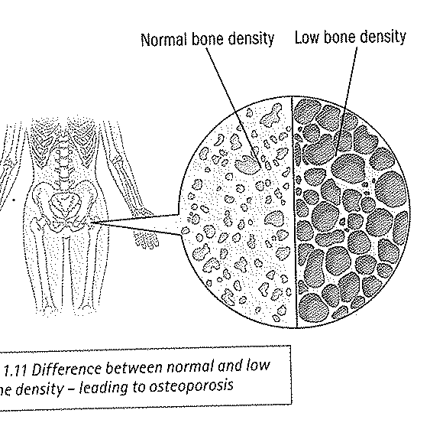
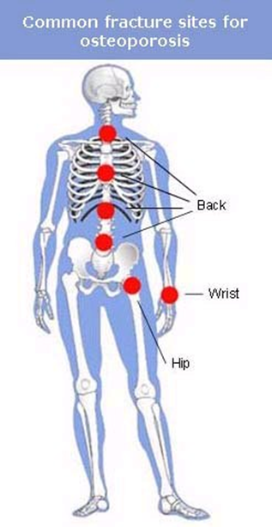
OSTEOPOROSIS

Slide 33
Work Sheet
Using the type of activity below state the significance on bones and link to Osteoporosis.

Slide 34
Osteoporosis
Common bone disorder, usually in the elderly but can be any age affected
Caused by low bone density and deterioration of bone tissue
This makes the bone prone to fractures and breaks.

Slide 35
Osteoporosis Risk Factors
Inactivity in childhood, adolescence or adulthood
Having a serious injury that leads to sedentary lifestyle

Slide 36
Osteoporosis and Physical Activity
In early adulthood, bone growth is almost complete - this is the time when the bones have reached their peak density.
High impact activity at this time can assist peak bone density.
Activities such as load-bearing (weights), resistance and strength training can have a positive effect on bone health and reduce risks of osteoporosis

Slide 37
4 types of PHYSICAL
CONTACT
LOW IMPACT/
REPETITIVE
HIGH IMPACT
Rugby
Jogging
Tennis
Gymnastics

Slide 38
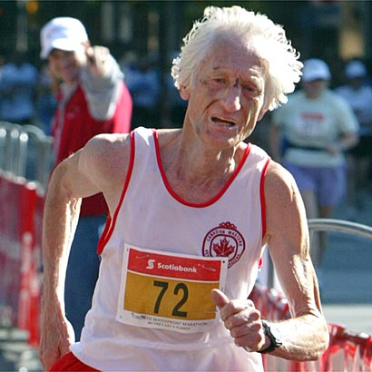
Osteoporosis
Impact of High Impact Activities if suffering from Osteoporosis
Greater risk of bone fractures
Especially jumpers, basketball (hard surfaces), runners

Slide 39
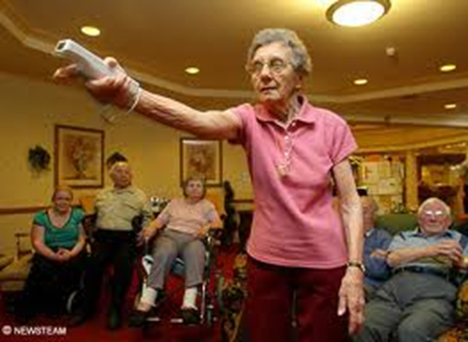
Impact of Repetitive Activities if suffering from Osteoporosis
Potential overuse Especially jogging, throwers, racket sports In moderation, can stimulate greater bone density - caution

Slide 40
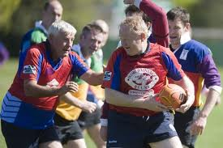
Impact of Contact Activities if suffering from Osteoporosis
Greatest risk of fractures
Especially rugby, kick-boxing

Slide 41
Prevention or management of Osteoporosis.
Manage weight?
Reduction in weight reduces the amount of stress on the bones.
Taking part in physical activity that is low impact can increase the bone density.
Some high impact activity (in moderation can increase bone density).
Linked to where the injuries usually take place, if you increase core strength you can reduce strain on spine.

Slide 42
WHY DO IT?
PEAK BONE DENSITY
A time at the end of adolescence where the bone is at its strongest.
Developed through physical activity. Strength training increases bone density
Should be a gradual increase overload in intensity caution
With some caution, can increase bone density
Increases calcium deposits at the epiphyseal plates – strengthens bones and reduces risk of fracture
“So why are we trying to encourage the next generation to take part in sport if it’s so bad for us?”

Slide 43
Taking part in physical activity is considered essential to maintaining a healthy lifestyle. However, taking part in some activities can result in injury and a reduction in activity levels.
Discuss both the positive and the negative impact of participating in different types of physical activity on the joints and bones [6]

Slide 44
Other answers;
Increase in peak bone density/ calcium deposits.
Weight reduction so less weight on weakened bones.
Weight reduction so less weight on growth plates.
Increased core stability reduces likelihood of problems with lumbar vertebrae.

Slide 45
Joints
Osteoarthritis

Slide 46
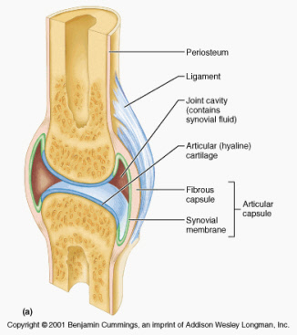
Joints:
Draw and label a synovial joint.
White boards.

Slide 47
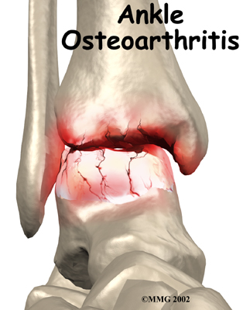
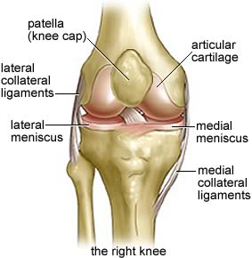
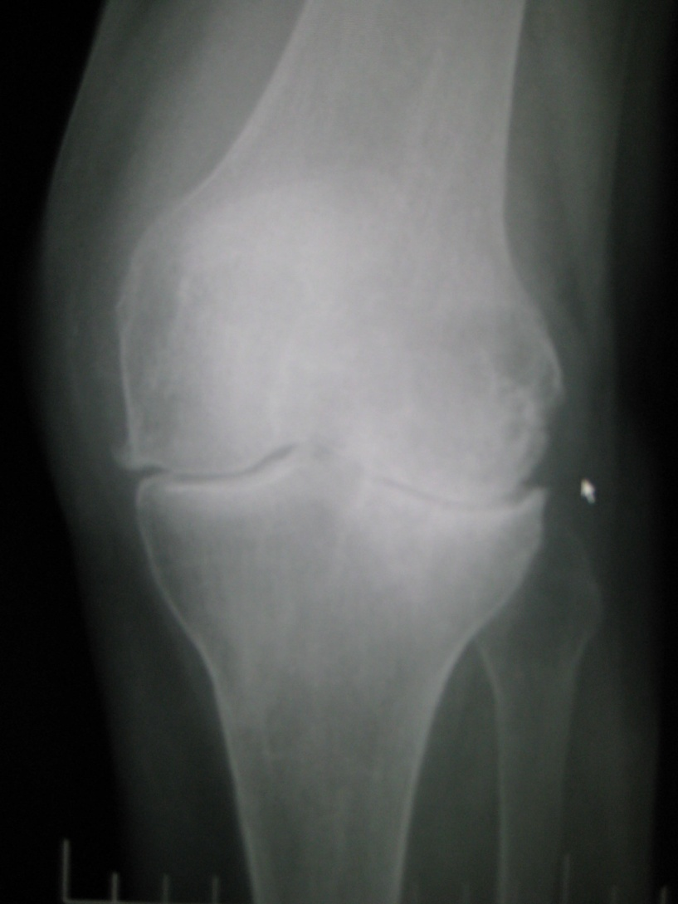

Slide 48
Arthritis and Osteoarthritis
Places affected: Hands knees hips spine
Cause: unknown
Risk factors overweight
Joint injury
Repetitive strain
Problem with alignment
Family tendency
Process= Reduction of articular cartilage
Bone spurs
Control
Medication
Ice-pack
Lifestyle –resting
Loosing weight
Physical activity/ low impact to increase muscles to support joint
Increase strength of tendons
Increase strength of ligaments
Increase in strength of articular cartilage

Slide 49
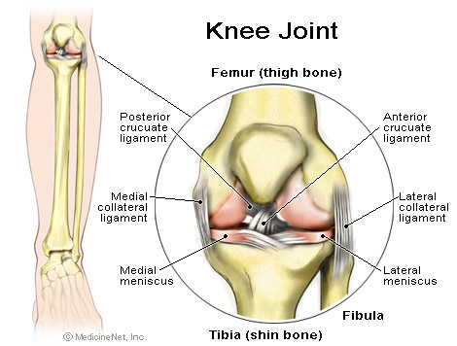
Joint stability
Joint stability ; refers to the ability of the surrounding muscle and ligaments to resist movement.
Increase in ligament strength increases the stability.
Answer: Yes
Physical activity strengthens ligaments and cartilage, allowing stability when performing eg, golf swing, place kick in football of the supporting leg. A reduction in physical activity will lead to a shortening of ligament reducing flexibility, leaving them prone to injury. Muscle tone is reduced surrounding the joint loosing stability. Can lead to a reduction in synovial fluid and ease of movement.
Is this a good thing for sport?
Can you give a sporting example that will help explain your answer?

Slide 50
Knowledge check : Do you know ?
The functions of the skeleton (bones)
Axial & appendicular skeleton
The 5 types of bone – structure /function
Structure and characteristics of a long bone (anatomy)
How bones grow?
The effects of PA (contact, high and low impact / repetitive activities on bones
The descriptions and impact of exercise on osteoporosis and growth plate problems

