Slide 1
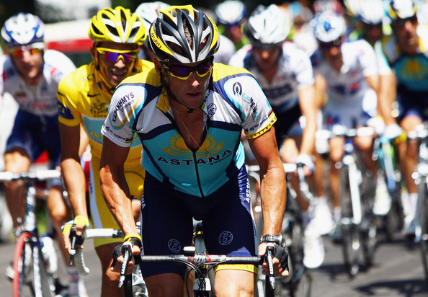
Ethics and Deviance in Sport Part 2

Slide 2
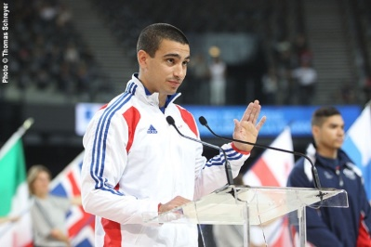
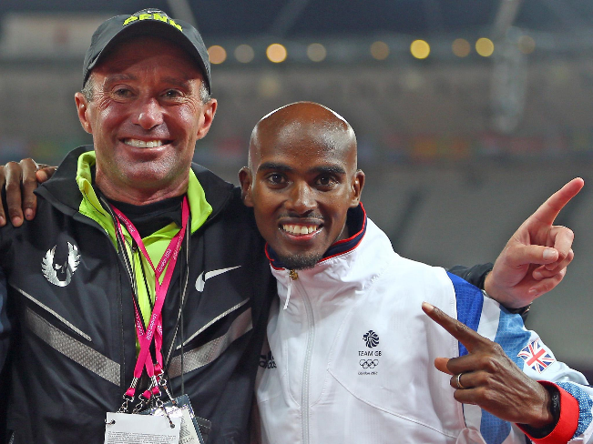
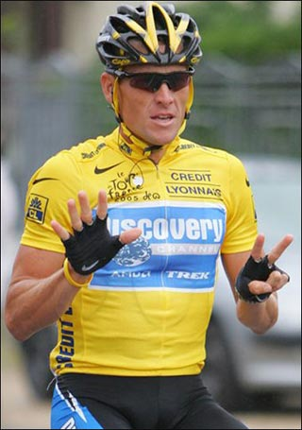
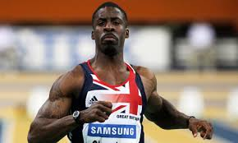
Reasons to take illegal Drugs
Pressure:
Coaches
Friends/Family
Performers

Slide 3
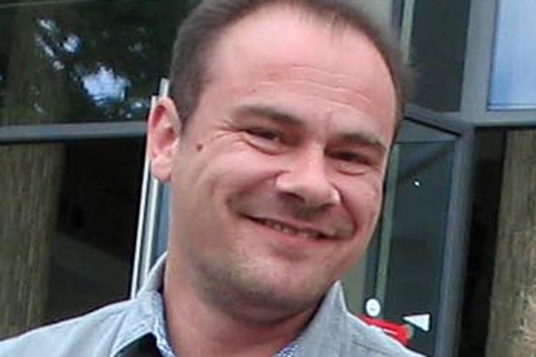
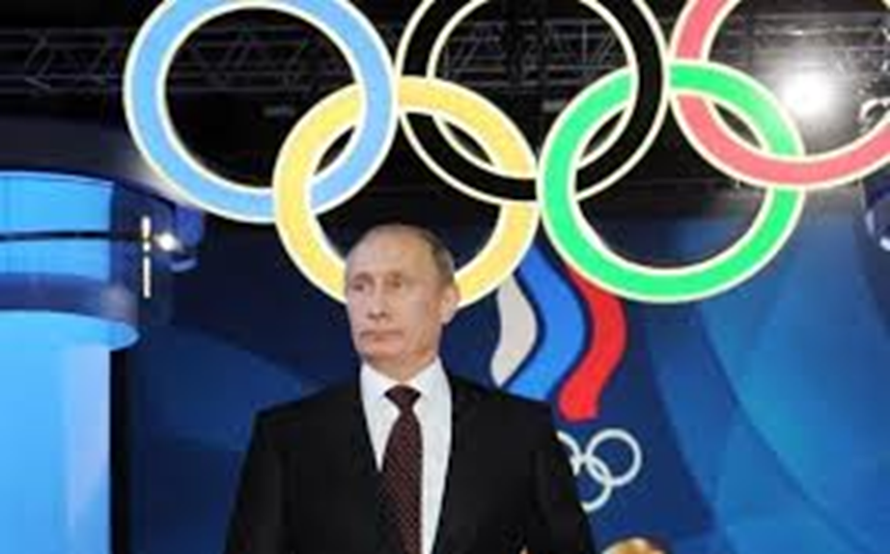
Pressure: political
Systematic cheating
Whole systems cheating.
East German Doping Programme
Russian Athletes banned.

Slide 4
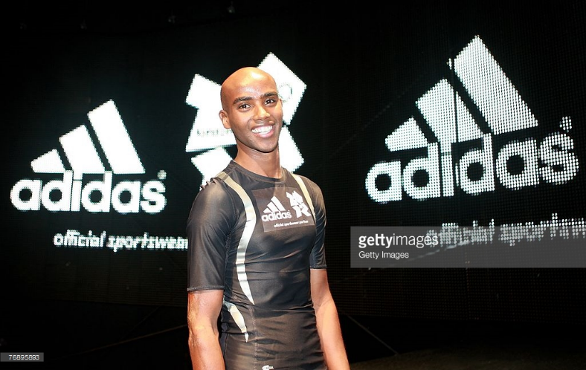
Pressure to take illegal drugs

Slide 5
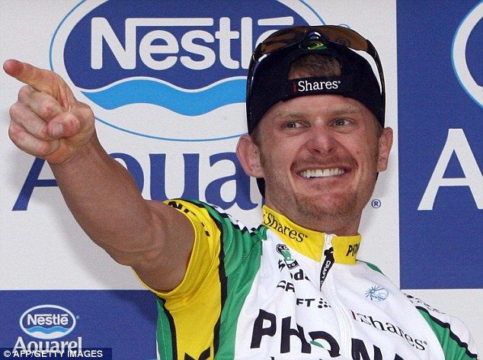
Reason for taking drugs in sport
“Everyone else is taking them”.
Sharapova
(Tennis)
Floyd Landis (Cycle)

Slide 6
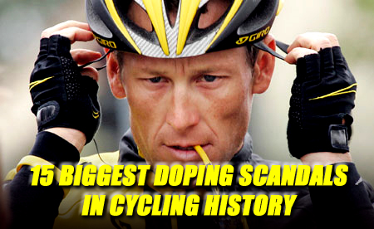
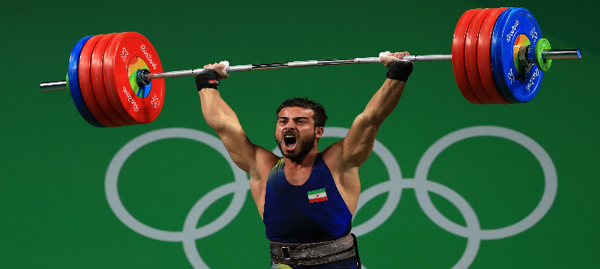
Consequences
Wonder if you lose to a clean athlete.
Discredited sport!
Discredited country and society.
Morality- Gives an unfair advantage
Health
Against the law
Role model- bad example

Slide 7
Strategies
(educate performers) | educate performers/make performers aware of dangers or aware of moral issues/education at schools or clubs/100% ME
(educate coaches) | educate coaches/make coaches aware of dangers/awareness of moral issues/100% ME (if not given above)
(punishments) | stricter punishments/life bans/standardisation of punishments/Olympic ban/harsher consequences/return of medals or funding/lose records
(testing) | stricter or random or targeted or more testing/out of season testing/more money for testing
(role models) | role models or Sports Ambassadors to publicise or encourage drugs free sport/’name and shame’
(research) | more research into dangers/research into testing
(counter-culture/legalise) | make performance enhancing drugs legal/radical action
(WADA) | WADA/standardise world wide doping policy

