Slide 1
AMS Screencast
Motor programmes, open and closed loop control

Slide 2
Motor programme
Plan of the whole skill
Every skill in sport is the product of a motor programme.
Hierarchical
Grooved
Executive motor programme (EMP)
Sub routines
Sub routines
Sub routine
Back swing
Forward swing
Ball toss

Slide 3
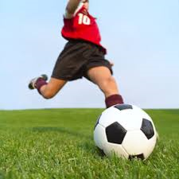
Examples of a sub-routine of a executive motor programme
Planting foot next to the ball
Forward swing
Executive motor programme (EMP)
Sub routines
Sub routines
Sub routine
Follow through

Slide 4
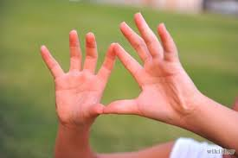
Open loop control level 1
Memory trace
The plan or EMP stored in the long term memory
The action of the working muscles. (movement effectors)
The memory trace is formed when the skill has been well learned.
Open loop control does not produce feedback
Can’t change the movement during performance. Open loop is thought to start all motor skills

Slide 5
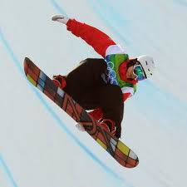
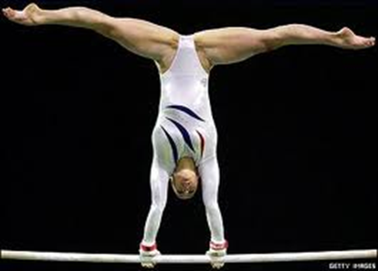
Closed loop control
The memory trace has triggered a response.
At this level the feedback loop is short.
This allows quick subconscious corrections to take place.
Although subconscious these adjustments are stored in the LTM
The plan or EMP stored in the LTM
The action of the working muscles (movement effectors)
Memory trace
Feedback via Kinaesthesis
Perceptual trace

Slide 6
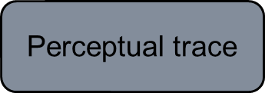
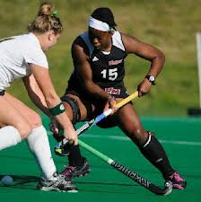
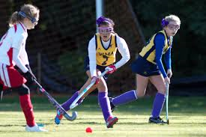
Closed loop level 3
The memory trace has triggered a response.
The feedback loop is longer as it relayed back to the brain.
Control or modifies the movement.
Changing direction when dribbling.
Reliant on feedback as we have not yet developed correct feel
The plan or EMP stored in the LTM
The action of the working muscles (movement effectors)
Conscious feedback via the brain

Slide 7
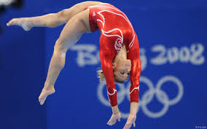
Application
Open loop initiatives the movement but has no feedback e.g. jump onto the beam. (memory trace).
Closed loop level 2 (perceptual trace/feedback via kinesthesis) Balance on the beam and make adjustments if required.
The perceptual trace completes the loop.

Slide 8
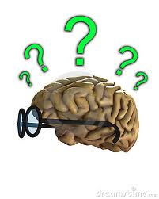
Draw backs of Adams Open and Closed system.
If a separate plan or memory trace is needed for each skill it would not be possible to store such an infinite number of motor programmes. Therefore, retention is a problem.
If it were possible to store all the motor programmes it would be difficult to recall the plan quickly enough to execute the skill.

Slide 9
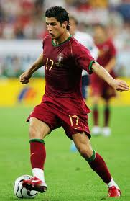
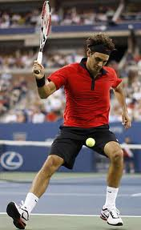
Novel response
Often responses in sport are creative, unusual. These usually arise in open skills and are called ‘novel responses’.
If the relevant motor programme does not exist, this theory can’t explain the ‘novel response’.

Slide 10
The End
What type of learner would you associate with each loop control?

