Slide 1
Mass participation and sporting excellence
Contemporary Sporting Issues

Slide 2
Objective of the session
Understand the funding approach to sports in the UK.
Understand the role of UK sports in supporting sporting excellence.
Understand the role of Sport England in supporting mass participation.
Understand the role of national governing bodies in supporting mass participation and sporting excellence.
Understand the role of government in supporting mass participation and sporting excellence.

Slide 3
The approach to sports in the UK
Amateur
Someone who participates for pleasure
May receive funding, but not a salary.
Professional
Paid to play, try and think of examples other than football.
Amateur approach
Professional approach

Slide 4
Approach to sports in the UK
Amateur Approach
Using unreliable, inconsistent and erratic methods; disorganised.
Casual with no real commitments and pressures in time, success or money.
Enthusiastic dedicated volunteers run clubs, etc.
Professional Approach
Using reliable methods
Highest quality coaching specialists
High quality facilities
Sports science support
Holistic approach
Explain the recent move away from the traditional amateur approach to sports in the UK to a more professional approach. 3

Slide 5
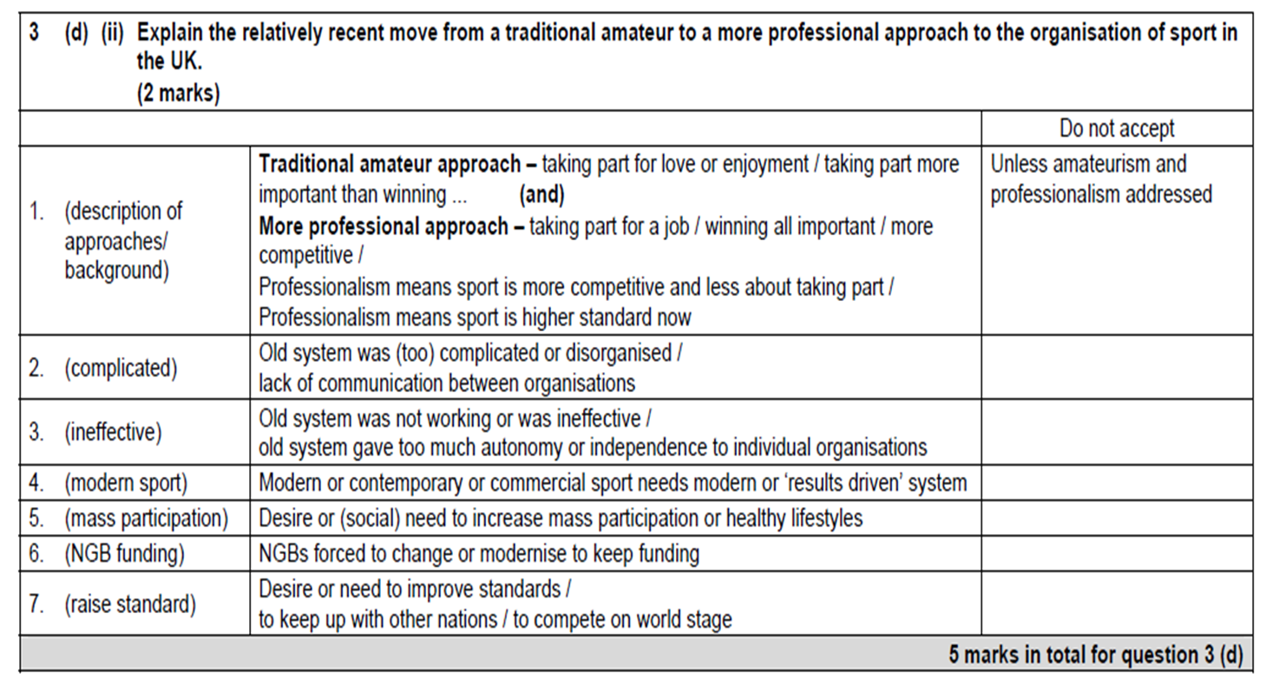
Mark Scheme

Slide 6
Q1 Can you explain the change in attitude of the government over recent years towards sport? Read the extract on page 241/256

Slide 7
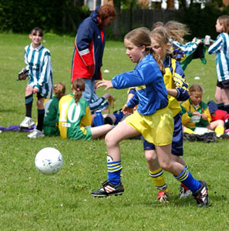
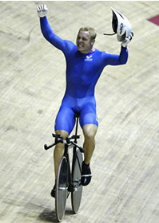
Do we support the bottom?
Medals cost money but how do we get them?
Do we support the top?
Sporting excellence
Mass Participation

Slide 8
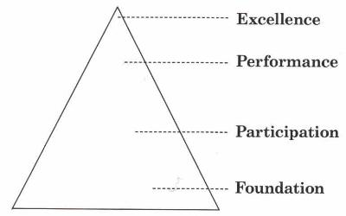
SPORTS DEVELOPMENT PYRAMID
Do we support the bottom?
Do we support the top?

Slide 9
SPORTS DEVELOPMENT PYRAMID
Where would you put yourself on the Sports development pyramid?
Ensure that you use this information in your EPIP
Level | Description | Egs
EXCELLENCE | Elite – National / International Specialist coaching Sport Science support Committed performers - professionals
PERFORMANCE | Serious club or school representation Focus = winning & competition Skill, competent, training, coaching, committed District or county or regional
PARTICIPATION | School or club participation Focus = Non-comp, extra-curricular, FUN, health Recreational
FOUNDATION | Introduction to sport Learning basic skills Positive attitudes towards physical activity

Slide 10
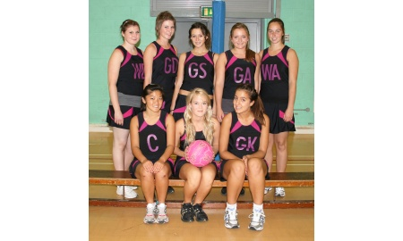
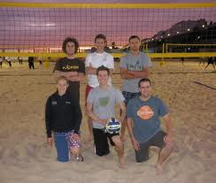
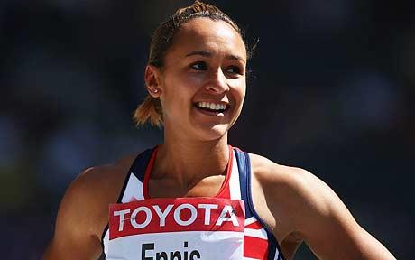

Slide 11
DCMS
Department of Culture and Media
The DCMS is the government department that is responsible for sport. It decides and organises the funding and distribution of lottery money.
Lets have a look at the evidence that is in front of the DCMS to help them make their decision.

Slide 12
Funding from Government and local authorities, also National lottery
Funding from business, companies and investors, often by the way of sponsorship
Private
Voluntary
Public
Funding from donations or charities, some private clubs.

Slide 13
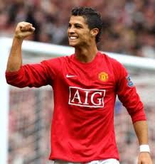
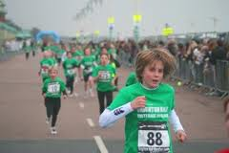
Where do these people get funding from?

Slide 14
Group work
In threes investigate one of each of the areas listed below.
Your task is to discover what each organisation is doing for mass participation or sporting excellence.
UK Sport
Home Countries (e.g. Sport England)
National governing bodies
Government.

Slide 15
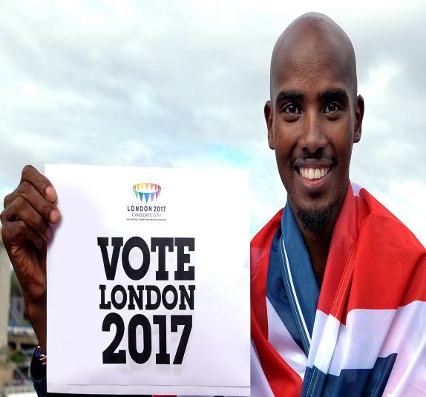
UK sports funded from the Lottery
World class podium
World class development
World class talent
Home country development system
0
-2
-4
-6
-8
Sporting excellence programmes
World class pathway programme
World class events programme
What happened on Friday at 4pm? Oct 2012
We won the bid for the 2017 world athletics to be hosted in England.

Slide 16
UK Sports Institutes for Sport
A network of satellite centres giving practical
Support to UK’s top sportsmen and women.
How do they do this?
Sports science support
Biomechanical advice
Physiotherapy
Strength conditioning
Seeking to achieve a holistic development.
(All aspects of the athlete)

Slide 17
UK Sports Talent identification
Are you tall and talented?
Can you go from pitch to podium?

Slide 18
Home Countries Sports England
Develop and encourage mass participation.
Create more opportunities for young people to play sport
Nurture and develop talent
Provide the right facilities in the right places
Support local authorities and unlock local funding
Ensure real opportunities for communities

Slide 19
Government initiatives
National Curriculum
Competence
Performance
Creativity
Healthy active lifestyle

Slide 20
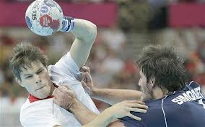
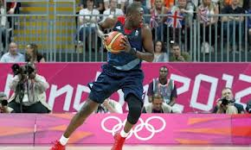
National Governing Bodies
Increase participants from grass roots to elite level
Increase international success
What happens if you don’t fulfil your Whole sports Plan?
Reduction in funding from the Home country council (sports England).
Where do they get there funding from?
Depends on which NGB you are talking about.
Who are they trying to support?
Mass participation and Sporting Excellence.
Whole sports plan.

Slide 21
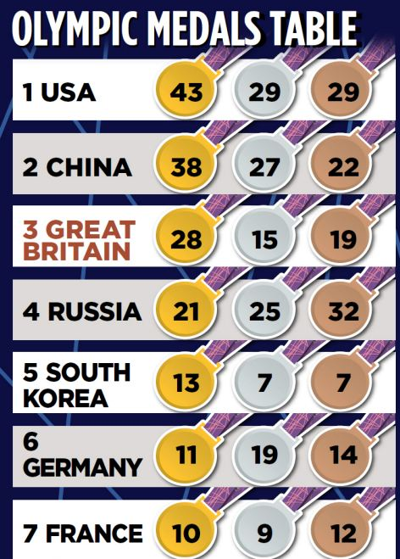
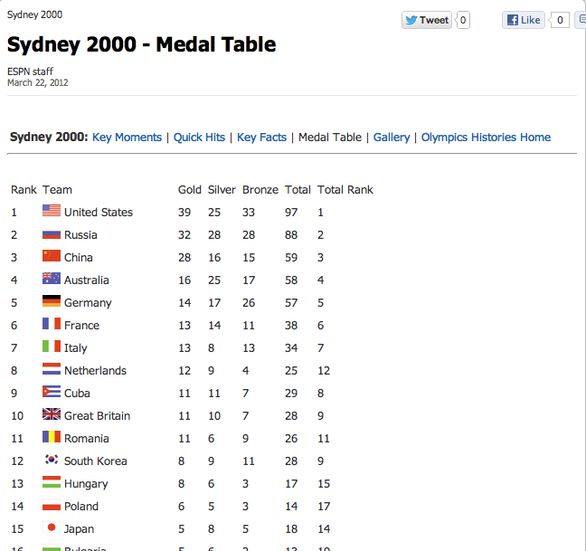
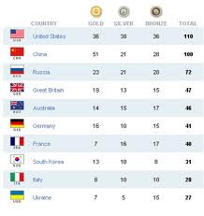
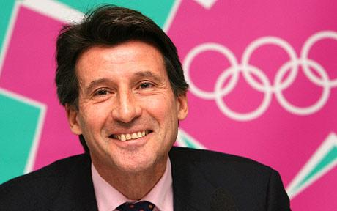
British Olympic Association
Dedicated to obtaining the Olympics for the country.
Looks after all aspects of the British team during and after the Olympic games.
Submit the bid for British Sports.

Slide 22
IOC
International Olympic Committee
Decides who gets the Olympics?
“The games is awarded to the city of……….London”.
Non profit organisation
Obtains funding from T.V and marketing.

Slide 23
New professional approach to Sport in the UK
Has this new professional approach to sport been successful ?
Has there been a legacy left for the next generation?

Slide 25
Department Culture Media Sport
Where does the DCMS get it’s money from?
Who does the DCMS give it’s money to?
Mass participation | Sporting excellence
Sports England National Governing bodies Sports Coaching | UK Sports National Institutes for sport

Slide 26
FUNDING - + / -
PRIVATE – TV rights, ticket sales - (buy TV rights, sponsor teams)
PUBLIC – taxes, national lottery sales (DCMS) - (awards and grants, community provision / facilities)
VOLUNTARY – A4 All, NGB, fundraising - (facility, coach fees)

Slide 27
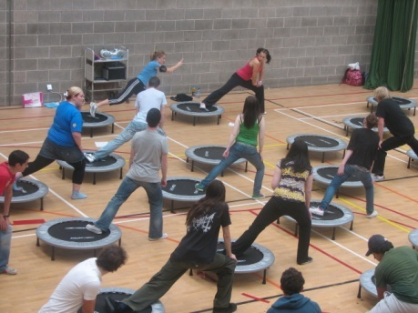
What is Mass Participation and what are the benefits?
INCLUSIVE CONCEPT
Taking part not winning; health, enjoyment and fitness.
All should have the choice and opportunity to participate in activity.
Benefits
more participate and so more potential for finding sporting excellence (this isn’t the intention though’.
Remember – Lifelong PA; Lifetime Sport; Lifelong participation

Slide 28
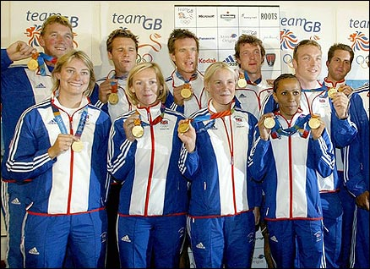
What is Sporting Excellence?
EXCLUSIVE OR SELECTIVE CONCEPT – few make it
‘A state of exceptional merit or quality’– elite, professional, highly skilled and committed performers at national or international level!
Have sports science support – physios, analysis, biomechanists
More make it in some countries. WHY? Oz / USA?

Slide 29
Funding
How have we managed to achieve such success in the last two Olympics?
What has been the difference?

Slide 30
Where do these people get funding from?

Slide 31
Homework
Investigate what your National governing body is doing to increase mass participation and sporting excellence.
Investigate what the International Olympic committee do and the British Olympic Association
Complete Biomechanics question on the VLE.

Slide 32
National Governing Bodies
It’s fine to know the answer but we need to write it showing our depth of knowledge.
Correct terminology
Reference previous knowledge
Give examples
Think of alternative points of view if asked for.

Slide 33
A: The DCMS distribute money to develop mass participation and sporting excellence which can go to National governing bodies. However, they may not all get the same amount due to some sports getting substantial funding from private sources. The FA gains money from sponsors and shirt sales so they don’t need a great deal of support compared to squash. So squash will receive more funding to support and develop the sport, for example creating programmes or developing provisions like more courts.

Slide 34
END

Slide 35
UK Sport – UKSI / EIS and support network; World Class Pathway programme (Podium, Development, Talent); TASS; World Class Events Programme; NGBs;
IOC / BOA - International Olympic Committee & British Olympic association

Slide 36
Govt – NC; PESSCLs Strategy
Home Country Councils – SPORT ENGLAND: invest & advise to stay & succeed; support PESSCLs – club links; volunteer, coach, officiate; ‘Sport champions’ visits

Slide 37
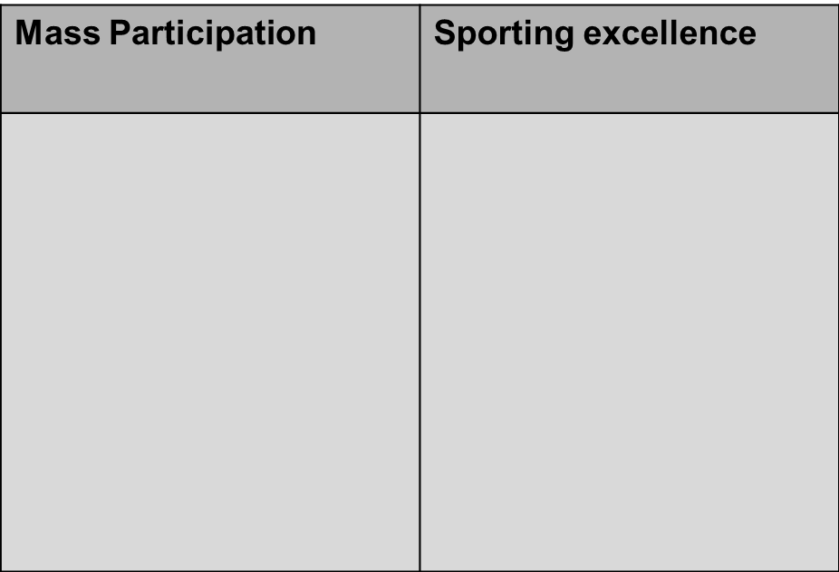
SCHOOL Tom is a 15 who is taking part in the compulsory part of physical education and is taking GCSE P.E. Tom plays for the school team at football and has recently started a CSLA award. Tom was selected by the school to go for trials for the county team, however, he didn’t get in because he was rubbish. (kidding) . Tom parents have recently been looking into scholarships at different sports colleges but Tom is keen to stay at his current school.

Slide 38
Sports Coaching Lauren is 17 and has been injured for the last two years in her sport of gymnastics. However, Lauren has been coaching the junior group at her local club. Lauren has been approached by her coach to take her coaching badges at gymnastics. Lauren spend a lot of time doing college work so can’t commit, however, the coach has suggested taking advantage of the distance learning to get her award. If Lauren takes the badges she might be able to get funding from the National governing bodies.

Slide 39
Sports England Callum is a P.E teacher in a new school in Crawley. Callum is very keen on setting up new activities like orienteering and Lacrosse. The school have said they have no money for new activates due to the recent financial climate, however, he might try sports England.

Slide 40
UK Sports Ryan has just been selected for the England common wealth games at hammer. This was a surprise to Ryan as he has never thrown the hammer. Ryan must now prepare for his trip and needs funds to go to Delhi for the games. Ryan is considered to be one of the best hopes of a medal in 2012 as is expected to finish on the podium.

