Slide 1
THE OLYMPIC GAMES
Philosophy and organisation

Slide 2
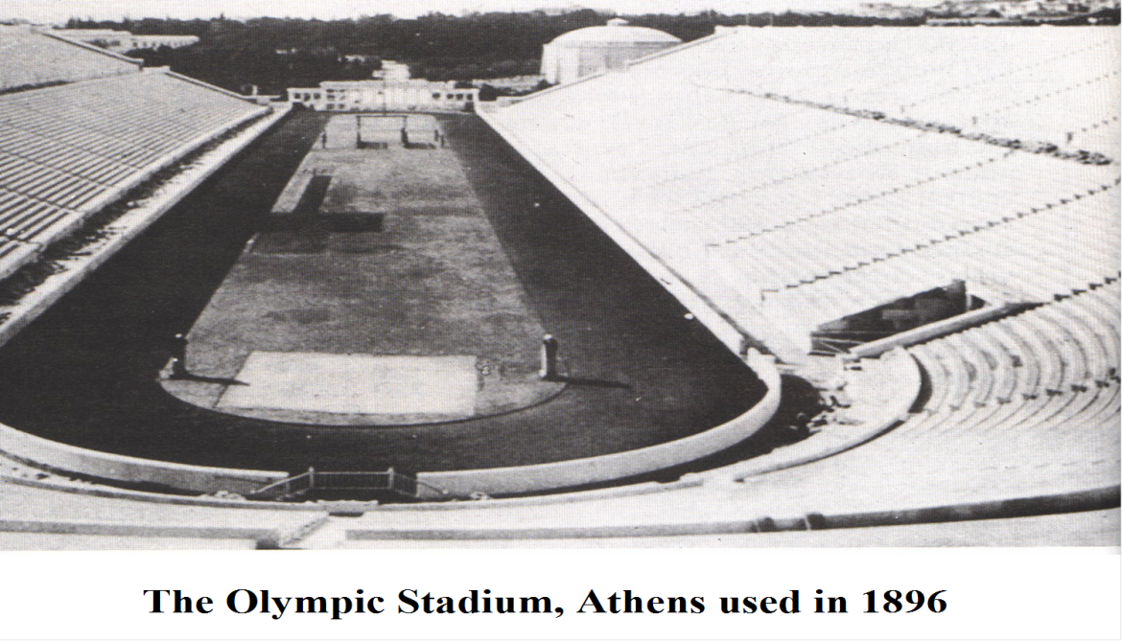
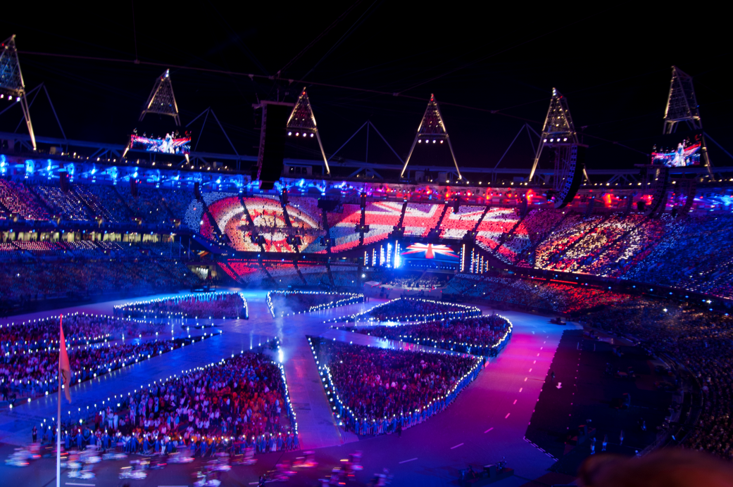
https://www.youtube.com/watch?v=TbsXUJITa40

Slide 3
The vision of Baron Pierre de Coubertin in establishing the modern Olympic Games on 1896
The principles, aims and philosophy of the Olympic Games
The British Olympic association and the International Olympic Committee – two bodies that are central to Olympic organisation and administration

Slide 4
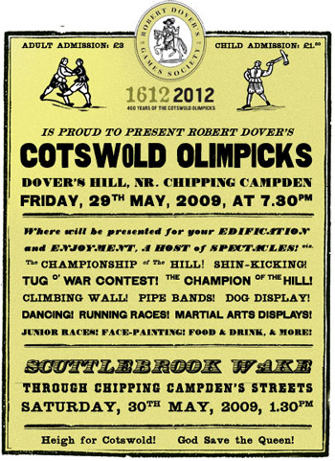
You will not be asked direct closed questions on the Ancient, Robert Dover or Penny Brookes’ Much Wenlock games.
However, you may be asked a question that tests your knowledge of the background of the games.

Slide 5
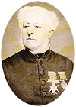
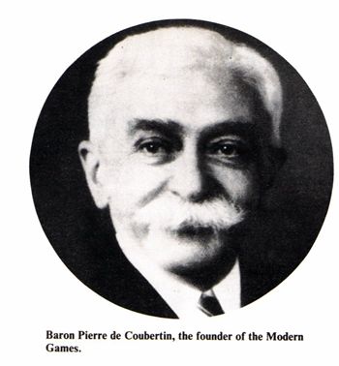
William Penny Brookes – Much Wenlock Games
Doctor in Much Wenlock
Founded MW Games – 1880 (still annually)
To promote moral, physical and intellectual improvement in townspeople
Opening ceremony, athletics, football and traditional country sports (quoits)

Slide 6
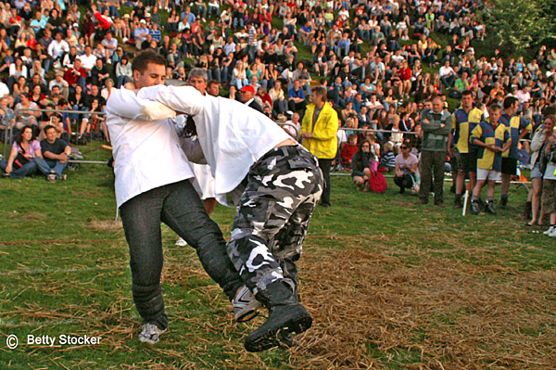
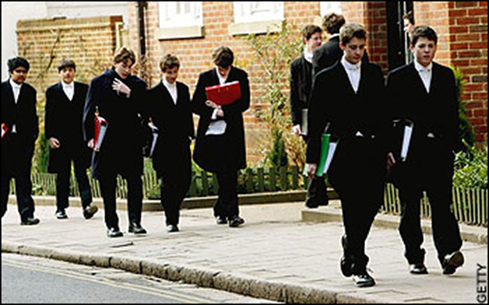
Observed games like cricket, football, athletics, and traditional country sports
Considered games to be the vehicle for promoting courage and manly young men who could take leading roles in society.

Slide 7
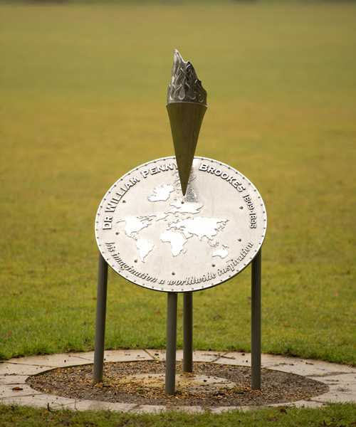
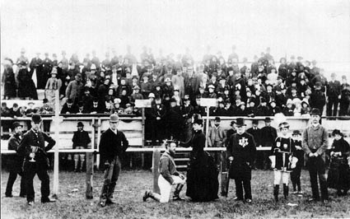
Penny Brookes died age 86 four months before the 1896 Olympics
President of the IOC visited Dr Brookes grave and stated, “he was the true father of the modern Olympics

Slide 9
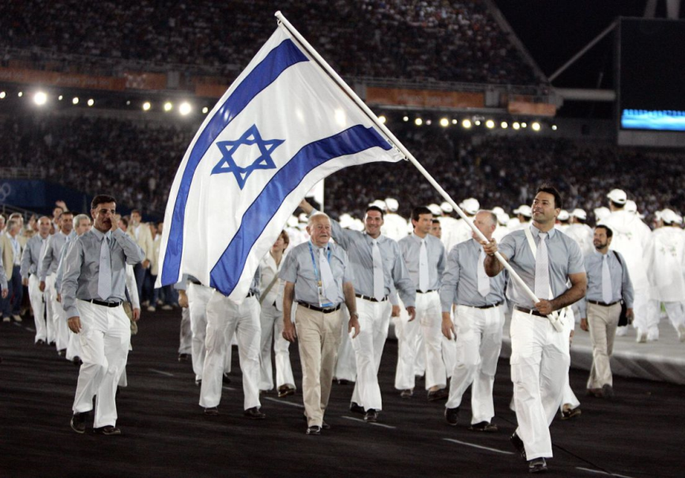
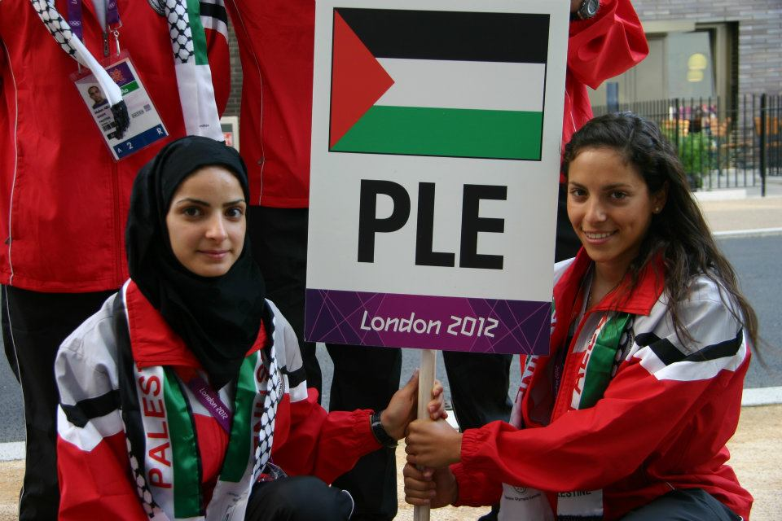
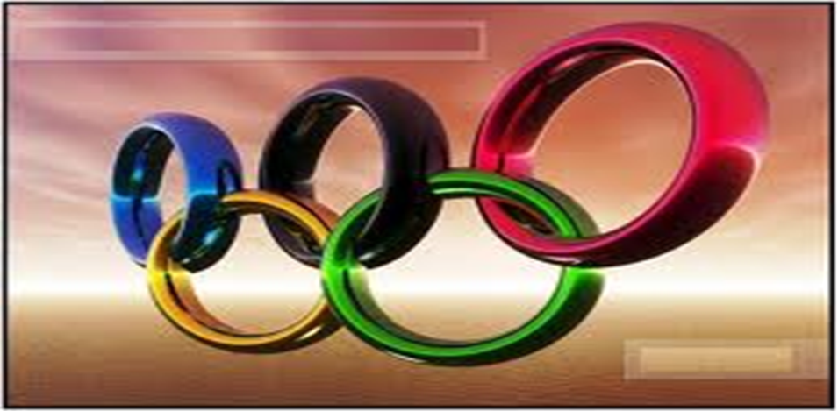
The principles, aims and philosophy of the Olympic Games
To promote the development of the physical and moral qualities that are the basis of sport.
To spread the Olympic principles throughout the world, creating international goodwill.
To bring together athletes from around the world.
To educate young people through sport in a spirit if better understanding.

Slide 10

Values of the Olympics
FRECODIE!
FRIENDISHIP
ReSPECT
Excellence
COURAGE
DETERMINATION
INSPIRATION
Equality
FOR EXAMPLE?
Creating friends from one athlete to another at an elite level, can be seen by others and mirrored.

Slide 11

British Olympic association
Key facts
Formed in 1905
Responsible for team GB participation in Olympic games.
For supporting for team GB before and during Olympic games. WIN/SUM.
Select team GB
Responsible for Olympic bids
Responsible for the promotion of the Olympics movement throughout the UK.
Help to educate the public about the Olympics
Interesting fact:
Only one of five countries to have been represented at each Olympics since 1896.
Has no government ties, completely dependent on commercial sponsorship.

Slide 12
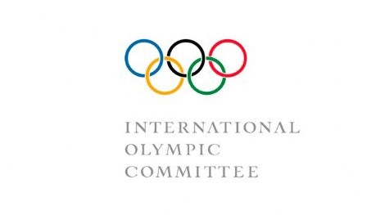
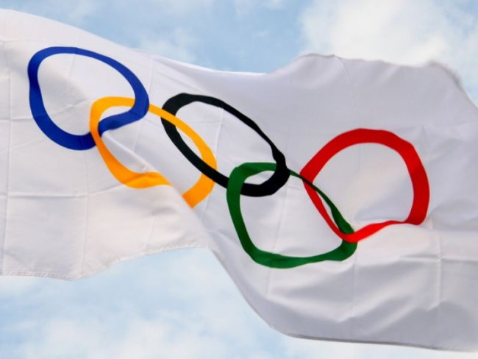
International Olympic Committee
1894
Owns the rights to the Olympic symbol
World governing body
Members are appointed to the IOC.
Responsible for the selection of the host cities for the winter and summer Olympics.

Slide 13

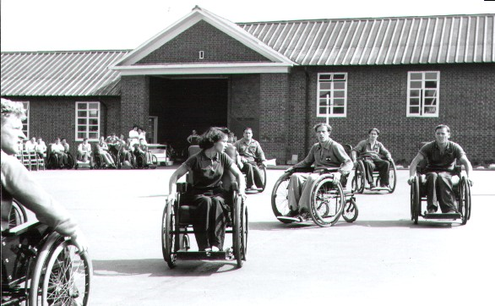
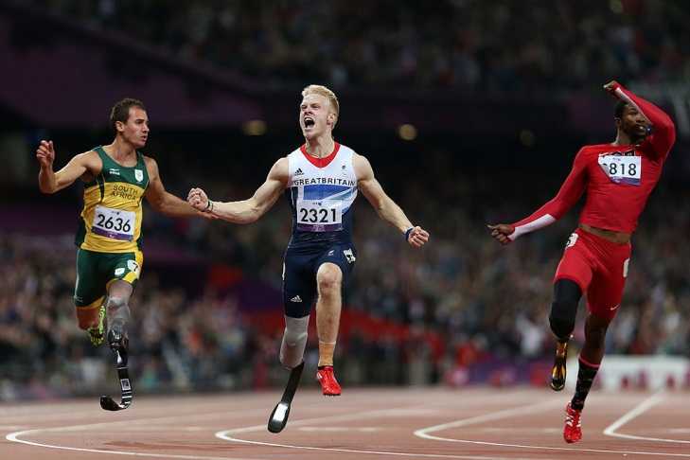
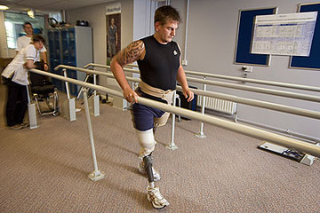
Originated as a sports competition involving second world war veterans, injured in the line of duty.
1960 Rome was the first Olympic style games for disabled athletes.
1976 Toronto other disabled groups were added.

Slide 14


Slide 15
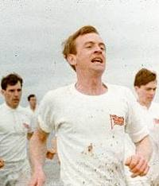
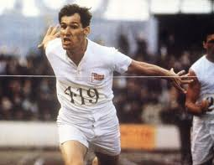
Olympics
“Taking part is much more important than winning old boy. You have to maintain fair play”.
Until recently the modern games were strictly for amateurs.
You had to be a gentleman by birth.
“Fair play! All I’ve done is practice and tried to be the best I can, how is this an unfair advantage?”
“Well for one thing you have employed a coach. You either have it or not old chap”.

Slide 16
Amateurism
Even though you may not got a direct question on amateurism this gives you an excellent understanding of the reasons for change.
Having an example will support your point.
What happened to the two cyclists who tried to compete in the 1896 Olympics?

