Slide 1
Take a copy of the Spider graph and then add a section on commercialism.
Unsure you add in the key terms
Commercialisation
University Scholarship
Sponsorship
T.V Rights
T.O.P Programme.

Slide 3
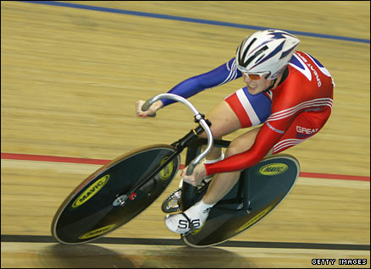
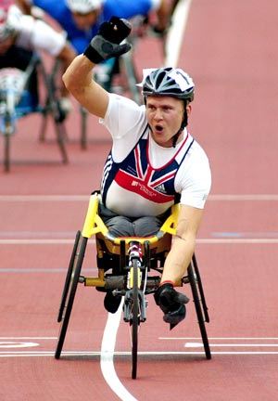
What are the benefits to SPORT of events like the Olympics?
Which SPORTS ??

Slide 4
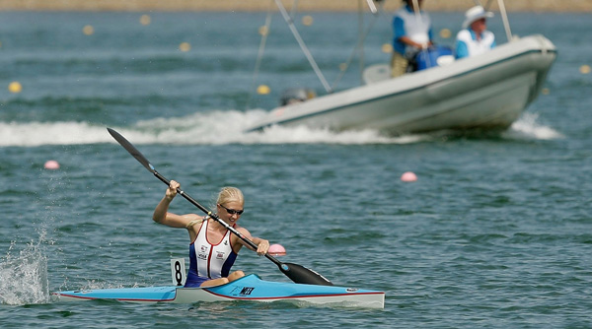
Rachel Cawthorn

Slide 5
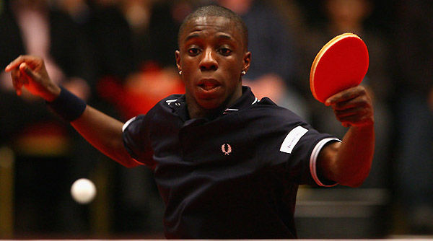
Darius Knight

Slide 6
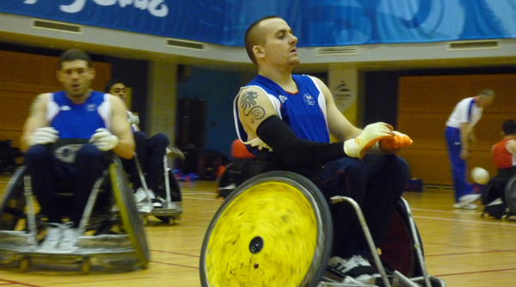
Andy Barrow

Slide 7
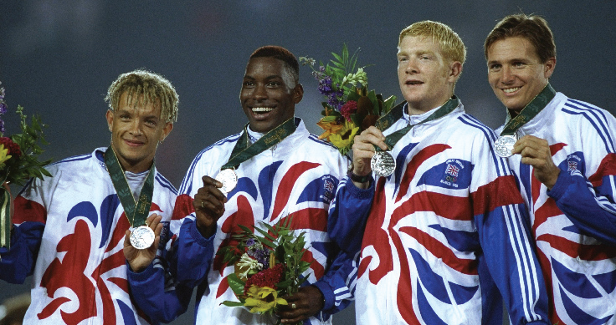
SPORTING EXCELLENCE

Slide 8
BENEFITS TO SPORT
More mass participation / base of sports development pyramid
Facilities – regional training camps
Funding
NHS provision
Legacy of facilities in London
Better organisation and administration
Higher profile in UK

Slide 9
What are the benefits to BRITAIN as a NATION for hosting the 2012 games?

Slide 10
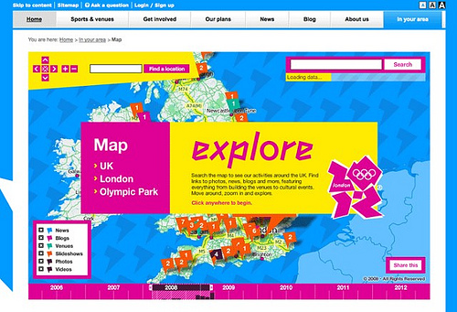

Slide 11
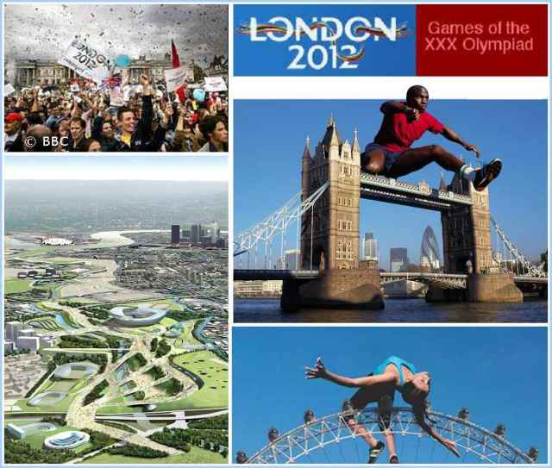

Slide 12
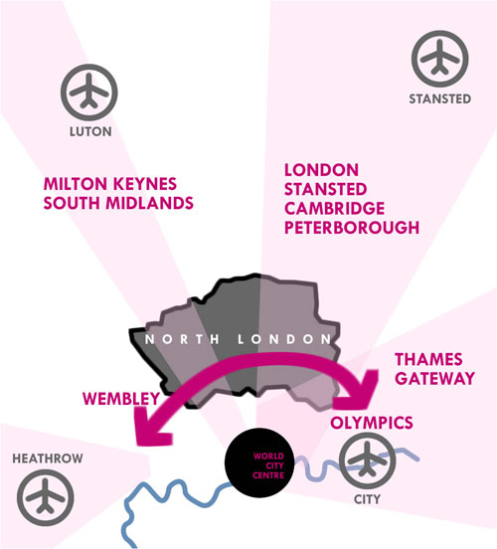

Slide 13
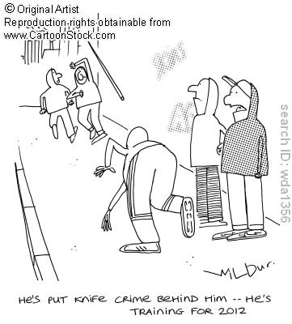

Slide 14
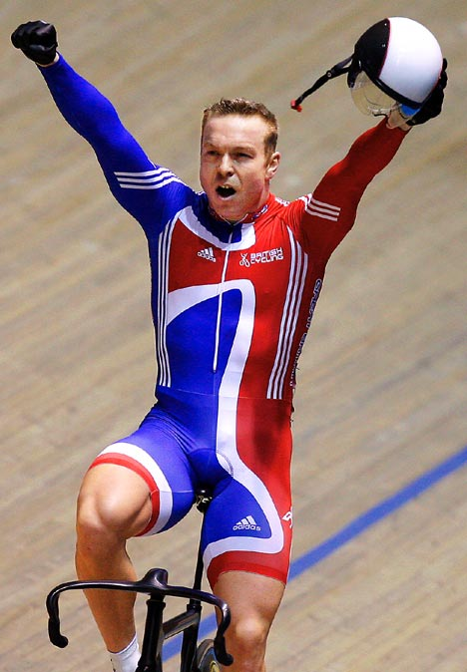
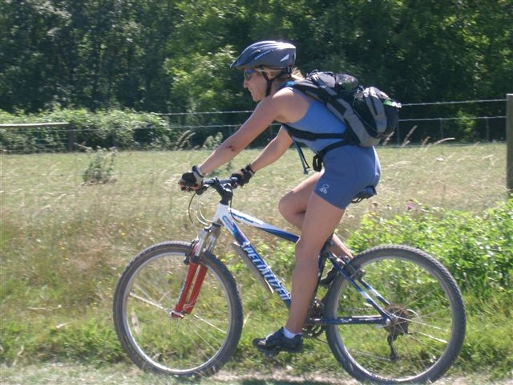

Slide 15
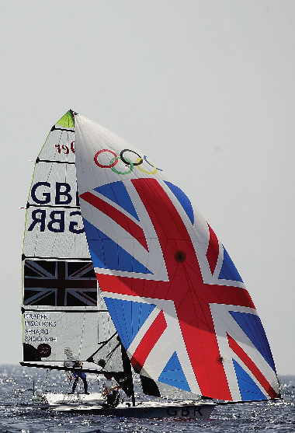
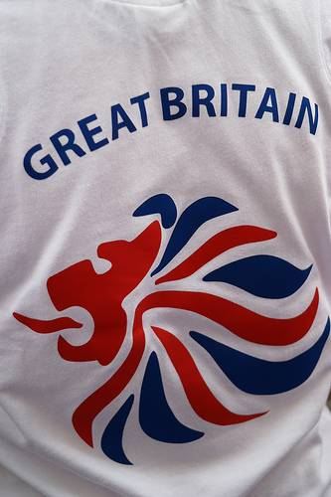

Slide 16
BENEFITS TO BRITAIN
Less discrimination – Paralympics and ethnic minority athletes
Tourism income
Business profit
Infrastructure – road and rail
Participation by youths
Health and well-being
Feel good factor for nation / pride

Slide 17
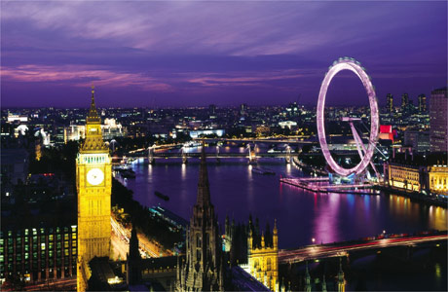
What are the benefits to London (the locality) for hosting most of the games events?

Slide 18
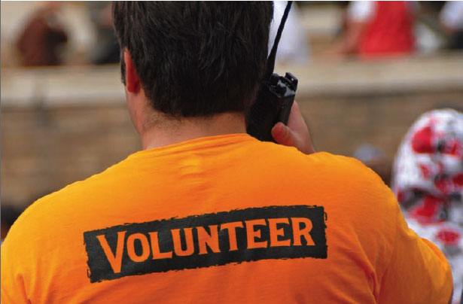

Slide 19
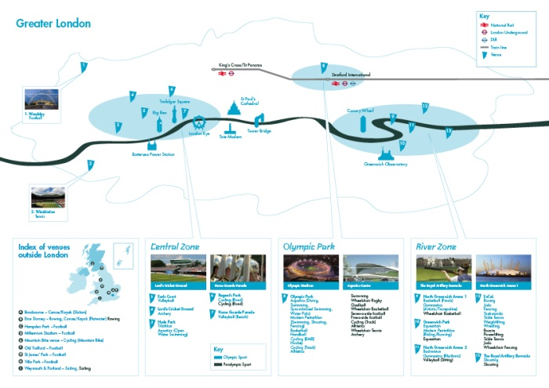

Slide 20
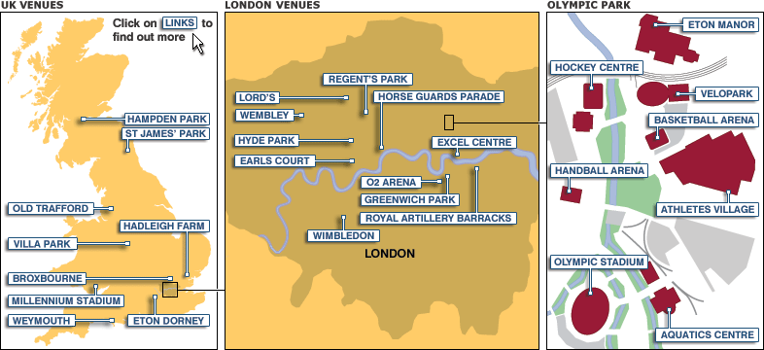

Slide 21
BENEFITS TO LONDON (East End)
Construction jobs / skilled jobs
Facilities
Urban renewal
Social integration and cooperation
Less crime
Well-being and sense of pride and belonging
Housing – ‘O village’ left for new residential community
London as business area

Slide 22
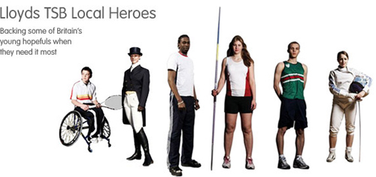
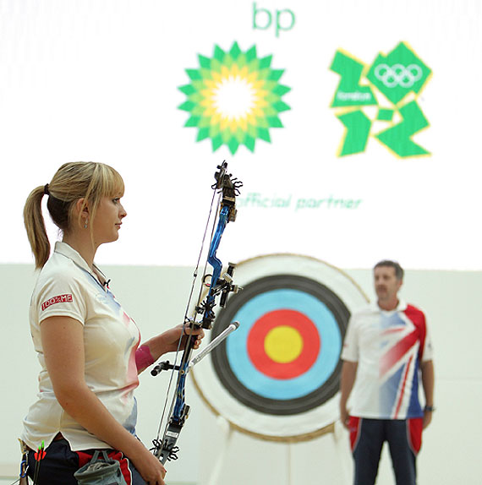

Slide 23
What are some possible drawbacks for hosting the games?

Slide 24
2012……………
SUCCESS ………
OR …………..

Slide 25
DISASTER

Slide 26
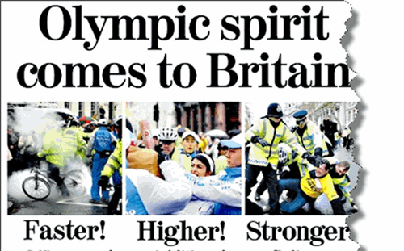

Slide 27
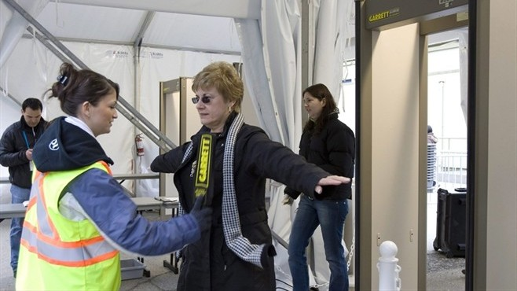

Slide 28
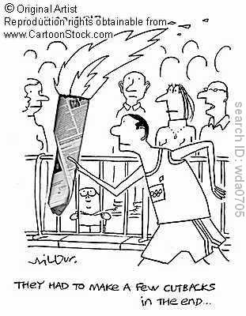

Slide 29
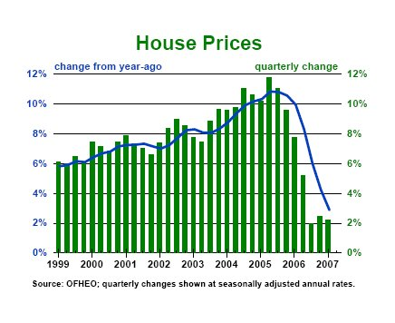

Slide 30
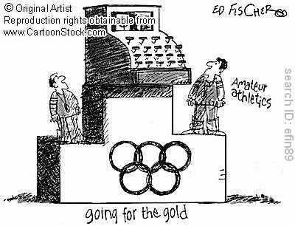

Slide 31
POSSIBLE DRAWBACKS – to nation and locality
Debt and miscalculated costs
Rising council tax to pay for it
No long term job opportunities
Rent and housing prices increase
Focus on elitism not participation
Benefits to Cornwall??

Slide 32
