Slide 1
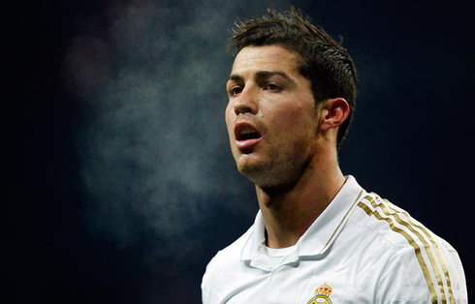
Control of Pulmonary ventilation

Slide 2
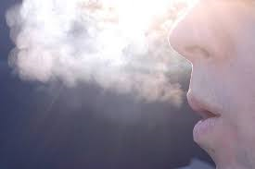
Control of breathing
What happens to O2 levels when we exercise?
What happens to CO2 levels when we exercise?
How does the body respond to these changes?

Slide 3
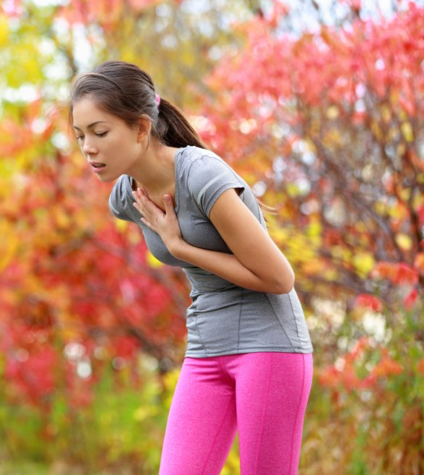
Respitory Regulation During Physical Activity
Breathing rate and depth are adjusted to meet the demands of the body
This is controlled by the respiratory control centre (RCC)

Slide 4
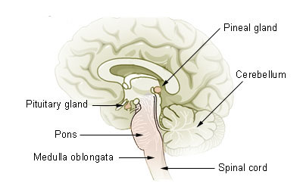
Respiratory Control Centre
The medulla oblongata in the brain contains the Respiratory Control Centre (RCC).
The RCC is responsible for regulating breathing rate and depth

Slide 5
RCC and Different Centres
The RCC consists of two different centres and controls rate and depth of breathing
The Inspiratory Centre (IC) stimulates inspiratory muscles to contract at rest and during exercise
The Expiratory Centre (EC) stimulates additional expiratory muscles to contract during exercise

Slide 6
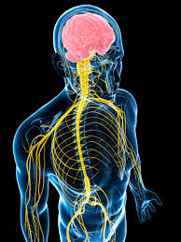
Inspiratory Centre (IC)
The IC is responsible for the rhythm of breathing
This uses the intercostal nerve to activate the intercostal muscles and the phrenic nerve to activate the diaphragm

Slide 7
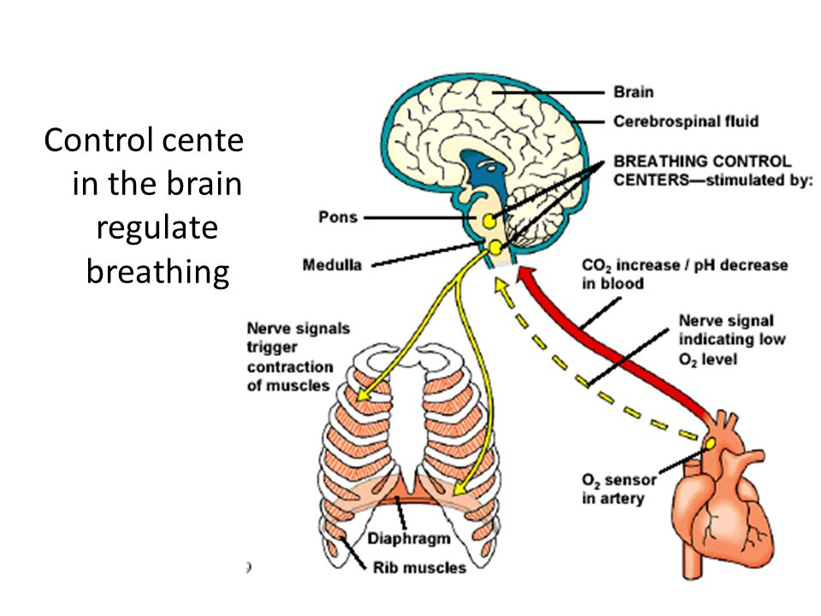

Slide 8
Neural Control Factors
During exercise, the RCC is stimulated by the following sensory receptors:
Proprioceptors
Chemoreceptors
Baroreceptors
Thermoreceptors

Slide 9
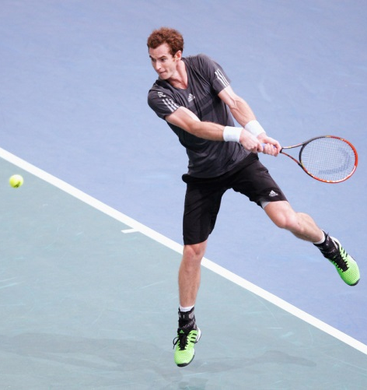
Proprioceptors
Proprioceptors are sensory receptors in muscles, tendons and joints that inform the RCC that motor movement has increased

Slide 10
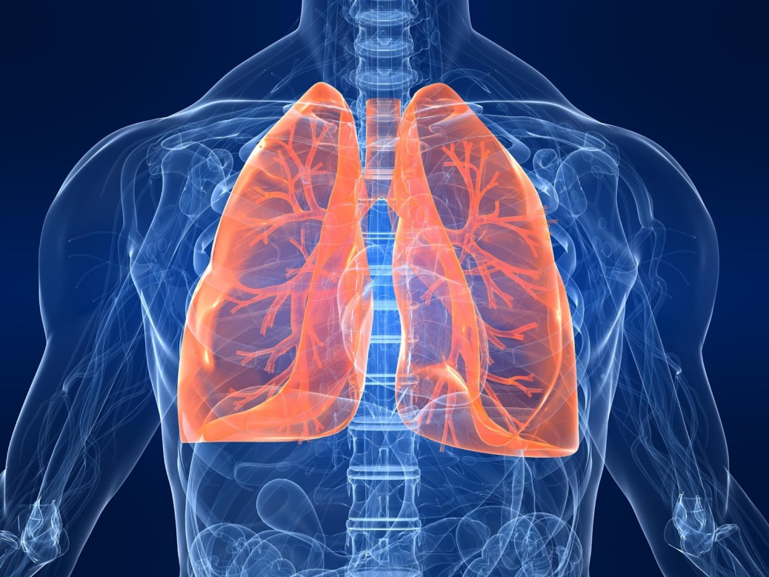
Chemoreceptors
Chemoreceptors are sensory receptors that are sensitive to chemical changes in the muscles, aorta and carotid arteries
Chemoreceptors inform the RCC that lactic acid and CO2 levels have increased
Chemoreceptors also inform the RCC that O2 and pH levels (acidity) have decreased.

Slide 11
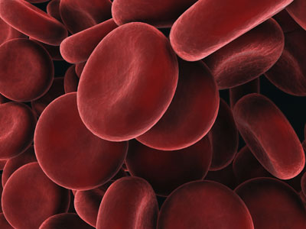
Baroreceptors
Baroreceptors are sensitive sensory receptors that stretch within the lungs
Baroreceptors inform the RCC about the state of lung inflation
They are also known as stretch receptors during exercise

Slide 12
Thermoreceptors
Thermoreceptorsend information to the RCC about the increase in blood temperature

Slide 13
Expiratory Centre – Exercise Only!
The Expiratory Centre is inactive during rest
BUT when exercising helps stimulate:
Sternocleidomastoid, Pectoralis Major and Scalanes for inspiration
Rectus abdominus and obliques for expiration

Slide 14
Stretching the Lungs
Baroreceptors inform the RCC about the state of lung inflation
As soon as the lung tissue stretch becomes excessive, the EC stimulates additional muscles to contract
This creates forced expiration

Slide 15
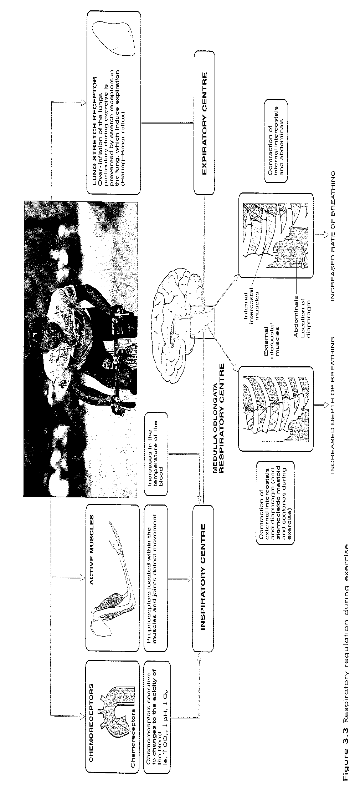

Slide 16
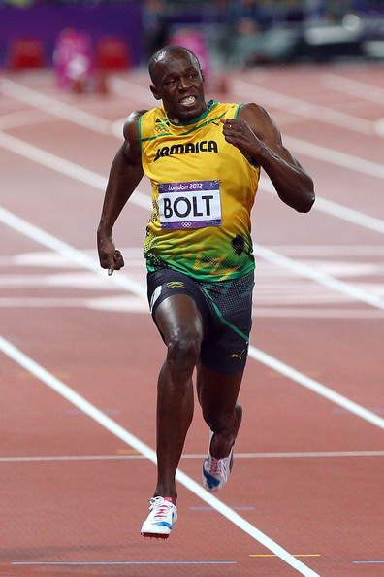
Task
Describe what changes happen to breathing rate regulation for a runner…
As they rest before the start of the race
As they start to run in the event itself

Slide 17
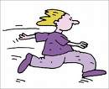
Earlier in exercise, TV (depth of breathing) is increased – which is better for alveolar ventilation (O2 getting to alveoli).
Later in exercise, BR increases more – by as much as 30-40 breaths per min. TV probably decreases and makes breathing more shallow.
CONTROLLING BREATHING IS IMPORTANT IN PERFORMANCE
Slower deeper breaths provide better ALVEOLAR VENTILATION.

Slide 18
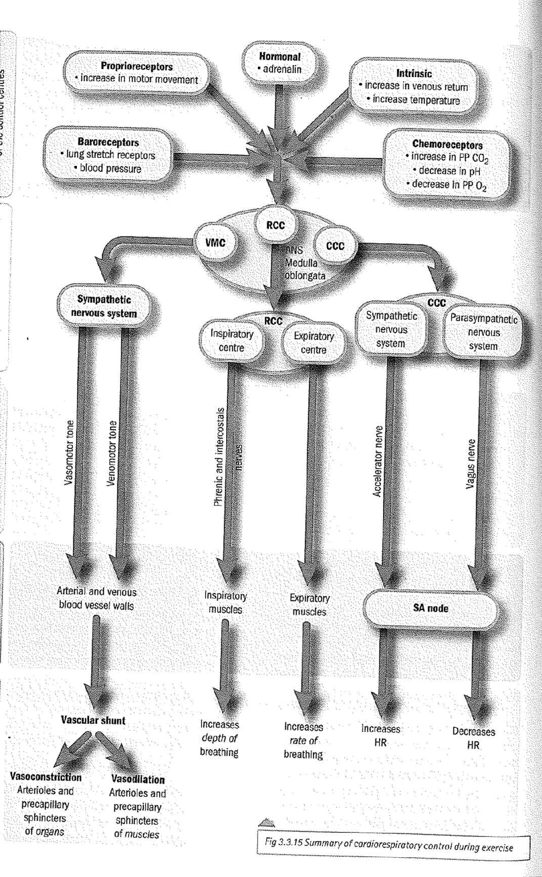
Summary of cardio-respiratory control

Slide 19
Neural Control of Breathing
Complete a diagram of the Neural control of breathing.
During exercise the mechanics of breathing allow for greater volumes of air to be inhaled per breath.
Describe how the mechanisms of neural control cause changes to the mechanics of breathing during exercise.

Slide 20
Answer
Neural control - sub max 3
1(chemo.) Chemoreceptors detect decrease in O2 or ppO2 or pH or increase in CO2 or ppCO2 or carbonic acid or acidity or lactic acid
Accept concentration for ppO2
2(prioprio.) Proprioceptors detect movement or motor activity
Do not accept detect activity
3(baro.) Baroreceptors detect increase in pressure
4(thermo.) Thermoreceptors or temperature receptors detect increase in blood temperature
5(RCC) Messages are sent to the respiratory control centre (RCC) or to the inspiratory

Slide 21
Answer
(nerve stimulation) Increased stimulation of external intercostals (EIM) via intercostal nerve or diaphragm via phrenic nerve
External intercostal muscles (EIM) or diaohraam contract harder or more (than at rest)
Accept diaphragm flattens more than at rest
(volume and pressure) Ribs move up and out more than at rest / volume or area of thoracic cavity increases more than at rest / pressure in thoracic cavity decreases more (than at rest)
Stretch receptors (in the lungs) stimulate the expiratory centre
(air out) More air out of lungs / increased rate of breathing (from rest)

