Slide 1
Acquiring Movement Skill
Classification of Motor Skills and abilities

Slide 2
Definition of Skill
The learned ability to bring about the predetermined result with the maximum certainty often with the minimum outlay of time energy or both.

Slide 3
Consistent
Able to execute action with maximum certainty
Learned
Through practice and experience
Aesthetic
Looks controlled, effective and effortless
Goal directed
Intention to do it not just luck
Organised
Predetermined
Have an aim to achieve
Efficient
Minimum of time and energy
Recognisable

Slide 4
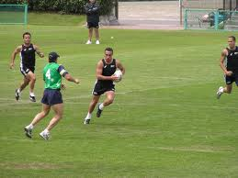
Intellectual Skill
Skills that involve thought process.
E.g., problem solving, planning, strategies, tactics to outwit your opponent.
Deciding to kick over instead of run through as the opponent is slow to turn.

Slide 5
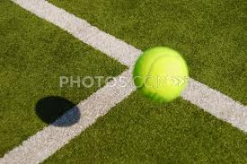
Perceptual skill
Perception
Detecting and interpreting, making sense of information in the environment.
I.e., interpreting the speed of the support player you need to pass to.
Detecting the speed and direction of a ball as it comes over the net in tennis.
Position of others players in a netball game, to judge the flight of a ball.

Slide 6
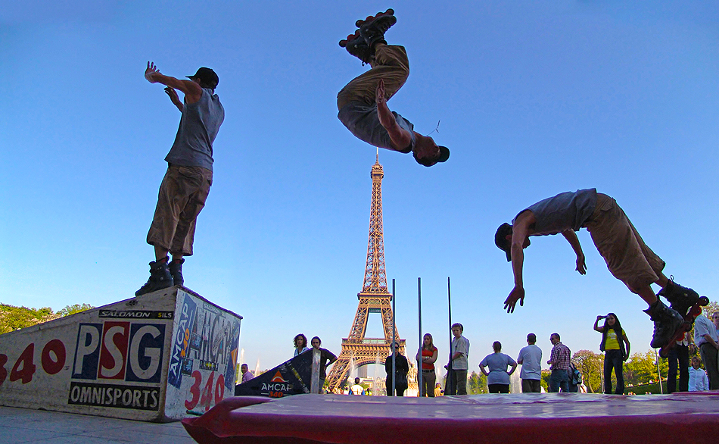
Motor Skill
When you see this term think of movement.
Skill which involves physical movement and muscular control.
Smooth executing movement
E.g., passing the ball, shooting, completing a forward roll.

Slide 7
Objective: know the classifications of skill
Muscular involvement Gross-fine
Environmental Open-closed
Continuity (discrete, serial, continuous)
Pacing (self paced, external paced)
Difficulty (simple-complex)
Organisational (low high)
Can you describe the characteristics of each of the continuums?

Slide 8
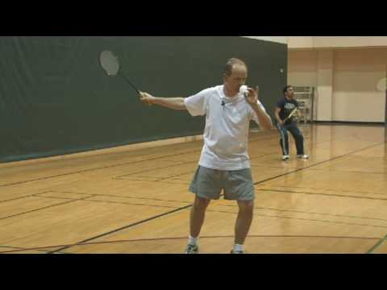
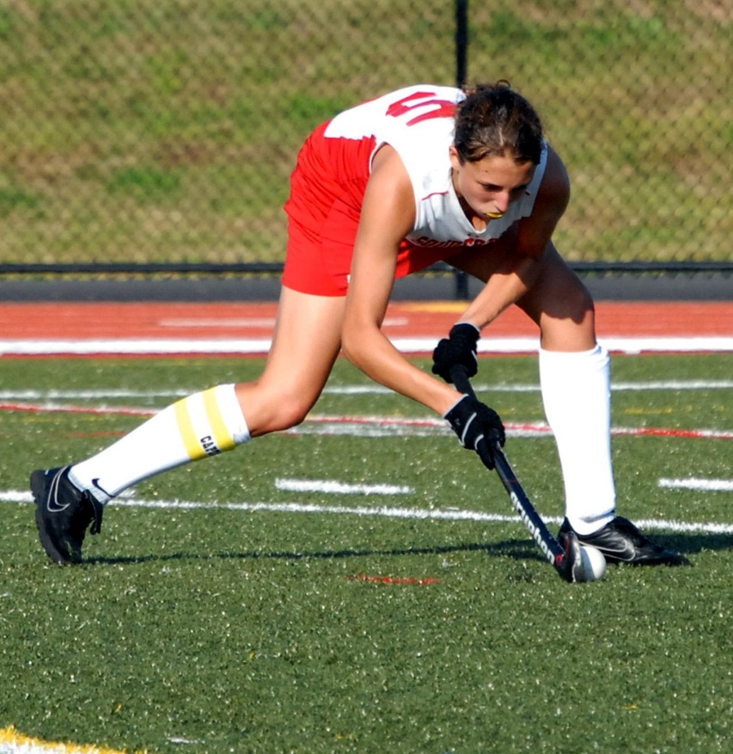
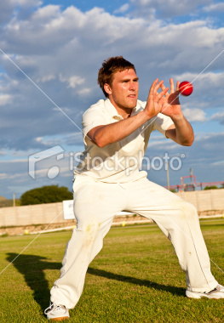
Continuity Continuum Discrete, serial, continuous
Discrete Skill
Motor skill that has a clear start and finish.
To be repeated it must start again, (single brief skill)
E.g.,……..

Slide 9
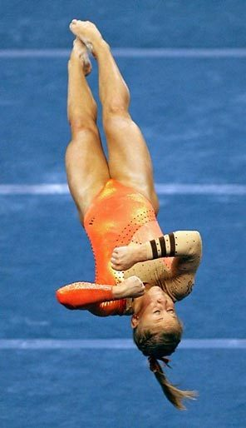
Serial Skill
A motor skill that has a number of discrete skills put together in a set order to make the sequence.
What example can you think of?

Slide 10
Continuous
Motor skill with no definite beginning or end
End of one cycle of movement is start of next.
Movement to be repeated several times to mean anything.
E.G.,………….

Slide 11
The difficulty Simple- Complex Continuum
Key term sub routines.
Free style in swimming consist of leg kick, arm action, breathing, body position.
These are sub routines that together make up motor skill.

Slide 12
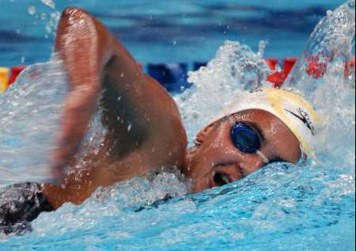
Difficulty
Simple
Small number of sub-routines-speed-timing, not critical.
Little information to process and few decisions to make
Use of feedback not significant
Swimming, cycling

Slide 13
Complex Skill
Performers have a high perceptual load with many decision to be made.
Skill has many sub-routines that when linked together speed and timing are crucial.
Somersault, gymnastics, tennis serve.

Slide 14
Organisational Low-High Continuum
Low organisation
Made up of subroutines which are easily separated and practiced alone.
Gymnastics, trampoline, swimming stroke.

Slide 15
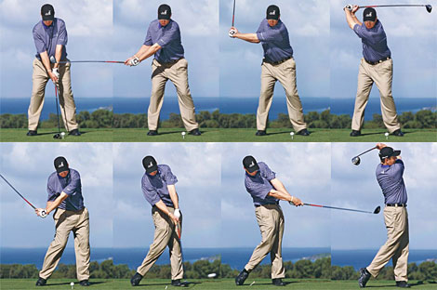
High organisation
Sub-routines are very closely linked and difficult to separate without disrupting the skill.
Practiced as a whole skill
Golf swing
Kicking a ball

Slide 16
Classify the skill
Observer the skill
Classify using the following continua.
Gross…………………………Fine
Open………………………….Closed
Self Paced……………………Ext P
Catch.
Batting in cricket.

Slide 17
Classify the skill
Observer the skill
Classify using the following continua.
Complex…………………………Simple
Open………………………….Closed
Discrete……………………Continuous
Catch.
Batting in cricket.

Slide 18
Classify the skill
Observer the skill
Classify using the following continua.
High…………………………Low Complex………………………….Simple
Discrete……………………Continuous
Badminton serve
Return in badminton

