Slide 1
THE OLYMPIC GAMES

Slide 2
The vision of Baron Pierre de Coubertin in establishing the modern Olympic Games on 1896
The principles, aims and philosophy of the Olympic Games
The British Olympic association and the International Olympic Committee – two bodies that are central to Olympic organisation and administration
Commercialisation of the games after 1984
London 2012 – opportunity and implication for UK sport and society
The Olympics as a vehicle for national building, when sport is used as a political tool, e.g. in China

Slide 3
Background
You will not be asked direct closed questions on the Ancient, Robert Dover or Penny Brookes’ Much Wenlock games.
However, you may be asked a question that tests your knowledge of the background of the games.

Slide 4
Robert Dover – Cotswold Olympick Games
Founded COTSWOLD GAMES 1600s after interest in Ancient culture
Sometimes called Dover Games
1852 - games stopped due to rowdiness and dangerous activates
1980 – revived and celebrated each June in Chipping Campden (Gloc)

Slide 5
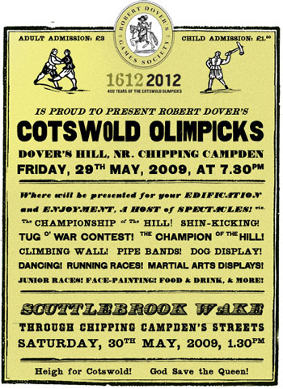

Slide 6
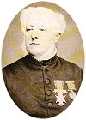
William Penny Brookes – Much Wenlock Games
Doctor in Much Wenlock
Founded MW Games – 1880 (still annually)
To promote moral, physical and intellectual improvement in townspeople
Opening ceremony, athletics, football and traditional country sports (quoits)

Slide 7
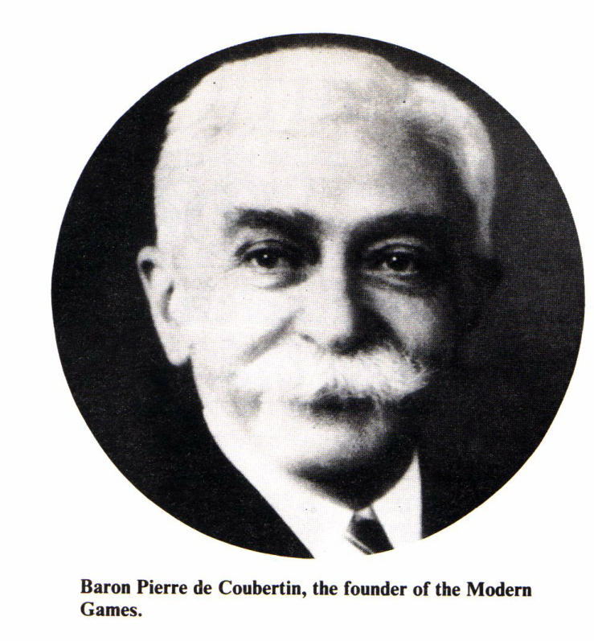
Influential, French educator and keen sportsman
Vision to use sport to educate Young French people and increase international understanding
De Coubertin was invited to Brookes’ games (Much Wenlock games).
While in England De Coubertin visited the games obsessed English public schools.

Slide 8
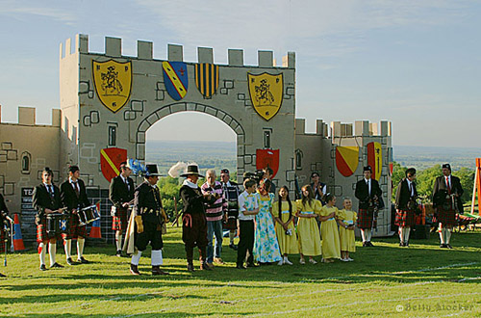
De Coubertin enjoyed the opening ceremony

Slide 9
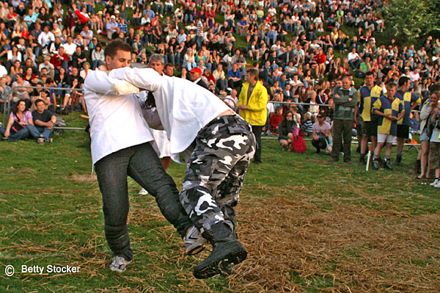
Observed games like cricket, football, athletics, and traditional country sports

Slide 10
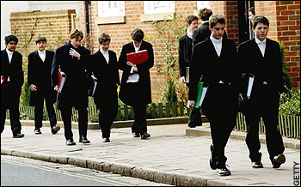
Public school gentleman
Considered games to be the vehicle for promoting courage and manly young men who could take leading roles in society.

Slide 11
Penny Brookes died age 86 four months before the 1896 Olympics
De Coubertin and Brookes discussed the idea of an international competition which should encourage:
Moral
Physical
Intellectual improvement.
Following similar characteristics of public schools.

Slide 13
The principles, aims and philosophy of the Olympic Games

Slide 14
Aims of the Olympic Games
“Why did I restore the Olympic Games? To ennoble and strengthen sports, to ensure their independence and duration, and thus to enable them better to fulfill thee educational incumbent upon them in the modern world. For the glorification of the individual athlete, whose muscular activity is necessary for the community, and whose prowess is necessary for the maintenance of the general spirit of competition”.

Slide 15
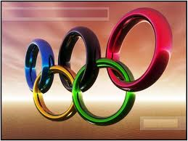
Philosophy of the Olympic Games
Balance body and mind
Effort
Role modelling to educate and inspire others through sport
Tolerance, generosity, unity, friendship, respect and non-discrimination
To build peace
Olympic Motto
Citius Altius Fortius
Swifter Higher Stronger

Slide 16
What are the 6 aims of the Olympic Games?
Personal Excellence
Mass Participation
Sport as Education
Fair Play
Cultural Exchange
International Understanding

Slide 17
Issues around amateurism
De Coubertin was keen on copying the ideal around British Public School
Amateurism

Slide 18
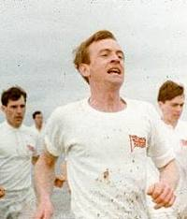
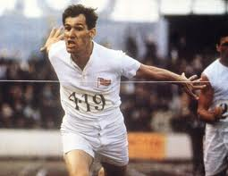
Olympics
“Taking part is much more important than winning old boy. You have to maintain fair play”.
Until recently the modern games were strictly for amateurs.
You had to be a gentleman by birth.
“Fair play! All I’ve done is practice and tried to be the best I can, how is this an unfair advantage?”
“Well for one thing you have employed a coach. You either have it or not old chap”.

Slide 19
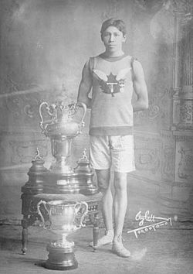
Amateurism
Even though you may not got a direct question on amateurism this gives you an excellent understanding of the reasons for change.
Having an example will support your point.
What happened to the
Canadian Longboat?

Slide 20
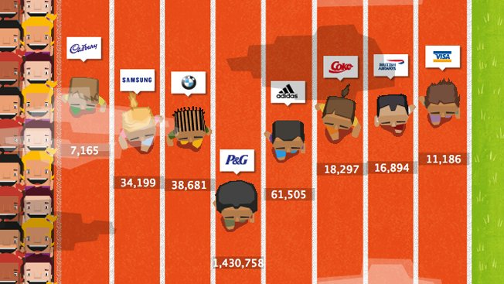
What is Commercialism?
How many products can you remember from 2012?
Using the games in a business-related way to make a profit

Slide 21

WHEN did commercialism hit the Olympics and WHY?
LIFE BEFORE COMMERCIALISM
Montreal Olympics (1976)
Lost millions and
nearly faced bankruptcy
after hosting the games

Slide 22
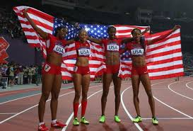
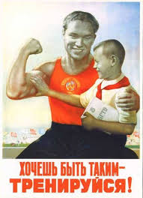
How did financial issues and the appeal of MONEY affect ‘amateur’ status?
USA offered athletes scholarships
Communist bloc had heavy state funding
UK struggled to compete on world stage
Professional athletes CAN now participate

Slide 23
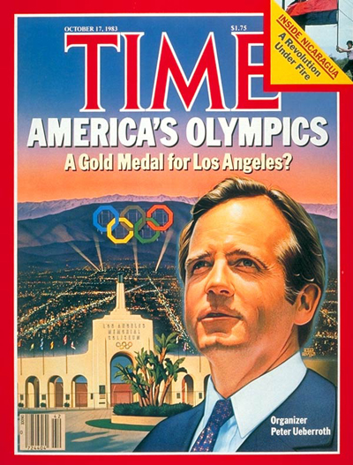
Peter Uberoth
Appointed by IOC to make games practical and possible financially.
Shift TO COMMERCIALISM
ALSO – attractive opportunity for ‘SHOP WINDOW’ effect for politicians = a stage

Slide 24
What Uberoth did!
Uberoth charged huge TV / radio rights
TV increasingly popular and larger audiences, SO attractive to sponsors
Sydney (2000) 16k journalists and 3.8 billion viewers
Athens (2004) 20k journalists and 4billion viewers
Uberoth persuaded large companies to build facilities and invited sponsors to invest

Slide 25
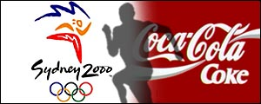
Since LA games – ‘The Olympic Partner’ programme (TOP programme
Multinational companies want to be involved and become appointed companies
Official Sponsors
Official Suppliers
Official Licencees

Slide 26
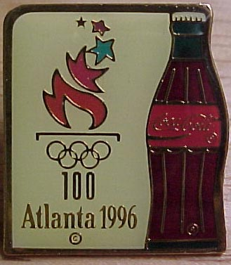
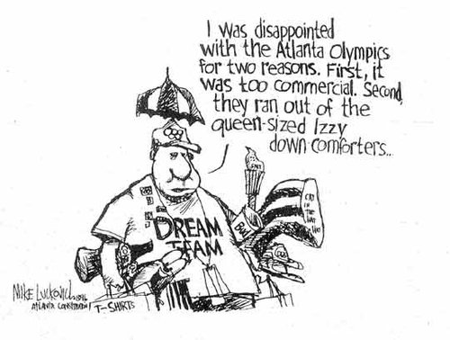
Name some of the TOP companies
Who will be sponsors of 2012?

Slide 27
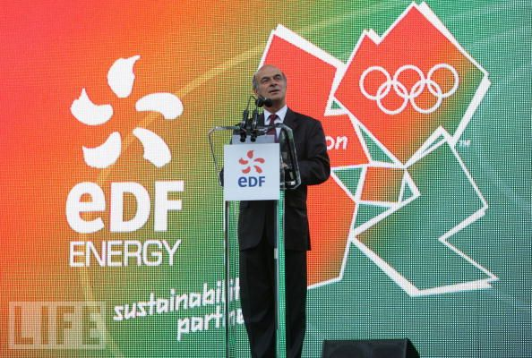


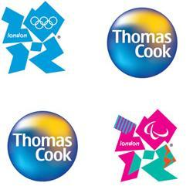
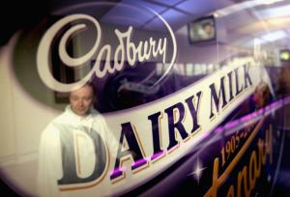
http://

Slide 28

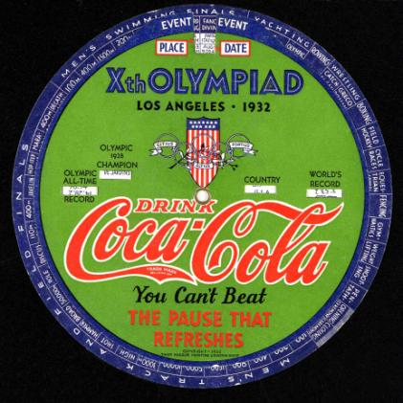
LIFE AFTER COMMERCIALISM
Los Angeles (1984)

Slide 29
Evaluate the role of commercialism in the games

Slide 30
Read the article on page 319-320
Write a concluding paragraph that highlights the key issues.
Then reflect in your groups on the original question.
Q How has the Olympics moved away from the original ideals of Baron De Coubertin.

