Slide 1
Vascular shunt Anatomy of the arteries veins and capillaries.
Anatomy and Physiology

Slide 2
On the white boards outline the process of fainting after an athlete performs exercise and then stops abruptly. (clue, vascular return)
Cause
During exercise – high Q (what is Q)
After and stop – drop in muscle pump and less VR
SO – less SV, Q, BP drops and less flow O2 to brain = dizzy
Solutions
Put head below heart to aid blood flow there
Lie down - restores BP and aids VR.
Active cool down will aid reduction in VR

Slide 3
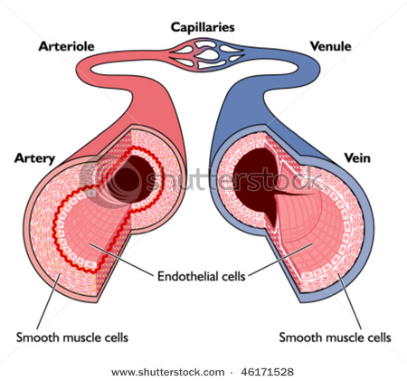
Venule Structure & Function
Venule Structure
Venule Function
Venules are minute vessels that drain blood from capillaries and into veins. Many venules unite to form a vein.
Drains blood from capillaries into veins, for return to the heart

Slide 4
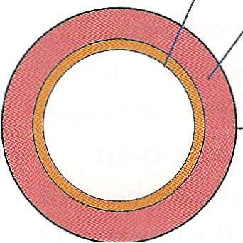
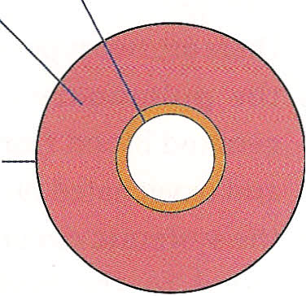
Artery & Vein Composition
1 - an outer fibrous layer — tunica externa
2 - a thick middle layer — tunica media
3 - a thin lining of cells to the inside — tunica interna.
The tunica media is comprised of smooth muscle and elastic tissue, which enables the arteries and arterioles to alter their diameter.
3
2
1

Slide 5
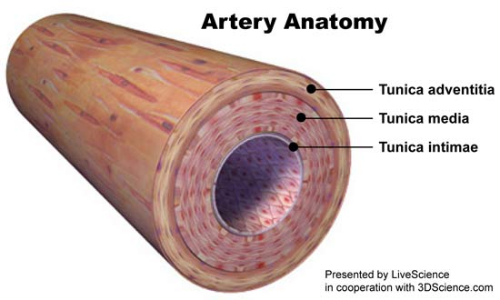
Artery Structure
Artery Function
The blood is under HIGH PRESSURE and HIGH VELOCITY as it has been ejected from the heart.
The artery wall has a thick muscular / elastic layer to expand as the blood surges through, and recoil after.

Slide 6
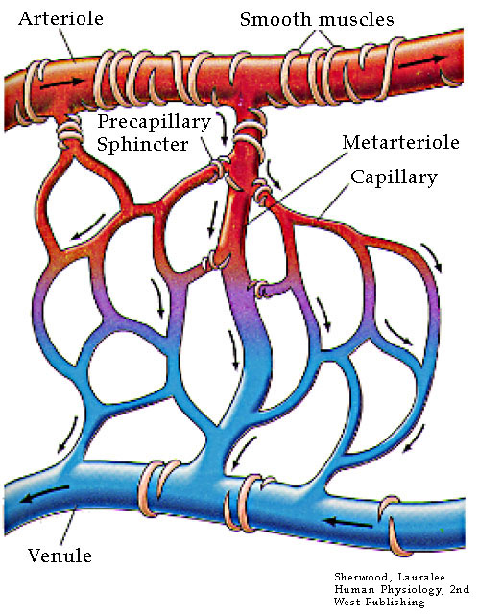
Arteriole Structure & Function
Arterioles are tiny branches of arteries that lead to capillaries.

Slide 7
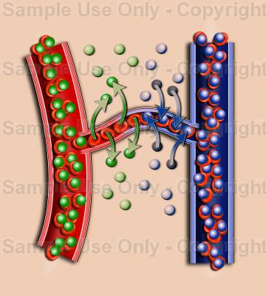
Capillary Structure & Function
Capillaries are tiny (extremely narrow) blood vessels – 1 cell thick
Capillary beds surround organs.
These capillaries are supplied with blood by arterioles and drained by venules.
Capillary walls are only one cell thick which permits exchanges of material between the contents of the capillary and the surrounding tissue.
Supply gases & nutrients – remove waste
Diffusion of oxygen, carbon dioxide, water, salts, between the blood and the organs
BP and BLOOD FLOW here are much less, as the total area of capillaries is immense.

Slide 8
Vascular shunting.
What percentage of blood is used in the muscles while we are at rest?
20%
Have a look at page 85 to discover how this changes when we take part in high intensity exercise.

Slide 9
Chart on page 85
Don’t panic the blood supply to the brain is maintained.

Slide 10
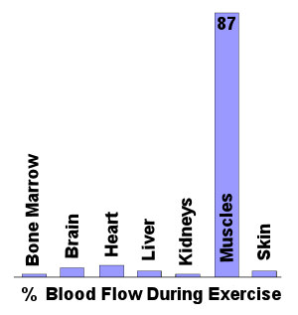

Slide 11
So how does this all transfer into an exam question?
See page 120 and hand out.
Organs (during exercise)
There is vasoconstricts in the arterioles and pre-capillary sphincter.
These both decrease the distribution of blood flow from the essential organs.
Muscles (during exercise)
The arterioles and pre capillary sphincters vasodilate.
Both increase the blood flow towards the capillaries in the working muscles.

Slide 12
Exam Q Explain the vascular shunt mechanism during exercise. 4
Vasodilation of arteries/arterioles/blood vessels/leading to working muscles/vascular shunt
Opening/vasodilation of pre capillary sphincters leading to working muscles
Vasoconstriction of arteries/arterioles/blood vessels leading to non-essential organs
Closing of pre capillary sphincters leading to non-essential organs

Slide 13
Exam Question
During exercise the body has to respond to an increased demand for oxygen by the working muscles.
Figure 2 shows the distribution of cardiac output during exercise.
Describe the mechanism that allows for the redistribution of blood flow during exercise and explain how it is controlled.
(10 marks)

Slide 14
Reading the flipping question.
Break it down into the command words and the subject qualifiers.
What is it asking for?
Section 1 we can answer.
Section 2 Look at page 86 and bullet point on the white boards the answer. See where you will get ten marks in total.

Slide 15
Mark Scheme
Distribution of blood flow during exercise (mechanism) (subsub max 4)
vascular shunt mechanism
(redistributes blood during exercise so that) areas with the greatest need receive more blood/areas with low demand receive less blood through vasodilation of arterioles/blood vessels feeding working muscles
and vasodilation/opening of precapillary sphincters feeding working muscles
through vasoconstriction of arterioles feeding others organs (e.g. liver/kidney/intestines)
and vasoconstriction/closing of precapillary sphincters feeding these organs

Slide 16
vascular shunt mechanism) (control explanation) (subsubmax 4)
controlled by the vasomotor control centre CCC;
located in the medulla (oblongata) of the brain
VCC responds to changes in blood pressure/muscle/blood chemistry
chemoreceptors detect changes in lactic acid/carbon dioxide/oxygen/pH/ content of blood
chemoreceptors located in muscles/aorta/carotid arteries
baroreceptors detect changes in blood pressure
baroreceptors located in aorta/carotid arteries
VCC uses sympathetic nervous system which acts on the middle layer of smooth muscle in an arteriole/the ring of smooth muscle at the opening of a capillary (precapillary sphincter)/control diameter of arterioles/precapillary sphincters

Slide 17
Using the white boards draw the transfer of blood highlighting the affiliation to Hb. Give values where appropriate.
Next person add in the affiliation to monoxide (smoke).

Slide 18
Application of understanding. Can you check your answers against someone else in the group. See if you have the same answer. (speed dating).
Can you explain why the blood pressure in the endurance training will plateau at around 140-160?
Can you account for the increase in systolic Bp in line with exercise intensity?
Why during exercise does the diastolic pressure stay roughy the same?
Can you explain why localised muscular diastolic pressure may fall?

