Slide 1
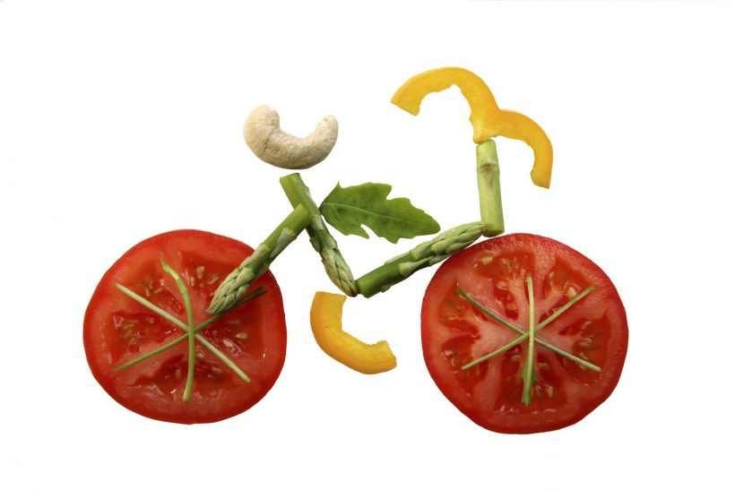
Exercise Physiology

Slide 2
Diet and Nutrition
Diet affects sporting performance
Well planned diets support performers training programmes
Men = 2,550 Kcals
Women = 1,940 Kcals

Slide 3
Composition of a Healthy Diet
A healthy diet should also contain:
Variety of foods
Five portions of fruit and vegetables per day
Less than 5% of sugar
How do you think this diet would change for an endurance athlete? Why?

Slide 4
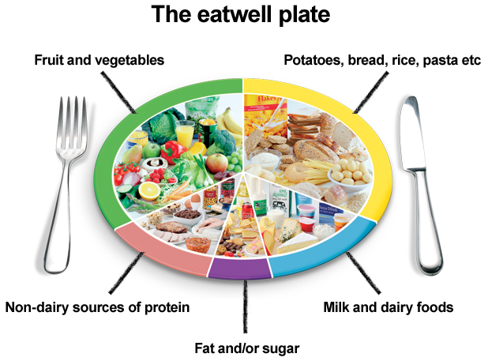
Composition of a Healthy Diet

Slide 5
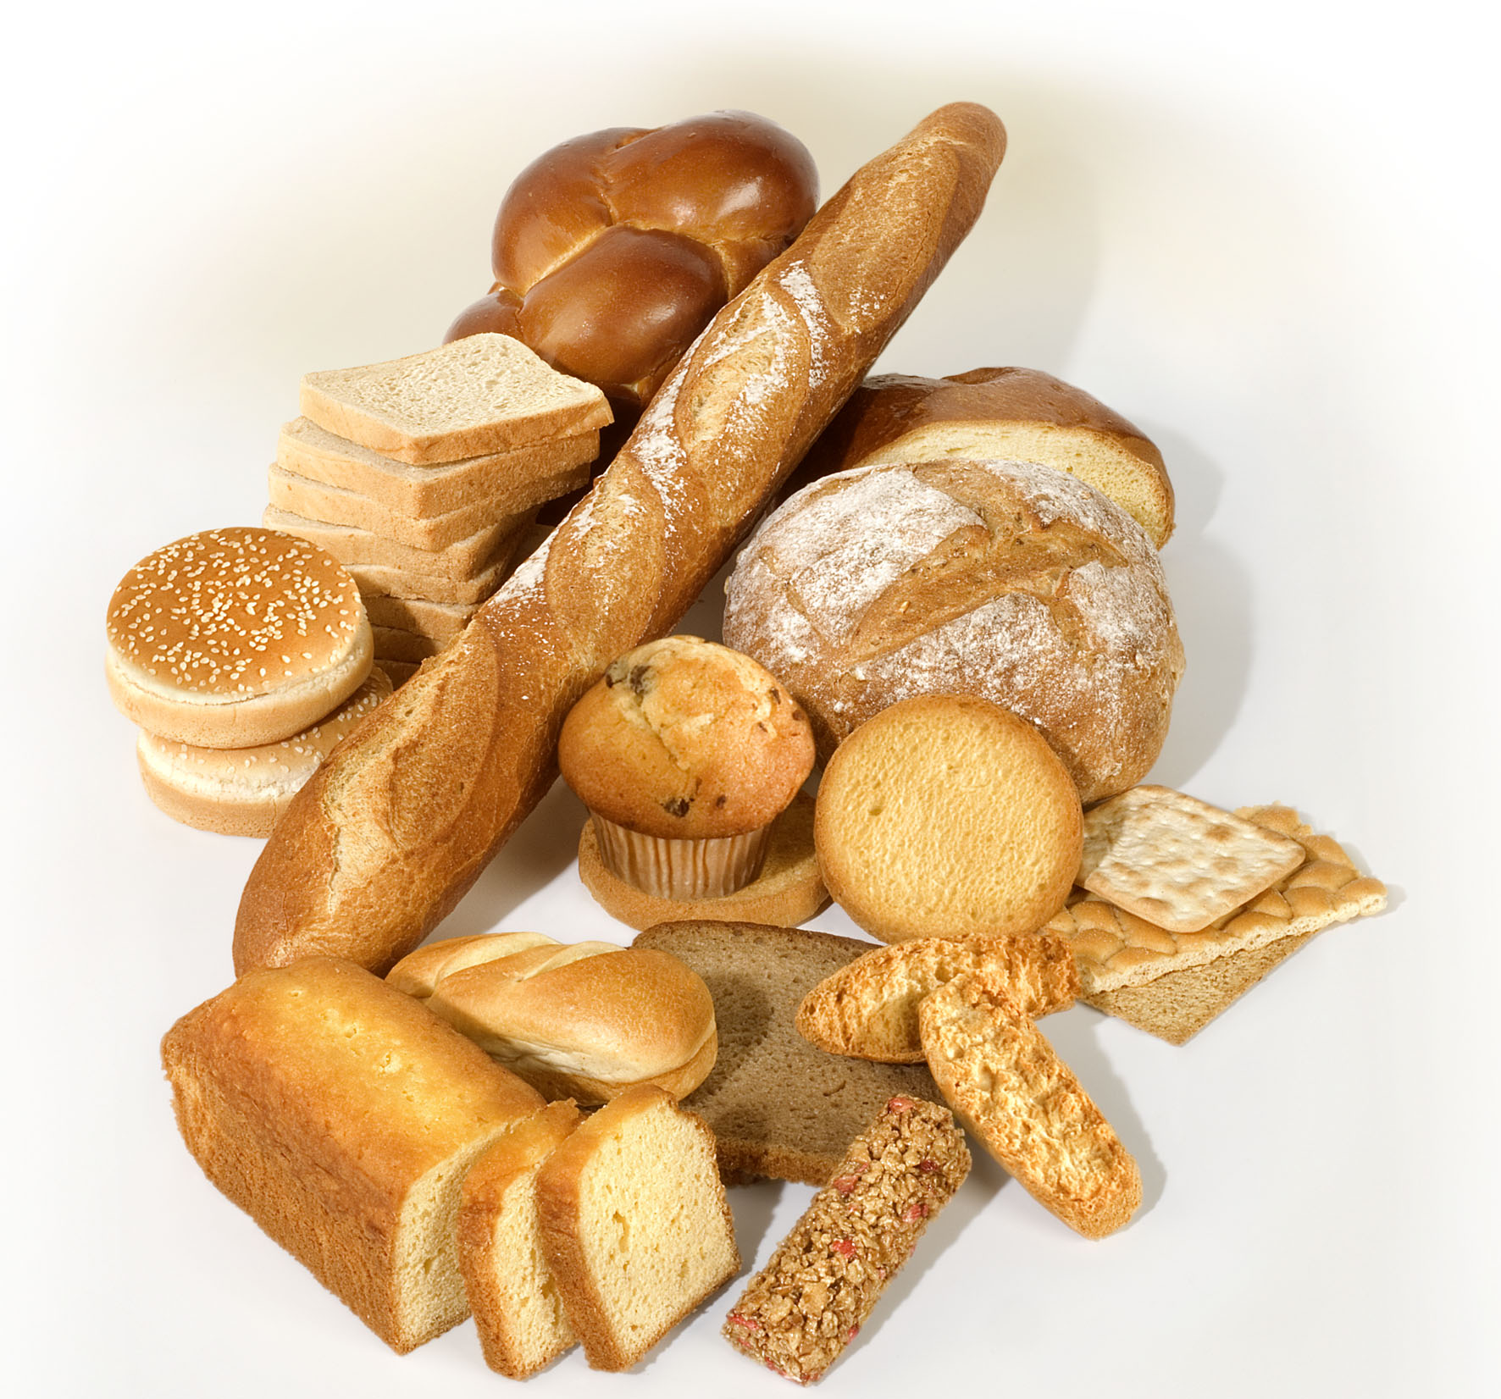
Carbohydrates (CHO’s)
Essential for energy production, cell division, active transport and formation of molecules
Preferred fuel for exercise (75% of energy requirements)
Consists of sugars and starches
1g CHO’s = 4Kcal Energy

Slide 6
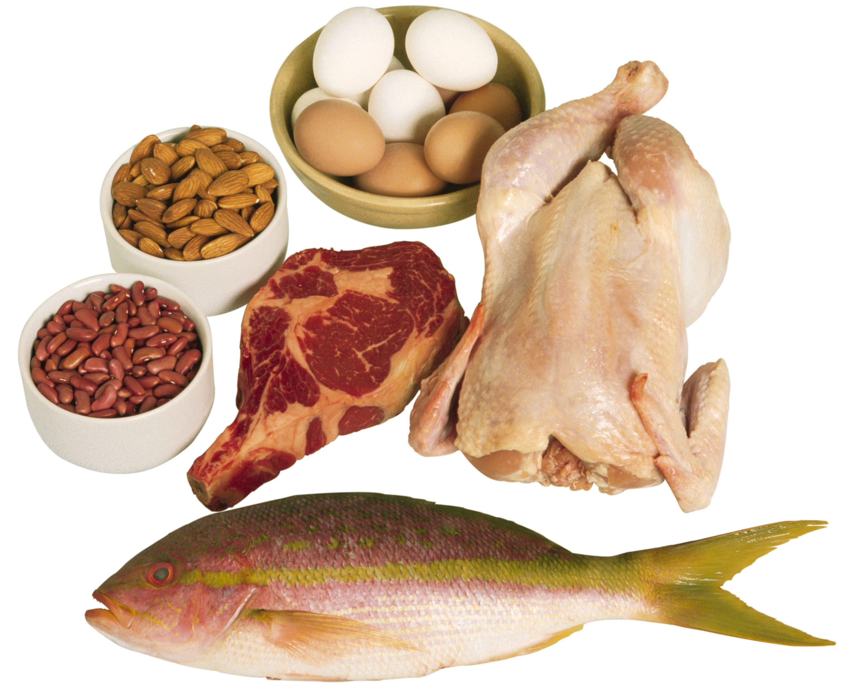
Proteins
Amino acids essential for the body
Amino acids are essential for:
Growth
Repair
Energy (if no other fuel is available)
Used to make:
Muscle proteins
Haemoglobin
Enzymes
Antibodies
Collagen
1g Protein = 4Kcal Energy

Slide 7
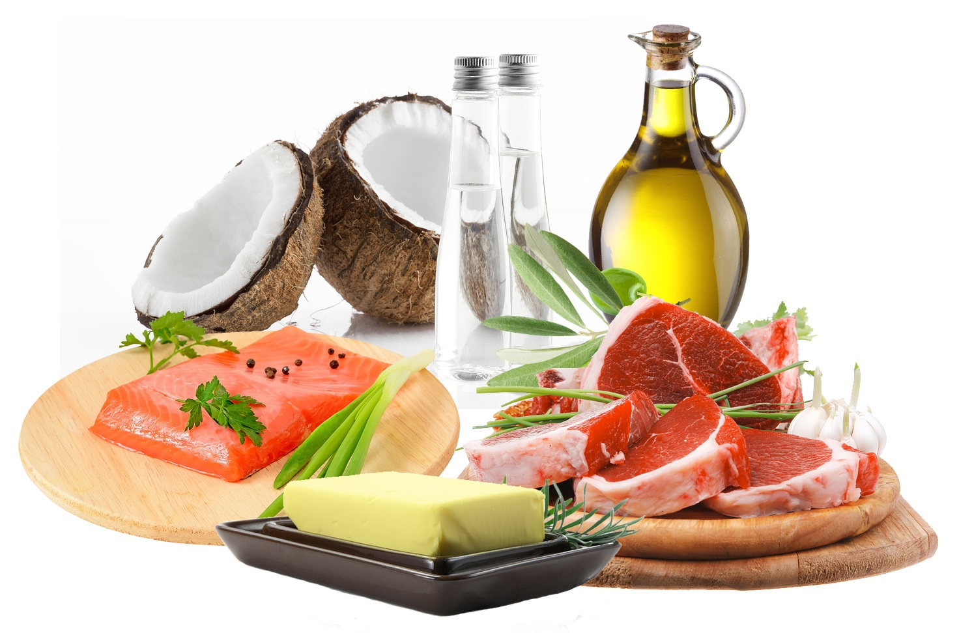
Fats
Fats are triglycerides that provide the body with fatty acids
Fat is required to:
Insulate nerves
Form cell membranes
Cushion organs
Provide energy
1g Fat = 9Kcal of Energy

Slide 8
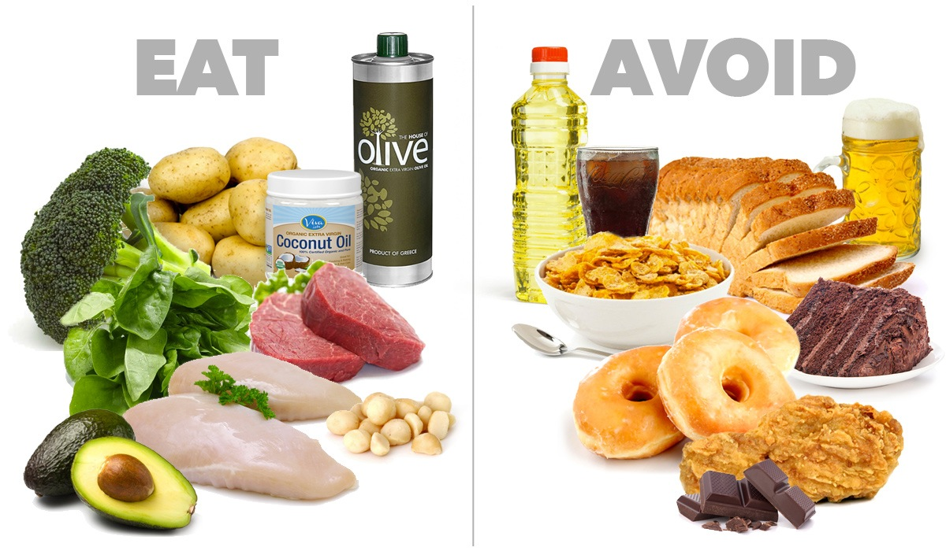
Two Types of Fats

Slide 9
Two Types of Fats
Saturated fats
Unsaturated fats
Fat molecule is solid at room temperature
Mainly found in animal products
Associated with heart disease
Fat molecule is liquid at room temperature
Mainly found in sunflower, olive oil and fish oil
Helps lower cholesterol

Slide 10
Vitamins and Minerals
Vitamins and minerals are essential organic and inorganic nutrients required for healthy body function
They are both required in small quantities – known as micronutrients

Slide 11
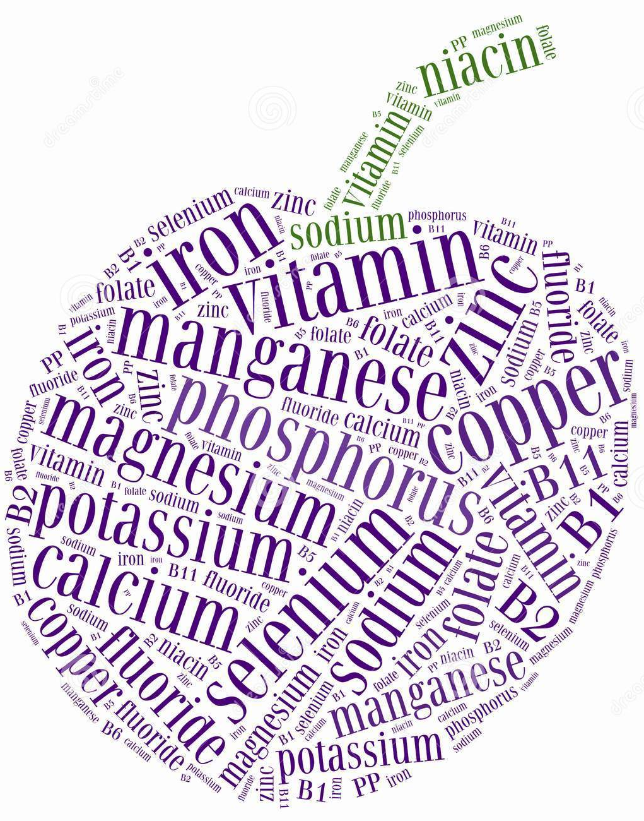
Minerals
Necessary for:
Bone and Tooth health
Controlling body fluids
Enzyme formation
Breaking down food to release energy
Normal nerve function

Slide 12
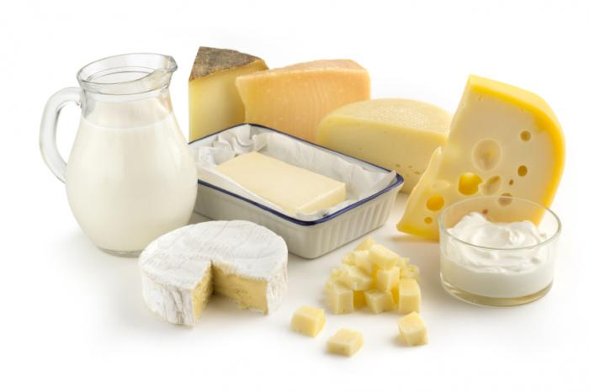
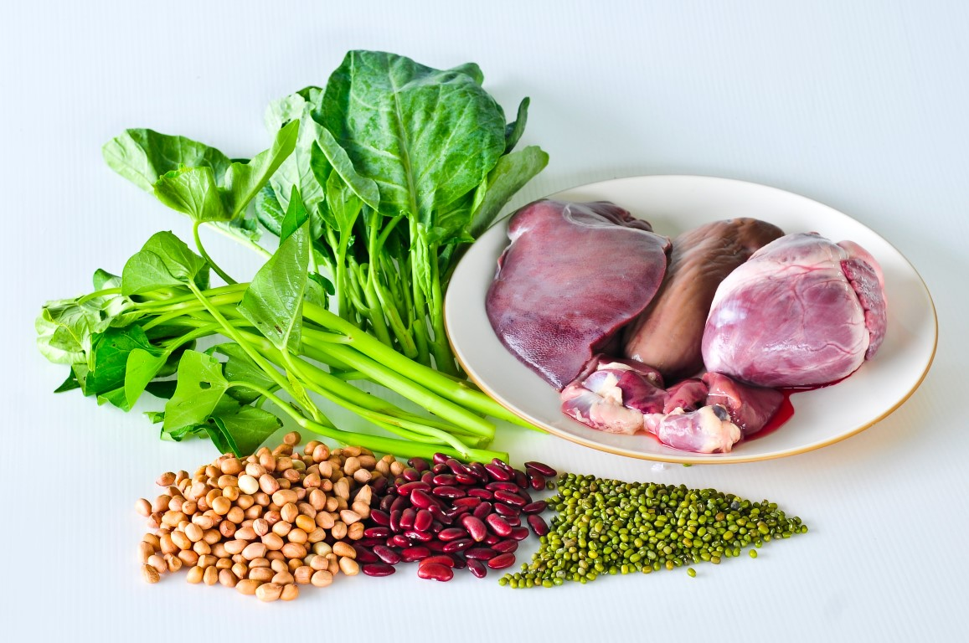
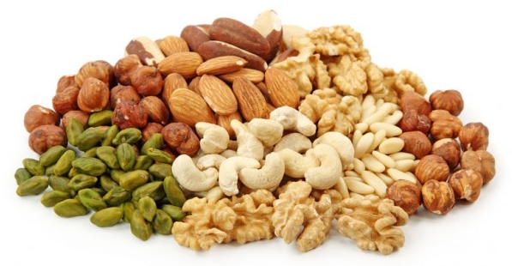
Key Minerals

Slide 13
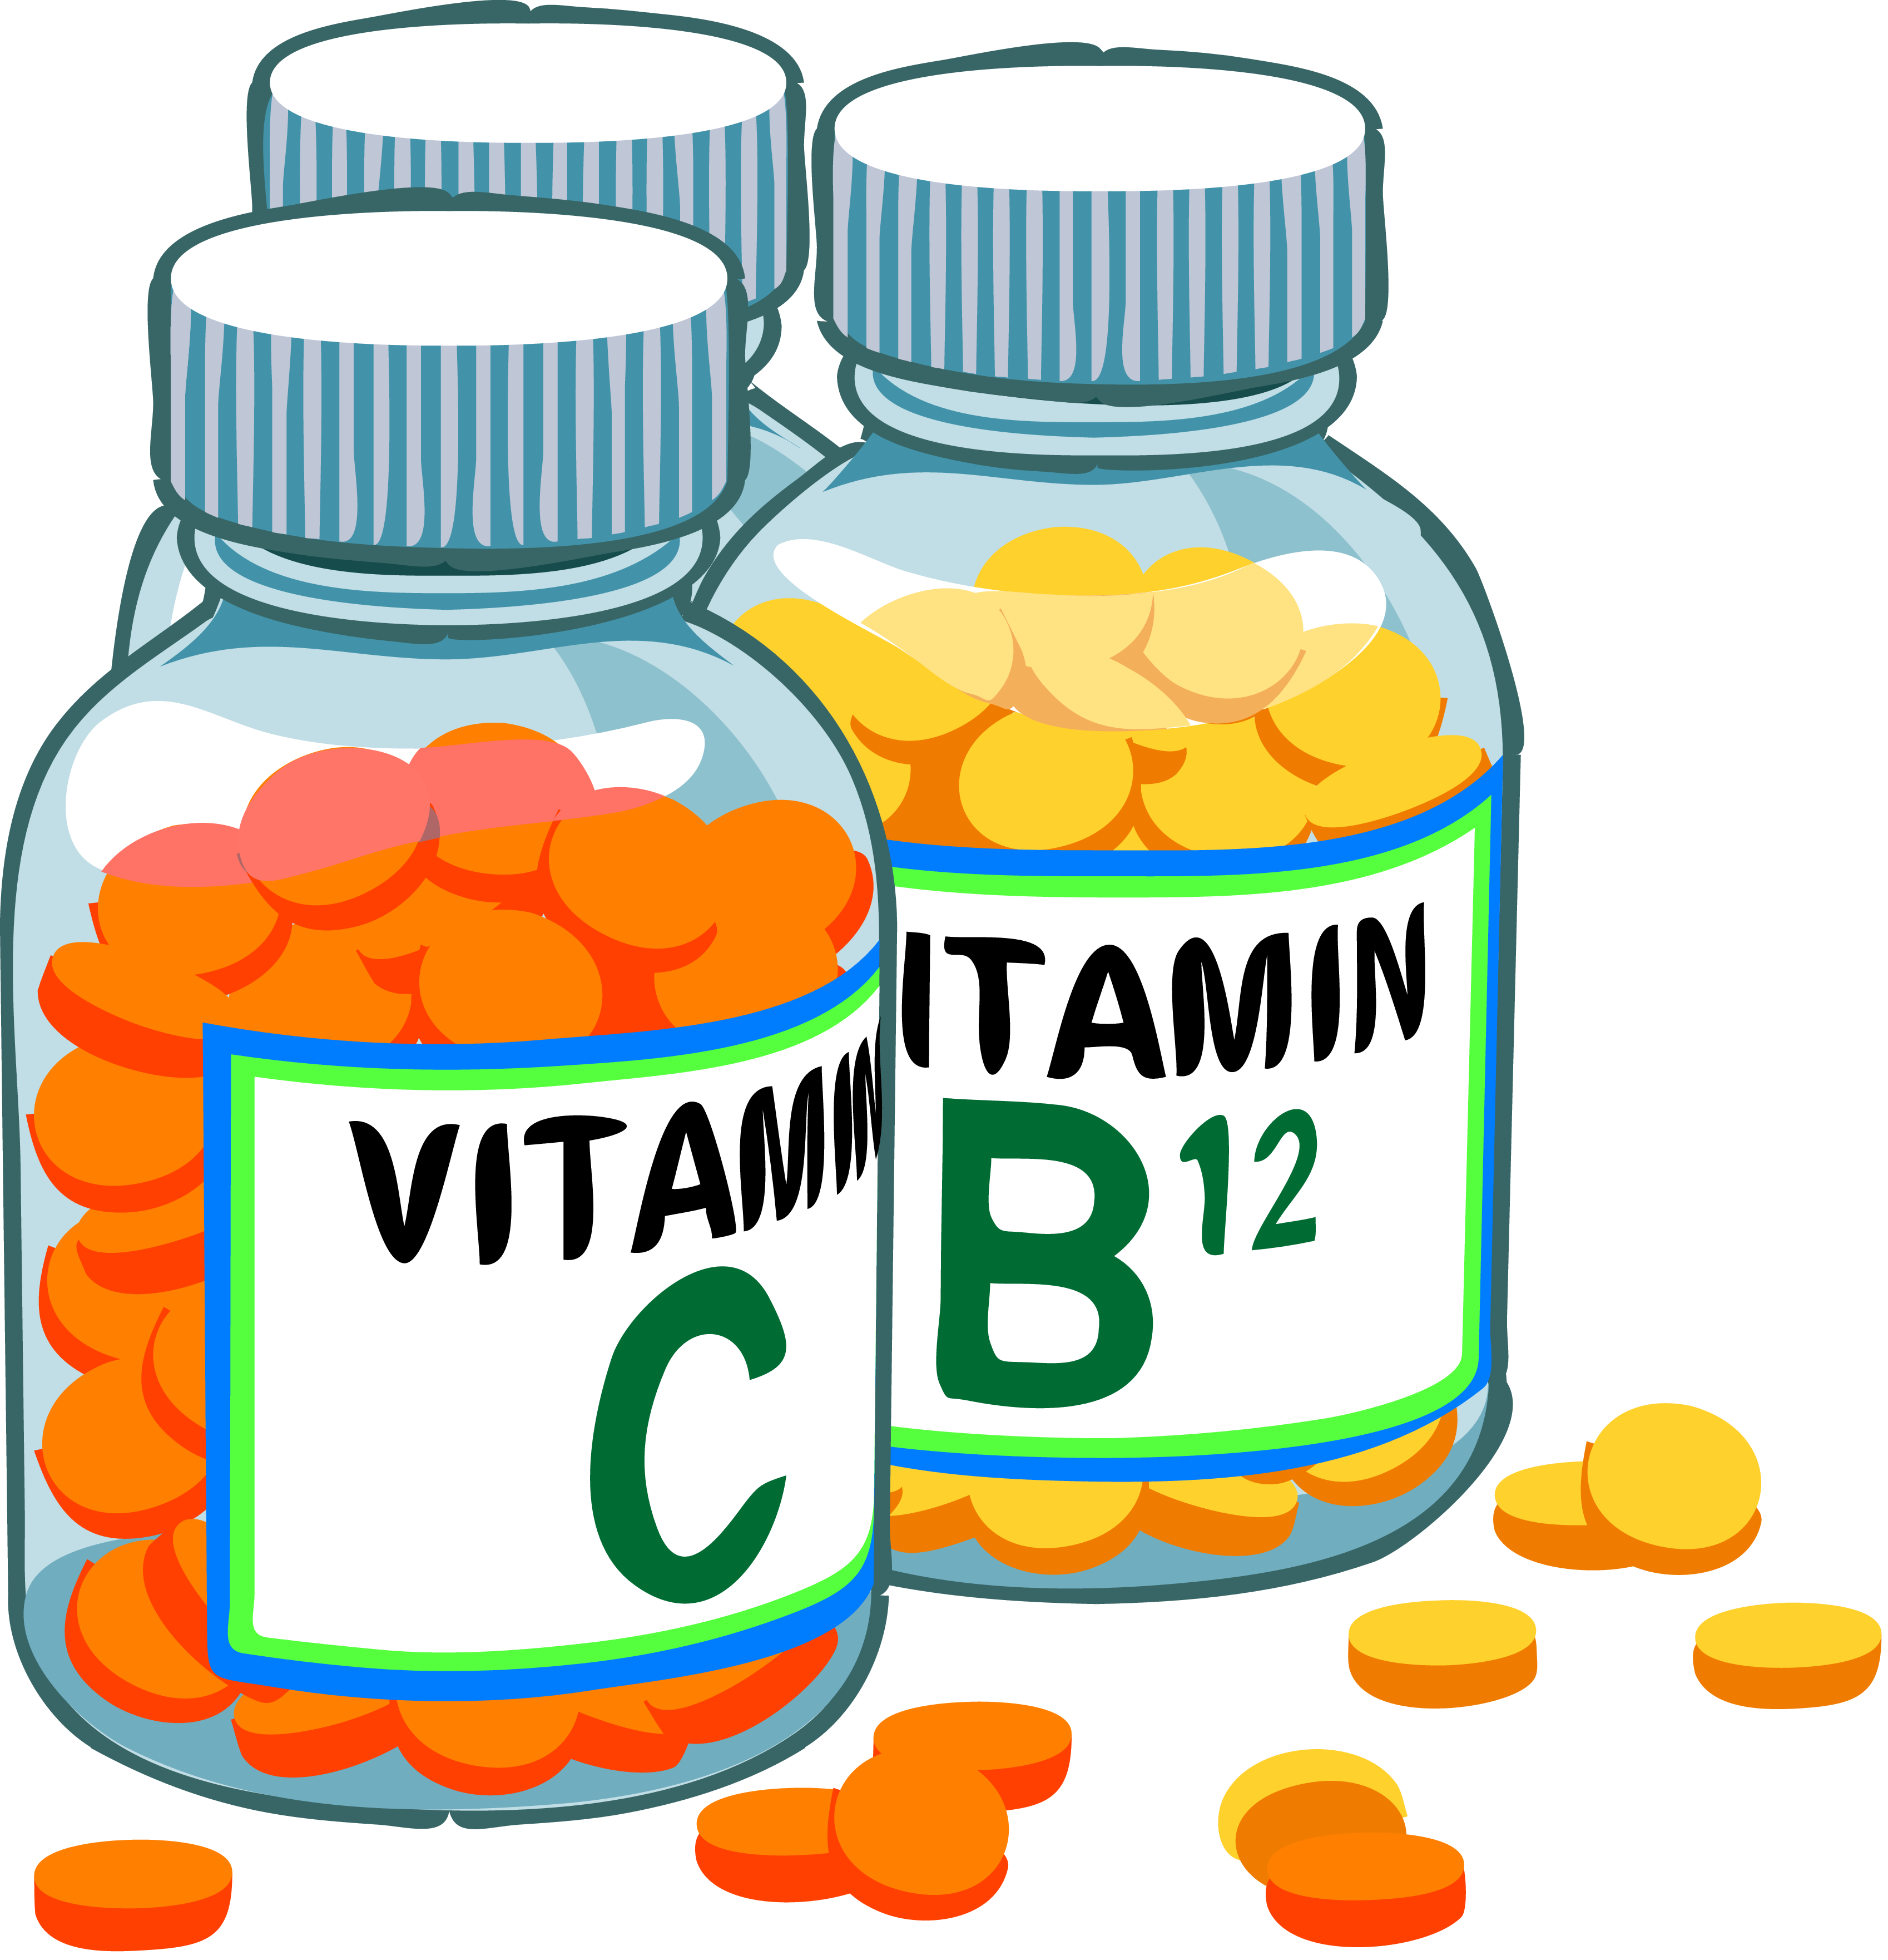
Vitamins
Two main types:
Fat-Soluble Vitamins
(Vitamins A, D, E and K)
Water-Soluble Vitamins
(Vitamins C and B)
No supplements required if you have a balanced diet!

Slide 16
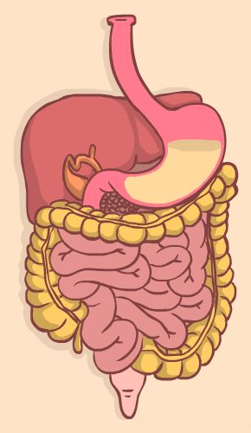
Fibre
Aids function of the large intestine, and reduces cholesterol
Two types:
Insoluble – easier to digest, helps to push waste through the intestines
Soluble – provides slow release energy as difficult to digest easily

Slide 17
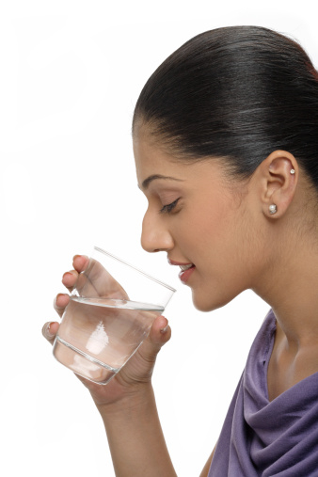
Water
Accounts for two thirds of your body weight
Allows chemical reactions to occur
Helps to dissolve and move substances around the body
Required to regulate temperature

Slide 18
Problems with Lack of Water During Exercise

Slide 19
Component of a Healthy Diet | Function and Importance | Sources
Carbohydrates (CHO’s)
Fats
Proteins
Vitamins
Minerals
Fibre
Water

