Slide 1
PERSONALITY
PE SPORTS PSYCHOLOGY

Slide 2
What is personality?
WHAT IS YOUR PERSONALITY?

Slide 3
Personality
Personality is from the word ‘persona’ - which was a mask in Greek drama!
“What a man (or woman) really is” and also “Not what (s)he appears to be”
Personality is the sum total of an individual’s characteristics which make a human unique.
“The pattern of thoughts and feelings and the way in which we interact with our environment and other people that make us a unique person.”

Slide 4
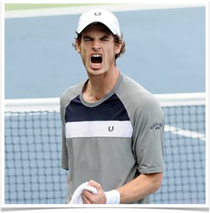
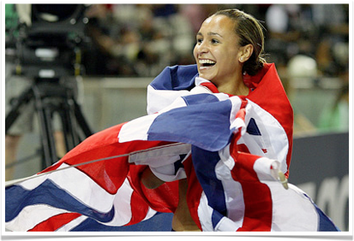
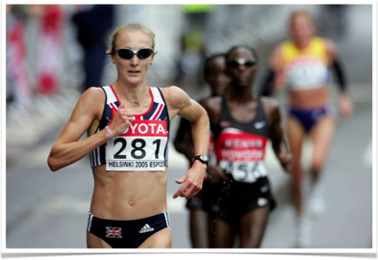
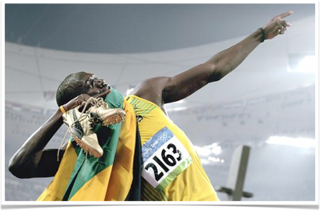
Do you have to have a certain personality be a successful sports person?

Slide 5
Three Views on Personality
There is no clear theory to state exactly how personality works, but in a general sense the three main views on personality are as follows:
Trait Perspective
Social Learning Perspective (also known as Social Learning Theory)
Interactionist Approach

Slide 6
Trait theory
Group task: prepare notes on the main idea behind trait approach to personality.
Eysenck's approach to personality trait theory
Cattell’s personality personality theory
Friedman and roseman developed ‘narrow-band theory’
This was applied to sports by girdano in 1990.
Evaluate the theories and present your notes on the white boards

Slide 7
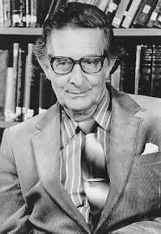
Trait Theory
Suggests that people are born with established personality characteristics, that are:
Inherited from genetics
Stable and enduring
Not easily changeable
Is your personality stable?

Slide 8
scenario
You have been playing in a football match and for no fault of your own you were late. You were put on the bench for the first half but got on in the second.
You have been man marked by a person who keeps pulling your shirt. You make an attacking run into the penalty box and you are tackled to the ground.
How do you think you would react?
Is the way you react consistent with your stable personality traits?

Slide 9
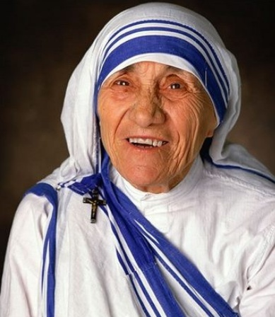
Stable personality traits
Working
In sports
Coaching
At home
What is your consistent personality trait in most situations?

Slide 10
Stable personality traits
A changeable and unpredictable, example, may be emotionally aggressive but the aggression will vary from time to time.
Swimming
Gymnastics
Football
COACH
What is your consistent personality trait in most situations?
Emotional unstable characteristics is often referred to as neurotic

Slide 11
scenario
You have turned up to a swim lesson and you were last in the pool.
The coach shouts at you during the session saying that your technique is not good enough.
You are placed with one of the good swimmers and asked to race for 5 lengths. You are doing a stroke you like.
How would you react?
Would you exhibit one of your consistent personality traits?

Slide 12
Personality Types (Eysenck)
Introvert
Can you place a sport on the dimensions?
Introvert/ extrovert = how social you are
Stable
Neurotic
Where is Andy Murray?
Stable/ Neurotic = how nervous or anxious you are
Where is Jess Ennis?
Extrovert

Slide 13
Extrovert and introversion
SEEKS MORE EXTERNAL STIMULATION
The part of the reticular formation in the brainstem that plays a central role in bodily and behavioral alertness
One explanation of EXT/INT is (RAS)
Reticular activation system
Ext have RAS that inhibits the effect of external sensory stimuli. Therefore, parts of the brain experience low levels of arousal.
Therefore, ……..

Slide 14
Personality Types (Eysenck) true or false?
Evaluation:
Extroverts are more likely to take part in sport and be successful?
Extroverts prefer team games?
Extroverts cope better with competitive situations that are highly charged or stressful?
Extroverts cope better in the presence of distracting stimuli?
Can cope with pain more easily in all sports?

Slide 15
Cattell 16 personality factors
Trait theory
But argued that more than two dimensions. Hence 16 personality factors.
What’s the flaw with this theory as well as Eysenck's
Both are based around answers that may change.
Cattell did acknowledge that answers may vary on mood.

Slide 16
Narrow Band Theory (Girdano)
Type A | Type B
Lacks patience | Tolerant towards others
Strong urge for competition | More relaxed and reflective
High desire to achieve goals | Experience lower levels of anxiety
Always rush to complete activities | Display higher levels of imagination and creativity
Can multi-task under time constraint
Lack tolerance towards others
Experience higher levels of anxiety

Slide 17
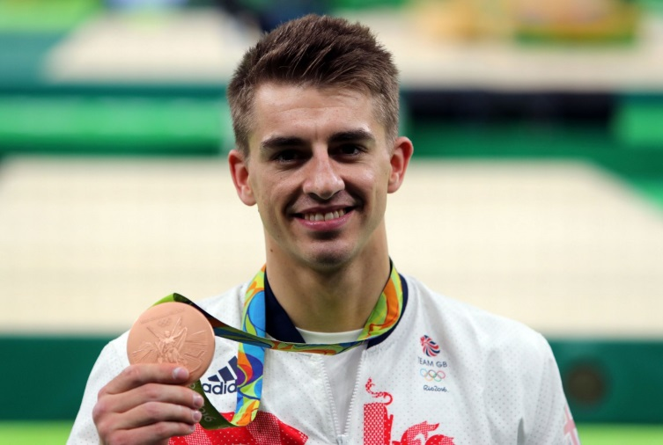
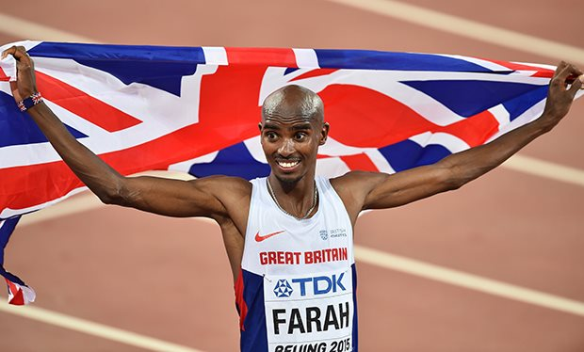
What type of personality are you?
Both personalities have the same value of productivity, there is little evidence to suggest whether the distinction between the two types is helpful in sport.

Slide 18
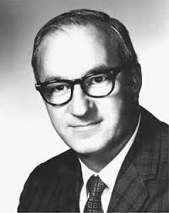
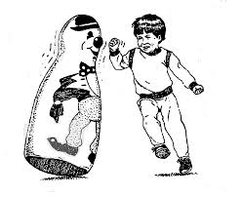
Social Learning Theory (Bandura)
Suggests that all behaviour is learned from environmental experience.
Unstable
Changeable through adapting to the environment
Behaviour is acquired through copying others but only when reinforced

Slide 19
Interactionist Approach (Hollander)
Psychological Core
Typical Responses
Role Related Behaviour
Interactionist approach suggests that behaviour occurs from
the influence of inherited traits and learned experiences.

Slide 20
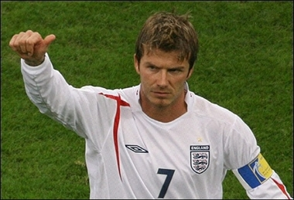
INTERACTIONIST APPROACH
B = F (PE)
BEHAVIOUR = FUNCTION (PERSONALITY ENVIRONMENT)
http://www.youtube.com/watch?v=CvAljV71-Yg

Slide 21
INTERACTIONIST APPROACH
Believes PERSONALITY is just ONE ELEMENT of BEHAVIOUR
Suggests we are BORN with TRAITS but the SITUATION we are in also influences our BEHAVIOUR
E.G. May be a confident Rugby player but show signs of anxiety prior to a world cup final
It COMBINES the TRAIT and SITUATION.
Can you relate this to yourself and your own experience?

Slide 22
Mike Tyson, Jess Ennis, Serena Williams
Using the notes you have around the different personality theories, watch the three documentary clips.
In your opinion, what are the different personalities like?
Looking at the personality theories, which theory suits which sportsperson?
Justify your answer here – explain why you have chosen this!
https://www.youtube.com/watch?v=_KvdDQ55EP8
https://www.youtube.com/watch?v=_9V0Ewy4p3g
http://www.youtube.com/watch?v=VAc3BNeZmBw

Slide 23
Evaluation and Criticisms of the Trait Theory
Very Limited View
Does not recognise effect of different environmental situations
Does not recognise individuals do change
Is behaviour predictable? Do you know how you would behave in ALL situations?
Does not consider the influence the environment and others have on shaping our personalities

Slide 24
Limitations to Social LearningTheory?
Too extreme, doesn’t recognise traits
Are personalities more stable than this?
There is some consistency in individuals behaviour over time and in various situations

Slide 25
What do we think about the INTERACTIONIST APPROACH?
It is an INDIVIDUALISTIC approach
Offers an explanation as to why the personalities of sports performers can change in different situations
Recognises performers in similar sports do not necessarily exhibit the same characteristics

Slide 26
What do we think about the INTERACTIONIST APPROACH?
I.E. Top marathon runners may appear introverted, it does not mean they have to be to get to the top
I.E. All Rugby players are not extroverts all of the time, it is not a prerequisite for success

Slide 27
Personality and Sport What conclusions can we draw?
Social learning – Vicarious processes draw young people to games
Eysenck – people attracted to sport scored high on the extroversion/psychoticism in the EPI
Schurr (1977) – athletes more independent and less anxious than non-athletes

Slide 28
Personality and Sport What conclusions can we draw?
McKelvie (2003) – found no differences in extroversion between athletes and non-athletes, however athletes were more stable
Performers in high risk sports were high in extroversion and low in neuroticism

Slide 29
LIMITATION | EXPLANATION OF LIMITATION
PROOF | Link between personality types and sport performance not proven
EVIDENCE | No evidence that an ideal ‘sports personality’ exists i.e. Stable-extrovert may not be best player to create team cohesion
SUBJECTIVITY | Profiling tests subjective i.e. Conclusions influenced by personal opinions and not scientific evidence
STEREOTYPING | Profiling may stereotype a performer

Slide 31
Exam question

Slide 32
3 (a) 2 marks for characteristic of extrovert and neurotic 2 marks for practical examples of Type A and Type B
1. (extroversion) Outgoing/affiliates to other people/likes to be with
others/sociable
(Do not accept confident on its own unless
‘confident in the presence of others’)
2. (neurotic) Unstable/unpredictable/(tends towards) mood
swings/(highly) emotional/tendency to
worry/exhibit anxiety
3. (Type A) Practical example showing high personal stress
levels/anxious/high arousal/apprehensive/
intolerant/impatient/works fast / ambitious /
aggressive / highly competitive
Eg Football player being very anxious and
wound-up about playing
4. (Type B) Practical example showing low personal
stress/low arousal/cool under
pressure/confident/tolerant/relaxed / passive /
less competitive (than Type A).
Eg Athlete being very confident or calm when
preparing for a race
4 2 marks for characteristic of extrovert and
neurotic
2 marks for practical examples of Type A
and Type B

Slide 33
Exam question Success in sport is often linked to the performance having the appropriate personality characteristics.
Using examples from sport, explain the interactionist approach to personality and identify the limitations of personality profiling. (7)

Slide 35
Homework
Prepare notes on attitude

