Slide 1
Biomechanics

Slide 2
Modern Technology to Analyse Performance
Limb Kinematics
Force Plates
Wind Tunnels

Slide 3
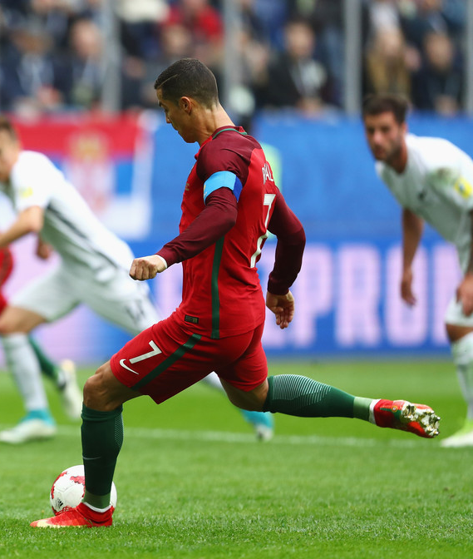
Limb Kinematics 28 min
Kinematics is the study of movement in relation to time and space.
3D or optical motion analysis records an athlete performing
This allows joint and limb efficiency to be evaluated, as well as velocity and acceleration

Slide 4
Think!
What are the advantages or disadvantages of using this technology?
Think about….
Accuracy, reliability, validity, cost, quality of data provided, suitability to everyone

Slide 5
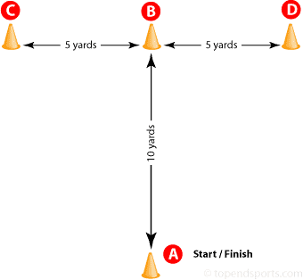
Reliability: The extent to which the experiment, test or measure procedure gives the same results after repeated trails.

Slide 6
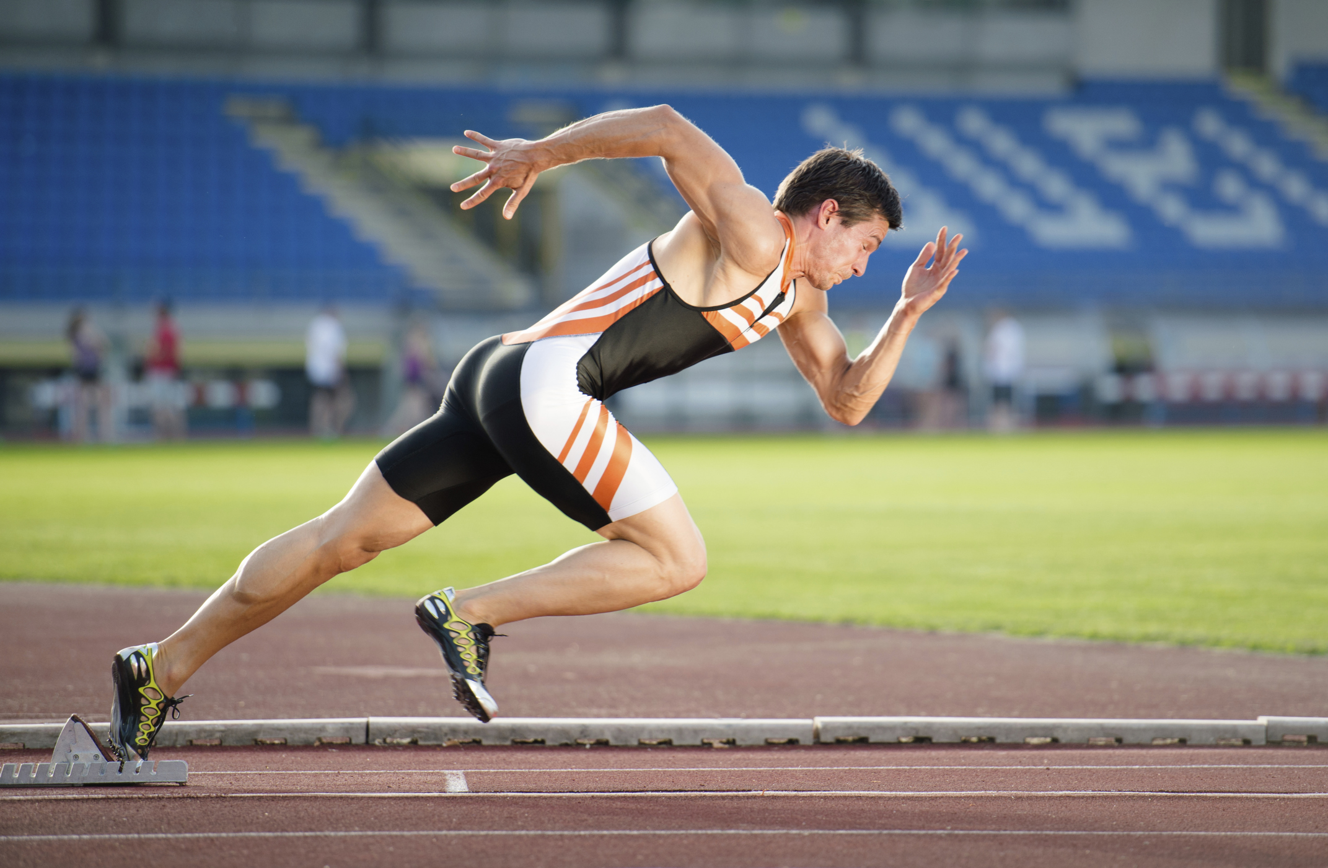
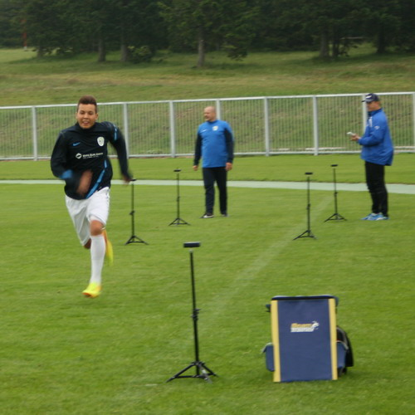
Validity: How well the test measures what it claims to test.
Speed test?
Acceleration test?
Is it a valid test?

Slide 7
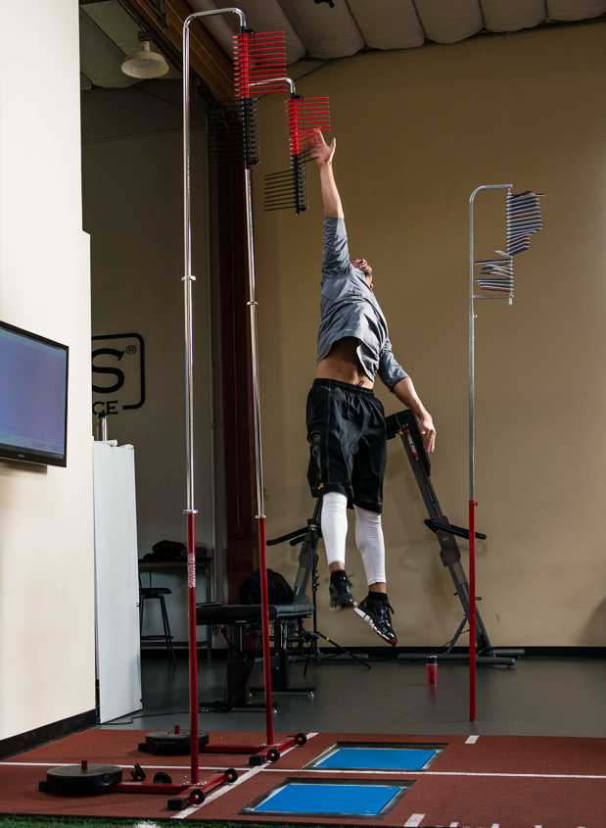
Force Plates
Force Plates are used for different elements of biomechanical assessment
They help measure size and direction of ground forces on an athlete
This can support gait analysis, balance, posture for running, rehabilitation and physical therapy, as well as acceleration, work and power output

Slide 8
Think!
What are the advantages or disadvantages of using this technology?
Think about….
Accuracy, reliability, validity, cost, quality of data provided, suitability to everyone

Slide 9
Wind Tunnels
Wind Tunnels are used to investigate wind resistance and its effects on a body
This can improve air flow around an object, and create more streamlined
performance (increasing lift or decreasing drag)

Slide 10
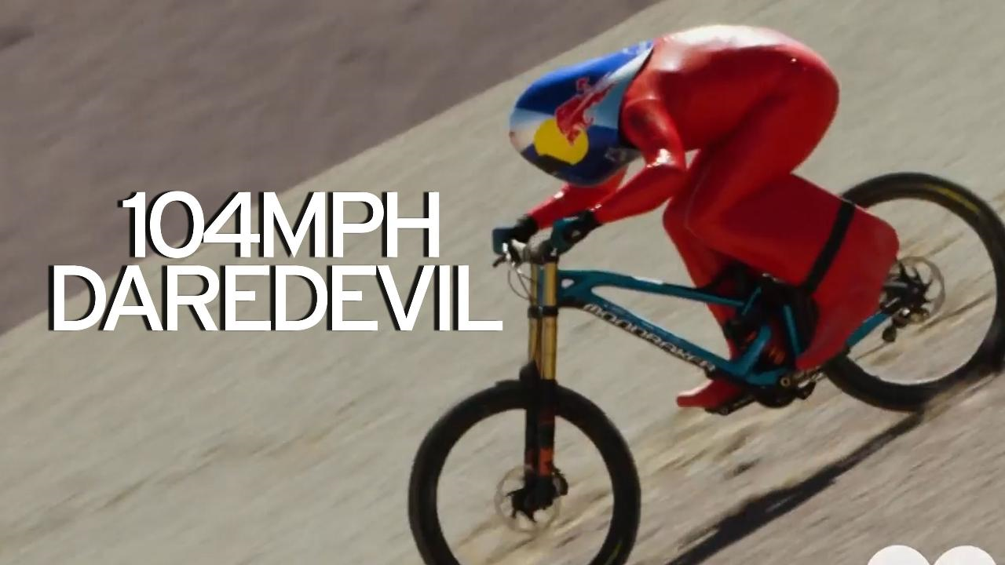
Wind Tunnels
https://www.youtube.com/watch?v=RFwrGa6IswY

Slide 11
Think!
What are the advantages or disadvantages of using this technology?
Think about….
Accuracy, reliability, validity, cost, quality of data provided, suitability to everyone

Slide 12
 | Limb Kinematics | Force Plates | Wind Tunnel
How does it work? (Description)
Advantages
Disadvantages

Slide 13
Summer Homework
Revise ALL content from the 1st year
Mock Exam 5 will be on the 1st week we return!
This will include:
Physiological (A+P, Ex Phys and Biomechanics)
Psychological (Skill Acq and Sp Psych)
Sociological (Sport and Society)

