Slide 1
Starter Tasks
MRS VOPP Testing WC
State what each letter represents

Slide 2
Aerobic training

Slide 3
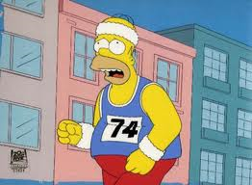
Aerobic Capacity
Aerobic capacity is defined as:
“The ability to take in, transport and use O2 to sustain long periods of aerobic / sub-maximal work.”
It is dependent on the respiratory system, cardiovascular system and the muscular system.

Slide 4
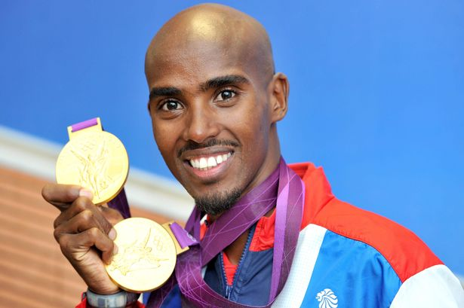
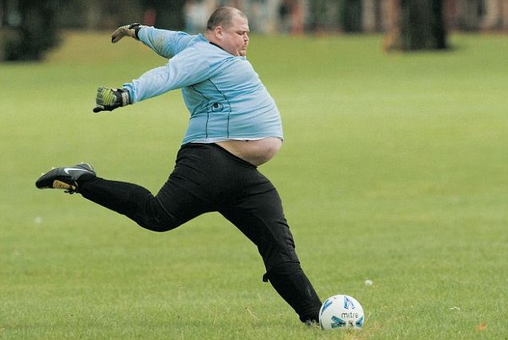
VO2 Max
VO2 Max is defined as the maximal amount of oxygen that can be taken in, transported and consumed by the working muscles per minute.
An ability to work at a high % of VO2 Max (below anaerobic threshold) is considered to be one of the best indicators of aerobic endurance.

Slide 5
Task
VO2 Max is affected by the following characteristics:
Individual Physiological Make-Up
Training
Age
Gender
In groups:
Read the information about one of the factors affecting VO2 Max.
Discuss it with the group, understand it and complete the worksheet.
This will then be discussed as a whole class.

Slide 6
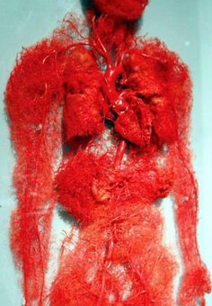
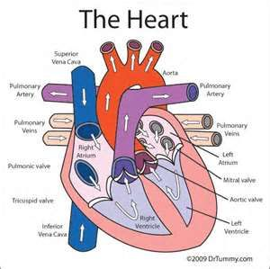
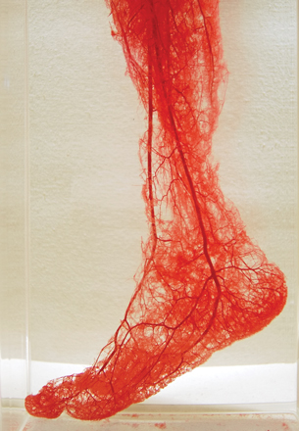
Physiological make-up
Can inspire more air
Increase in SV which is amount of blood forced out of ventricle per beat/ increase 02 delivery to working muscles
Increase surface area for gas exchange/ more 02 to working muscles.

Slide 7
training
V02 10-20%
Ageing will maintain or reduce the decline of V02.
Causes long term adaptations, which are increase in respiratory muscle strength, levels of haemoglobin increase, therefore, increase in 02 transfer

Slide 8
age
Loss of elasticity of the heart, vessels, lung tissue, reduce the efficiency to inspire and transport 02.

Slide 9
gender
15-30% lower VO2 max than males from the same group.
Smaller lung volume, SV therefore,
Reducing the efficiency of CO removal, transporting 02 for aerobic energy production.

Slide 10
Exam Question
Define the term VO2 Max and identify three factors that affect a performers VO2 Max.
[4 Marks]

Slide 11
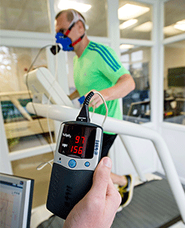
Measurement / Testing
Direct= accurate tests of vO2
The only direct method of testing for VO2 Max is through Direct Gas Analysis.
Subjects are measured on progressively increasing intensities until exhaustion on a laboratory ergometer (treadmill, cycles, rowing machine or swimming benches).
Computers analyse the relative concentrations of oxygen inspired and expired when the subject performs the test.

Slide 12
PWC – 170 Test
Sub-maximal test on a cycle ergometer
PWC stands for physical working capacity
Performer cycles at three progressive low to moderate work intensities and their heart-rate is recorded.
A workload is added so that the performer’s heart rate is increased to:
100bpm -115bpm
115bpm – 130bpm
130bpm – 145bpm
As heart rate increases, a graph is produced and the graph can predict the intensity level the performer will be working (VO2 Max) at when their heart rate reaches 170bpm.
Graph scores are used against a standard norm table of results to predict VO2 Max

Slide 13
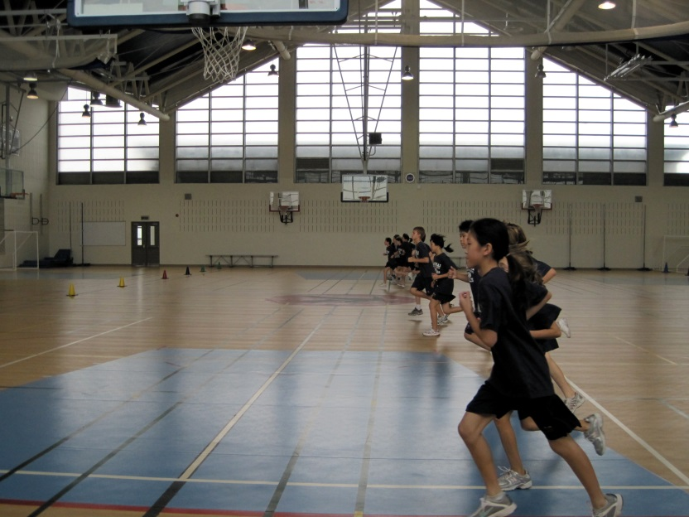
Multi-Stage Fitness Test
A progressive shuttle run test (starts easy and gets harder)
This gives a prediction of VO2 max based on shuttle and level that is recorded.
The level is compared to standardised norm tables.

Slide 14
Queens college step test
41.3 cm (16.25 inch) step
Metronome set to cadence of
▪ 88 beats per minute (22 steps per minute for females)
▪ 96 beats per minute (24 steps per minute for males)
Subject completes a 10 minute warm up.
Subject records 15 second heart rate prior to participation (x4 and recorded)
Complete the test for 3 minutes
Record the heart rate 5 secs after the completion of the test. (x4 )
men: VO2max (ml/kg/min) = 111.33 - 0.42 x heart rate (bpm)
o women: VO2max (ml/kg/min) = 65.81 - 0.1847 x heart rate (bpm)

Slide 15
Think!
Using each test, what would be the advantages of each test?
And what would be the disadvantages?
Think about time, cost, facility / equipment, validity, reliability, how easy it is to set-up

Slide 16
Assessment
Define VO2 Max and identify a common method to evaluate it.
Explain three physiological reasons why males tend to have a higher VO2 Max than females.
Explain the PWC-170 test.

Slide 17
 | Heredity / Genetics | Gender | Individual Physiological Make-Up | Age | Training
How does this factor affect Aerobic capacity of an individual? What are the key points?

Slide 18
Method of Testing Aerobic Capacity | Notes
PWC-170 Test
Multi-Stage Fitness Test (MSFT)
Direct Gas Analysis

