Slide 1
Exercise Physiology Aerobic capacity

Slide 2
starter
State what v02 max represents
State the factors that affect the VO2 max
A/B
B explains

Slide 3
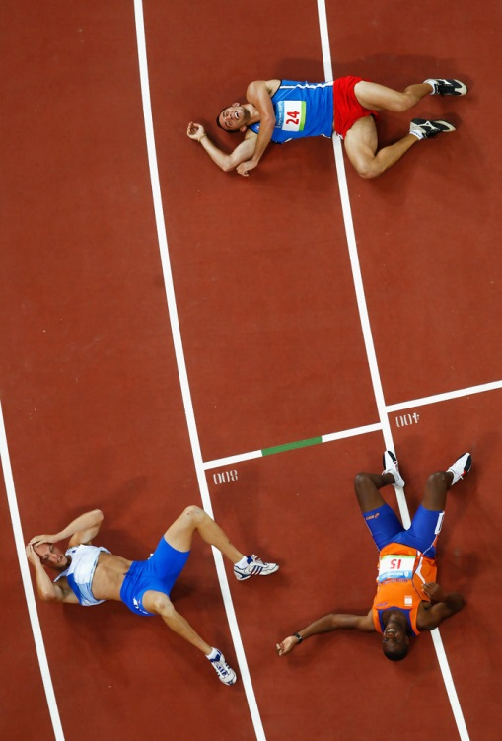
12 Minute Cooper Run
Maximal test to exhaustion
Subjects perform continuous running to achieve a maximum distance within 12 minutes
Performed on a 400m running track, with cones placed at intervals
At the end of the 12 minutes, the test ends and the distance is recorded
The distance ran is then converted VO2 max via a calculation

Slide 4
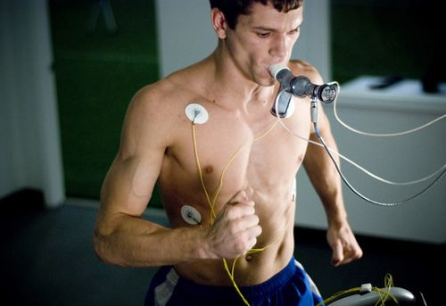
Direct Testing
The only direct method of testing for VO2 Max is through Direct Gas Analysis.
Subjects are measured on progressively increasing intensities until exhaustion on a laboratory ergometer (treadmill, cycles, rowing machine or swimming benches).
Computers analyse the relative concentrations of oxygen inspired and expired when the subject performs the test.
https://www.youtube.com/watch?v=A2z0l9B6aGE

Slide 5
G453 Jan 2013
There are several methods of evaluating aerobic capacity such as the multi stage fitness test and the 12 minute Cooper Run.
Describe one method of measuring aerobic capacity.
Outline one advantage and one disadvantage of this method.
[5 Marks]

Slide 6
Answers
MSFT
Queens college step test
1. Progressive test to exhaustion
2. Shuttle runs between 20m markers to a timed beep
3. Timed between bleeps reduces / speed increases
until performer fails to keep up with bleep
4. Level & shuttle number estimates or predicts a VO2max value
Sub max 1 for advantage
5. Good levels of validity and reliability/scores easily evaluated in published table/easy to set up (easy to access/available)/large groups can be tested
Sub max 1 for disadvantage
6. Test to exhaustion not good for unfit/overweight individuals/predicted values and not 100% accurate/not good correlation/estimated with similar
others/favours runners not cyclists or swimmers or rowers/relies on motivational levels of performers
1. Sub max test
2. Subject performs continuous stepping on and off a box for 3mins (box is 41.3cm high)
3. Pulse rate is taken for 15 secs post test
4. Pulse rate is used to predict VO2 max
Sub max 1 for advantage
5. Sub-maximal test not requiring work to exhaustion/ good for less fit/overweight individuals/satisfactory levels of validity/reliability/easy to set up / published VO2 max tables
Sub max 1 for disadvantage
6. Does not favour specific sports/ does not directly measure aerobic capacity or O2 consumption/predicted test of VO2max from HR/step height may be a disadvantage for smaller subjects

Slide 7
Aerobic Capacity - Planning Training
In order to plan a training programme for Aerobic Capacity, you need to consider:
Types of training
Training adaptations
Principles of overload and reversibility
Intensity of training
The duration and intensity of work must be correct for an individual…why?

Slide 8
Karvonen’s Principle
In order for the body to adapt to aerobic exercise, the heart rate must be working at a certain % of its maximum.
Karvonen developed a formula to identify correct training intensities.
The formula used to calculate maximum heart, and its working %’s is called Karvonen’s Principle.

Slide 9
Name | Resting Heart Rate
Karvonen Principle | 220 - Age = MAX HR
MAX HR | Resting Heart Rate | MAX HR - Resting Heart Rate
e.g. | e.g. | e.g.
Calculating Critical Thresholds
MAX HR - Resting Heart Rate | Percentages in Decimals | (MAX HR - Resting Heart Rate) x Percentage in Decimals + Resting HR
e.g. 203bpm - 70bpm = 133bpm | e.g. 60% = 0.60 | e.g. 133 x 0.6 + 70 = 150bpm
 | 0.55
 | 0.6
 | 0.7
 | 0.8
 | 0.85
 | 0.9

Slide 10
Basic Endurance
To basic endurance and to gain general health benefits:
55% of maximum heart rate when exercising
at least x3 20mins sessions per week
The higher the heart rate %, the greater the aerobic adaptions.

Slide 11
Training zones (%) | Heart Rate (bpm) | Training Objectives
50% - 60% |  | Basic Endurance
60% - 70% |  | Fat burning / re-energise glycogen stores
70% - 80% |  | Develop O2 Transport systems / Aerobic Zone
80% - 85% |  | Improve Lactic Threshold
85% - 90% |  | Lactic Threshold
90% + |  | Speed

Slide 12
Aerobic Capacity and FITT principles
Apply the fit principle to aerobic training
Frequency - e.g. minimum of x3 sessions per week
Intensity - e.g. measured heart rate %
Time (duration) - e.g. 3-5mins for novice, 40mins+ for elite
Type - e.g. what type of training method?

Slide 13
Methods of Training for Aerobic Capacity
Continuous
Fartlek
Interval
High Intensity Interval Training

Slide 14
Task
In groups:
Read through type of training sheets
Design a series of exercises to show the three different types of training, with key points
Can you show how this would differ for a sedentary individual vs elite athlete?

Slide 15
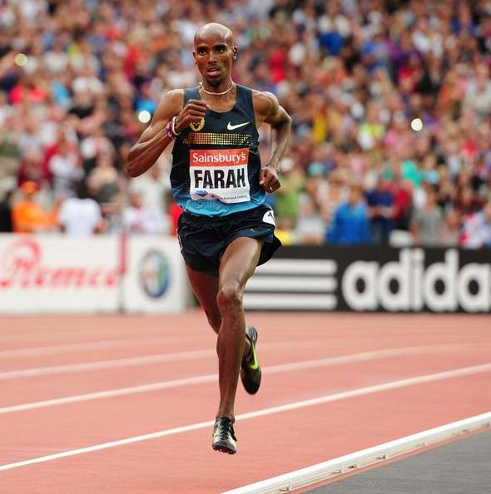
Continuous Training
Best suited for long distance / endurance athletes
Low – moderate intensity exercise that uses large muscle groups
Training should be between 60-80% max heart rate
Duration should be between 20mins - 80mins

Slide 16
Fartlek Training
Known as ‘speed play’
Continual steady-state training interspersed with varied higher intensity work periods (sprinting to walking)
A mixture of continuous and interval training
Can develop both aerobic and anaerobic fitness - perfect for games players
Heart rate can vary but must be at least 55% (critical threshold)

Slide 17
Interval Training
Intermittent training that involves periods of alternating exercise and rest
Very versatile - can change many variables to gain improvements in different components of fitness:
Duration of work interval
Intensity of work interval (heart rate %)
The number of sets
The number of reptitions
Duration of recovery period (work - relief ratios)
Activity during the recovery period

Slide 18
Notes on Work-Relief Ratios for Interval Training
Work = activity undertaken
Relief = rest period
In aerobic training, the work duration is often high and the relief is low e.g. timed run for 1500m, with the time taken (e.g. 2mins) given for rest (1:1 ratio).
In anaerobic training, the work duration is lower, but the relief is higher to allow for fuller recovery. e.g. sprint for 10secs, then rest for 30secs (usually 1:3 ratio).

Slide 19
Interval Training – Key Factors that MUST be considered! | Aerobic Athlete | Anaerobic Athlete
Interval Duration | 3-5mins + (longer) | 0-90 secs (longer)
Interval Intensity | Low-Moderate (50-70% Vo2 / HR Max) | High / Sprint (70 - 90% Vo2 / HR Max)
Interval Relief | 1:1 (can have active jog, walk or run for rest) | 1:2 - 1:3 (usually 1-90secs)
Ratio of Work-Relief | 1 set of 3-5 reps | 2-6 sets of 1-10 reps
Frequency | 3-5 sessions weekly | 3-6 sessions weekly
Specificity | Aerobic Energy System | ATP-PC / Lactic Acid Systems

Slide 20
Linking to Energy Systems Work
The energy used to re-synthesise ATP during aerobic training comes from the aerobic system.
Aerobic work is fuelled by FFA’s, but this varies due to:
duration and intensity of the activity undertaken
availability of glycogen and FFA’s

Slide 21
Aerobic System Fuels
Glycogen / Glucose for first 20-40mins
During mild - more severe exercise, glycogen stores will be used
After 25mins - 40mins, FFA’s will be used alongside glycogen
As duration increases, glycogen gets depleted and more FFA’s are used
After all glycogen depleted (2rs), FFA’s main fuel source
If intensity increases at any time, the lactic acid system is used which causes rise in OBLA.

