Slide 1
Exercise Physiology
RS

Slide 2
G453 June 2010 Q5 b)
Interval training is a popular method of training. Describe an interval training session designed to improve maximal strength.
Explain the benefits that interval training has over other methods of training.
[5 Marks]

Slide 3
Flexibility
Flexibility is the range of motion around a joint.
Flexibility is joint specific, sport-specific and has two components; static and dynamic

Slide 4
Static Flexibility
Static flexibility is the range of motion without taking into account speed of movement.
It is the maximum range of movement a muscle or connective tissue will allow with an external force.
e.g. holding a hamstring stretch at its fullest range.

Slide 5
Dynamic Flexibility
Dynamic flexibility is the range of motion which takes into account the speed of movement and reflects the joints’ resistance to movement.
e.g. straddle jump
Good static flexibility is a pre-requisite to achieving good dynamic flexibility.

Slide 6
Task
Select your chosen sport.
Identify Static and Dynamic flexibility examples within the sport itself.

Slide 7
Benefits of Flexibility Training
Flexibility is extremely undervalued and neglected - it is critical to promote BAHL.
Benefits of flexibility training include:
Reduced risk of injury
Improved posture and alignment
Reduction of DOMS
Performance enhancement!

Slide 8
Factors Affecting Flexibility
Type of Joint
Joint Shape
Length / Elasticity of Connective Tissues
Muscle Length / Elasticity
Gender
Age
Elasticity
Temperature
Muscle Mass
Nerves
Hypermobility
Flexibility Training

Slide 9
Answers to G453 Q4d
Factors affecting
1. Joint type
Eg ball and socket joint has a wider RoM/planes of movement than a hinge joint.
2. Joint shape/articulating bones - Shallow socket of shoulder in
creases RoM/decreases stability / Deep socket of Hip decreases RoM/increases stability
3. Elasticity/length of surrounding connective tissues
All points below increase RoM/flexibility if increased:
Elasticity/length of surrounding muscles / Elasticity/length of surrounding
Tendons / Elasticity/length of surrounding ligaments / Strength of opposing muscle group / Elasticity of Epi/peri/endo-mysium of muscles/ fascia joint capsule / Nerves/Muscle spindle activation point before initiating
stretch reflex
4. Muscle/fat mass - Excessive muscle /fat mass can decreases RoM.
Eg body builders/rugby players at the shoulder.
5. Temperature/ viscous warmer internal muscles/connective tissues increase
elasticity/ RoM
7. Gender
Females generally more RoM/flexible than males Due to the hormone oestrogen
8. Age
Flexibility/RoM decreases with age / Connective tissues harden/decrease in elasticity with age
9. Training
Stretching with in a training programme may
maintain/increase RoM. Generally more physically active individuals will have a greater flexibility than those inactive
10. Others
Clothing restrictions
Eg golfer with waterproof jacket.
Injuries to joint tissues decreases RoM
External temperature +/- to RoM

Slide 10
Measuring Flexibility
There are two main ways to measure flexibility -
Sit and Reach Test (indirect)
Goniometer (more direct)
Prior to each test, the subjects would have completed a warm-up. Why?

Slide 11
Flexibility – Sit and Reach
Sit with your heels placed against the edge of the sit and reach box.
Keep your legs flat on the floor, i.e. keep your knees down.
Place one hand on top of the other and reach forward slowly.
Your fingertips should be in contact with the measuring portion of the sit and reach box.
As you reach forward, drop your head between your arms and breathe out as you push forward.
The best of three trials should be recorded.

Slide 12
Scoring for Flexibility Sit and Reach
Rating | Males (in cm) | Females (in cm)
Excellent | 25+ | 20+
Very Good | 17 | 17
Good | 15 | 16
Average | 14 | 15
Poor | 13 | 14
Very Poor | 9 | 10

Slide 13
Flexibility Test Disadvantages
Potential for inconsistency of test methods (warm up allowed or not?)
Performance can be influenced by length or width of body segments
Assumed to be valid for all populations, but Jackson and Baker (1986) reported it is not valid for lower back flexibility in teenage girls.

Slide 14
Goniometry
The most valid and direct measurement of flexibility is by using a Goniometer.
A Goniometer is a double-armed ruler which measures the angles of degrees from a neutral starting position of any joint.
http://www.youtube.com/watch?v=D5uywZB79HY&feature=related

Slide 15
Flexibility Training
Flexibility is either maintained or improved by stretching.
Stretching as part of a warm-up and cool-down is called maintenance stretching as this only helps the individual’s current RoM.
Flexibility training involves 10-15min sessions devoted solely to stretching. this is called developmental stretching.

Slide 16
Types of Stretching Training
There are four different types of stretching training that are used to develop flexibility:
Static Stretching
Ballistic Stretching
Dynamic Stretching
PNF
The aim is to stretch the muscle / connective tissues around a joint just beyond the end points of the resistance (RoM) to cause long-term adaptations.

Slide 17
Stretching and the FITT Principle
F = e.g. 2-4 times per week, depending on initial flexibility
I = mild tension (no pain) to stretching to the extreme point of resistance
T = duration of each stretch e.g. minimum 10secs, maximum 30 secs, repeat 3-6 times
T = Static / Dynamic / Ballistic / PNF

Slide 18
Task
In groups, work your way around the various stretch training types in the room.
What do you think are the benefits of each of the stretching types?
Are there any disadvantages of any of the types?
Think about how they work within your sport to justify your answers.

Slide 19
Static Stretching
Static stretches is divided into static active and static passive stretches.
Static active stretches are unnassisted; a voluntary static contraction of an agonist muscle to create a force to stretch the antagonist muscle.
Static passive stretches are assisted by an external force e.g. gravity, a partner etc. to help move the joint beyond its point of resistance.

Slide 20
Ballistic Stretching
Ballistic stretching involves the use of momentum to move a joint through to its extreme range or point of resistance.
It involves fast, swinging, active or bounding movements.

Slide 21
Dynamic Stretching
Dynamic stretching is a much more controlled version of ballistic stretching.
Dynamic stretching involves taking the muscles through a joint’s full RoM with muscle tension, but in a controlled manner.
Dynamic stretching doesn’t take the RoM to the extreme point of resistance.

Slide 22
PNF Stretching
PNF stands for Proprioreceptive Neuromuscular Facilitation and is the most complex type of stretching
The aim of PNF is to inhibit the stretch reflex mechanism to increase flexibility and allow a greater stretch of muscle / connective tissue.
The most often used PNF type of stretching is the ‘contract - relax’ method. This involves isometric muscle contractions.
Most PNF stretches require the assistance of a partner to resist the movement as isometric contractions take place.

Slide 23
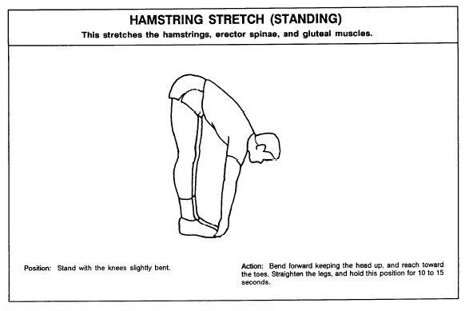

Slide 24
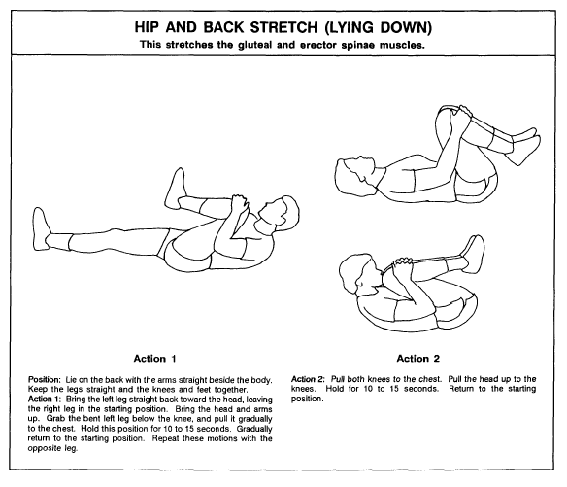

Slide 25
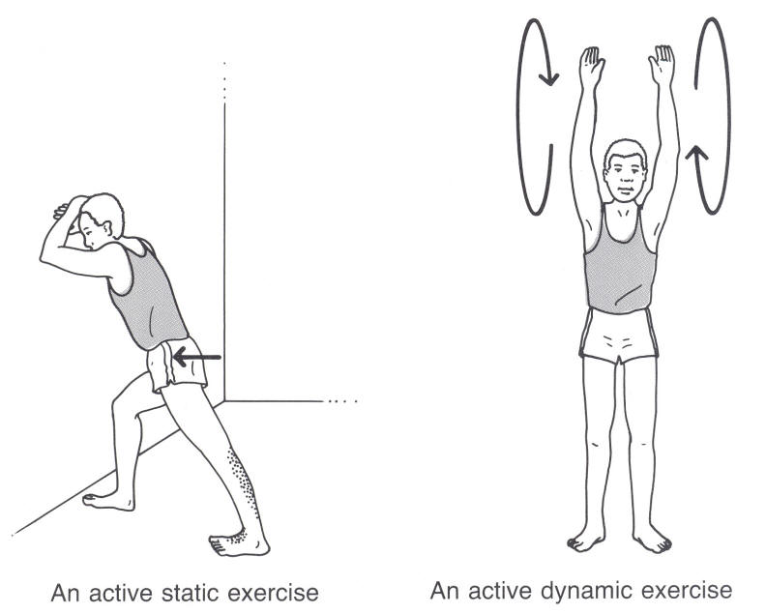

Slide 26
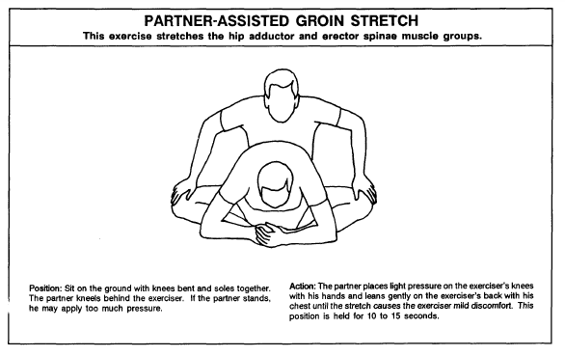

Slide 27
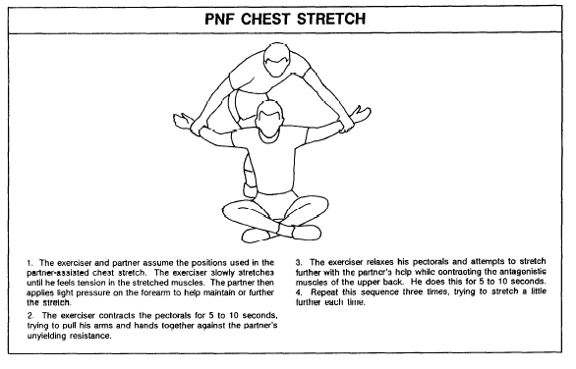

Slide 28
Type of Stretching | Explanation of this Method and Example | Advantages / Benefits of this method | Disadvantages / Weaknesses of this method
Static Stretching
Ballistic Stretching
Dynamic Stretching
PNF Stretching

Slide 29
2566 June 2007 – Qc i)
Describe two types of stretching that could be used to develop flexibility.
[4 Marks]

Slide 30
G453 Jan 2011 Q5 b
Describe how you would perform a stretch during a proprioceptive neuromuscular facilitation (PNF) session.
Explain the physiological principle behind this type of flexibility training.
[5 Marks]

Slide 31
Flexibility Adaptations and Benefits
Adaptations of Flexibility training are linked to the elasticity of muscle and connective tissues. The benefits are:
Increased elasticity / length of muscle / connective tissue
Increased resting length of muscle / connective tissue
Muscle spindles adapt to the increased length
Increased RoM around a joint before stretch reflex
Increased distance and efficiency for muscles to create force and acceleration
Reduces potential for injury during dynamic sports movements

Slide 32
G453 June 2013
Define the term flexibility.
Using examples, explain factors that can affect the flexibility of a performer in sport.
Critically evaluate different types of training used to develop flexibility.
[20 Marks]

Slide 38
Scenario
Emily has scored -2cm on the Sit and Reach test. She also has poor general body flexibility for her sport of Dance.
Design a six-week training programme for Emily in order to increase her flexibility. Refer to the principles of fitness in your answer.
[20 Marks]

